Slide 1
Global Energy Efficiency, Economic Indicators, and CO2 mitigation
A DUAL PERSPECTIVE: GLOBAL TRENDS AND UK HOUSEHOLDS

Slide 2
Key Findings
Post-Soviet Transition
Development and Efficiency
UK as a Leader in Energy Efficiency
Regional Heterogeneity
Energy Efficiency and Environmental Impact
Determinants of EEI

Slide 3
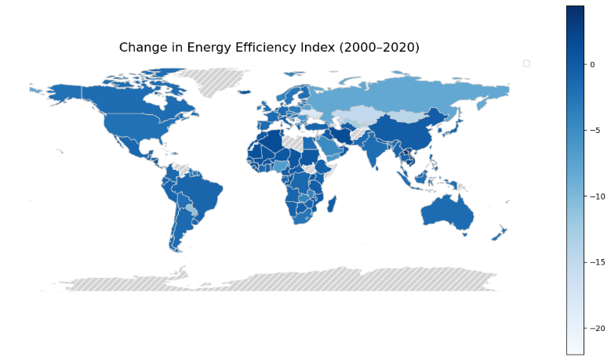
Post-Soviet Transition
Potential Explanations:
Energy-Intensive Industrialization
Inefficiencies in Energy Generation and Distribution
Rapid economic growth.
Shift in economic structure
Figure 1: Percentage Change in Energy Efficiency Index(2000-2020), the colour scale represents the percentage change in EEI. Lighter shade of blue represents significant decrease in EEI.

Slide 4
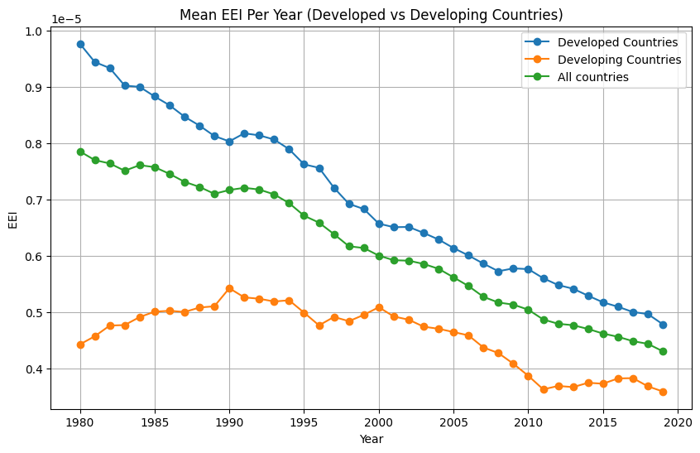
Development and Efficiency
Potential Explanations:
Quality and consistency of data in developing countries
Reliance light industries (e.g., agriculture)
Limited access to energy infrastructure
Important note:
The graph does not imply that developing countries are more energy efficient
Figure 2: Average EEI (Quad/USD) for selected developed (UK, Canada, US, Japan) and developing (India, Brazil, China, Pakistan) countries, 2000–2022.

Slide 5
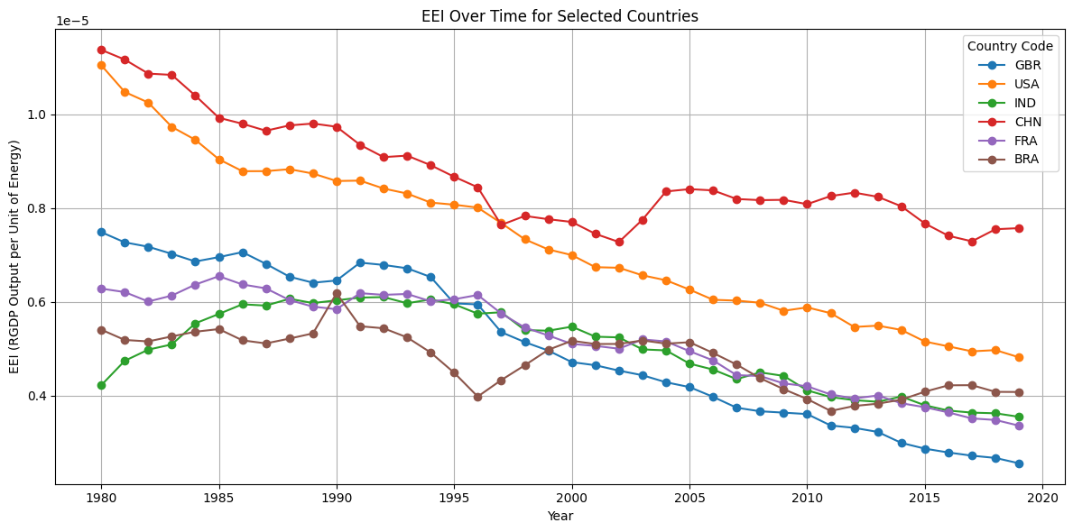
UK as the leading energy-efficient economy
Potential Explanation:
Strong legal and policy regulations
Carbon Pricing and Emission Reduction Initiatives
Introduction of EPC(2007)
Figure 3: Cross-country comparison of EEI trends, the axes and scaling are the same as in Figure 1. Each coloured line represents EEI trajectory for different countries within the sample.

Slide 6
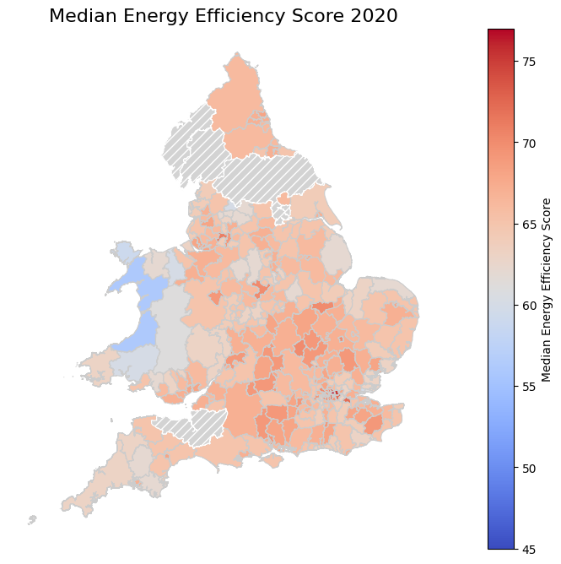
Regional Heterogeneity in England and Wales:
Potential Explanations:
Age of housing stock
Urban vs. Rural composition
Adoption of energy efficient technologies
Renovation and Retrofitting
Figure 4: Median Energy Efficiency in England and Wales in March 2020.

Slide 7
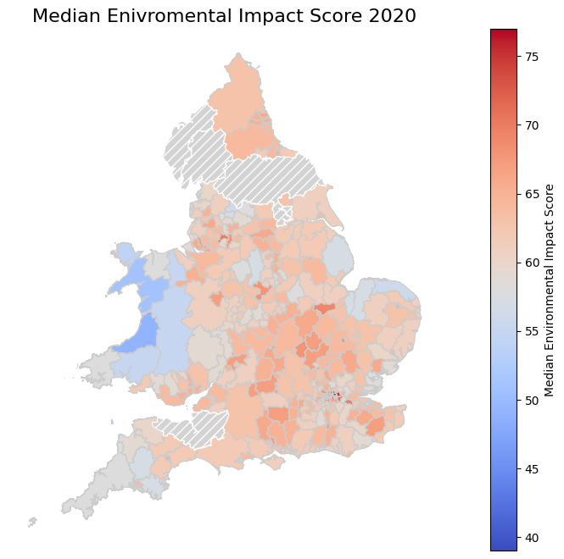
Similarity of Environmental Impact Score and Energy Efficiency Score
Energy Efficiency Score and Environmental impact score are measured similarly.

Slide 8
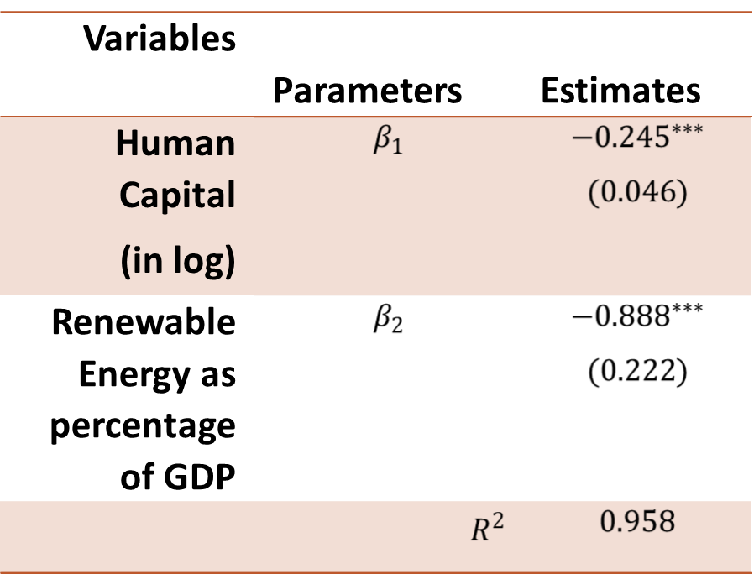
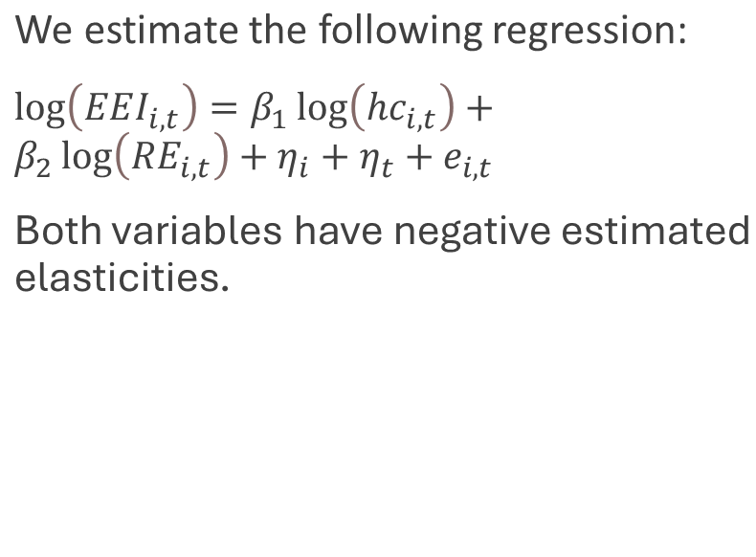
Determinants of EEI

Slide 9
Policy Recommendation
1. Investment in Human Capital:
Give more access to education
Encourage people to pursue more education
2. Incentivize Renewable Energy Investment
Subsidise renewable energy sources
Tax non-renewable methods
3. Regional Targeting
Encourage energy retrofits in regions lagging behind

