Slide 1
SEIZURE PREDICTION RESEARCH
Defining Preprocessing Pipelines
Pipeline A (Filter-First Approach)
Raw EEG → Bandpass Filtering → Statistical Feature Extraction → Imputation (if needed)
Rationale:
Applies bandpass filtering (0.5–40 Hz) before feature extraction to remove noise such as muscle artifacts and power line interference. This ensures that statistical features are computed on a cleaner neural signal, improving signal-to-noise ratio and feature stability.
Pipeline B (Feature-First + Dimensionality Reduction)
Raw EEG → Statistical Feature Extraction → Scaling → PCA (95% variance retention)
Rationale:
Extracts statistical features directly from raw EEG signals, which may still contain noise. Standardization is applied to normalize feature scales, followed by PCA to reduce redundancy and compress feature space while retaining most variance.

Slide 2
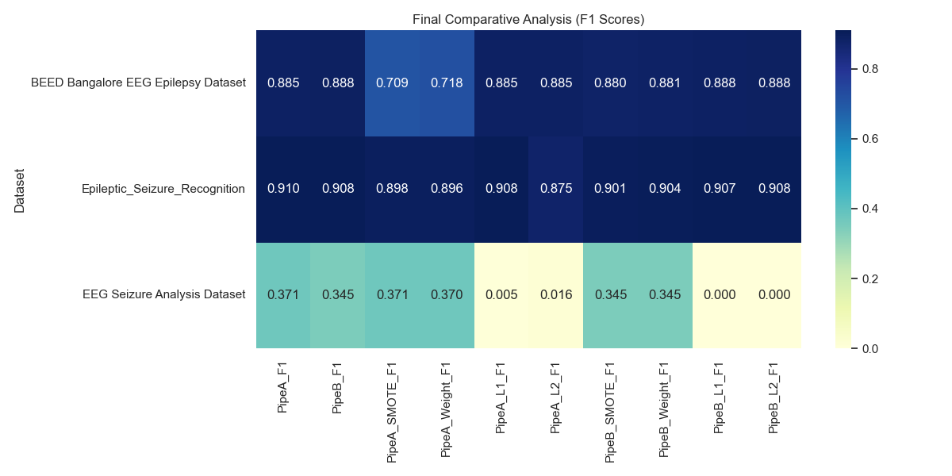
SEIZURE PREDICTION RESEARCH
Regularization: L1 Sparsity vs. L2 Stability
L1 Penalty (Lasso): Adds absolute weights sum .
L1 Clinical Impact: Acts as an automated feature selector by driving non-informative weights to exactly zero. Lasso discarded 82.5% of Recognition features while preserving F1 (0.908).
L2 Penalty (Ridge): Adds squared weights sum .
L2 Clinical Impact: Shrinks weights uniformly but keeps all features active. Ideal for clean, independent static tables (like BEED).

