Slide 1
EEG Seizure Comparative Analysis
Generalization Study and Imbalance Handling
Semester Major Assignment

Slide 2
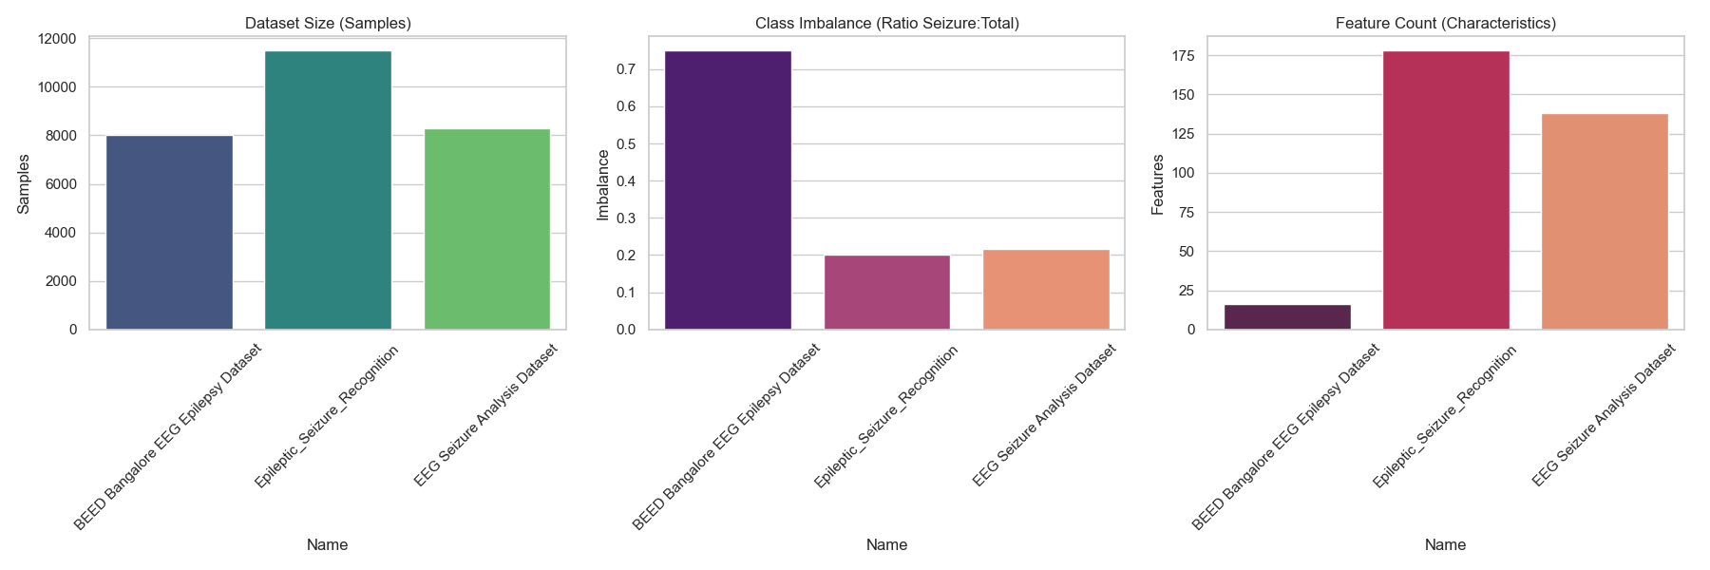
Dataset Justification

Slide 3
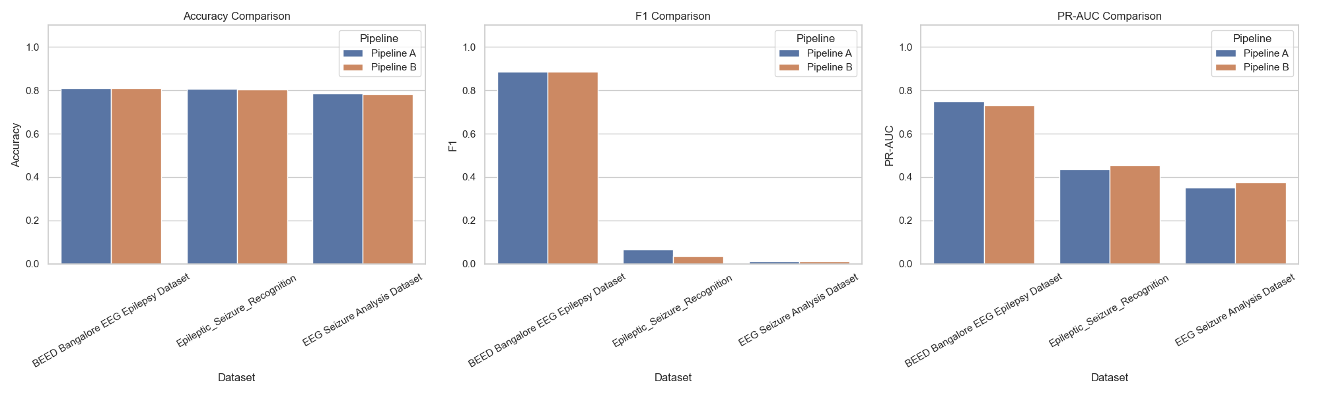
Pipeline Comparison

Slide 4
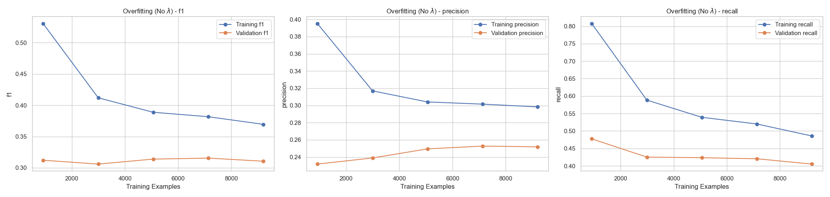
Overfitting Analysis

Slide 5
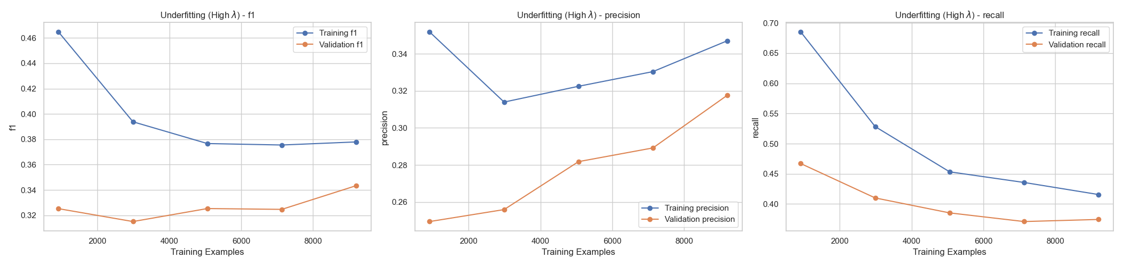
Underfitting Analysis

Slide 6
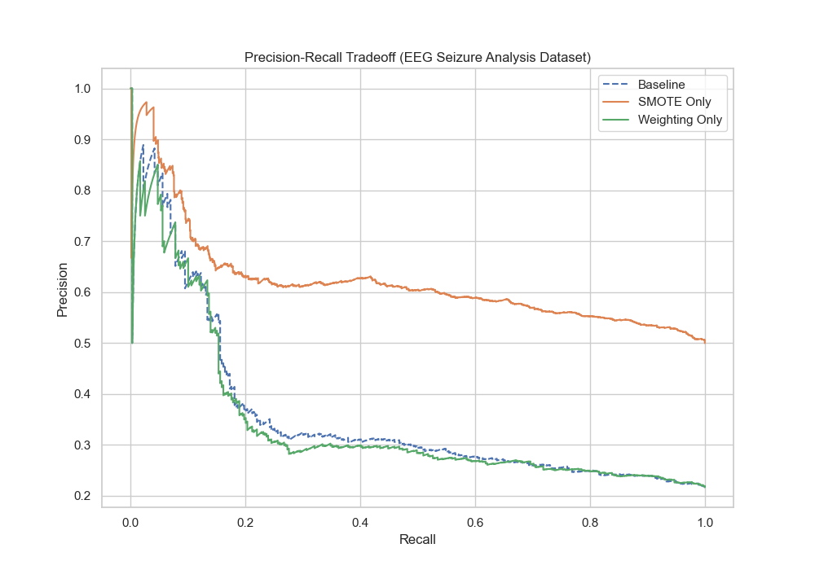
Imbalance Handling (SMOTE)

Slide 7
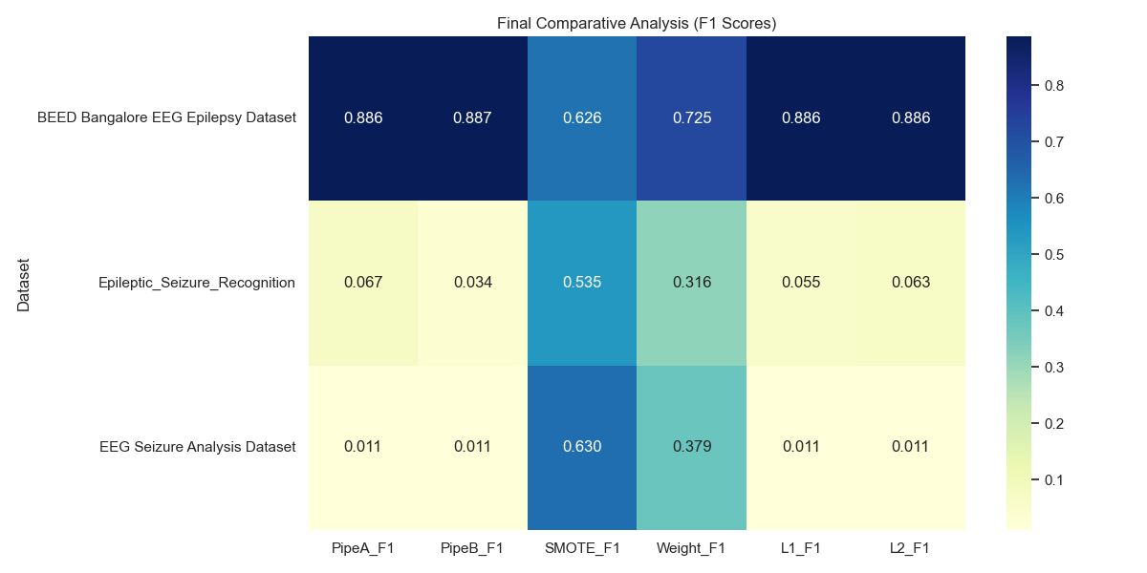
Final F1-Score Summary

