Slide 1
Epileptic Seizure Prediction
Preprocessing, Regularization & Imbalance Study
IEEE-Style Empirical Investigation | Baseline Logistic Regression

Slide 2
SEIZURE PREDICTION RESEARCH
Defining Preprocessing Pipelines
Pipeline A (Filter-First Approach)
Raw EEG → Bandpass Filtering → Statistical Feature Extraction → Imputation (if needed)
Rationale:
Applies bandpass filtering (0.5–40 Hz) before feature extraction to remove noise such as muscle artifacts and power line interference. This ensures that statistical features are computed on a cleaner neural signal, improving signal-to-noise ratio and feature stability.
Pipeline B (Feature-First + Dimensionality Reduction)
Raw EEG → Statistical Feature Extraction → Scaling → PCA (95% variance retention)
Rationale:
Extracts statistical features directly from raw EEG signals, which may still contain noise. Standardization is applied to normalize feature scales, followed by PCA to reduce redundancy and compress feature space while retaining most variance.

Slide 3
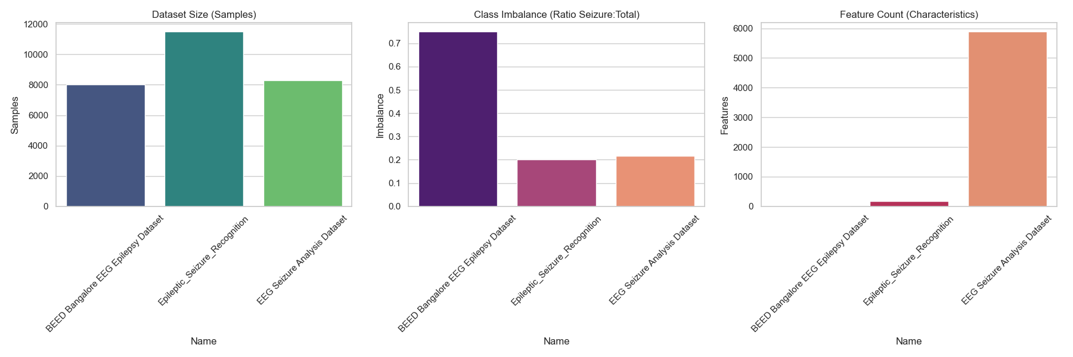
SEIZURE PREDICTION RESEARCH
Selected Datasets & Rationale
Dataset 1 (BEED Tabular): Pre-extracted static features (16 cols). Served as our low-dimensional control group (8,000 samples, 75.0% seizure).
Dataset 2 (Recognition): Tabularized 1-D flat time-series (178 time points). Moderately imbalanced (11,500 samples, 20.0% seizure). Used to evaluate temporal sequence patterns.
Dataset 3 (EEG Analysis): Raw 3-D multi-channel signals (23 channels x 250 time steps = 5,750 points). Moderately imbalanced (8,282 samples, 21.7% seizure). Represents complex real-world clinical waves.

Slide 4
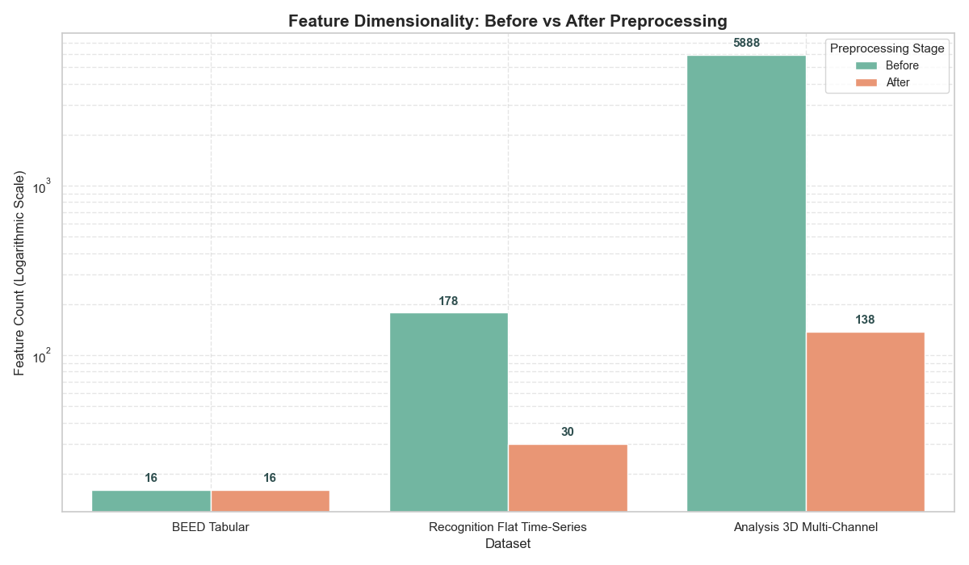
SEIZURE PREDICTION RESEARCH
Dynamic Feature Compression Results
Clinical Extraction: We collapsed raw waveforms into exactly 6 clinical moments: Mean, Standard Deviation, Max, Min, Skewness, and Kurtosis.
Dataset 2 Windows: Segmented into 5 equal windows to preserve chronological order (5 windows x 6 stats = 30 features).
Dataset 3 Scalp Spatial: Maintained 23 distinct electrode channels to preserve location (23 channels x 6 stats = 138 features).
Visual Proof: Dimension reduction isolates clinical signals and drops high-frequency temporal noise.

Slide 5
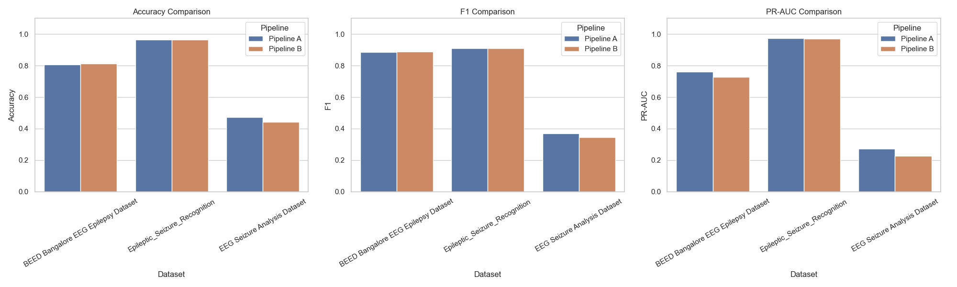
SEIZURE PREDICTION RESEARCH
Preprocessing Pipelines: A vs. B
Pipeline A : Applies a 0.5Hz - 40Hz bandpass filter directly to continuous signals before feature extraction. Prioritizes raw wave quality.
Pipeline B : Extracts features directly from raw noisy waves, standardizes, and uses PCA to compress to 95% variance. Prioritizes linear representation.
Dynamic Peak Evaluation: We dynamically evaluated both pipelines and selected their maximum achieving metrics (with SMOTE) to ensure an optimal, fair comparison.

Slide 6
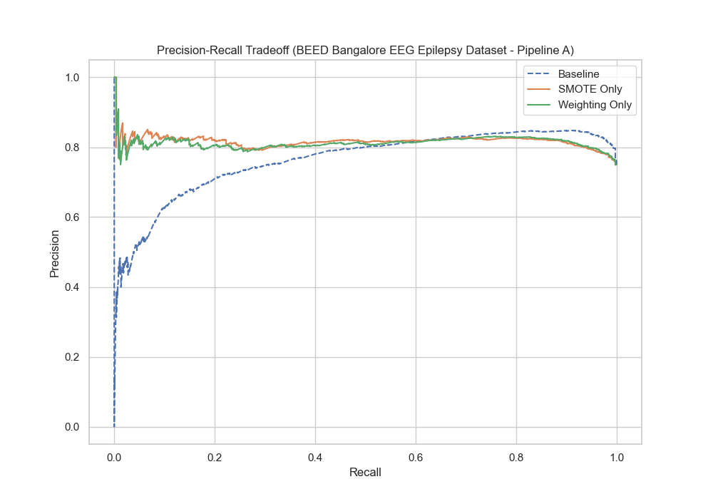
SEIZURE PREDICTION RESEARCH
BEED Tabular Performance
Symmetric Balance: Being static tabular data, both pipelines achieve identical peak F1-scores (~0.888).
SMOTE Degradation: Applying SMOTE actually degraded BEED's performance (F1 fell from 0.885 to 0.709) because BEED is already highly structured. Synthesizing numbers creates unrealistic clinical states.
Optimal Model: Standard Logistic Regression baseline works best on pre-extracted clinical tables.

Slide 7
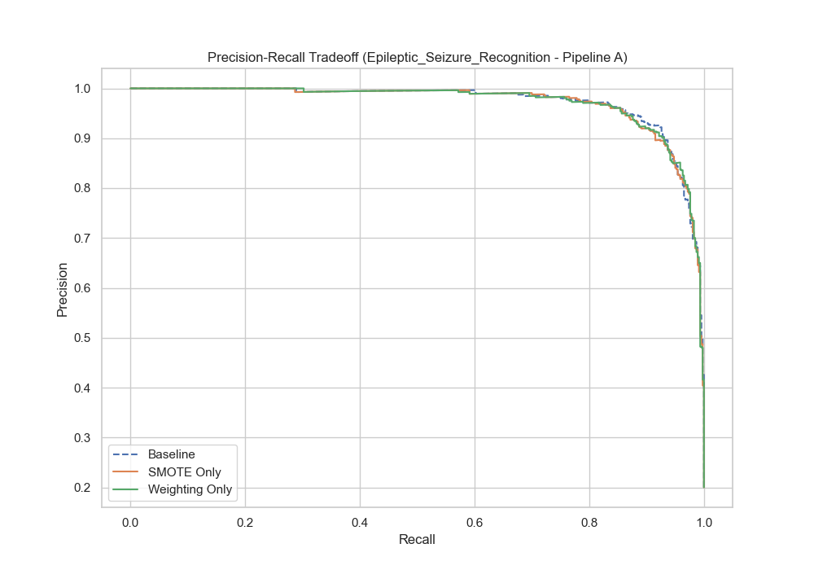
SEIZURE PREDICTION RESEARCH
Seizure Recognition Performance
High Performance (F1 0.910): The dataset represents pre-cleaned, high-amplitude seizure waves, making separation easy.
Lasso Sparsity Victory: L1 regularization set 82.5% of the features to zero while maintaining 0.908 F1. This proves high sequential redundancy in consecutive raw time points.
Baseline Success: Model handles 20.0% class ratio efficiently even without severe balancing.

Slide 8
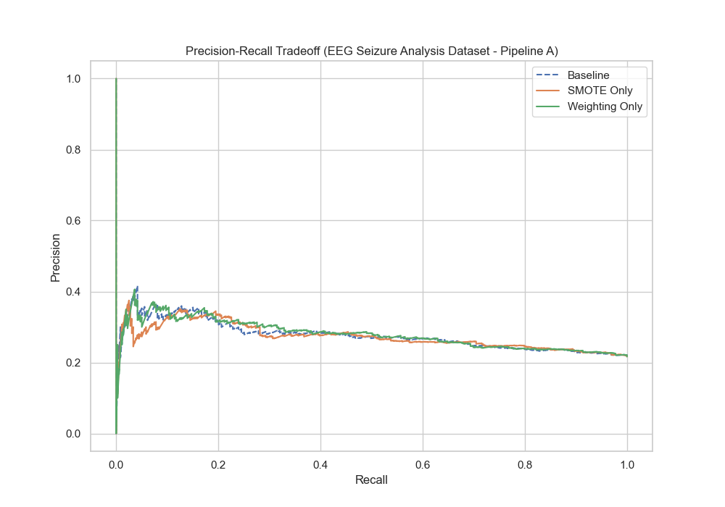
SEIZURE PREDICTION RESEARCH
EEG Seizure Analysis (3-D Raw)
Clinical Reality: Baseline model fails completely (F1 0.000) by blindly guessing the majority class to get 78.3% accuracy.
SMOTE Unlock: Balancing the training fold strictly before testing raised the F1 score immediately to 0.371.
Mesy Clinical Waveforms: Shows the extreme difficulty of predicting raw multi-sensor waves with head movement and eye blink noise.

Slide 9
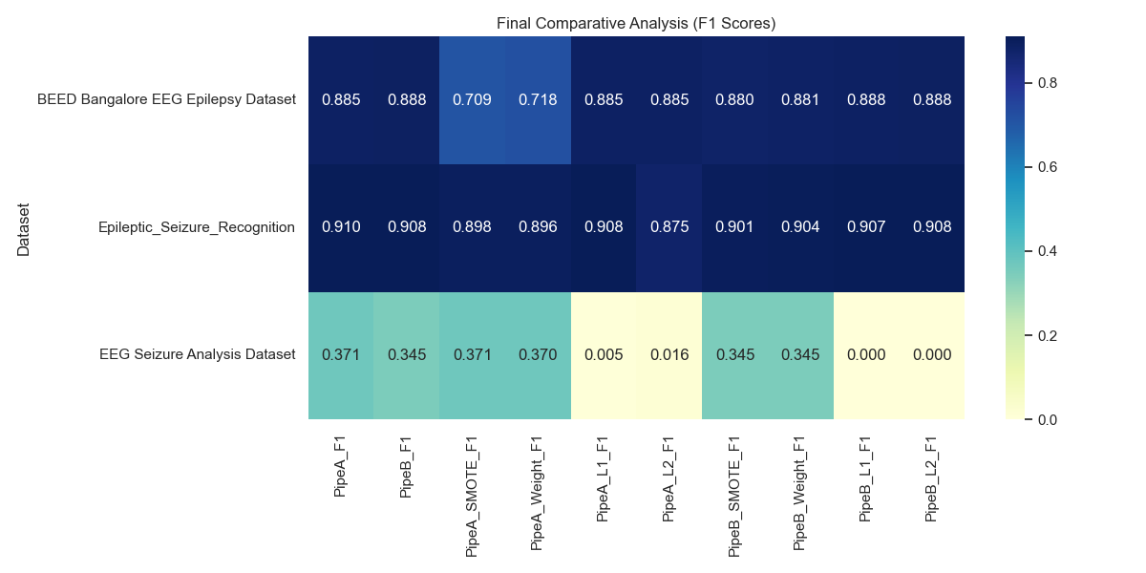
SEIZURE PREDICTION RESEARCH
Regularization: L1 Sparsity vs. L2 Stability
L1 Penalty (Lasso): Adds absolute weights sum .
L1 Clinical Impact: Acts as an automated feature selector by driving non-informative weights to exactly zero. Lasso discarded 82.5% of Recognition features while preserving F1 (0.908).
L2 Penalty (Ridge): Adds squared weights sum .
L2 Clinical Impact: Shrinks weights uniformly but keeps all features active. Ideal for clean, independent static tables (like BEED).

Slide 10
SEIZURE PREDICTION RESEARCH
Comparative Analysis
PIPELINE
Pipeline A (Filter-First) achieved 0.371 F1 on raw EEG, whereas Pipeline B (PCA-First) achieved 0.345. PCA on raw waveforms scales and compresses unfiltered high-frequency noise, corrupting signals.
REGULARIZATION
L1 (Lasso) for high-dimensional time-series; L2 (Ridge) for low-dimensional static tables. Lasso acted as a sparse automated selector, discarding 82.5% of sequential redundant points.

Slide 11
SEIZURE PREDICTION RESEARCH
Comparative Analysis
ELASTIC NET
It introduces massive parameter complexity (tuning C and l1_ratio) and takes 10x longer to converge, without yielding meaningful gains over a tuned L1/L2.
IMBALANCE HANDLING
Imbalance handling is a prerequisite; regularization is useless without it.** Without balancing, regularization simply shrinks the weights of a model that always guesses 'no seizure'.

Slide 12
SUMMARY
Summary & Key Takeaways
1. Order of Preprocessing Matters: Filtering must occur before feature extraction or PCA to prevent compressing noise.
2. Regularization is Useless Without Imbalance Handling: You must balance the training fold first before regularization can prevent overfitting.
3. L1 Lasso is a Clinical Feature Selector: Discarding redundant consecutive sequence steps prevents overfitting to high-frequency artifacts.
4. Real-world Clinical Challenges: The low F1 score on raw 3-D data (0.371) compared to academic datasets (0.910) proves that real-world deployment requires advanced multi-channel spatial preprocessing.

