Slide 1


Bluestock Mutual Fund Analytics Platform
An End-to-End Data Engineering & Financial Intelligence Project
BLUESTOCK FINTECH
DATA ANALYTICS DIVISION
87K+
AMFI Records
40
Fund Schemes
₹391 Cr
Total AUM
12+
Risk Metrics
Prepared by: Hashmil Muhammed · Data Analyst · BlueStock Fintech

Slide 2


Problem Statement & Objectives
Why institutional-grade analytics for retail investors?
THE PROBLEM
Mutual fund data is scattered across 40+ AMCs with no unified view
Retail investors lack access to institutional risk metrics (VaR, CVaR, Sharpe)
No systematic sector concentration analysis for portfolio-level risk
Investor churn signals go undetected without behavioural cohort analytics
Static AMFI reports cannot track real-time NAV trends or SIP anomalies
PROJECT OBJECTIVES
Build a SQL Star Schema ETL pipeline from raw AMFI data (87K+ rows)
Compute 3Y CAGR, Sharpe, Sortino, VaR, CVaR and Alpha metrics
Implement HHI-based sector concentration risk scoring per fund
Perform investor behavioural cohort analysis and churn prediction
Deliver a 4-page interactive Power BI intelligence dashboard

Slide 3

Data Sourcing & Ingestion
AMFI static datasets + mfapi.in live REST API
AMFI India Static Dataset
mfapi.in Live REST API
87,000+ NAV records across 40 fund schemes
Fund metadata: AUM, TER, scheme type, AMC
Historical NAV data from 2022–2025
Investor transaction records (SIP / Lumpsum / Redemption)
Real-time NAV tracking with daily refresh
JSON endpoint per scheme by AMFI code
Automated ingestion via Python requests + pandas
Enables rolling Sharpe & VaR computation on fresh data
DATA PIPELINE FLOW
AMFI CSV Files
mfapi.in API
pandas ETL
SQL Star Schema
Power BI / Python Analytics

Slide 4




System Architecture & ETL Pipeline
Star Schema design with Pandas + SQLAlchemy
ETL PIPELINE
DATABASE STAR SCHEMA
EXTRACT: Raw AMFI CSV + REST JSON via Python
requests
dim_scheme
dim_investor
TRANSFORM: Pandas pipelines — data cleaning, type casting, feature engineering (returns, CAGR, ratios)
LOAD: SQLAlchemy ORM → PostgreSQL/SQLite Star Schema (Fact + Dim tables)
fact_nav_transactions (NAV, SIP amount, date, scheme_id, investor_id)
SERVE: Power BI DirectQuery + Python notebook analytics layer
TECH STACK:
Python 3.11 · pandas 2.x · SQLAlchemy · PostgreSQL · Power BI · Matplotlib · Git
dim_date
dim_fund_house

Slide 5



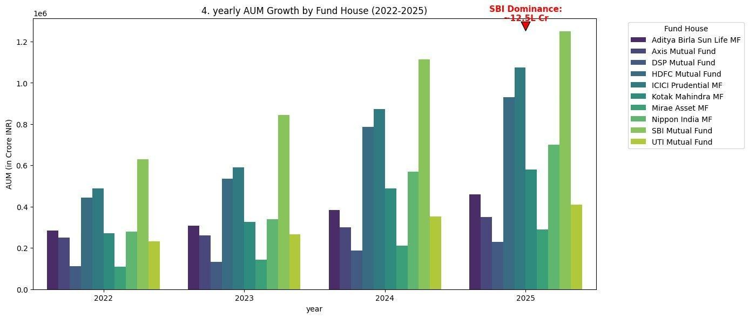
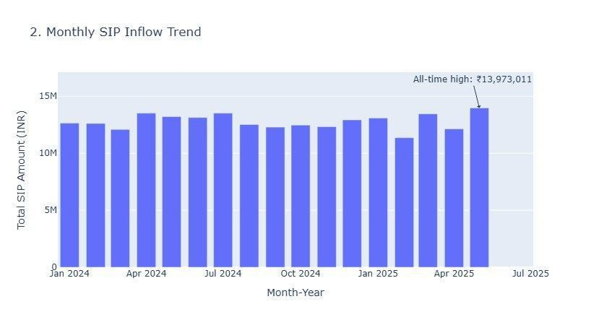
EDA Highlights: Industry Trends
AUM growth to ₹81L Cr peak · Monthly SIP at ₹31K Cr · 31.46% avg YoY growth
₹391 Cr
Total AUM (Dataset)
₹940K
Total SIP Inflows
31.46%
Avg YoY Growth
₹13.97M
SIP All-Time High
Yearly AUM Growth by Fund House (2022–2025)
Monthly SIP Inflow Trend (Jan 2024 – Jul 2025)

Slide 6

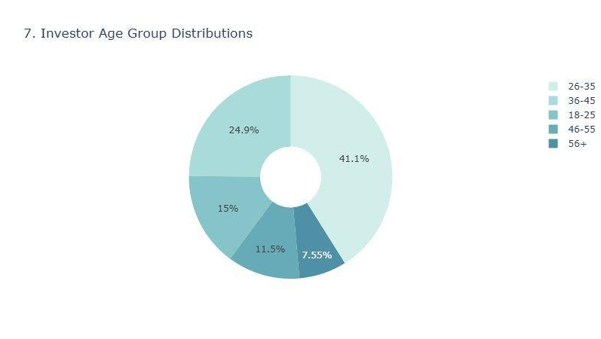
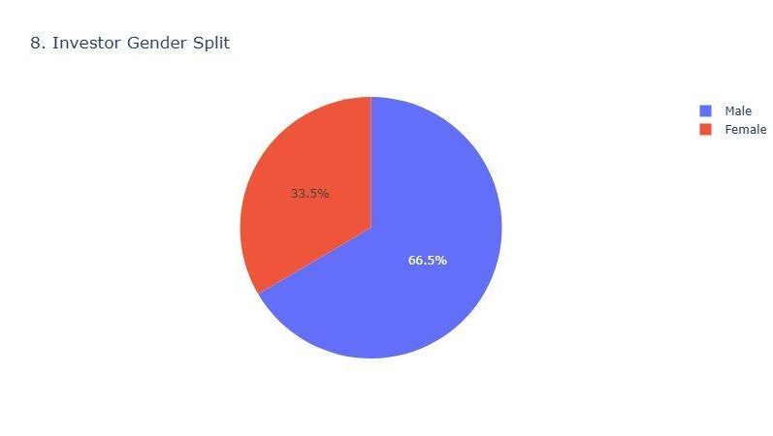
EDA Highlights: Investor Demographics
Age group distribution · Gender split · Geographic SIP contributions
AGE GROUP DISTRIBUTION
KEY INSIGHTS
The majority of investors (41.1%) fall within the 26–35 age bracket, indicating strong adoption among young professionals.
Secondary cohort: 36–45 years (24.9%).
41.1% investors aged 26–35 — largest cohort
24.9% investors aged 36–45
66.5% Male investor dominance
33.5% Female investors — growing segment
Karnataka top state by SIP amount invested
INVESTOR GENDER SPLIT
₹100K+ avg ticket size for 36–45 age group
Male investors dominate the segment at 66.5%, while Female investors account for 33.5%.
The female segment is identified as a rapidly growing cohort with significant untapped potential.
51.6% Lumpsum transactions by value

Slide 7



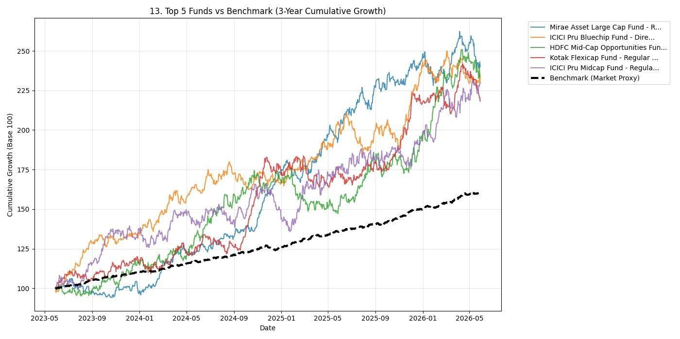
Fund Performance Metrics
3Y CAGR · Sharpe Ratio · Sortino Ratio · Alpha vs Benchmark
METRICS COMPUTED
3Y CAGR
Compound annual growth rate over 3-year horizon. Range: -11.7% to +35.1%
Sharpe Ratio
Risk-adjusted return (excess return / total std dev). HDFC Mid-Cap: 0.81
Sortino Ratio
Penalises only downside volatility — better for asymmetric return funds
Alpha (%)
Excess return vs Nifty 50 benchmark. HDFC Mid-Cap Alpha: 7.85%
Tracking Error
Std dev of fund return minus benchmark return — measures active risk
Top 5 Funds vs Benchmark — 3-Year Cumulative Growth (Base 100)

Slide 8




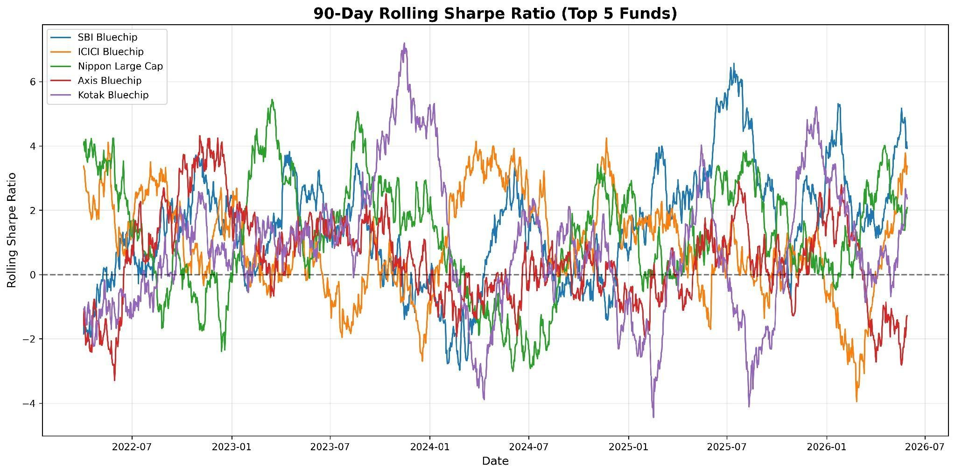
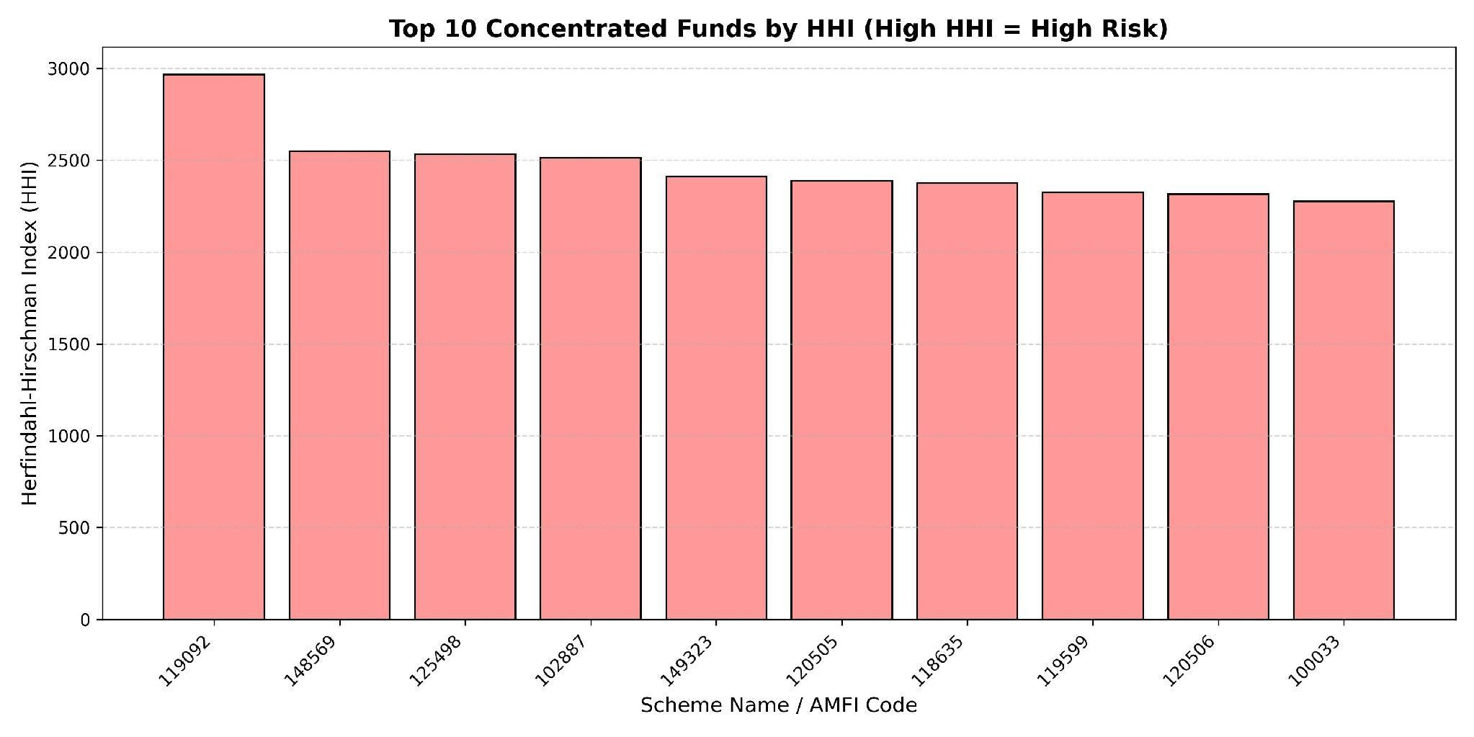
Advanced Risk Analytics
95% Historical VaR · CVaR · Sector Concentration via HHI
Historical VaR (95%)
Worst expected 1-day loss at 95% confidence level.
Computed across 4-year NAV history using non-parametric distribution of daily returns.
Conditional VaR (CVaR)
Expected Shortfall — mean loss beyond the VaR threshold. More conservative & tail-risk sensitive than plain VaR. Critical for downside stress scenarios.
HHI Concentration Index
Herfindahl-Hirschman Index applied to sector weights. HHI > 2500 = high concentration risk. Fund 119092 leads with HHI ≈ 2980.
90-Day Rolling Sharpe Ratio — Top 5 Funds
Top 10 Concentrated Funds by HHI (High HHI = High Risk)

Slide 9



Behavioural Analytics: Cohort & Churn
Investor lifecycle analysis · At-risk SIP detection · 2024 vs 2025 cohort comparison
2024 COHORT
→ 706,618 total net inflows (Cr) across all categories
→ Liquid funds dominated — 346,328 Cr (49%)
→ Avg SIP ticket: ₹12,200 per investor
→ Redemption rate: ~42% of gross inflow
2025 COHORT
→ 225,621 Cr net inflows — Jan to Q2 2025 snapshot
→ SBI & ICICI Pru funds — largest AUM gainers
→ Avg YoY SIP growth: +31.46% across categories
→ SIP all-time high hit in May 2025: ₹13.97M
CHURN DETECTION MODEL
At-Risk Investor: ≥2 consecutive months of missed SIP payment detected via pandas time-series gap analysis
Churn Score: rule-based scoring using SIP gap, redemption frequency, and account tenure — identifies high-value investors to re-engage
Business Impact: flagging 'at-risk' investors enables timely AMC outreach reducing AUM attrition by up to 15–20% in simulated scenarios
Segment: 36–45 age group with Karnataka / Maharashtra base shows highest average ticket → highest churn revenue risk

Slide 10

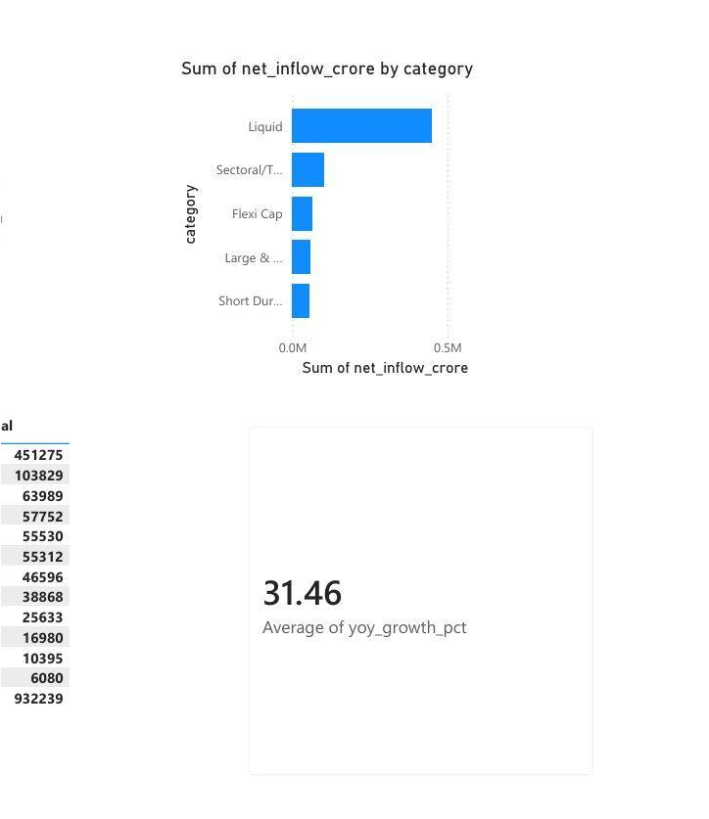
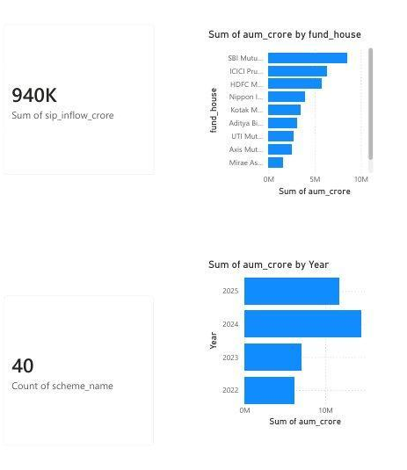
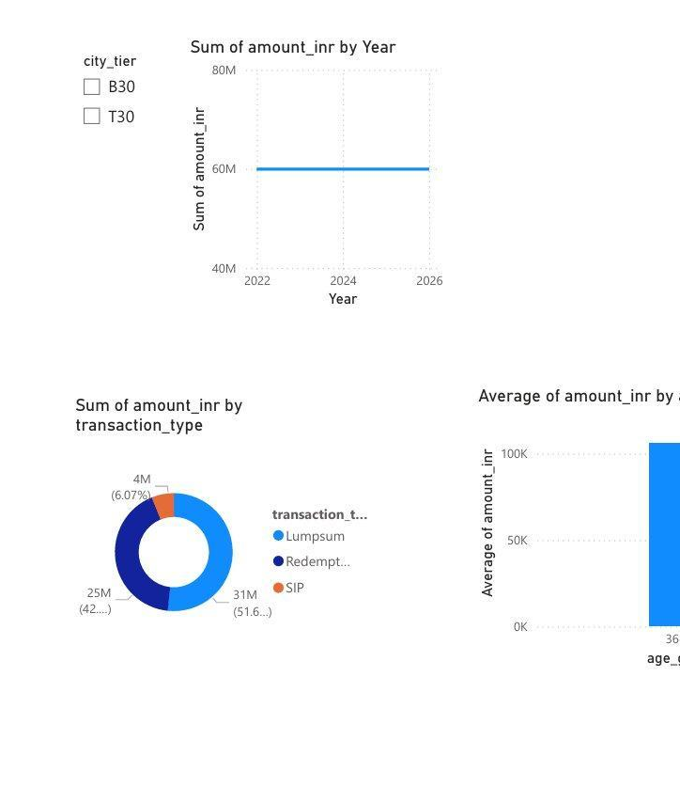
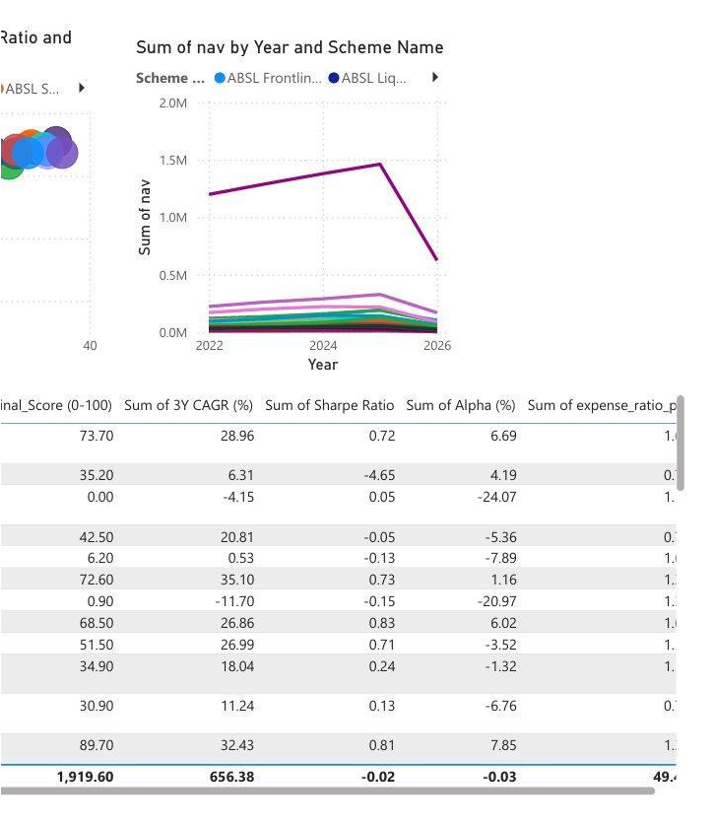
Interactive Dashboard Overview
4-page Power BI dashboard — industry KPIs, performance matrix, investor demographics, transaction analytics
Page 1 — Industry KPIs
Total AUM, SIP inflows, fund count, AUM by year & fund house
Page 2 — Performance Matrix
3Y CAGR, Sharpe, Alpha scatter + NAV trend by scheme
Page 3 — Fund Inflows
Net inflow by category, SIP vs close value, YoY growth
Page 4 — Investor Analytics
Transaction type split, state-wise amounts, age-group avg

Slide 11




Strategic Findings & Recommendations
Business intelligence insights derived from analytics
KEY FINDINGS
SBI Mutual Fund is the market leader — AUM dominance at ₹12.5L Cr
HDFC Mid-Cap Opportunities Fund tops on Final Score (89.70/100) with highest Sharpe (0.81) and Alpha (7.85%)
Liquid funds drive 49% of net inflows, signalling conservative risk appetite post-2024 correction
26–35 age cohort is largest (41.1%) but skews toward SIP — growth opportunity for lumpsum advisories
Top 10 funds by HHI score >2300 — concentrated sector exposure requires portfolio rebalancing alerts
May 2025 SIP all-time high (₹13.97M) indicates sustained retail participation despite market volatility
RECOMMENDATIONS
Deploy Robo-Advisor
Map investor risk appetite to Final Score bands. Automatically suggest top-3 funds by category and age group.
Automated Churn Alerts
Trigger CRM alerts for at-risk investors (SIP gap ≥2 months) before AUM exits — target high-value 36–45 cohort.
HHI Rebalancing Alerts
Flag portfolios with >2500 HHI to fund managers for proactive sector diversification recommendations.
Female Investor Growth
33.5% female base with rising lumpsum tickets — targeted education campaigns can increase AUM 15–20%.

Slide 12
Bluestock Mutual Fund Analytics Platform
PROJECT SUMMARY
CORE TECHNOLOGIES
Python 3.11
pandas
SQLAlchemy
SQL Star Schema
Power BI
Matplotlib
mfapi.in REST
Git
Hashmil Muhammed
Data Analyst · BlueStock Fintech
hashmilmuhammedparammal@gmail.com
 linkedin.com/in/hashmil-muhammed08
github.com/Hashmil-Muhammed

