Slide 1
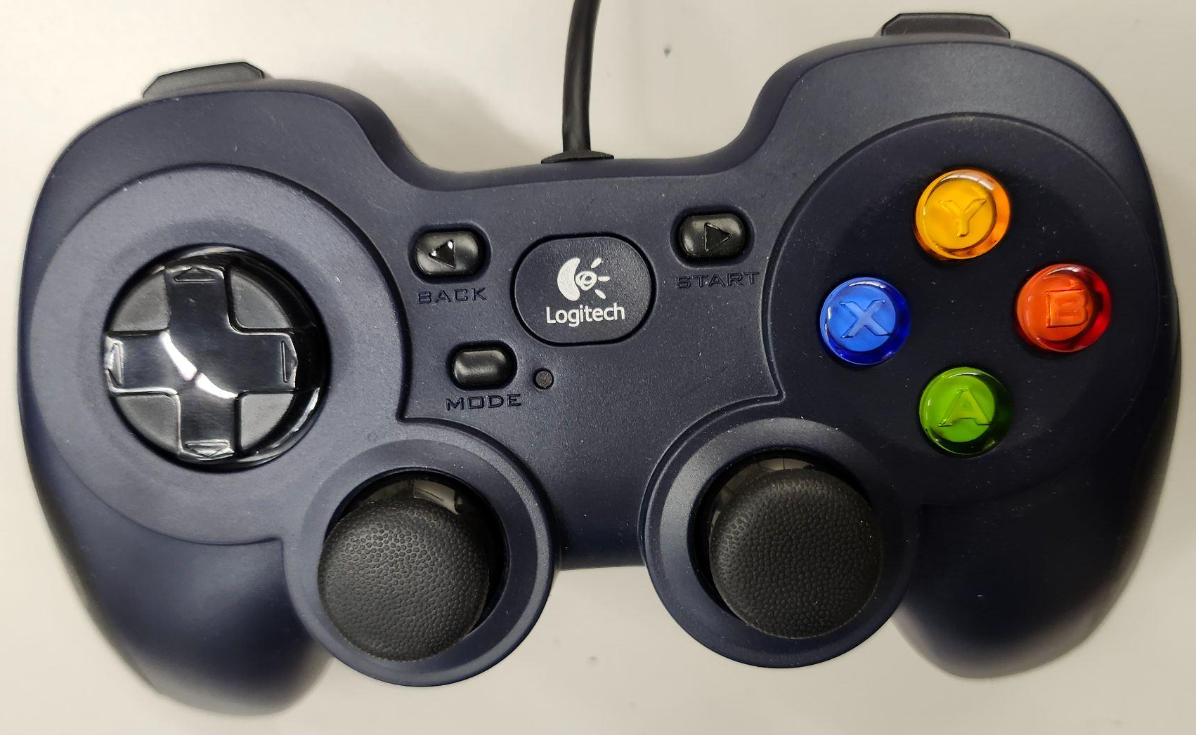
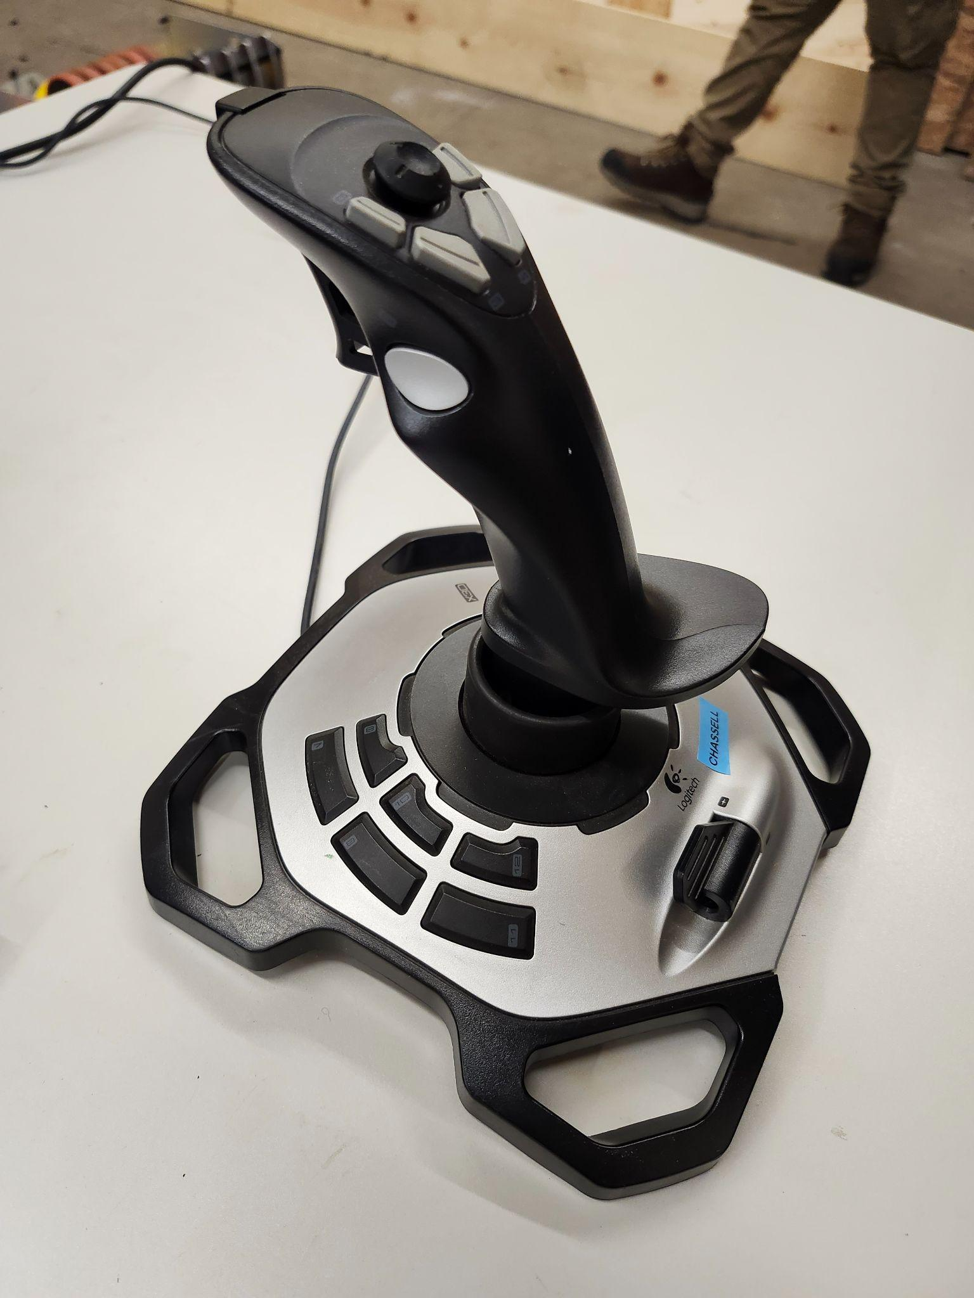
2026 Control Button Mapping
Speed Boost
Empty Hopper
(button 4)
Unstick
(button 3)
Intake Fuel
(button 1)
Launch
(button 2)
Forward and Reverse
Left and Right
Launch Speed Adjust
(axis 3)
Drive controller
Operation controller

