Slide 1

Restaurant Management System
Submitted to
Ms. Nusrat Tasnim
Lecturer
Department of Software Engineering-SWE
Daffodil International University

Slide 2
Submitted by
​
Name: Hasibul Islam Nabid
ID : 0242310005341282
Batch : 40
Section : A
Department of Software Engineering,
Daffodil International University
Name: Md. Muhtasim Fuad Rahat
ID : 0242310005341171
Batch : 40
Section : A
Department of Software Engineering,
Daffodil International University
Name: Md. Jahirul Islam
ID : 0242310005341083
Batch : 40
Section : A
Department of Software Engineering,
Daffodil International University

Slide 3
Index
# Overview
# Features
# Stakeholders
# Unique
# Limitations

Slide 4
Overview
The Restaurant Management System (RMS) is a comprehensive software solution designed using C programming to optimize and streamline the operations of a restaurant. This system addresses critical aspects of restaurant management, including menu management, order placement and processing and payment handling. It caters to the needs of various stakeholders such as customers, staff, and administrators, providing them with tailored functionalities to ensure efficient and smooth restaurant operations.

Slide 5
Stakeholders
Customer
Admin
Staff

Slide 6
Unique Features
Generate Invoice
Payment Method
Authentication
Password Hiding
User Friendly UI

Slide 7
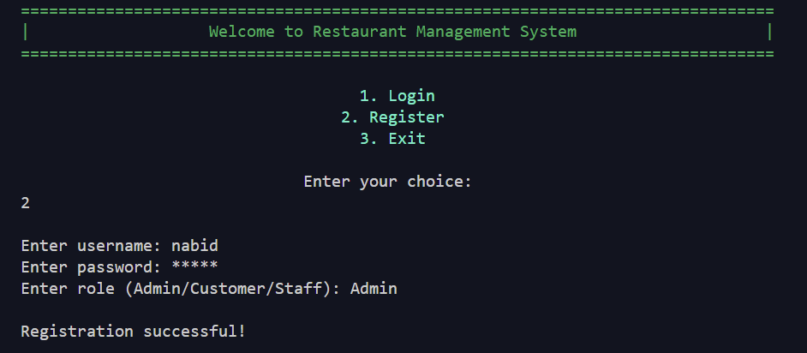
Features
1.Registration

Slide 8
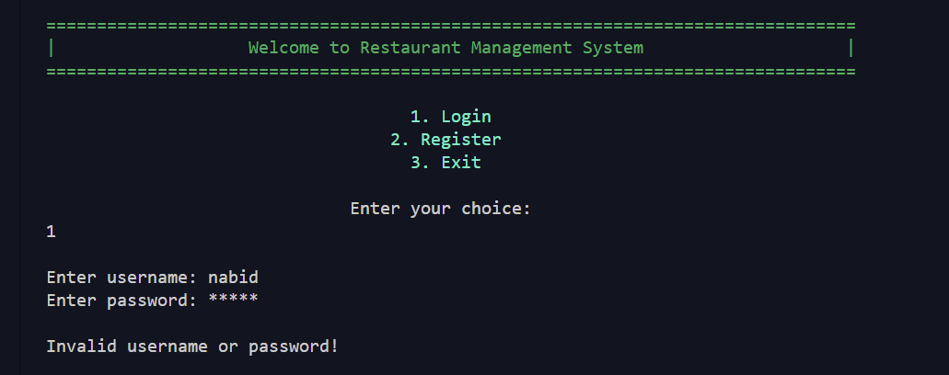
2.Authenitcation:

Slide 9
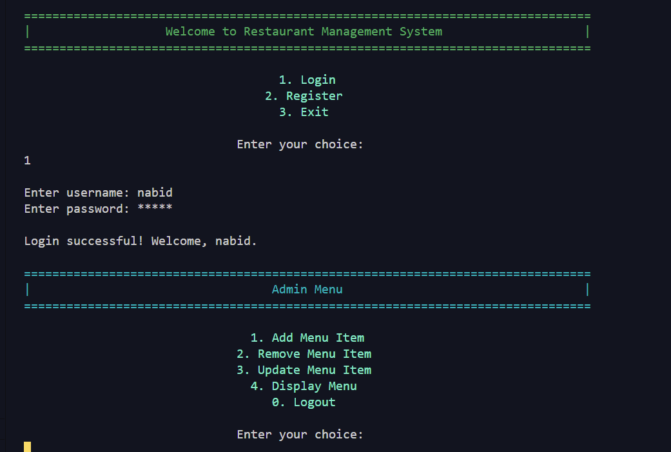
3.Log in (As a admin)

Slide 10
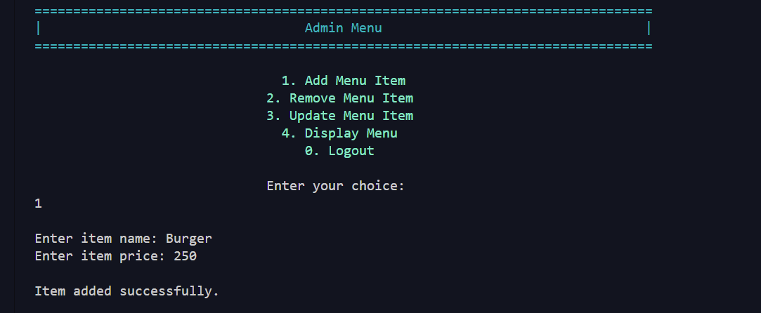
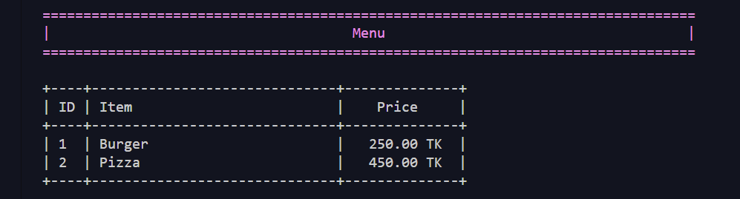
4.Add Menu
5. Display Menu

Slide 11
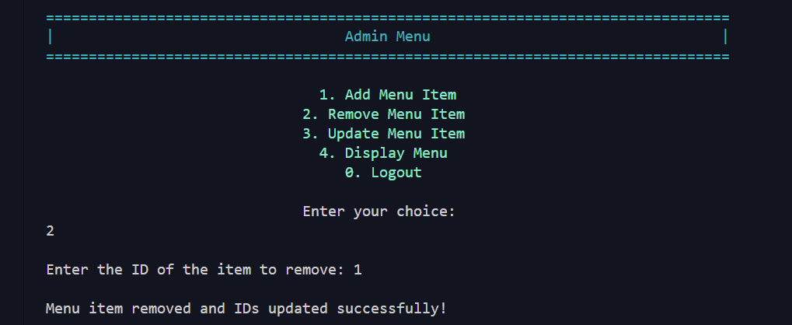
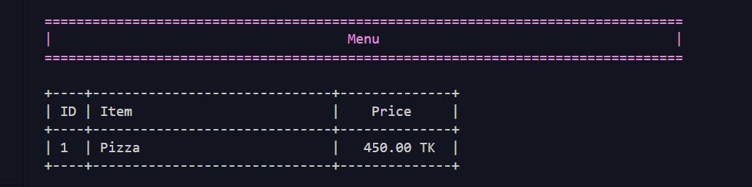
6. Remove Menu Item

Slide 12
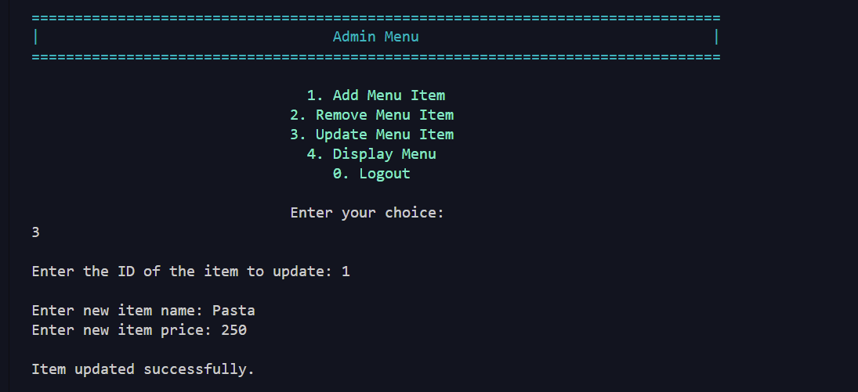
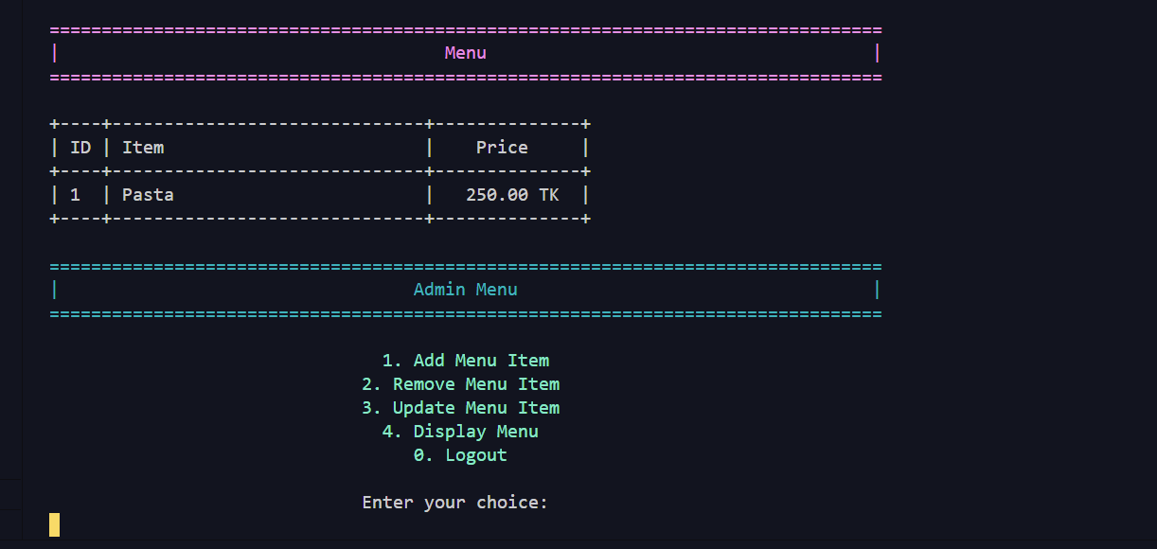
7.Update Menu Item

Slide 13
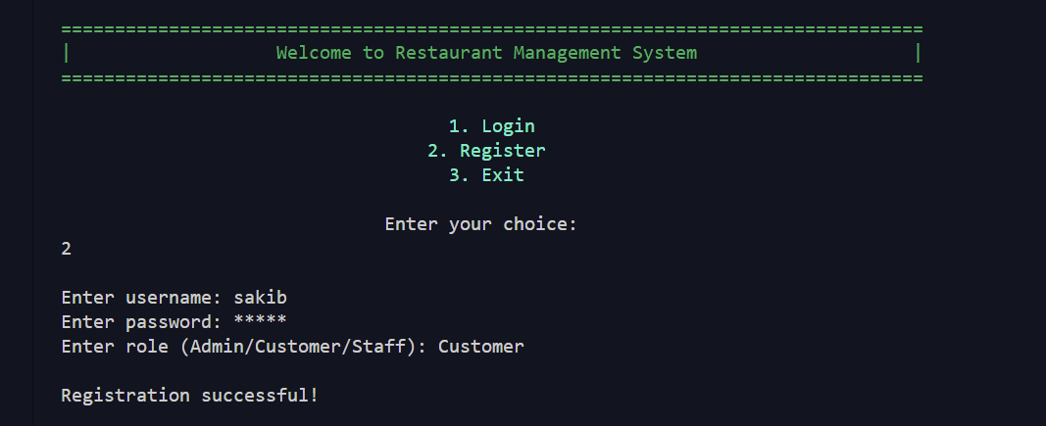
8.Register as a Customer:

Slide 14
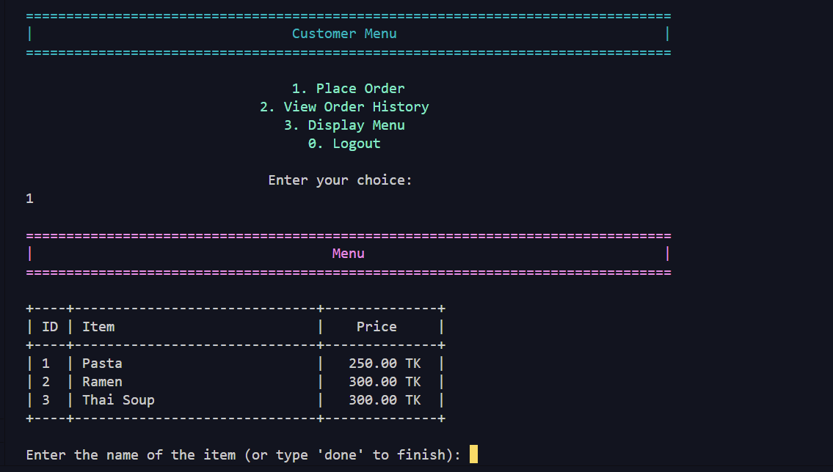
9.Place Order:
Step 9.1: See menu

Slide 15
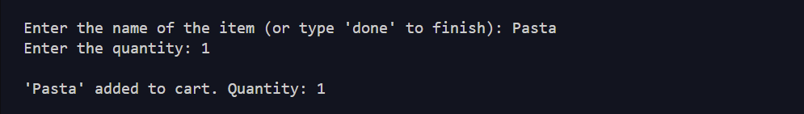
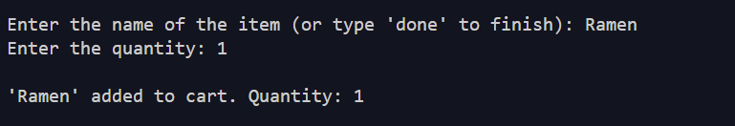
9.Place Order:
Step 9.2: Select your desired food and quantity

Slide 16
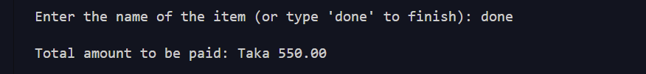
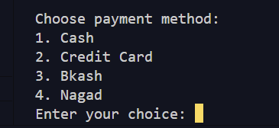
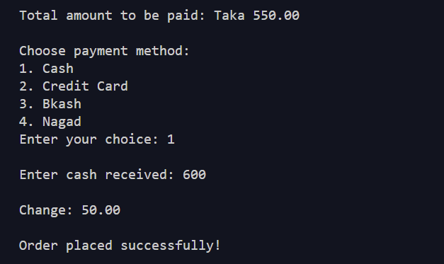
9.Place Order:
Step 9.3: See total cost
Step 9.4: Select payment method
Step 9.5: Make Payment

Slide 17
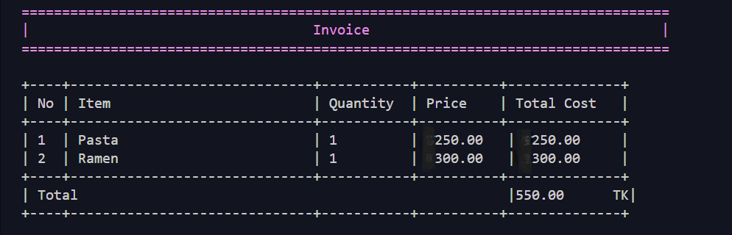
10.Receive Invoice:

Slide 18
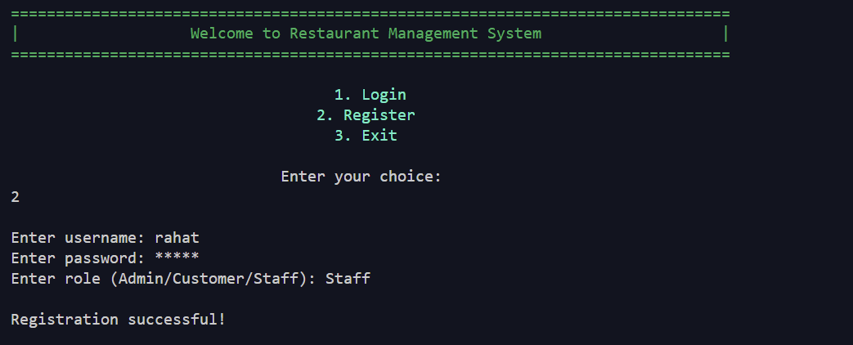
11.Register as Staff:

Slide 19
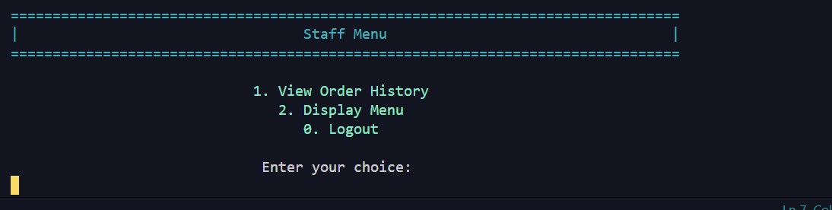
12. Login (as Staff):

Slide 20
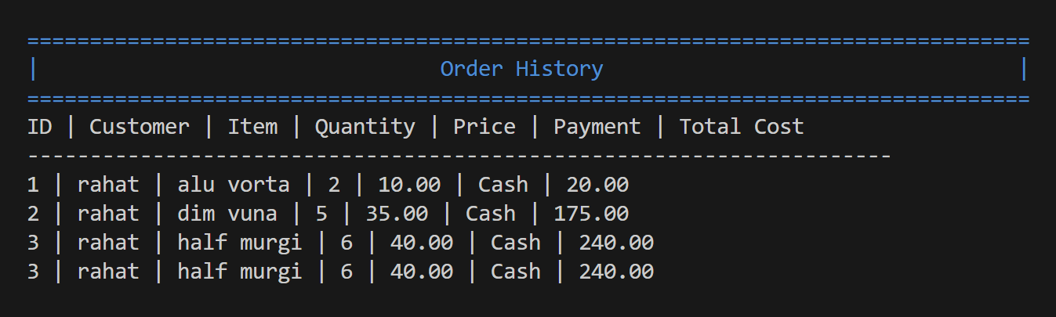
13.View Order History:

Slide 21
Limitation
User interface
No remove from cart
No tracking of date and time

Slide 22
Conclusion and future enhancement
Current system provides a solid foundation but has notable limitations. There is room for improvement to enhance its functionality and user experience. The current system effectively handles basic tasks but falls short in several critical areas..
Future Enhancements:
User Interface Improvement
Implement functionality to remove items from the cart.
Integrate a reservation system with reminders and notifications.
Add a customer feedback system.
Implement real-time inventory management.

Slide 23

This Photo by Unknown author is licensed under CC BY-NC.

