Slide 1

PROJECT WORK ON:- “SMART ASSISTANT”
GIET UNIVERSITY, GUNUPUR

Slide 2

A PROJECT WORK ON SMART ASSISTANT YOUR VIRTUAL COMPANION

Slide 3
SUBMITTED BY:-
->Sanna parbin(19cse215)
->Likith Patnaik(19cse300)
->Md Hasibur Rahman(19cse328)
SUBMITTED IN PARTIAL FULFILLMENT OF THE REQIREMENT FOR THE 3RD SESSIONAL EXAMINATION OF Bachelors of Technology In Department of Computer science and Technology Department of Computer science and Technology GIET UNIVERSITY,Gunupur Pin-765022,RAYAGADA,ODISHA

Slide 4
INTRODUCTION
Nowadays the Mobile Technology is being very famous for the User Experience, because it is very easy to access the applications and services from anywhere of your Geolocation. Android, Apple, Windows, Blackberry, etc. are various famous and commonly used Mobile Operating Systems. All the Operating Systems provides plenty of applications and services for users. For an instance, the Contacts Applications is used to store the contact details of the user's contact and also helps user to connect a call or send an SMS to other person using the contents stored in this application. We can get similar types of application all around the world via Apple Store, Play Store, etc. All this features gives birth to various kinds of sensors or functionalities to be implemented in the mobile devices. The Most famous application of iPhone is “SIRI” which helps the end user to communicate end user to mobile with voice and it also responds to the voice commands of the user. Same kind of application is also developed by the Google that is “Google Voice Search” which is used for in Android Phones. But this Application mostly works with Internet Connections. But our Proposed System has capability to work with and without Internet Connectivity. It’s named as Smast Assistant with Voice Recognition Intelligence, which takes the user
input in form of voice or text and process it and returns the output in various forms like action to be performed or the search result is dictated to the end user.

Slide 5
Objectives:
The Most famous application of iPhone is “SIRI” which helps the end user to communicate end user mobile with voice and it also responds to the voice commands of the user. Same kind of application is also developed by the Google that is “Google Voice Search” which is used for in Android Phones. But this Application mostly works with Internet Connections. But our Proposed System has capability to work with and without Internet Connectivity. It is named as Smart Assistant with Voice Recognition Intelligence, which takes the user input in form of voice or text and process it and returns the output in various forms like action to be performed or the search result is dictated to the end user. In addition, this proposed system can change the way of interactions between end user and the mobile devices. The system is being designed in such a way that all the services provided by the mobile devices are accessible by the end user on the user's voice commands.

Slide 6
What is a smart assistant ?
A smart assistant – also known as a virtual assistant – is a form of software installed in a smart device (such as a smart speaker or a smart phone) that can perform tasks or services, or answer questions. They're essentially the link between us and smart technology software and are essential for In order to communicate with your smart assistant, for controlling smart plugs, smart thermostats and similar devices.
A smart assistant is a software agent that can perform tasks or services for an individual based on commands or questions. Sometimes the term "chatbot" is used to refer to virtual assistants generally or specifically accessed online

Slide 7
Importance and need
1. GIVE YOU HANDS-FREE CONTROL
Voice control allows you to interact with your smart assistant, without lifting a finger. Whether controlling wider smart technology or searching the cloud through the internet to find exactly the information you need, this handy feature makes daily life easier and more efficient.

Slide 8
2. ANSWER YOUR QUESTIONS
One of the main uses for a smart assistant is to get instant answers to questions you may have, with the assistant searching the internet to find the information you need, before speaking it back to you. Simply use the wake word, and follow it with your question.
So far, Google Assistant tends to be the smartest helper for this sort of task due to its ability to tap into the vast knowledge of the Google search engine. But, all assistants are getting better at answering questions all the time.

Slide 9
3. GET RECOMMENDATIONS
Over time, your smart assistant will get to know your preferences and routines, offering recommendations for things to do, places to visit, or music to listen to.
Again, with its deep knowledge and links to your online search history, Google Assistant is great for getting tailored recommendations which can be surprisingly accurate.

Slide 10
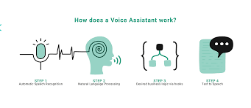
Objectives of a smart assistant
The long-term vision for voice assistants is to act as a smart bridge between humans and the vast knowledge and capacities which the internet delivers. Taking away the need to use any device or screen to interact with the internet, technology or other humans in different locations

Slide 11
Working principles & methodologies
Mainly It works on the principle on of speech_recognition and a python module “pyaudio”.
It takes a voice input from the user and gives a desired feedback as per the user’s command.
The project is executed using python and its basic libraries, out of which main libraries for input and output execution are “speech_recognition” and “pyaudio”.

Slide 12
Hardware & software requirements
Our project is a simple and general python code which can further be enhanced using artificial intelligence technology.
It can be executed on any computer system with certain software requirments.
Software requisites:-
It can work on windows-10, 8 or windows-7, having python installed with all the libraries used on our project.
Ideal python version for the execution is python v-3.6 and above. But python-3 is not supported on windows 7, so the ideal operating system is windows 10.
We are currently using windows-10 and python version 3.6 installed through visual studio 2019, and the python libraries installed which are being used.

Slide 13
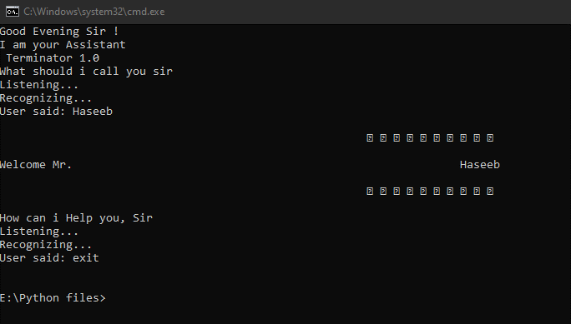
design
Our Project Does Not Have Any Gui Design, We Have Not Designed Any User Interface, It Just Works On Command Windows, Or If You Have Any Ide Installed The It Can Run Within Its Terminal Window., Yet The Smast Assistant Is Designed In A Very User Friendly Interface. It Greets You On The Very Starting As Per The Time. And Acts As Your Personal Assistant.
A Snapshot Of The Interface Can Be Seen Above.

Slide 14
development
Our development was simple and it required general python coding, the project is mostly dependent upon the libraries being used.
The following results of the python can also be converted to an .exe file or it can also be implementer on android os, if further modified.

Slide 15


results
Our results were satisfying and it gave an active result, the project is bit dependent upon the quality of internet connection, it responds bit slow if the quality of the internet connection is not good.

Slide 16
CONCLUSION
This PROJECT speaks to an initial phase in investigating the potential job of remote helpers in programming improvement ventures finished by virtual groups. This project will be help for visually impaired and physically challenge people (SPECIALLY FOR THE ONES WHO HAVE LOST THEIR EYESIGHT).
IT IS A BASIC NEED FOR TODAY’S WORLD AS MANY OF THE PEOPLE HAVE NOT ENOUGH time TO DO MANY OF THE JOBS, WHICH AN ASSISTANT CAN DO. SUCH AS SCHEDULING MESSAGES OR MAKING YOU FEEL BETTER..

Slide 17
FUTURE SCOPE
Interestingly, 50% or more of people say they never do include buying or ordering something via their voice assistant and using it to control other smart devices.
As for growth, Juniper Research says there will be 8 billion digital voice assistants in use by 2023. That means the stage is set for something significant.
The use of Artificial intelligence is increasing rapidly which indicates that the use of smart assistants will play a significant role fyrther, if integrated with an ai based application.

Slide 18
A recent survey from PWC reveals voice assistants have been used in a host of ways during the past decade and they will continue to mold our very essence. Here’s what some of the numbers are showing:
90% of people recognize voice assistants
72% had used a voice assistant
57% top commends come from a smartphone
27% issue commands to a speaker
20% issue commands for vehicle navigation purposes

Slide 19

thankyou

