Slide 1
aBC: An Android Application for Exploring the Proof-of-Work based Blockchain
System Development Project
CSE 3200
Supervisor: Md. Ahsan Habib Lecturer | Presented By: Israt Tasnim Esha Roll: 1907090 Hasibul Hasan Hasib Roll: 1907089 Year: 3rd, Semester: 2nd
Computer Science and Technology
Khulna University of Engineering & Technology, Khulna-9203

Slide 2
Outline
Introduction
Problem Statement
Objectives
Functional Outcomes
Broader Impacts
Related Works
Research Gap
Proposed System Architecture
Simulation Results
Comparison of Different Systems
Conclusion
Future Works
References

Slide 3
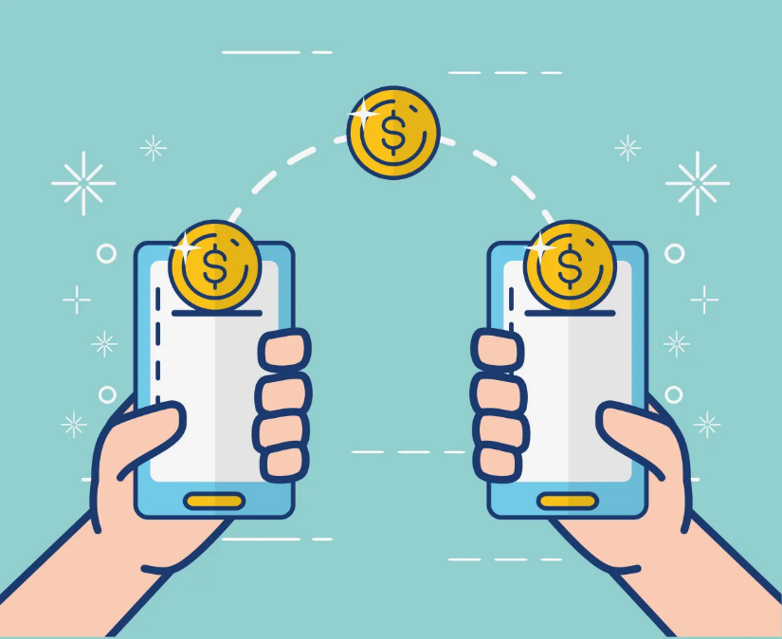
Introduction
Traditional transaction systems, reliant on centralized structures.
Most of the traditional transactions involve institutions.
Blockchain disrupting the conventional model by offering decentralization and heightened security.

Slide 4
Introduction
cont’d
Though decentralized, struggle to achieve efficiency for everyday transactions.
For example: Security concern, privacy concern , high energy consumption.
As a result some people might feel unsure or worried about using blockchains.

Slide 5
Problem Statement
There's no one-stop app for sender , receive and miner.
These solutions having a hard time keeping up with the increasing number of transactions.
The security measures they use are complicated and use a lot of power.

Slide 6
Objectives
Optimize Proof-of-Work Mechanism.
Overcome Conventional Blockchain Limitations.
Implement Five Layers of Security of a transaction.
Diminish Confirmation Times.
Prioritize cost-effectiveness through strategic measures.

Slide 7
Functional Outcomes
Users securely transact using a decentralized blockchain system.
Transactions are verified by miners through public-key cryptography.
Mining ensures only valid transactions are added to the main blockchain.
The system automates money transfers and deducts transaction fees.
Cross-verification with random user accounts discourages manipulation.

Slide 8
Broader Impacts
Digital signatures and decentralization enhance system security.
Users have control and trust in the security of their financial information.
A secure and transparent environment builds trust in digital financial interactions
Unauthorized attempts to alter user information are caught, ensuring database integrity.

Slide 9
Related Works
Table 1: Contributions and Limitations in Existing Solutions
Works | Contributions | Limitations
DCAP [3] | Privacy through dynamic-address approach Utilizes Ethereum smart contracts | Central authority introduces a single point of failure Account models less secure than UTXO models
PGC [4] | Lightweight ZK proofs for scalability | Lack of details on blockchain and consensus algorithm ZK proofs hinder amount observation
FAPC [5] | Guaranteed privacy through ring signatures | Omitted details on blockchain implementation Heavyweight transactions impact scalability

Slide 10
Related Works
cont’d
Table 1: Contributions and Limitations in Existing Solutions (contd.)
Works | Contributions | Limitations
[6] | Built on Hyperledger Fabric for privacy | Single point of failure in decryption process Complexity in token transfer process
[7] | Introduction of intelligent cross-border transactions | Unclear transaction verification scheme Lack of details on privacy and transparency
[8] | Reduction in memory consumption | Insufficiency of hash value for non-interactively verifying transactions Potential transparency issues in data integrity and privacy

Slide 11
Research Gap
The work [3] often rely on a central certificate authority (CA) for privacy.
In [4], it faces challenges with transparency for zero-knowledge (ZK) proofs.
The proposal [5] lacks essential details on its blockchain implementation.
The system [6] introduces complexities in the token transfer process.

Slide 12

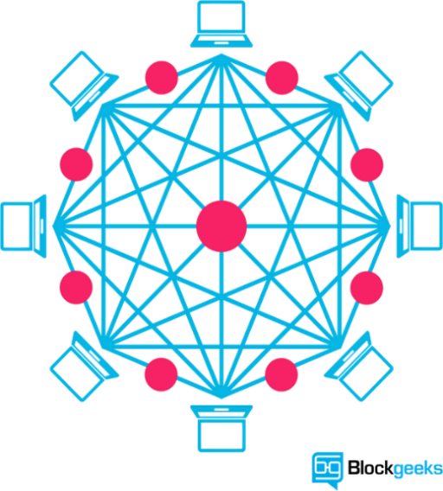














Proposed System Architecture
Receiver
Digital Signature
Miner’s Fees
Sender
Private Key
Public Key
Amount
Algorithm-2
Registration
Algorithm-1
Fig. 1. An overview of the Proposed System Architecture

Slide 13















Proposed System Architecture
cont’d
Algorithm-3
Block Queue
Mining
Transactions
Miner
Verify and Accept
Verify
Receive Money
Fees
Reward
Accepted Block
Algorithm-2
Fig. 1. An overview of the Proposed System Architecture (contd.)

Slide 14

Proposed System Architecture
cont’d
User’s Balances
Blockchain
Rejected Blocks
Fig. 1. An overview of the Proposed System Architecture (contd.)

Slide 15
Proposed Algorithm
Algorithm 1 Registration of a User
Input: Name N, Phone Number PH, Email E, Password PW Output: PUB_KEY, PRIV_KEY AUTH ← initAuth() createUser(AUTH, E, PW) if success(AUTH) then USER ← getUser(AUTH) KEYS ← genKeyPair() PUB_KEY ← getPubKey(KEYS) PRIV_KEY ← toBase64(getPrivKey(KEYS).encoded) MINERS ← getRandomMiners() if validateIntegrity(MINERS) then saveUser(N, PH, PUB_KEY, PRIV_KEY) ∧ goToSignIn() end if end if

Slide 16
Proposed Algorithm
cont’d
Algorithm 2 Add Transaction and Add to Block
Input: Receiver R, Amount A, Fees F, Sender S, USER, TRANS Output: Transaction T, Signature SIG, TRANS.STS fetchKey(USER) if keyExists() then T ← R+A+F+getCurrentDateTime() SIG ← signData(PRIVATE_KEY, T) if minerHasKey() then performTransaction(SIG) ∧ reduceMoney(USER, A+F) end if end if DATA ← decodeData(PUBLIC_KEY, TRANS.SIG) if TRANS.STS==”Unrecognized” then if match(DATA, TRANS.S, TRANS.R, TRANS.A, TRANS.F) then TRANS.STS ← “Verified” ∧ addToBlock() end if end if

Slide 17
Proposed Algorithm
cont’d
Algorithm 3 Mining Process
Input: TRANS[], PR_BLOCK Output: BLOCKCHAIN_BLOCK, BLOCK_QUEUE_BLOCK for i in range (0, len(PR_BLOCK.TRANS[])) do PR_DATA += PR_BLOCK.TRANS[I].S, PR_BLOCK.TRANS[I].R, PR_BLOCK.TRANS[I].A, PR_BLOCK.TRANS[I].F end for if match(PR_BLOCK.HASH, RSA_256(PR_DATA)) then for i in range (0, count(TRANS)) do DATA += TRANS[I].S, TRANS[I].R, TRANS[I].A, TRANS[I].F end for BLOCK.HASH ← RSA_256(DATA) startMining(BLOCK) ∧ blockChained(PR_BLOCK) ∧ blockQueued(BLOCK) for i in range (0, len(PR_BLOCK.TRANS[])) do sendToReceiver(PRBLOCK.TRANS[I].R, PRBLOCK.TRANS[I].A) sendToMiner(PRBLOCK.MINER, PRBLOCK.TRANS[I].F) end for end if

Slide 18
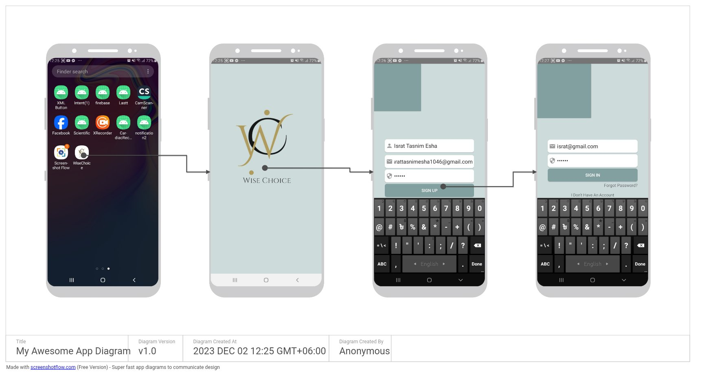
Simulation Results
Splash Screen
Sign Up
Sign In
Fig. 2. Simulation of The App

Slide 19
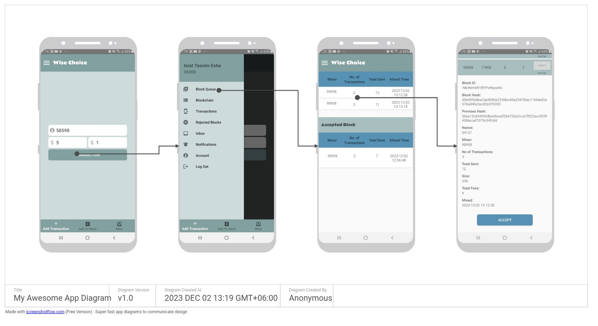
Simulation Results
cont’d
Add Transaction
Navigation Bar
Block Queue
Accept Block
Fig. 2. Simulation of The App (contd.)

Slide 20
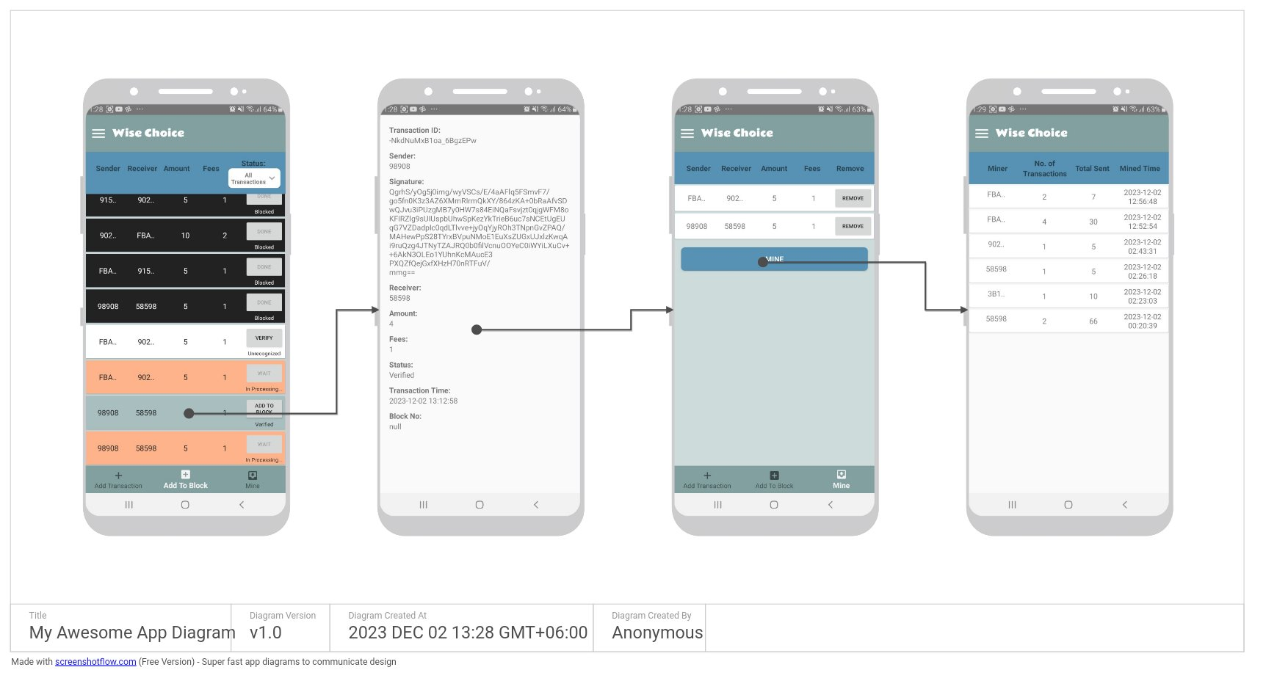
Simulation Results
cont’d
Add To Block
Transaction Details
Mine Block
Blockchain
Fig. 2 Simulation of The App (contd.)

Slide 21
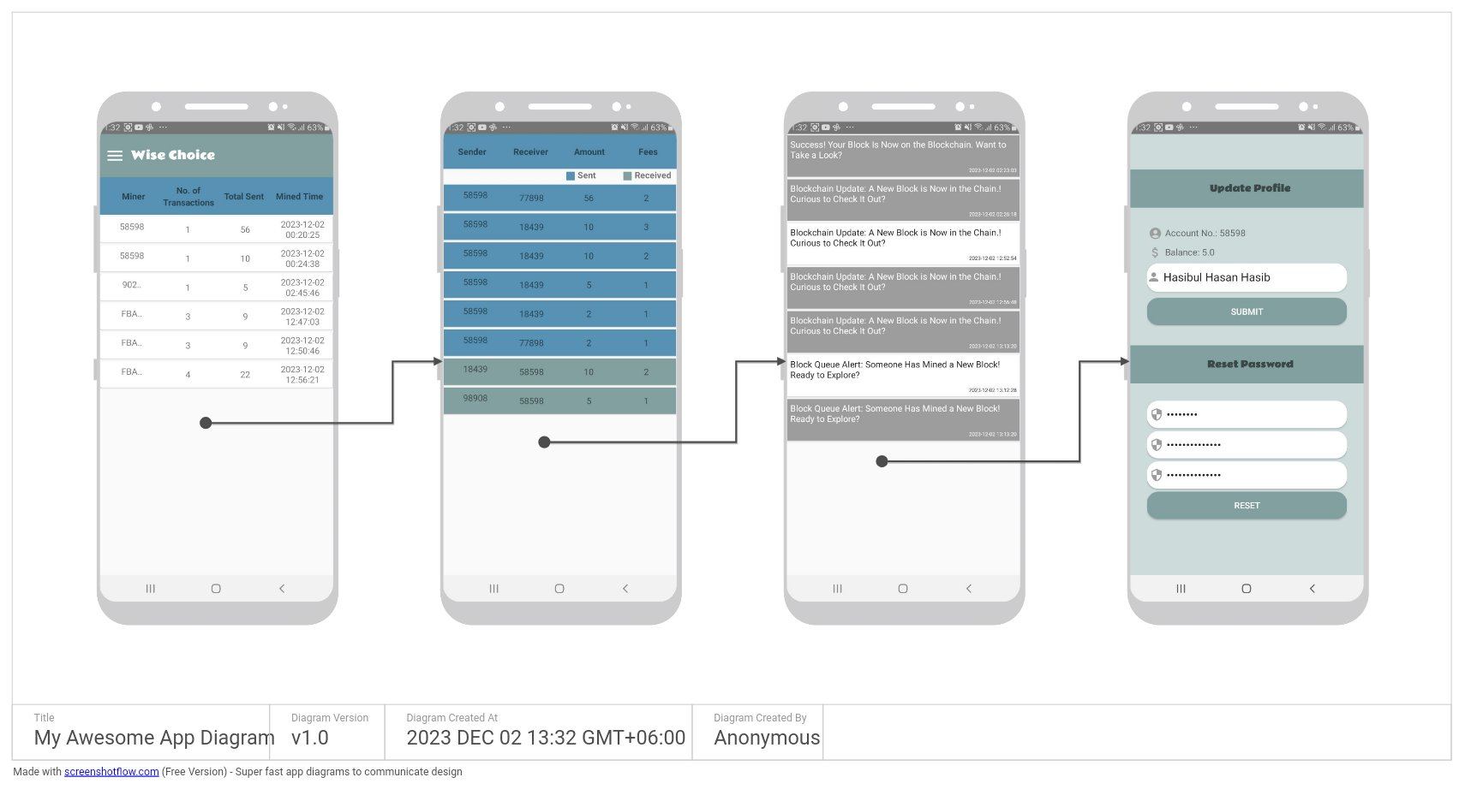
Simulation Results
cont’d
Rejected Blocks
Inbox
Notifications
Account
Fig. 2 Simulation of The App (contd.)

Slide 22
Simulation Results
cont’d
Table 2: System Analysis
Experiment Name | Attempt 1(s) | Attempt 2(s) | Attempt 3(s) | Attempt4(s) | Attempt 5(s) | Average Time Required(s)
Sign Up | 5.17 | 4.55 | 3.85 | 3.20 | 3.15 | 3.984
Sign In | 3.70 | 2.30 | 2.40 | 2.40 | 2.30 | 2.183
Transaction Time | 2.30 | 2.20 | 2.30 | 1.77 | 1.88 | 2.090
Validity Check Time | 1.20 | 1.00 | 0.85 | 0.60 | 0.30 | 0.791
Mining Time | 2.45 | 9.30 | 11.60 | 1.20 | 0.83 | 5.076

Slide 23
Comparison
Table 3: System Features Comparison
Parameters | PGC[4] | FAPC[5] | [6] | DCAP[3] | Proposed System
Transaction Type | Account-based | UTXO-based | UTXO-based | Account-based | UTXO-based
Network Type | - | Decentralized | Partially | Partially | Decentralized
Blockchain Used | - | - | Hyperledger Fabric | Ethereum | Own
Consensus | - | - | - | PBFT | PoW
Anonymity | No | Yes | Yes | Yes | Yes
Privacy | Yes | Yes | Yes | Yes | Yes

Slide 24
Comparison
cont’d
Table 3: System Features Comparison (contd.)
Parameters | PGC[4] | FAPC[5] | [6] | DCAP[3] | Proposed System
Transparency | Semi Transparent | Fully Transparent | Not Transparent | Semi Transparent | Fully Transparent
Auditability | Yes | Yes | Yes | Yes | Yes
Authentication Type | - | - | Interactive | Interactive | Password-Based.
Loss Recovery Scope | - | No | Yes | No | Yes
Address Type | Actual Address | Id-linked | Anonymous Credentials | Id-linked | Id-linked
Verification Scheme | ZK proofs | Ring Signatures | ZK proofs | ZK proofs | Digital Signature

Slide 25
Conclusion
Our system keeps transactions secure and tamper-proof.
Broadcasting lets users see and trust transactions.
Using SHA-256, cryptographic link is established.
A five-layer security approach prevents unauthorized tampering, ensuring system reliability.

Slide 26
Future Works
Allow the system to work together with other blockchain systems and traditional financial networks.
Add smart contracts for automated and rule-enforced transactions.

Slide 27
References
[3] C. Lin, D. He, X. Huang, M. K. Khan, and K. R. Choo, “DCAP:A secure and efficient decentralized conditional
anonymous payment system based on blockchain,” IEEE Trans. Inf. Forensic Secur., vol. 15, pp. 2440–2452, Jan.
2020.
[4] Y. Chen, X. Ma, C. Tang, and M. H. Au, “PGC: Decentralized confidential payment system with auditability,” in
Computer Security, Eds. Cham, Switzerland: Springer, 2020, pp. 591–610.
[5] W. Li, Y. Wang, L. Chen, X. Lai, X. Zhang, and J. Xin, “Fully auditable privacy- preserving cryptocurrency against
malicious auditors,” Cryptology ePrint Archive, 2019. [online]. Available: https://eprint.iacr.org/2019/925.pdf.
[6] E. Androulaki, J. Camenisch, A. D. Caro, M. Dubovitskaya, K. Elkhiyaoui, and B. Tackmann, “Privacy-preserving
auditable token payments in a permissioned blockchain system,” in Proc. 2nd ACM Conf. Adv. Financial
Technol., New York, NY, USA: Association for Computing Machinery, 2020, pp. 255–267.
[7] Z. Fu, P. Dong, S. Li, and Y. Ju, “An intelligent cross-border transaction system based on consortium blockchain: A
case study in Shenzhen, China,” PLoS ONE vol. 16, no. 6, p. e0252489, June 2021.
[8] P. Chatzigiannis and F. Baldimtsi, “MiniLedger: Compact-sized anonymous and auditable distributed payments,”
in Computer Security (LNCS), vol. 12972, Springer, Cham, Sep. 2021, pp. 407– 429.

Slide 28
Thank You All… Any Question???

Slide 29
Proposed Algorithm
cont’d
Algorithm 4 RSA Algorithm
Key Generation: Choose two large prime numbers, p and q. Compute n = p * q. Compute ϕ(n)=(p−1)(q−1), where ϕ is Euler's totient function. Choose a public exponent e such that 1<e<ϕ(n) and e is coprime to ϕ(n). Compute the private exponent d such that d≡e⁻¹modϕ(n). The public key is (n,e), and the private key is (n,d). | Signature Creation: The sender uses their private key (n,d) to create a digital signature for a message S≡M^{d} mod n. Signature Verification: The recipient uses the sender's public key (n,e) to verify the signature M′≡S^{e} mod n. If M′=M, the signature is valid.

