Slide 1
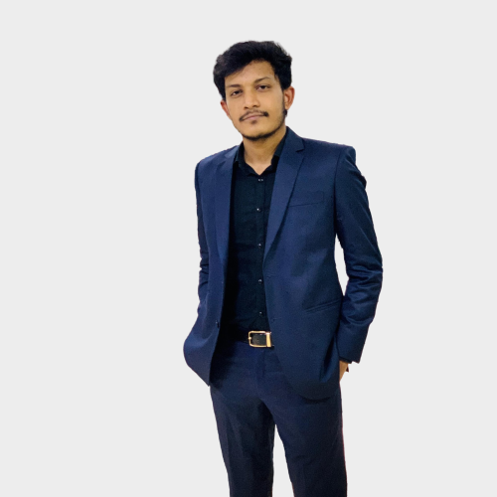
HASIBUL HASAN HASIB
CS Engineer
01300788208 hasibhasan305@gmail.com Dhaka , BD
PROFILE
EDUCATION
Computer science engineer and competitive programmer with strong foundation in C++, Java, Python, and database management.
KUET,2024
Bachelor of Science , CSE
Notre Dame College, 2019
HSC, Science(GPA 5.0 in all subjects)
Ideal School & College , 2017
SSC, Science(GPA 5.0 in all subjects)
SKILLS
C++
C++ Projects
Snake Game
University Management System
Java Project
Desktop ‘EZ Quiz’ App
Database Project
Restaurant Management System
ASP Project
Job Finding and Skill improving Website
Peripheral Project
Hand Gesture Car with Obstacle Avoider
Android Project
Blockchain Based Transaction System
Python Project
Chain Reaction Game (Player vs AI)
PROJECTS
JAVA
DATABASE
PYTHON
ASP.Net MVC
HOBBY
Coding
Chess
Guitar
Piano
CERTIFICATES
Dean’s Award, KUET, 2023
Best Team 2019 in IKPC

