Slide 1
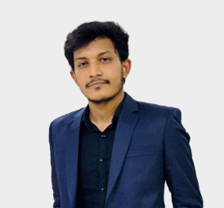
HASIB HASAN
CS Engineer
01300788208 hasibhasan305@gmail.com hasib.13 Dhaka , BD
PROFILE
EDUCATION
Enthusiastic computer science engineer with a recently acquired degree and a strong foundation in C++, Java, Python, and database management.
KUET , 2024
Bachelor of Science , CSE
NDC , 2019
HSC, Science
WORK EXPERIENCE
SKILLS
Freelancer , 2016 – Graphics & Web Design
Collaborated with cross-functional teams to develop visually stunning.
Python
Java
Software Engineer , 2023 – Graphics & Web Design Collaborated with cross-functional teams to develop visually stunning.
Database
Intern , 2022– Graphics & Web Design
Collaborated with cross-functional teams to develop visually stunning.
Software Engineer , 2021 – Graphics & Web Design Collaborated with cross-functional teams to develop visually stunning.

Slide 2
01300788208 hasibhasan305@gmail.com hasib.13 Dhaka , BD
INTERESTS
Languages
Open Source Contribution
Many CS engineers have a keen interest in contributing to open source projects. Engaging with the broader developer.
Bangla
English
Game Development
Graphics & Web Design
Collaborated with cross-functional teams
to develop visually stunning.
Hindi
Software Engineer , 2023 – Graphics & Web Design Collaborated with cross-functional teams to develop visually stunning.
References
Dr. John Doe
Position: Professor of Computer Science
Institution: KUET
Phone: +880 1XX XXX XXXX
Email: johndoe@kuet.ac.bd
Relation: Academic Advisor
Ms. Jane Smith
Position: Senior Software Engineer
Company: Tech Innovations Phone: +880 1XX XXX XXXX
Relation: Supervisor during Internship
Certifications & Courses
Advanced Web Design, Online Course, Coursera, 2023
Python for Everybody, Specialization, Coursera, 2022
Volunteer Experience
Volunteer Web Designer, Local Non-Profit Organization (2021 - Present)
Awards & Honors
Dean's List, KUET, 2023
Best Undergraduate Project Award, CSE Department, KUET, 2024

