Slide 1
Counting
CSE 2213 – Discrete Mathematics
Course teacher: Minhajul Bashir

Slide 2
Permutation and Combination
Permutation: How do we choose 6 students out of 10 and arrange them in one line?
Combination: How do we choose 6 students out of 10 and form a committee?

Slide 3
Permutation
Ordered arrangement of distinct objects
Two permutations of five different colored balls

Slide 4
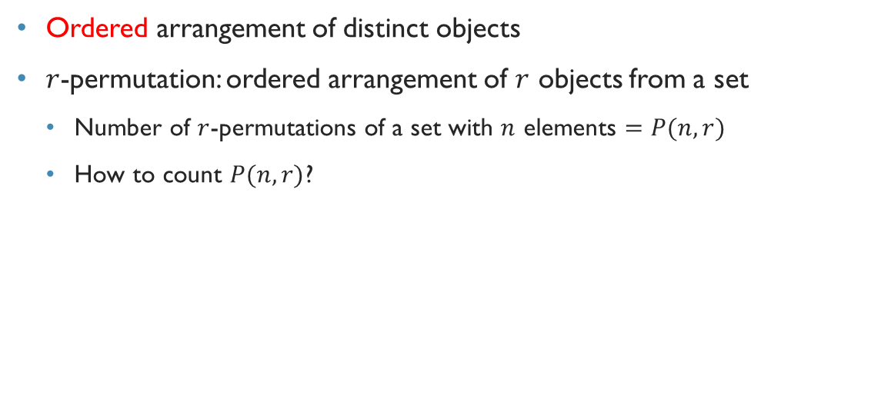
Permutation
Ordered arrangement of distinct objects
$r$-permutation: ordered arrangement of $r$ objects from a set
Number of $r$-permutations of a set with $n$ elements $=P(n,r)$
How to count $P(n,r)$?

Slide 5
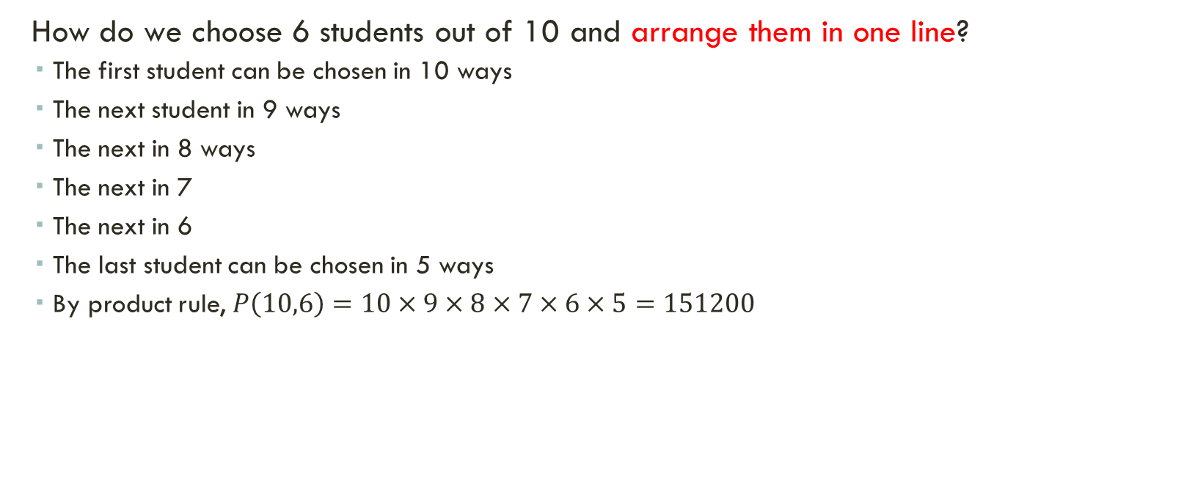
Permutation
How do we choose 6 students out of 10 and arrange them in one line?
The first student can be chosen in 10 ways
The next student in 9 ways
The next in 8 ways
The next in 7
The next in 6
The last student can be chosen in 5 ways
By product rule, $P\left(10,6\right)=10×9×8×7×6×5=151200$

Slide 6
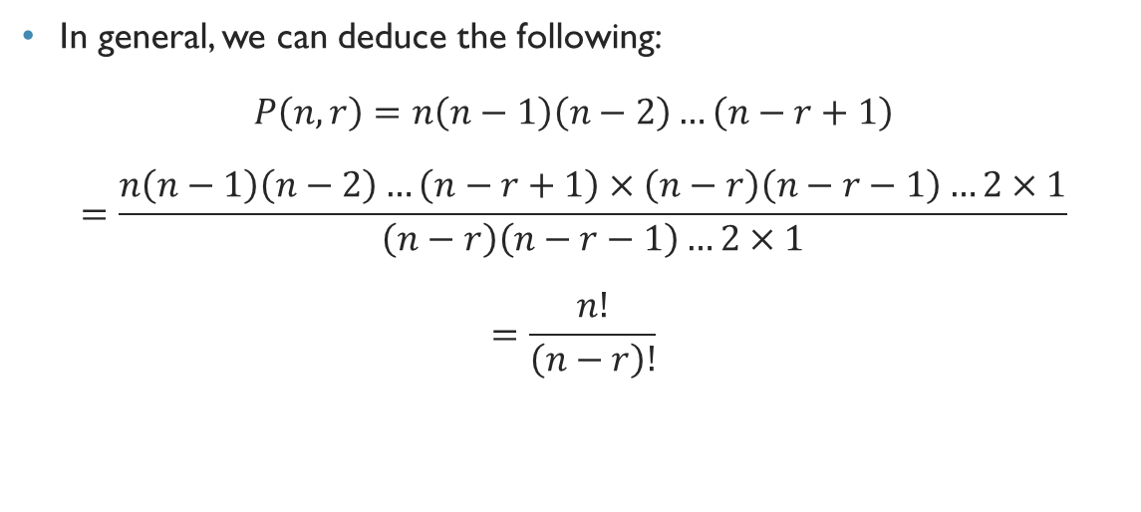
Permutation
In general, we can deduce the following:
$$P\left(n,r\right)=n\left(n−1\right)\left(n−2\right)…\left(n−r+1\right)$$
$$=\frac{n\left(n−1\right)\left(n−2\right)…\left(n−r+1\right)×\left(n−r\right)\left(n−r−1\right)…2×1}{\left(n−r\right)\left(n−r−1\right)…2×1}$$
$$=\frac{n!}{\left(n−r\right)!}$$

Slide 7
Combination
Unordered selection of distinct objects
We are only choosing the balls, not worrying about the order

Slide 8
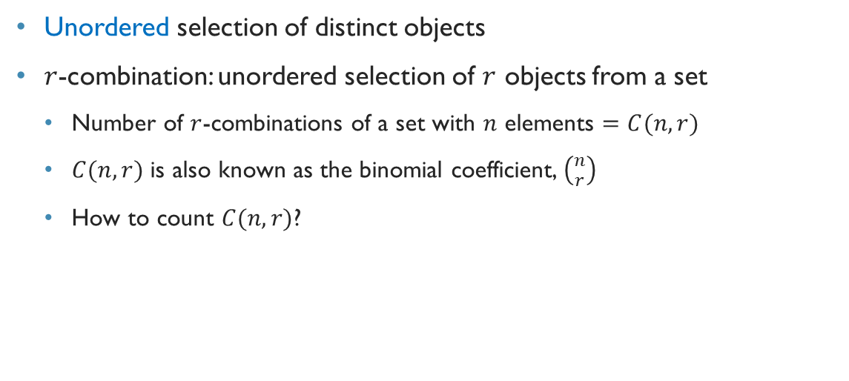
combination
Unordered selection of distinct objects
$r$-combination: unordered selection of $r$ objects from a set
Number of $r$-combinations of a set with $n$ elements $=C(n,r)$
$C(n,r)$ is also known as the binomial coefficient, $\left({n \atop r}\right)$
How to count $C(n,r)$?

Slide 9
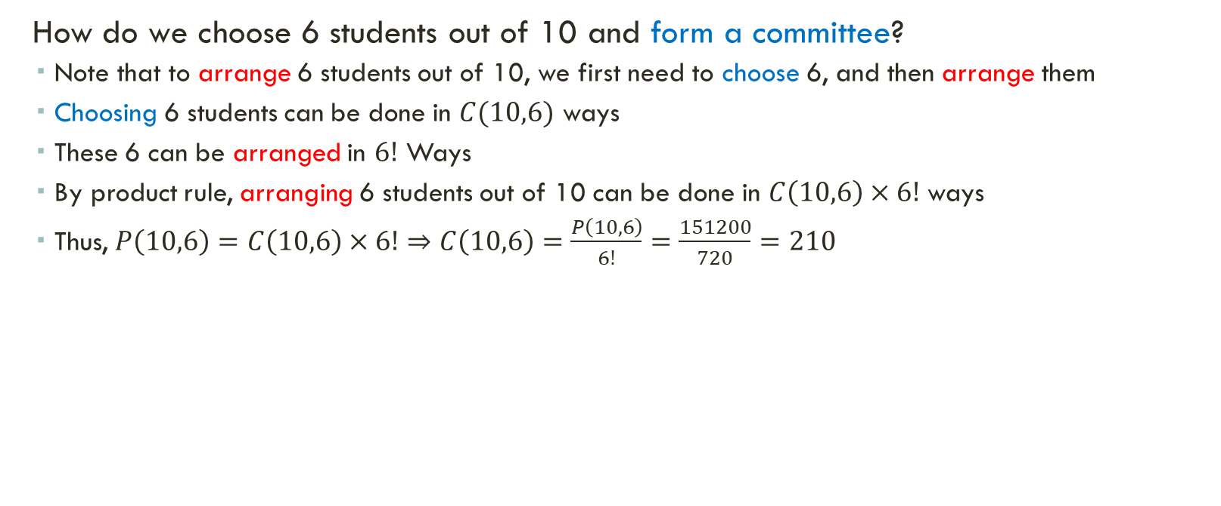
Calculate combination from permutation
How do we choose 6 students out of 10 and form a committee?
Note that to arrange 6 students out of 10, we first need to choose 6, and then arrange them
Choosing 6 students can be done in $C(10,6)$ ways
These 6 can be arranged in $6!$ Ways
By product rule, arranging 6 students out of 10 can be done in $C\left(10,6\right)×6!$ ways
Thus, $P\left(10,6\right)=C\left(10,6\right)×6!⇒C\left(10,6\right)=\frac{P\left(10,6\right)}{6!}=\frac{151200}{720}=210$

Slide 10
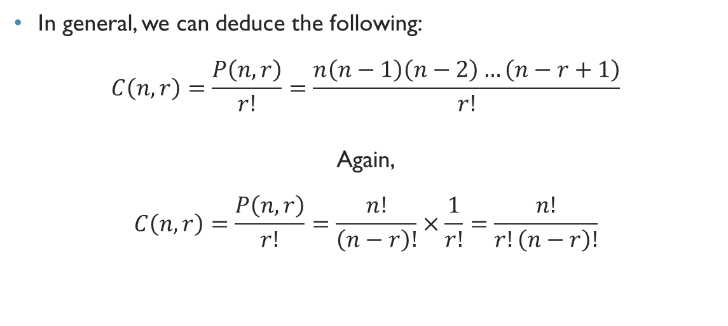
Combination
In general, we can deduce the following:
$$C\left(n,r\right)=\frac{P\left(n,r\right)}{r!}=\frac{n\left(n−1\right)\left(n−2\right)…\left(n−r+1\right)}{r!}$$
Again,
$$C\left(n,r\right)=\frac{P\left(n,r\right)}{r!}=\frac{n!}{\left(n−r\right)!}×\frac{1}{r!}=\frac{n!}{r!\left(n−r\right)!}$$

Slide 11
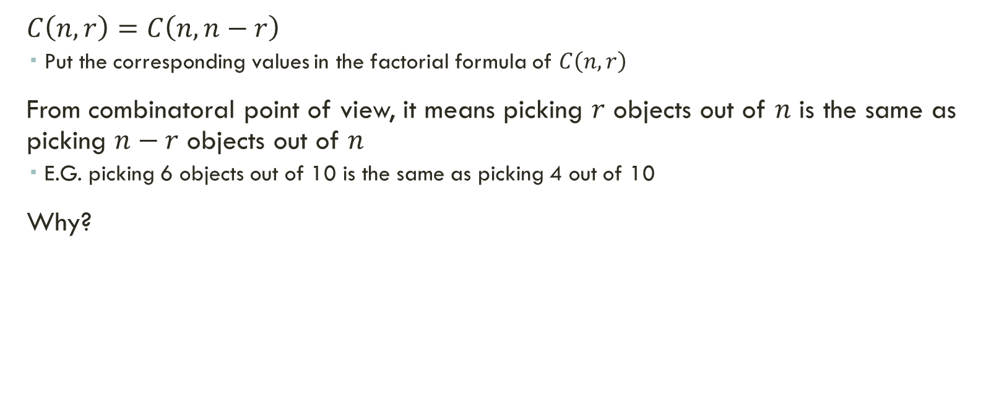

Symmetry of $C\left(n, r\right)$
$C\left(n,r\right)=C\left(n,n−r\right)$
Put the corresponding values in the factorial formula of $C\left(n,r\right)$
From combinatoral point of view, it means picking $r$ objects out of $n$ is the same as picking $n−r$ objects out of $n$
E.G. picking 6 objects out of 10 is the same as picking 4 out of 10
Why?

Slide 12

Example
How many ways to award gold, silver and bronze medals from 8 runners in a race?
Solution: $P\left(8,3\right)=8×7×6=336$
Note: There must not be a tie!!!

Slide 13
Example
How many ways to award gold, silver and bronze medals from 8 runners in a race, if one of them is Usain Bolt?

Slide 14
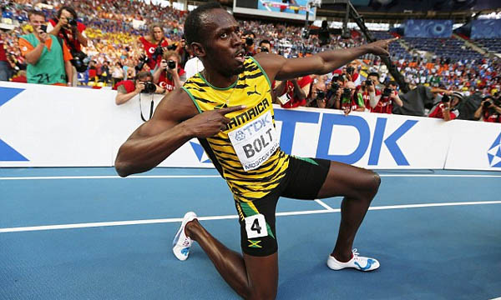
LIKE A BOSS

Slide 15

Example
How many ways to award gold, silver and bronze medals from 8 runners in a race, if one of them is Usain Bolt?
Solution: $P\left(7,2\right)=7×6=42$

Slide 16
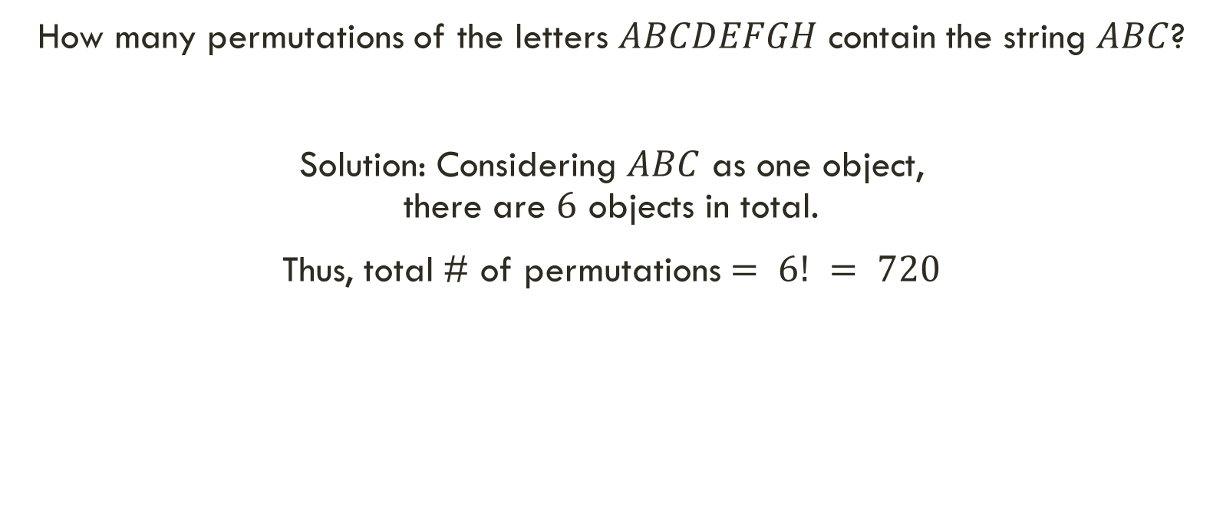
Example
How many permutations of the letters $ABCDEFGH$ contain the string $ABC$?
Solution: Considering $ABC$ as one object, there are $6$ objects in total.
Thus, total # of permutations $= 6! = 720$

Slide 17
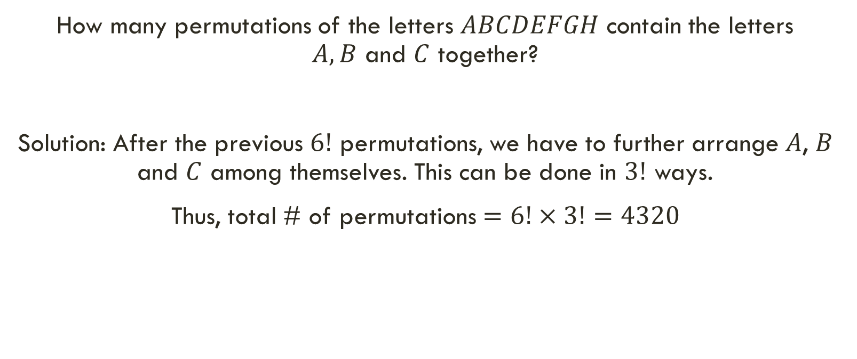
Exercise
How many permutations of the letters $ABCDEFGH$ contain the letters $A,B$ and $C$ together?
Solution: After the previous $6!$ permutations, we have to further arrange $A$, $B$ and $C$ among themselves. This can be done in $3!$ ways.
Thus, total # of permutations $=6!×3!=4320$

Slide 18
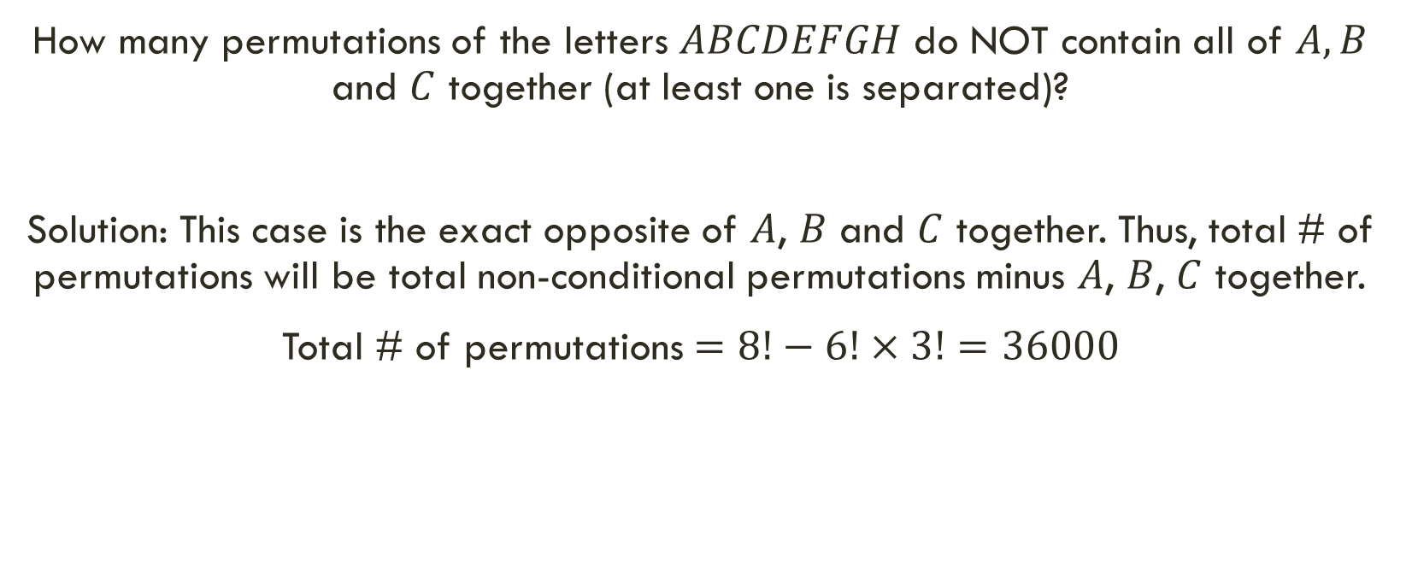
Exercise
How many permutations of the letters $ABCDEFGH$ do NOT contain all of $A,B$ and $C$ together (at least one is separated)?
Solution: This case is the exact opposite of $A$, $B$ and $C$ together. Thus, total # of permutations will be total non-conditional permutations minus $A$, $B$, $C$ together.
Total # of permutations $=8!−6!×3!=36000$

Slide 19
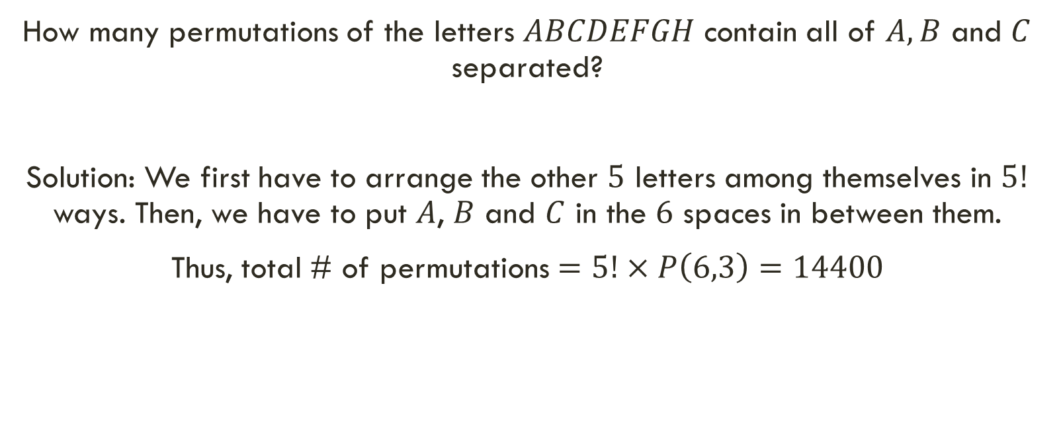
Exercise
How many permutations of the letters $ABCDEFGH$ contain all of $A,B$ and $C$ separated?
Solution: We first have to arrange the other $5$ letters among themselves in $5!$ ways. Then, we have to put $A$, $B$ and $C$ in the $6$ spaces in between them.
Thus, total # of permutations $=5!×P\left(6,3\right)=14400$

Slide 20
exercise
How many ways can the letters of the word “SILHOUETTE” be rearranged, such that –
No special condition is given
All the vowels are together
All the T’s are together
All the E’s are together

Slide 21
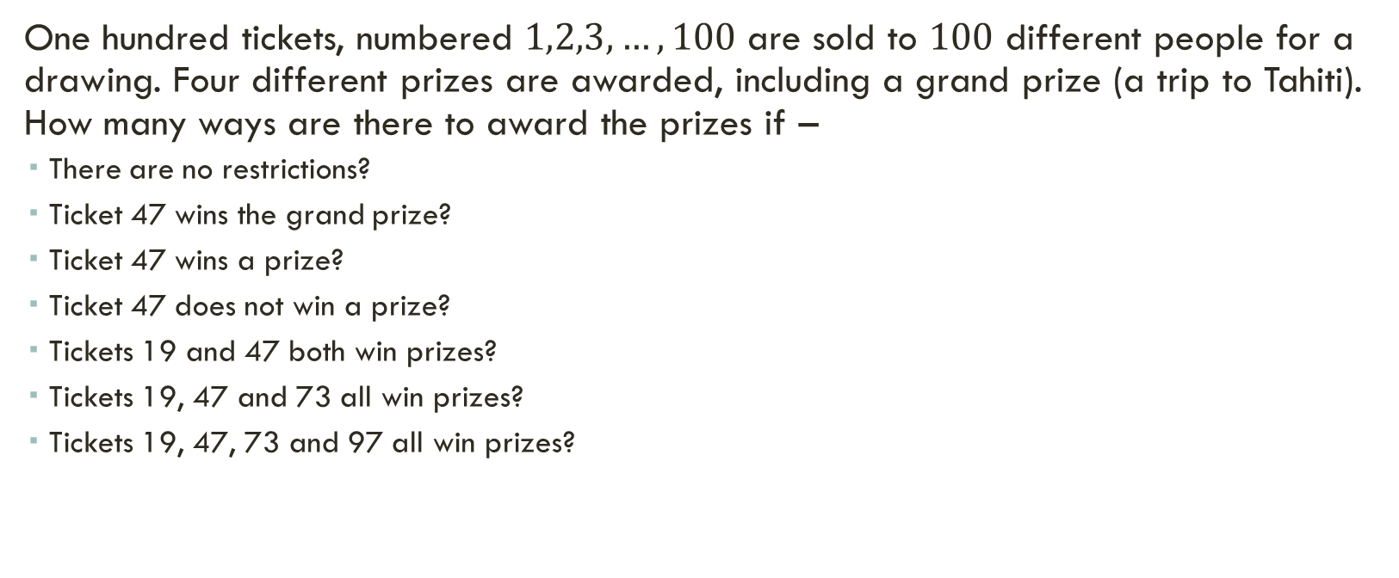
exercise
One hundred tickets, numbered $1,2,3,…,100$ are sold to $100$ different people for a drawing. Four different prizes are awarded, including a grand prize (a trip to Tahiti). How many ways are there to award the prizes if –
There are no restrictions?
Ticket 47 wins the grand prize?
Ticket 47 wins a prize?
Ticket 47 does not win a prize?
Tickets 19 and 47 both win prizes?
Tickets 19, 47 and 73 all win prizes?
Tickets 19, 47, 73 and 97 all win prizes?

Slide 22

exercise
One hundred tickets, numbered $1,2,3,…,100$ are sold to $100$ different people for a drawing. Four different prizes are awarded, including a grand prize (a trip to Tahiti). How many ways are there to award the prizes if –
None of the tickets 19, 47, 73, 97 wins a prize?
Ticket 19, 47, 73 or 97 wins the grand prize?
Tickets 19 and 47 win prizes, but 73 and 97 do not?

Slide 23
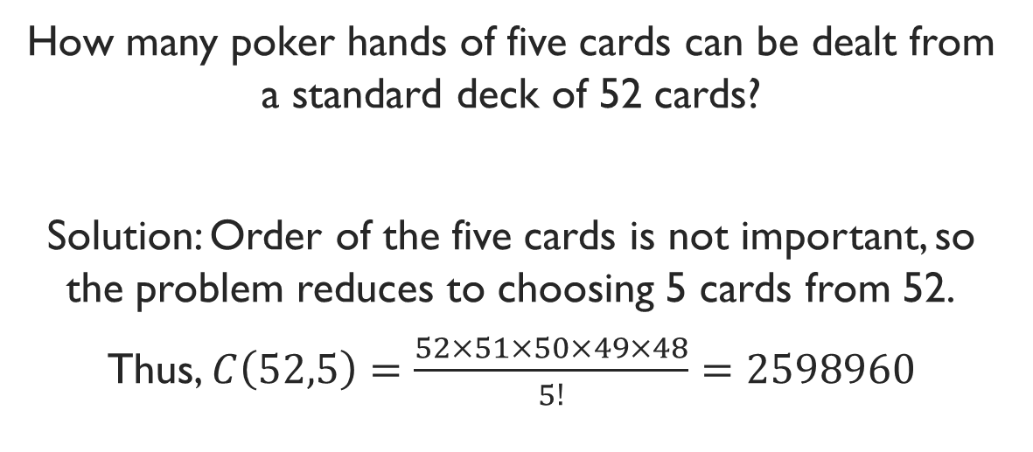
Example
How many poker hands of five cards can be dealt from a standard deck of 52 cards?
Solution: Order of the five cards is not important, so the problem reduces to choosing 5 cards from 52.
Thus, $C\left(52,5\right)=\frac{52×51×50×49×48}{5!}=2598960$

Slide 24
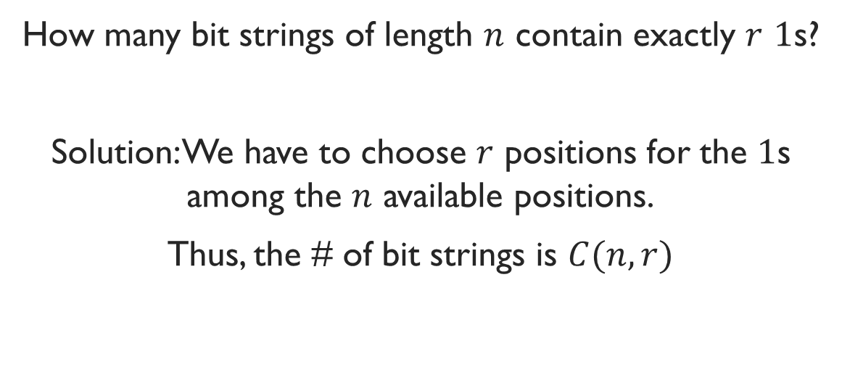
Example
How many bit strings of length $n$ contain exactly $r$ $1$s?
Solution: We have to choose $r$ positions for the $1$s among the $n$ available positions.
Thus, the # of bit strings is $C(n,r)$

Slide 25
Example
There are 9 Math faculties and 11 CS faculties in a university. The authority wants to form a committee to develop a Discrete Math course, such that 3 members of the committee are Math faculties, and 4 are CS faculties.
How many ways to form the committee?

Slide 26
Example
Seven women and nine men are on the faculty in the mathematics department at a school. How many ways are there to select a committee of five members of the department if at least one woman must be on the committee?

