Slide 1

Course Title: Database Management System Lab Course Code: CSE 212 Presented By: Name: Md. Hasibur Rahman Name: Mohammad Jonayed Sarkar Reg: 19101009 Reg: 19101019
University Of Asia Pacific

Slide 2
Laptop Arena
Search your desired Laptop

Slide 3
Introduction
Laptop Arena is an online website that offers comprehensive and up-to-date Laptop information
This project which is inspired from the website GSMArena based on mobile phone information
The website offers information about various Laptop Brands including ASUS, HP, Lenovo, Apple and Dell focused. It enables its users to get to know about latest Laptop related information.

Slide 4
Features
This is basic model for Website database management system.
We provide latest information about laptops.
We provide latest price according to market.
Our Admin update concurrent information.

Slide 5
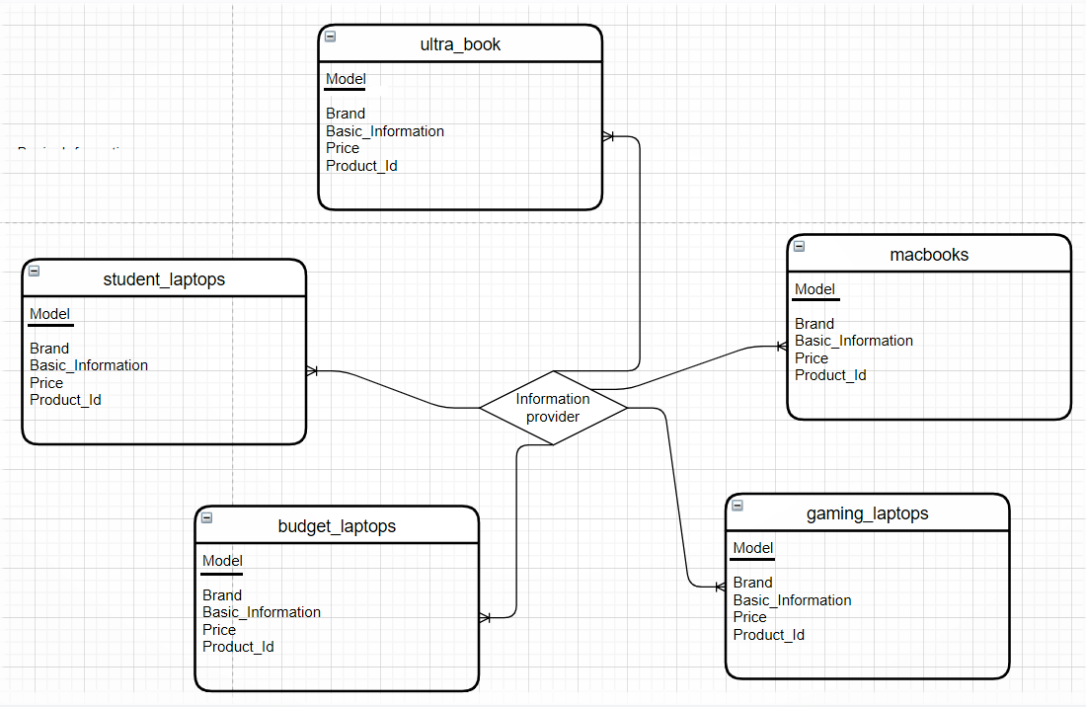
E-R diagram

Slide 6
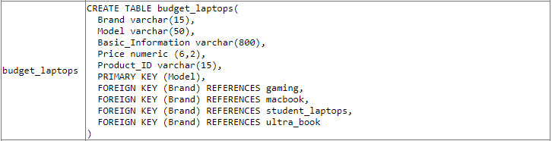
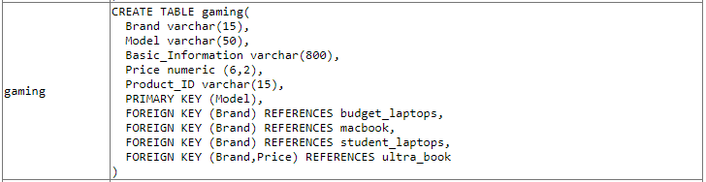
Tables
1. budget_laptops
2. gaming

Slide 7
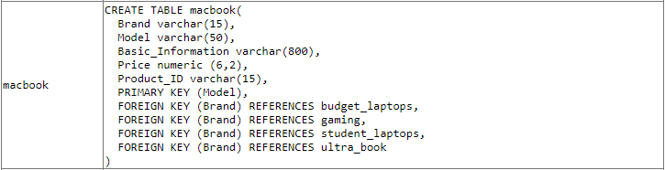
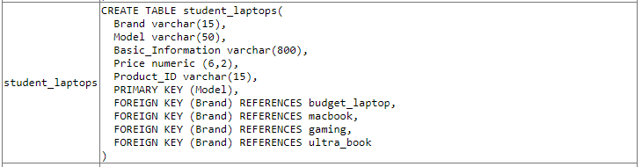
3. macbook
4. student_laptops

Slide 8
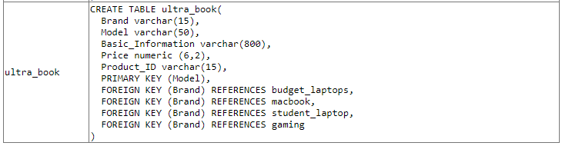
5. macbook

Slide 9
Thank You

