Slide 1

Information Technology Course Module Software Engineering by Damir Dobric / Andreas Pech
Presentation On
ML23/24-08: Implement Anomaly Detection Sample
Team Name: Simply-Coders
Hasibuzzaman hasibuzzaman@stud.fra-uas.de | Md Ikbal Husen Chowdhury md.chowdhury@stud.fra-uas.de | Suva Sarkar suva.sarkar@stud.fra-uas.de
Date: 31.03.2024

Slide 2


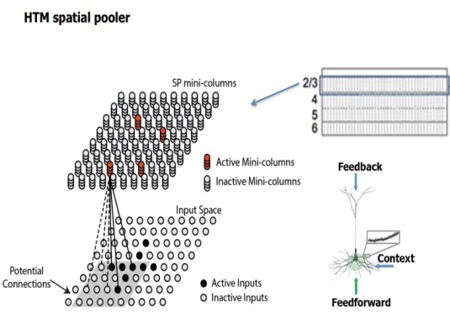

Presentation Topics
In this presentation our main goal will be on these below topics:
Introduction to the Project
Concept of NeoCortex API
Concept of HTM System
Multi Sequence Learning
Anomaly Detection
Result

Slide 3
Introduction and Objective
Anomaly detection is a crucial aspect of data analysis and machine learning.
It involves identifying patterns or instances that deviate significantly from normal behavior within a dataset.
Implementing effective anomaly detection techniques is essential for various applications, including fraud detection, cybersecurity, predictive maintenance, and fault detection.
In this presentation, we will explore the implementation of anomaly detection using NeoCortex API, HTM, MultiSequenceLearning .

Slide 4
Introduction and Objective
Our goal is to develop a robust anomaly detection system that can accurately identify and flag anomalies in real-time data streams or historical datasets.
By leveraging HTM algorithms and techniques, we aim to enhance decision-making, mitigate risks, and improve overall system reliability.

Slide 5
NeoCortex API
NeoCortex API focuses implementation of Hierarchical Temporal Memory Cortical Learning Algorithm.
Support for HTM Algorithms: Includes spatial pooling, temporal memory, sequence learning, and anomaly detection.
Sensory Input Processing: Encodes data into sparse distributed representations (SDRs).
Learning and Inference: Enables real-time learning, prediction, and anomaly detection

Slide 6
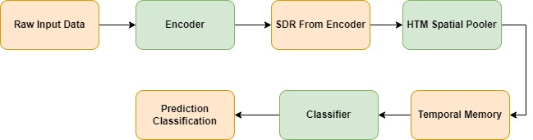
Hierarchical Temporal Memory (HTM)
Figure : HTM System Pipeline

Slide 7
Multi Sequence Learning
HTM CLA is good is finding patterns in data
We are using NeoCortex API, specifically multisequence class, which is based on htm CLA.
Multiple number of sequences can be trained with different datatypes.
We are going to use simple numerical integer sequences.
We have to tune hyper-parameters, like encoder and htmconfig, which facilitates training this type of data.

Slide 8
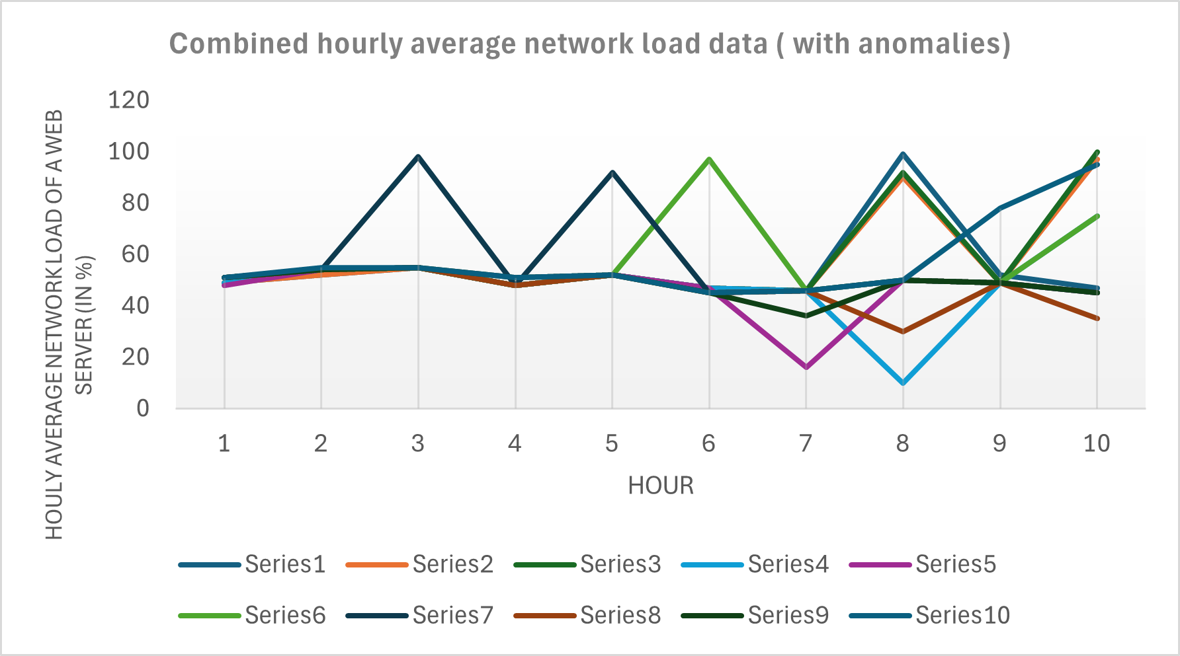
Anomaly Detection
We have taken network load data and trained our htm engine.
After that added anomalies randomly in our prediction data.
Later on trained our data and detect anomalies using trained htm engine
Here(in figure) is the shown outcome of the project where both combined training data and predicting data.
The Range 45 to 55 is the normal range and all outliers outside the range are considered as Anomalies.

Slide 9
Result
Average FNR of the experiment: 0.65
Average FPR of the experiment: 0.24
Sample output:
Testing the sequence for anomaly detection: 54, 98, 48, 92, 45, 46, 50, 49, 45.
Current element in the testing sequence: 54
****Anomaly detected**** in the next element. HTM Engine predicted: 48 with similarity: 80%, actual value: 98.
Skipping to the next element in the testing sequence due to detected anomaly.
Current element in the testing sequence: 45
No anomaly detected in the next element. HTM Engine found similarity: 4,17%.

Slide 10
Thank You

