Slide 1
1
Basic concepts of Management

Slide 2

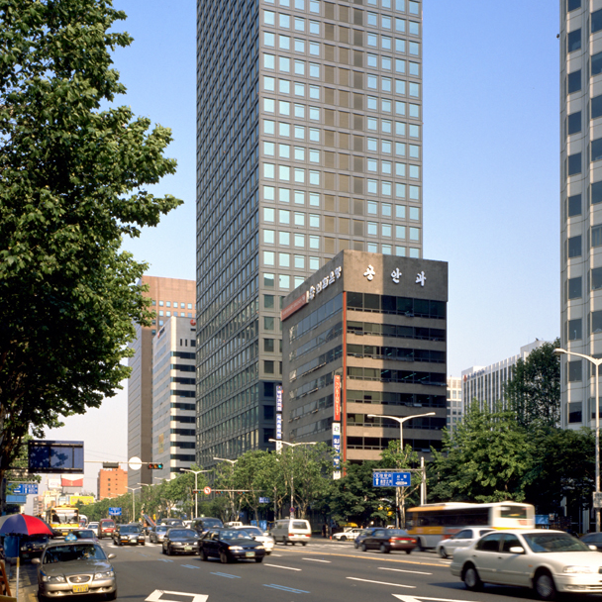
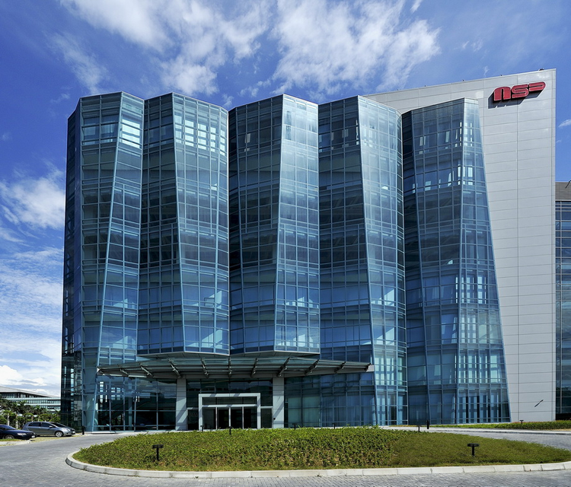
What Is an Organization?
A group of people working together in a structured and coordinated fashion to achieve a set of goals.

Slide 3
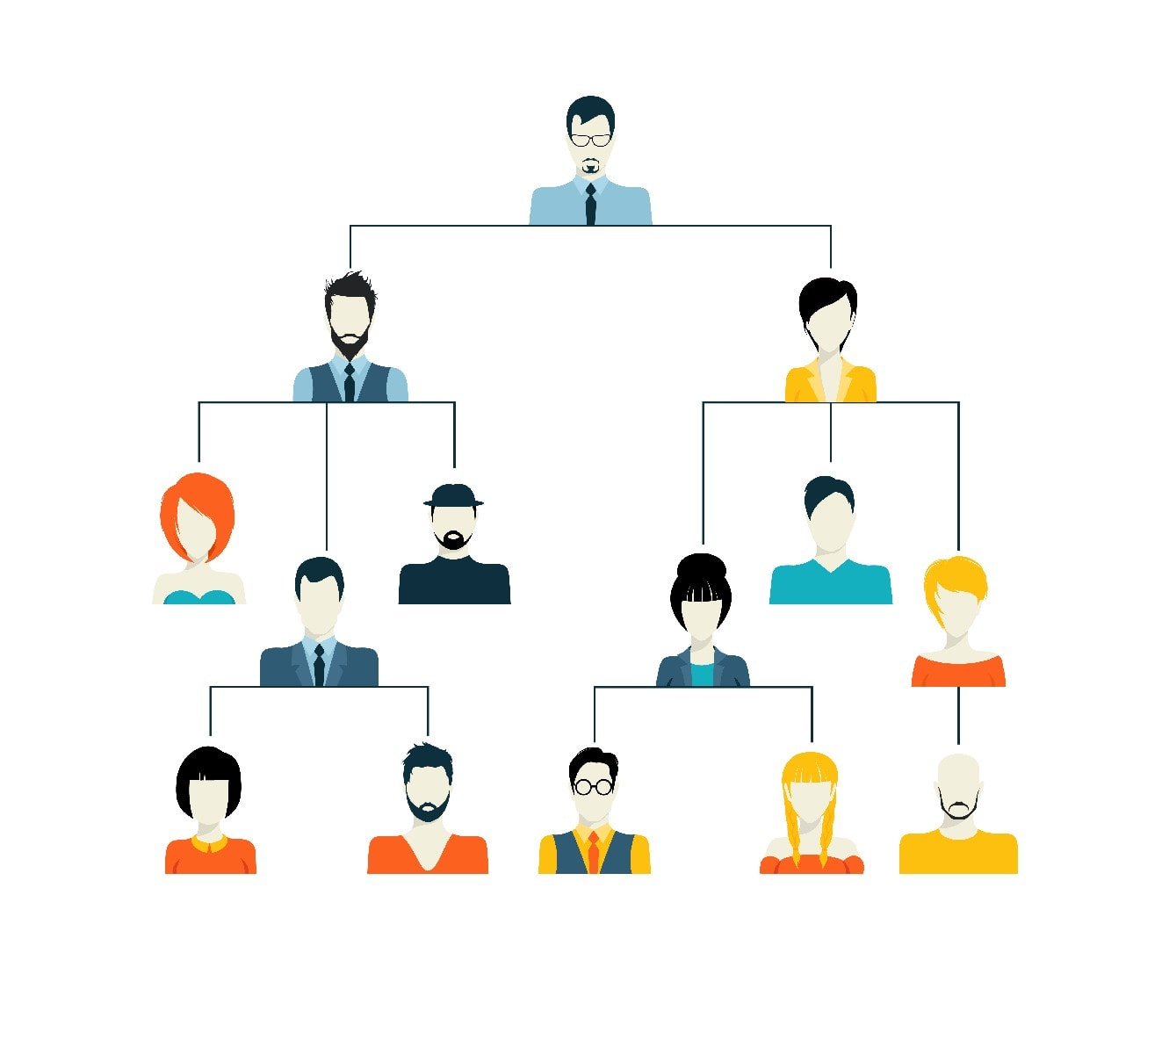

Types of Organization?
FORMAL
INFORMAL
Well defined structure
For organizational goals
Roughly defined structure
For social goals of members

Slide 4
Organizational Resources
All assets that are available to use for the running of the organization.
Physical
Financial
Human
Information

Slide 5
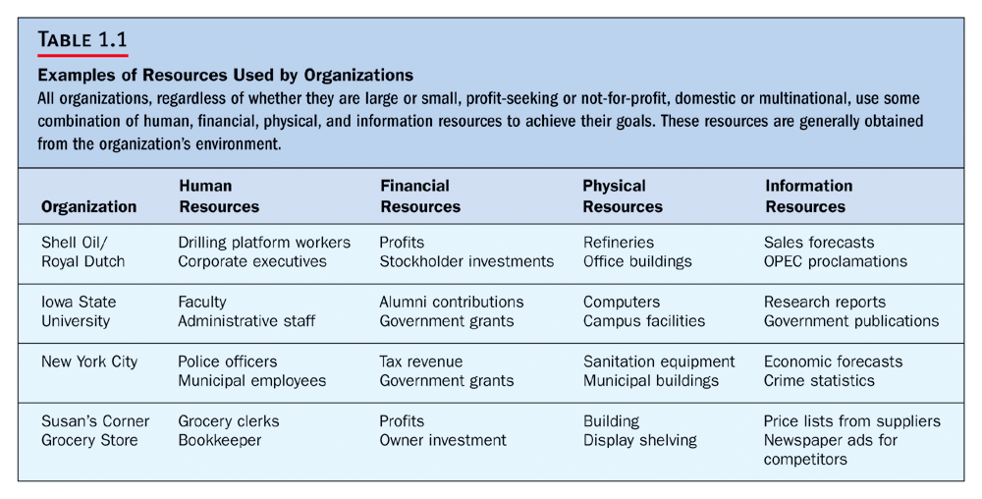
Notes:
Proclamation: announcements, declaration

Slide 6
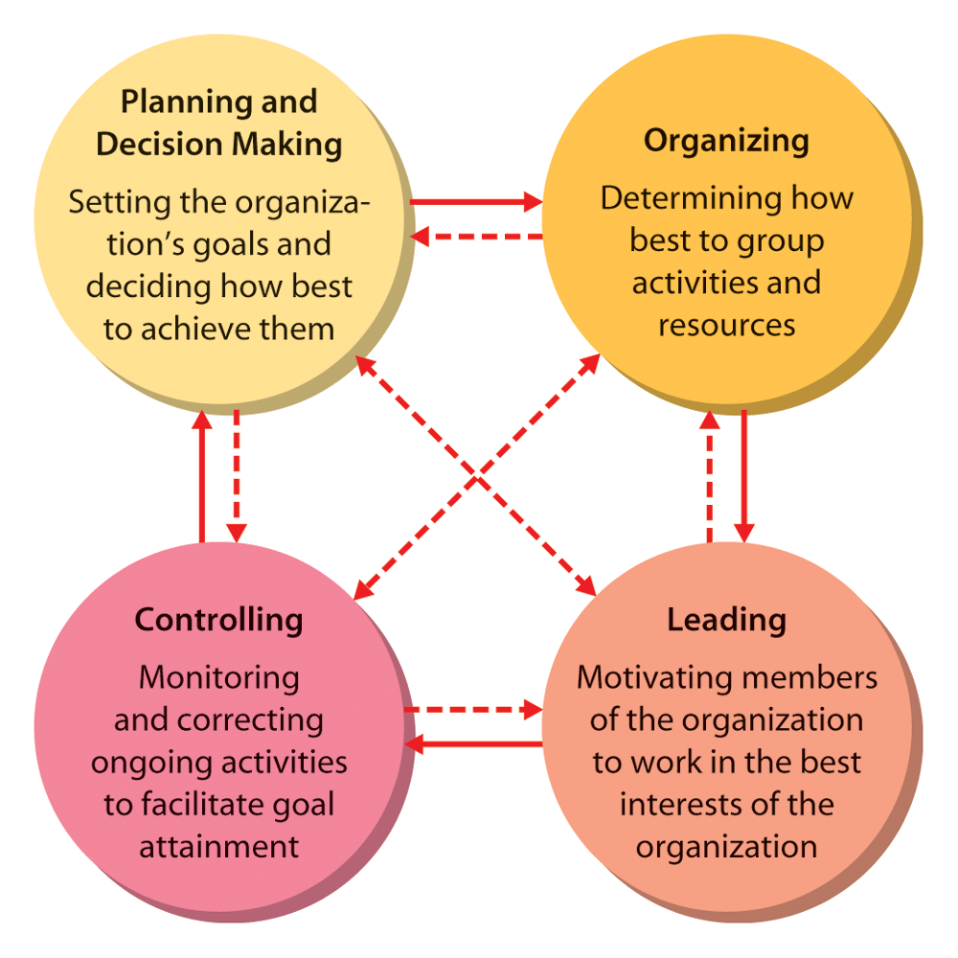
Management Activities/Functions

Slide 7

What Is Management?
A set of activities directed at an organization’s resources with the aim of achieving organizational goals in an efficient and effective manner.

Slide 8
What Is Management?
Activities
Planning and decision making
Organizing
Leading
Controlling
Resources
Human
Financial
Physical
Informational

Slide 9
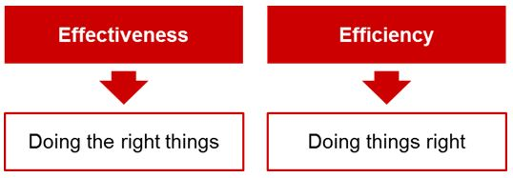
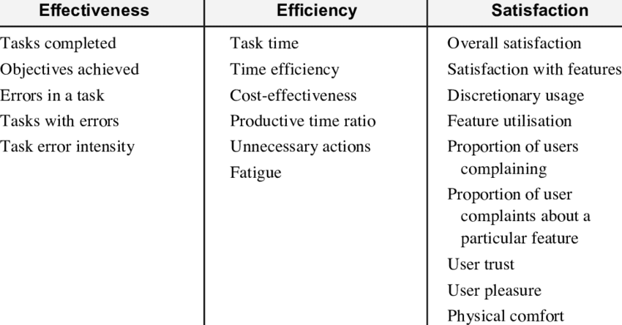

Slide 10
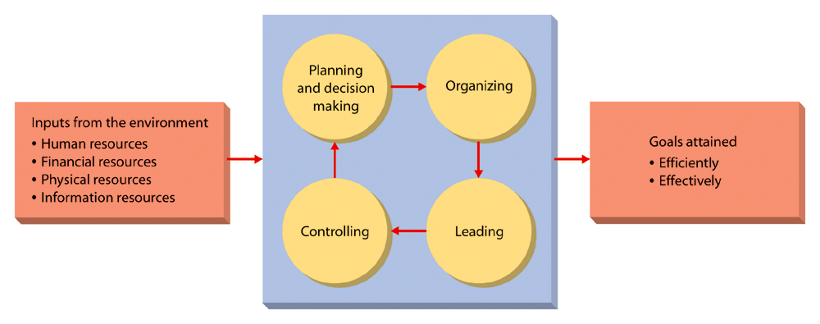
Management Process

Slide 11
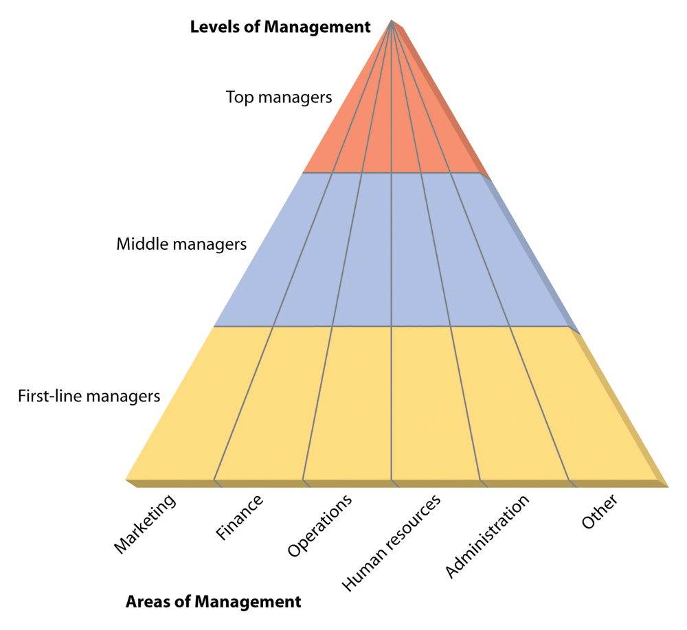
Kinds of Managers by Level and Area

Slide 12
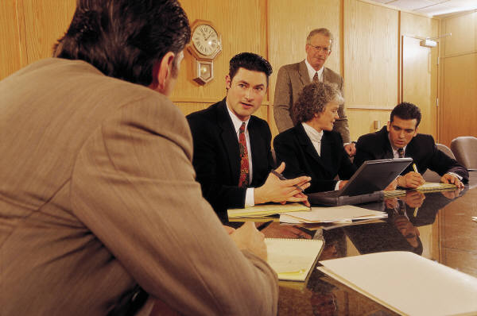
Kinds of Managers
Top Managers
Small group of executives who manage the overall organization, the strategic level.

Slide 13
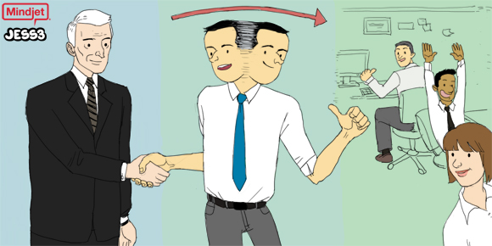
Kinds of Managers
Middle Managers
A large group that implements the strategies developed at the top.

Slide 14
Kinds of Managers
First-Line Managers
Supervise and coordinate the activities of operating employees.

