Slide 1
9
Managing Decision Making and Problem Solving

Slide 2
Group and Team Decision Making in Organizations
Group Decision Making is the collective activity wherein several persons interact simultaneously to find out the solution to a given statement of a problem.

Slide 3
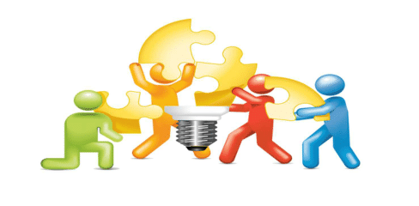
Forms of Group and Team Decision Making
Interacting group or team
Delphi group
Nominal Groups

Slide 4

Advantages of Group and Team Decision Making
More information and knowledge available.
More alternatives generated.
More acceptance.
Enhanced communication.
Better discussions.
Notes:
Groupthink: the practice of thinking or making decisions as a group, resulting typically in unchallenged, poor-quality decision-making.

Slide 5
Disadvantages of Group and Team Decision Making
The process takes longer.
Compromised decisions result from indecisiveness.
One person may dominate.
Groupthink may occur.
Notes:
Groupthink: the practice of thinking or making decisions as a group, resulting typically in unchallenged, poor-quality decision-making.

Slide 6

Groupthink
A situation that occurs when a group or team’s desire for consensus and cohesiveness overwhelms the goal of reaching the best possible decision.

Slide 7
Avoiding Groupthink
Follow the proper group formation process.
Train the group.
Instill good group leader.
Introduce devil’s advocate.

Slide 8
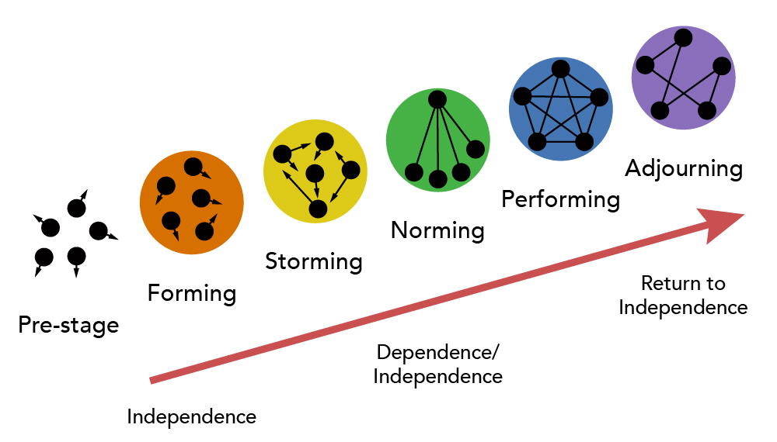
Stages of group formation

Slide 9


Slide 10
