Slide 1
1
Managerial Roles and Skills

Slide 2
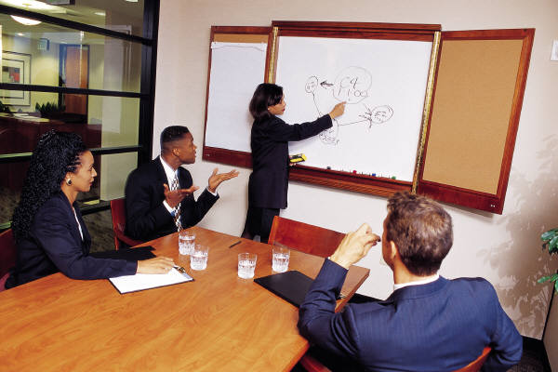
Basic Managerial Roles
Role
The function assumed or part played by a person or thing in a particular situation.
Do certain things.
Meet certain needs.
Have certain responsibilities.

Slide 3
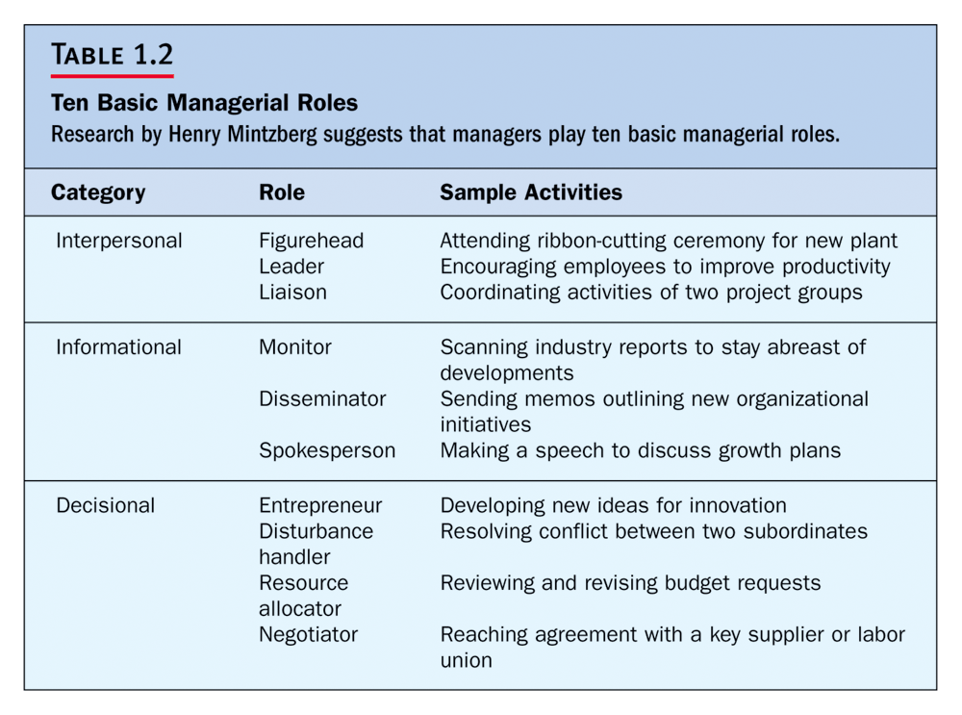

Slide 4

The Three INTERPERSONAL Roles
Figurehead
Leader
Liaison, Coordinator

Slide 5

The Three INFORMATIONAL Roles
Monitor
Disseminator
Spokesperson

Slide 6

The Four DECISIONAL ROLES
Entrepreneur
Disturbance Handler
Resource Allocator
Negotiator

Slide 7

Managerial Skills
Skills
The learned expertise or talent needed in order to do a job or task.

Slide 8


Managerial Skills
Communication Skills
Interpersonal Skills
Technical Skills

Slide 9



Managerial Skills
Time Management
Skills
Diagnostic Skills
Conceptual Skills
Decision Making
Skills

