Slide 1
2
History of Management

Slide 2
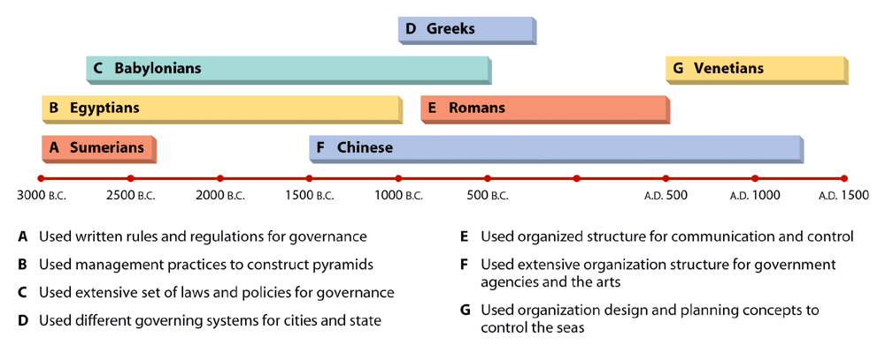
Management in Antiquity

Slide 3
Perspective of Management
Classical
Behavioral
Quantitative
Scientific Management
Administrative Management

Slide 4
The Three Traditional Management Perspectives
The Classical Management Perspective:
Ideas of the early 20th century theorists and managers
Emerged with the advent of industry

Slide 5
Scientific Management
Main contributor was Frederick Taylor, The Father of Management
Concerned with improving the performance of individual workers
Developed:
Rest periods
Piece work pay system

Slide 6
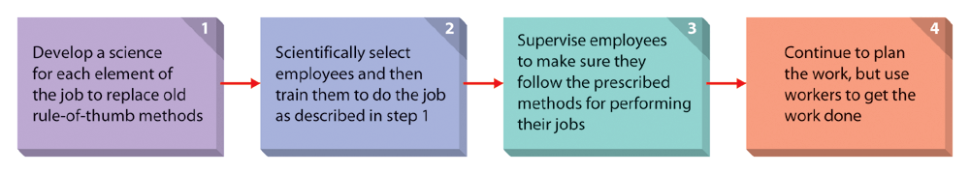
Scientific Management
Developed a system, which he believed would lead to a more efficient and productive work force.

Slide 7
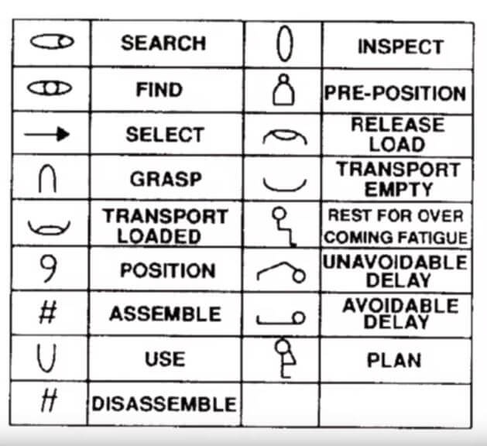
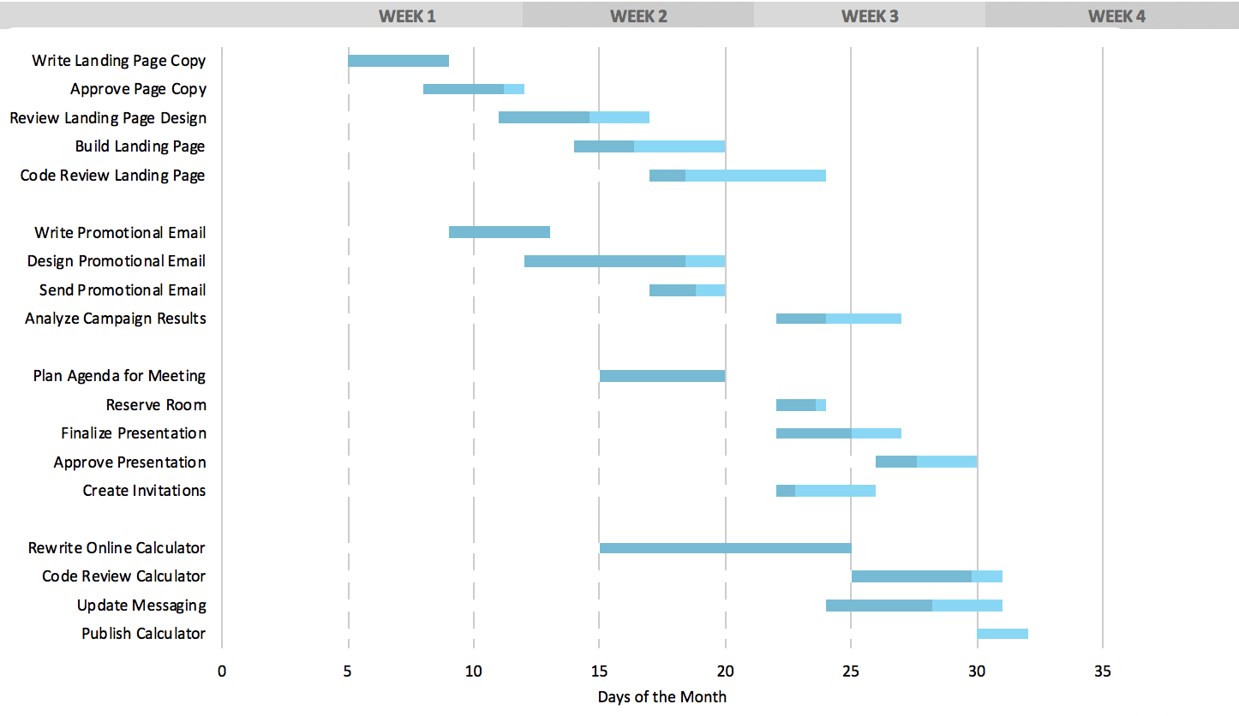
Scientific Management
Other contributors
Gilbreths – Therblig
Henry Gantt – Gantt Chart

Slide 8
Administrative Management
Pioneered by Henry Fayol
Focuses on managing the total organization.
Administrative management laid the foundation for later development in management theory.

Slide 9
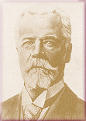
Administrative Management
Henry Fayol Presented
Management functions
14 principles of management

Slide 10
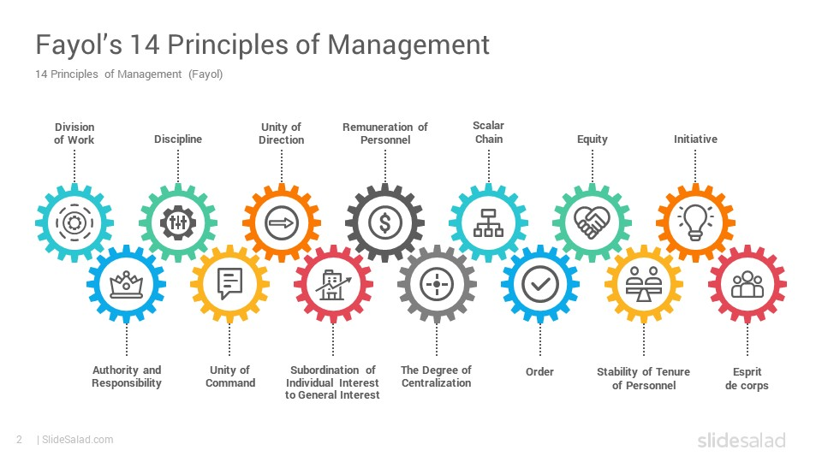

Slide 11
1. Division Of Work
Specialization allows the individual to build up experience, and to continuously improve his skills. Thereby he can be more productive.

Slide 12
2. Authority
The right to issue commands, along with which must go the balanced responsibility for its function.

Slide 13
3. Discipline
Employees must obey, but this is two-sided: employees will only obey orders if management play their part by providing good leadership.

Slide 14
4. Unity Of Command
Each worker should have only one boss with no other conflicting lines of command.

Slide 15
5. Unity of Direction
People engaged in the same kind of activities must have the same objectives in a single plan. This is essential to ensure unity and coordination in the enterprise. Unity of command does not exist without unity of direction.

Slide 16
6. Subordination of individual interest
Management must see that the goals of the firms are always dominant.

Slide 17
7. Remuneration
Payment is an important motivator although by analyzing a number of possibilities, Fayol points out that there is no such thing as a perfect system

Slide 18
8. Centralization (Or Decentralization)
This is a matter of degree depending on the condition of the business and the quality of its personnel.

Slide 19
9. Scalar chain (Line of Authority)
A hierarchy is necessary for unity of direction. But lateral (cross) communication is also fundamental, as long as superiors know that such communication is taking place. Scalar chain refers to the number of levels in the hierarchy from the ultimate authority to the lowest level in the organization. It should not be over-stretched and consist of too-many levels

Slide 20
10. Order
Both material order and social order are necessary. The former minimizes lost time and useless handling of materials. The latter is achieved through organization and selection.

Slide 21
11. Equity
In running a business a ‘combination of kindliness and justice’ is needed. Treating employees well is important to achieve equity.

Slide 22
12. Stability of Tenure of Personnel
Employees work better if job security and career progress are assured to them. An insecure tenure and a high rate of employee turnover will affect the organization adversely.

Slide 23
13. Initiative
Allowing all personnel to show their initiative in some way is a source of strength for the organization. Even though it may well involve a sacrifice of ‘personal vanity’ on the part of many managers.

Slide 24
14. Esprit de Corps
Management must foster the morale of its employees. He further suggests that: “real talent is needed to coordinate effort, encourage keenness, use each person’s abilities, and reward each one’s merit without arousing possible jealousies and disturbing harmonious relations.”

