Slide 1
9
Managing Decision Making and Problem Solving

Slide 2
Behavioral Aspects of Decision Making
The Administrative Model:
Is based on behavioral perspective of management.
It rejects the assumptions of classical model

Slide 3
Behavioral Aspects of Decision Making
The Administrative Model:
A decision making model showing that managers:
Have incomplete and imperfect information.
Are constrained by bounded rationality.
Tend to satisfice when making decisions.

Slide 4
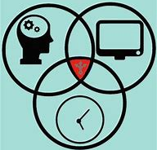
Bounded Rationality
A concept suggesting that decision makers are limited by their values and unconscious:
Values.
Skills.
Habits.

Slide 5
Satisficing
The tendency to search for alternatives only until one is found that meets some minimum standard of sufficiency.

Slide 6

Factor that bind our rationaltity
Intuition
Escalation of commitment
Risk propensity

