Slide 1

Xin.he 2145653
Warby Parker
Warby Parker
Xinhe · 2145653

Slide 2
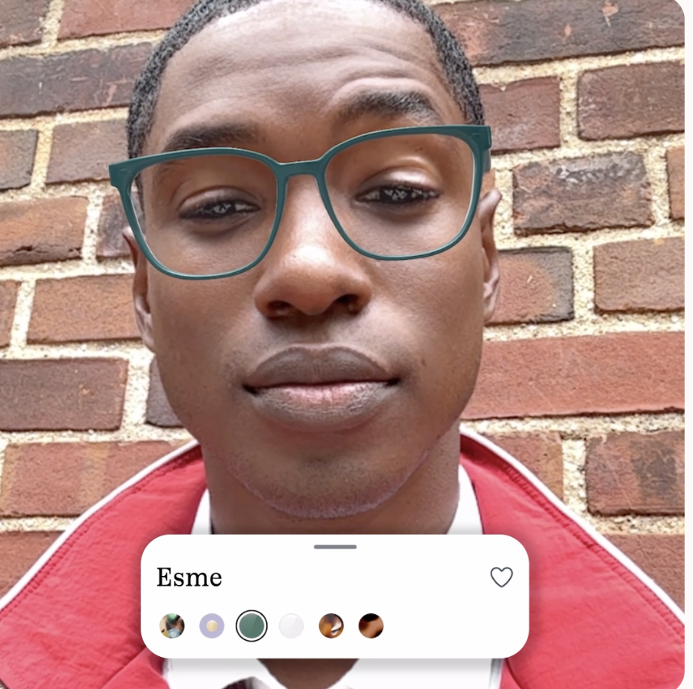
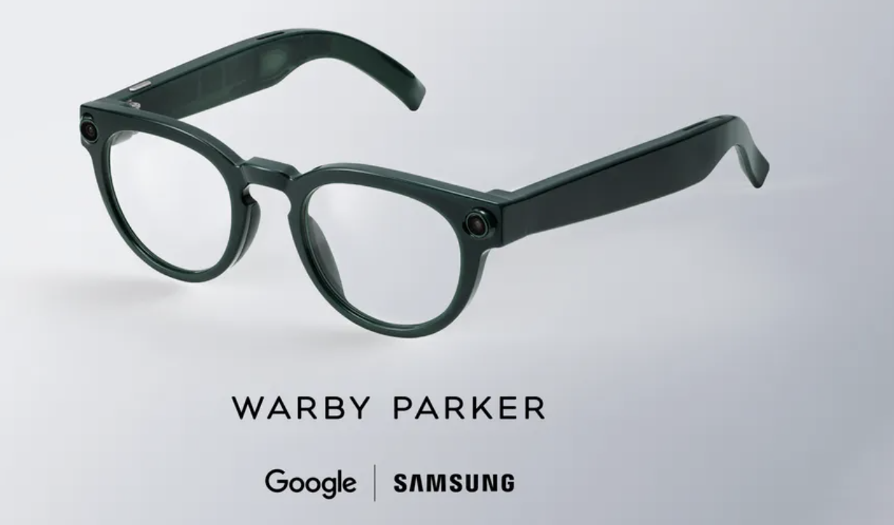
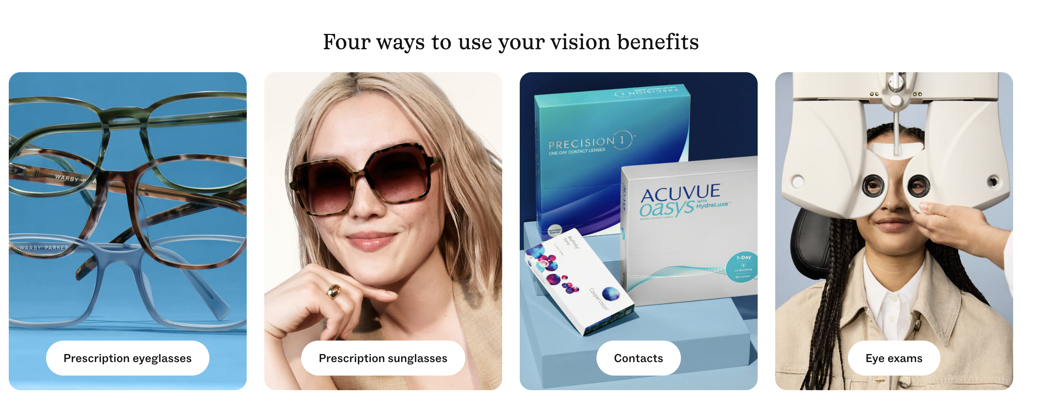
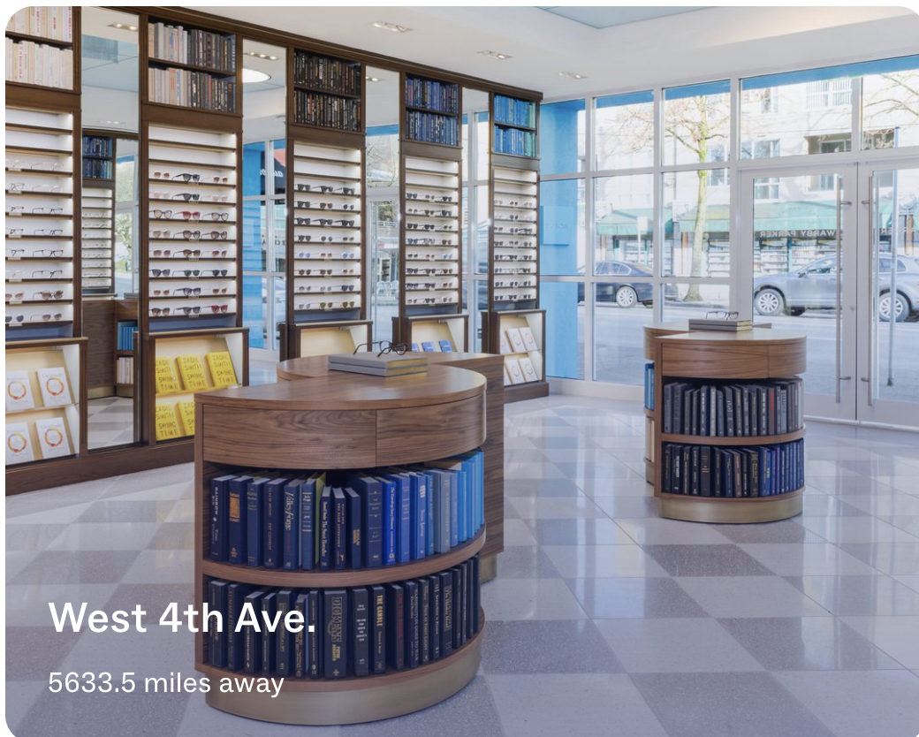
Xin.he 2145653
Warby Parker
Warby Parker：用电商策略重塑眼镜零售
Strategy | Warby Parker’s Measures | Business Components | Result
Differentiation – Customer Intimacy | Virtual Try-On + Advisor personalized recommendations 323 stores by end of 2025; 285 offer in-person eye exams • Home Try-On discontinued; shifted to Virtual Try-On + in-store experience (Warby Parker Inc., 2026a; Warby Parker Inc., 2026b; Wassel, 2025) | Value proposition: Reduce uncertainty of buying prescription glasses online Market strategy: Boost conversion with AR/AI recommendations + physical stores Competitive advantage: Online convenience + offline professional service closed-loop | Creates an omnichannel experience: Discover online → Virtual Try-On → In-store exam → Purchase 3/4 of iOS app users use Virtual Try-On, showing digital experience boosts customer engagement (Wassel, 2025)
Differentiation -Product Leadership | In-house design team for consistent brand aesthetic Expanded product lines: eyeglasses, contacts, eye exams, lens upgrades Partnered with Google / Samsung to develop intelligent eyewear, launching fall 2026 (Warby Parker Inc., 2026a; Google, 2026; Samsung Electronics, 2026) | Value proposition: Upgraded from “affordable eyewear” to design + vision care + smart eyewear Revenue model: Eyeglasses + contact lenses + eye exams + future AI hardware Competitive advantage: Prescription eyewear capability + store network + tech partnerships | Expanded from an eyewear retailer to a vision-care / consumer-tech brand; AI eyewear opens new growth potential (Samsung Electronics, 2026)

Slide 3
Xin.he 2145653
Warby Parker
Warby Parker：用电商策略重塑眼镜零售
Strategy | Warby Parker’s Measures | Business Components | Result
Focus / Niche Strategy | Targets digital-native, design-focused, price-sensitive young consumers Starts at $95, emphasizes affordable design Social media + brand storytelling + Buy a Pair, Give a Pair (Warby Parker Inc., 2026a; Earnest Analytics, 2024) | Market opportunity: Serves the design + affordable niche, avoiding direct competition with Luxottica Market strategy: Reach target consumers via social media, brand storytelling, and affordable positioning Competitive advantage: Priced above Zenni, below traditional brands, creating a differentiated buffer zone | Market share: 7.2% (2024), up from 6.8% in Q4 2023 Customers switching from LensCrafters to WP: +3.4% YoY (Earnest Analytics, 2024)
DTC Cost Advantage | Direct-to-consumer via official website & app In-house design, reduced reliance on brand licensing Integrated owned stores + e-commerce channels Starting at $95 (Warby Parker Inc., 2026a) | Revenue model: Cut out middlemen, revenue flows directly to the brand Competitive advantage: Cost savings support low prices and experience investment Value proposition: Supports affordable design positioning | 2025 net revenue: $871.9M, +13.0% YoY Gross margin: 54.0% Adjusted EBITDA margin: 10.9% Full-year net profit: $1.6M (first positive annual profit) (Warby Parker Inc., 2026a)

Slide 4
Xin.he 2145653
Warby Parker
Feasibility Analysis & Recommendations
Warby Parker’s strategy is viable in the short term, but long-term sustainability depends on defending differentiation, controlling store/service costs, and managing privacy risks in AI eyewear.
Viability Analysis | Warby Parker Status | Risks | Suggestions
Strategic Analysis — Industry | U.S. eyewear retail remains highly competitive; Luxottica holds ~28% market share Warby Parker: 7.2% share, up from 6.8% in Q4 2023 “Other” small retailers: 32% share, indicating a fragmented market with many entrants (Consumer Edge, 2024) | Competition from low-cost online brands & traditional optical stores Low comparison cost; customers are price-sensitive AI eyewear segment faces competition from tech companies | Avoid price wars; strengthen design + vision care + online convenience AI eyewear highlights WP’s integration of prescription, eye exams, and in-store services
Strategic Analysis — Firm | 323 stores by end of 2025; online DTC + stores form an omnichannel system Virtual Try-On / Advisor improve online selection experience Intelligent Eyewear designed by Warby Parker, with Google AI and Samsung hardware, launching Fall 2026 (Warby Parker Inc., 2026a; Warby Parker Inc., 2026b) | Store expansion raises rent, staffing, doctor costs and management complexity AI eyewear involves privacy, security, data usage and consumer trust Vision care expansion brings medical and compliance pressure | Stores positioned as vision care centers, not just retail outlets Launch AI eyewear with small-scale trials and clear data & privacy rules Leverage Advisor and AR to reduce selection uncertainty and service costs
Financial Analysis | 2025 net revenue: $871.9M, +13.0% YoY First full-year positive net profit: $1.6M; Adjusted EBITDA margin: 10.9% 2025 operating cash flow: $110.8M; Free Cash Flow: $43.7M (Warby Parker Inc., 2026a) | Gross margin affected by tariffs, optometrist headcount, contact lens sales mix and shipping costs GAAP operating loss remains negative, with thin profit buffer High risks in AI eyewear R&D and hardware inventory | Control store expansion pace, prioritize improving single-store profitability Boost sales of lens upgrades, contact lenses, insurance orders and repeat purchases Replace part of high-cost in-store trials with AR and Advisor tools

Slide 5
xin.he 2145653
Warby Parker
Reference
Earnest Analytics (2024) Eyewear market share 2024: Luxottica loses sales to Warby Parker. Available at: https://www.earnestanalytics.com/insights/eyewear-market-share-2024-luxottica-loses-sales-to-warby-parker (Accessed: 27 May 2026).
Izadi, S. (2026) 'Intelligent eyewear is coming this fall', The Keyword, 19 May. Available at: https://blog.google/products-and-platforms/platforms/android/android-xr-io-2026/ (Accessed: 27 May 2026).
Samsung Electronics (2026) Samsung and Google Give First Look at New Intelligent Eyewear，19 May. Available at: https://news.samsung.com/us/samsung-google-first-look-new-intelligent-eyewear/ (Accessed: 27 May 2026).
Warby Parker Inc. (2026a) Form 10-K for the fiscal year ended December 31, 2025. Available at: https://www.sec.gov/Archives/edgar/data/1504776/000150477626000006/wrby-20251231.htm (Accessed: 27 May 2026).
Warby Parker Inc. (2026b) Home Try-On. Available at: https://www.warbyparker.com/home-try-on (Accessed: 27 May 2026).
Wassel, B. (2025) 'Warby Parker pushes CX investments in-store and online', CX Dive, 28 February. Available at: https://www.customerexperiencedive.com/news/warby-parker-customer-experience-AI-try-ons/741312/ (Accessed: 27 May 2026).

