Slide 1
IOM302 | E-Commerce Business Strategy
E-Commerce Business
Case Studies
▸ Alibaba
Strategies Analysis
▸ Amazon
▸ Warby Parker
Group Number: [TBD]
▸ Tesla
Group Members
▸ Zara
Yiwen Hao 2253659
Kaiwen Jiang 2251793
Xin He 2145653
Xuan Wu 2254778
Youtai Wang 2251996
Zezheng Liu 2143890
1

Slide 2
Table of Contents
01
Alibaba
7
02
Amazon
14
03
Warby Parker
18
04
Tesla
23
05
Zara
28
06
Acknowledgements & Q&A
35
2
IOM302 | E-Commerce Business Strategies Analysis

Slide 3
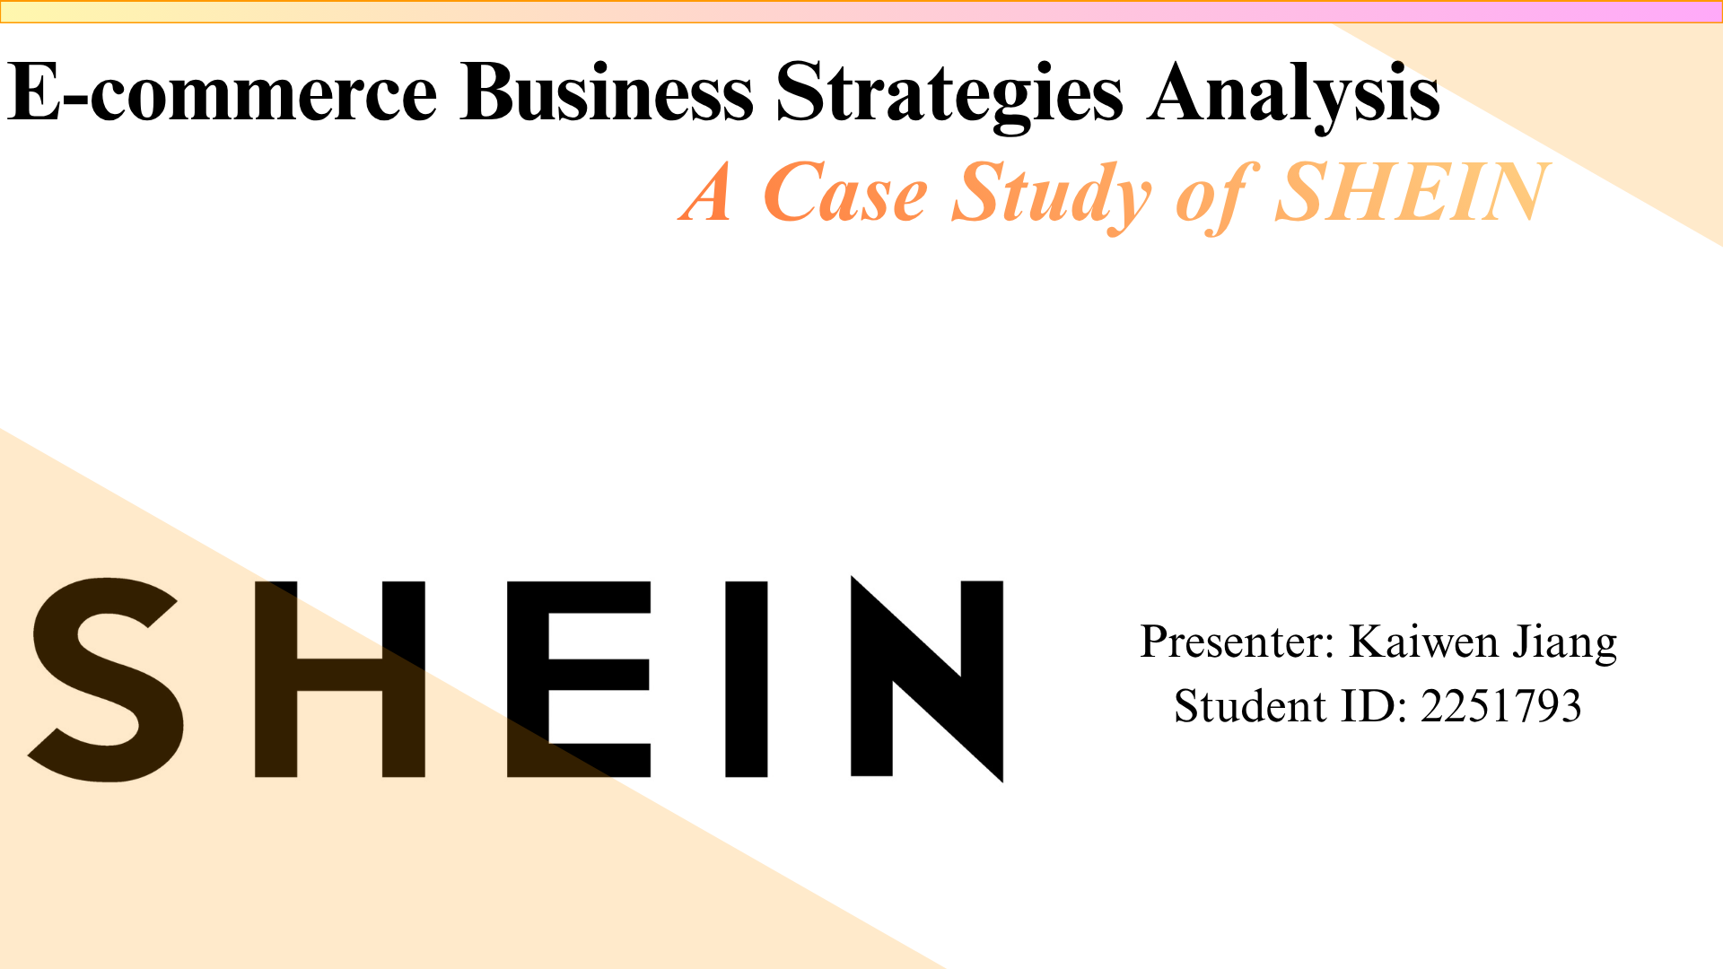
3

Slide 4
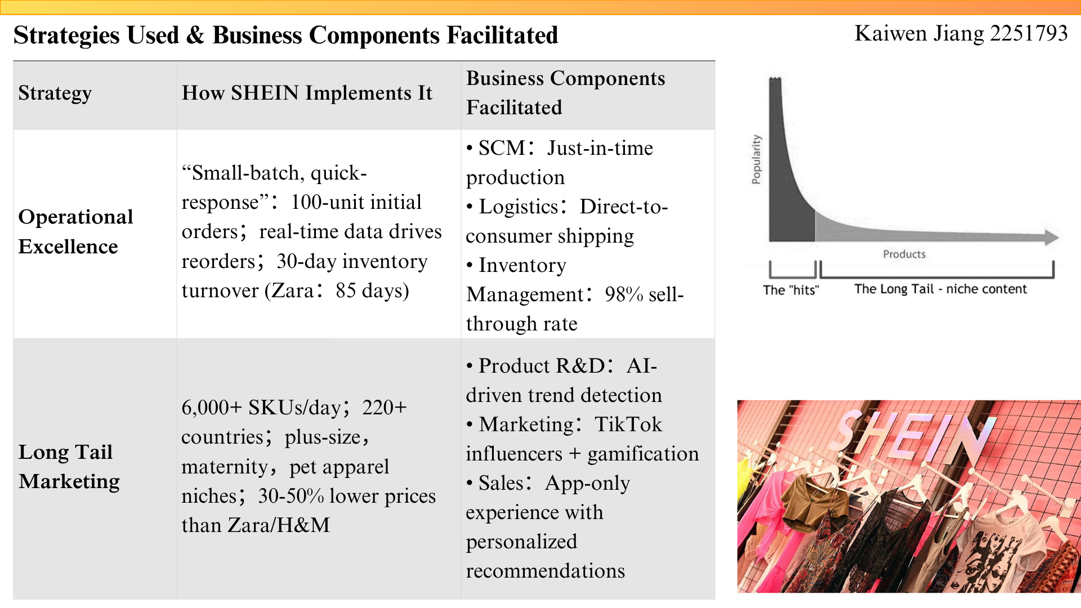
4

Slide 5
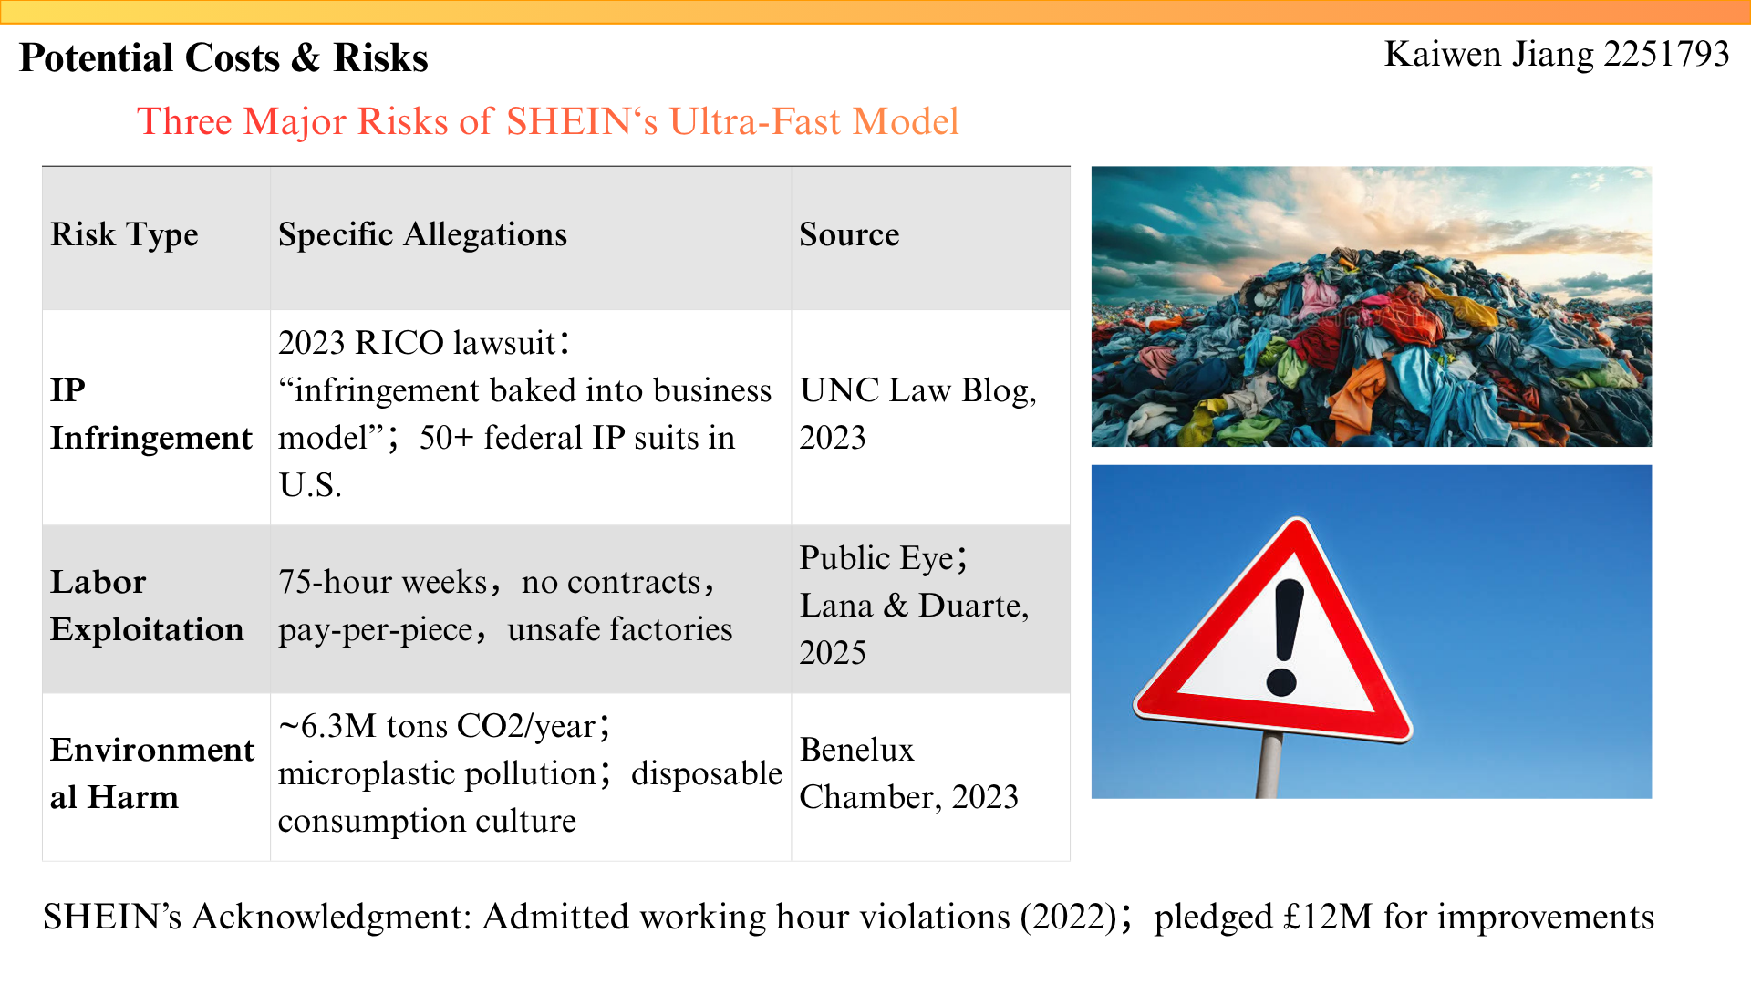
5

Slide 6
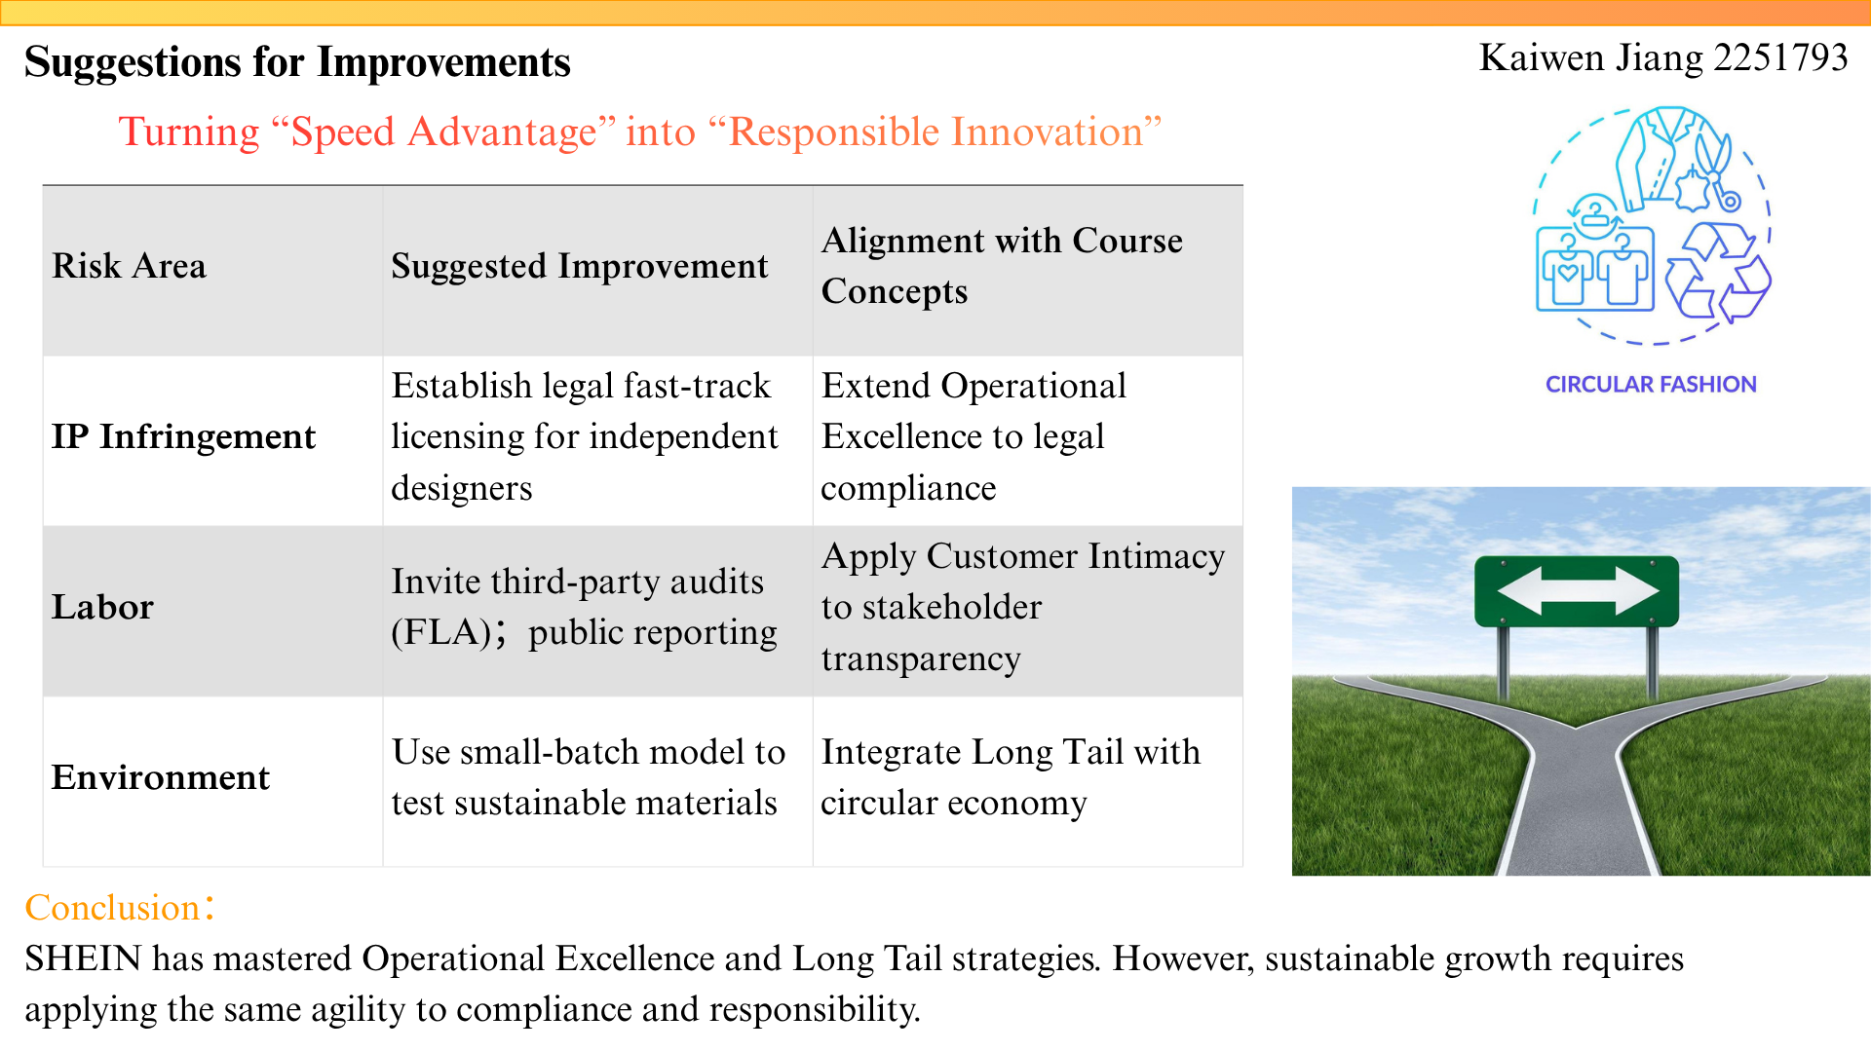
6

Slide 7
Alibaba's
E-commerce Strategy Analysis
Yiwen Hao 2253659
7
Notes:
Hello everyone. This slide illustrates how Alibaba's strategy has reshaped its business model.
First, in terms of Value Proposition, Alibaba has moved beyond just providing a marketplace. It now offers an AI-driven, one-stop consumption experience, supported by its strategic pivot to 'User First, AI-Driven'.
Second, its Revenue Model has become highly diversified. As the evidence shows, over 70% of its revenue comes from customer management services like advertising and commissions, proving its success as a service platform for merchants.
Finally, its Competitive Advantage is built on a powerful ecosystem of network effects and data, with nearly a billion active consumers creating a significant barrier to entry for competitors.

Slide 8
The Strategy of Alibaba
Strategic focus: FY2025 annual report defines strategy as “User First, AI-Driven”, with core engines e-commerce and AI+Cloud.
Tailoring products and services to customers’ specific needs(Treacy & Wiersema,1993)
Increase engagement and repeat purchases by user data, algorithmic recommendations, the 88VIP membership and AI shopping assistants
Customer intimacy
Platform ecosystem
Operates as a multi-sided platform that connects consumers, merchants, brands, logistics providers and technology service provider
Customer management revenue (ads/commissions) represented 71.7% of the total revenue for fiscal year 2025, proving revenue comes from merchant services, not direct sales
8

Slide 9
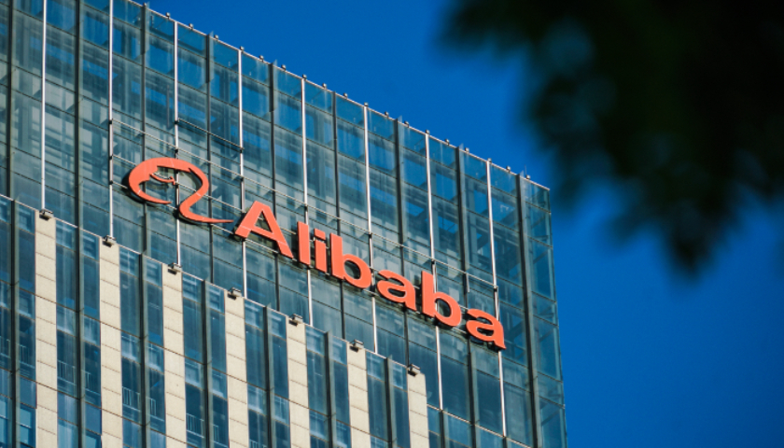
Business Model Impact
Value Proposition:
Shift from “low-price transactions” to AI-powered one-stop consumption —personalization, membership, instant delivery, AI after-sales, enhancing convenience, trust and personalization. (Amit & Zott, 2001)
Revenue Model:
From “transaction matching” to diversified ecosystem monetization —
Customer management revenue, Instant commerce revenue, Logistics/cloud/merchant tool fees. (Alibaba Group, 2026)
Competitive Advantage:
Hard-to-copy network effects + data moat + closed ecosystem —
953M users + millions of merchants create high switching costs; AI algorithms optimize recommendations and stickiness
9

Slide 10



Risks & Costs
Profit Margin Pressure
Intense Market Competition
Regulatory & Data Risk
Large investment in AI, instant commerce, and user subsidies has significantly reduced short-term profitability.
Alibaba is losing users and merchant advertising budgets to aggressive competitors like Pinduoduo, Douyin e-commerce, and Xiaohongshu.
Strict enforcement of data privacy laws, AI algorithm regulations, and antitrust laws increase operational costs and restrict business expansion.
Evidence: Adjusted EBITA decreased by 40% year-on-year (Alibaba Group, 2026).
Evidence: Competitive threats and market share challenges explicitly disclosed in the 2025 annual report.
Evidence: Mandatory compliance with the Personal Information Protection Law (PIPL) and China State Council’s AI algorithm regulations.
10
Notes:
Now, let's turn to the risks and challenges. The first major risk is Profitability Pressure. As shown in the data, Alibaba's significant investment in AI and new initiatives has led to a 40% year-on-year decrease in adjusted EBITA.
Secondly, the company faces Intensifying Competition from all sides, not just traditional e-commerce rivals but also content platforms like Douyin.
Finally, Regulatory and Data Risks are a constant concern. Stricter laws in China are forcing the company to continuously adapt its business practices to remain compliant.

Slide 11
Recommendations
Profit Pressure
Competition Risk
Regulatory Risk
PRACTICAL RECOMMENDATION
Focus AI on improving operational efficiency rather than excessive user subsidies.
PRACTICAL RECOMMENDATION
Deepen customer intimacy and optimize user experience to enhance loyalty.
PRACTICAL RECOMMENDATION
Improve algorithm transparency and strengthen data privacy protection.
KPI MEASUREMENT
Increase AI-driven conversion rate by5%
KPI MEASUREMENT
Raise user retention rate to over85%
KPI MEASUREMENT
Reduce privacy complaints to below0.1%
11
Notes:
Based on these risks, here are my recommendations. To address profitability pressure, Alibaba should refocus its AI efforts on improving operational efficiency rather than just subsidizing users. To counter competition, the company must deepen customer intimacy by providing truly personalized experiences, similar to how Netflix recommends movies. And to mitigate regulatory risks, enhancing transparency and trust in its data practices is crucial for long-term sustainability. These steps will help Alibaba balance growth with profitability and trust.

Slide 12
Alibaba — Section Conclusion
KEY TAKEAWAYS
1
"User First, AI-Driven" strategy leverages AI personalisation and 88VIP membership to deepen customer intimacy.
2
Platform ecosystem model generates 71.7% of revenue from customer management services rather than direct sales.
3
Margin pressure from AI investment and intensifying competition requires a balanced efficiency and growth strategy.
12
IOM302 | E-Commerce Business Strategies Analysis

Slide 13
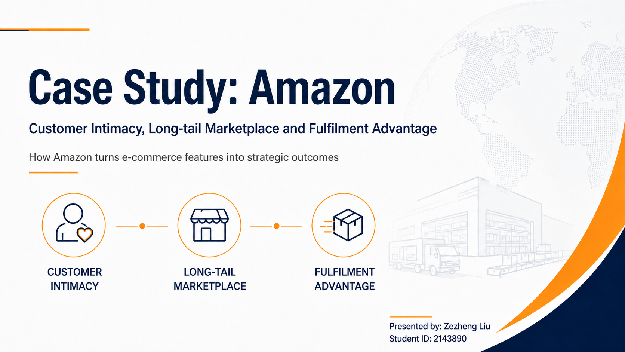
13

Slide 14





Amazon’s E-Commerce Strategy Overview
Customer intimacy | Long-tail marketplace | Fulfilment advantage
Personalization
Recommendations and targeted experience
Marketplace + 3P Sellers
Wider selection and niche products
Customer Data + Prime
Membership, purchase and browsing signals
customer intimacy
long-tail choice
Amazon E-Commerce Ecosystem
FBA + Fast Delivery
Storage, picking, shipping and returns
Advertising + Hybrid Revenue
Seller services, ads and membership income
convenience
service sales
Strategic purpose: price + selection + convenience + fast shipping
Amazon can be analysed as a B2C e-tailer, marketplace and digital ecosystem - not just a simple online shop.
14
1
Source: Amazon.com, Inc. Form 10-K, fiscal year ended Dec. 31, 2025.

Slide 15





How Amazon’s Strategies Support Business Components
IOM302 | Amazon Case
Strategy → Amazon example → business component → critical point
Strategy
Amazon Example
Business Component Supported
Critical Point
Customer intimacy
Personalization / Prime
Value proposition / customer relationship
Improves convenience, but depends on customer data
Long-tail marketplace
Third-party sellers offering diverse products
Market opportunity / customer segments
Expands choice, but quality control becomes harder
Fulfilment advantage
FBA: storage, picking, packing, shipping, returns
Competitive advantage / logistics
Improves reliability, but creates high operating cost
Information richness
Reviews, ratings, product information
Customer decision-making
Helps comparison, but trust governance is needed
Hybrid revenue model
Product sales, seller fees, ads, Prime membership
Revenue model
Diversifies income, but may increase platform dependence
Key insight: Amazon’s strategies reinforce each other: customer data improves personalization, marketplace scale expands choice, and FBA improves delivery reliability.
15
Sources: Amazon.com, Inc. Form 10-K, fiscal year ended Dec. 31, 2025; Amazon FBA official page.
Notes:
This slide connects Amazon’s strategies with business components. First, customer intimacy through personalization and Prime supports the value proposition and customer relationship because customers can discover relevant products more efficiently. Second, the marketplace supports a long-tail strategy by allowing third-party sellers to offer diverse products, including niche products. Third, FBA supports logistics and competitive advantage by improving delivery reliability. The key point is that each benefit also has a trade-off, such as data dependence, quality control, operating cost, or platform dependence.

Slide 16




Costs, Risks and Suggestions
IOM302 | Amazon Case
Critical analysis: e-commerce strategy creates both value and trade-offs
Risk Area
Strategic Risk / Cost
Improvement Suggestion
Privacy concern
Personalization depends on customer data and may reduce trust if data use is unclear
Improve transparency in customer data use and provide clearer privacy controls
Seller dependence
Third-party sellers may depend on platform rules, ranking, advertising and fulfilment services
Provide clearer and fairer seller rules; improve dispute and governance mechanisms
Fulfilment cost
FBA, fast delivery, warehousing and technology infrastructure create high operating costs
Use AI demand forecasting to reduce waste, overstocking and over-fulfilment risk
Sustainability pressure
Fast fulfilment and packaging may increase environmental and reputational pressure
Develop greener fulfilment, packaging and route optimization
Caution: FTC-related claims should be described as allegations; Amazon disputes the allegations.
Overall takeaway: Amazon’s e-commerce advantage depends not only on technology and scale, but also on managing cost, trust, platform governance and sustainability.
16
Sources: Amazon.com, Inc. Form 10-K; Amazon Privacy Notice; FTC Second Amended Complaint; AP News; Amazon Sustainability Report.
Notes:
This slide adds critical analysis. Amazon’s strategies create value, but they also create trade-offs. Personalization may raise privacy concerns because it depends on customer data. Third-party sellers may become dependent on Amazon’s platform rules, ranking, advertising system and fulfilment services. The FTC’s updated Amazon e-commerce case alleges that Amazon’s marketplace practices may overcharge sellers and reduce competition; however, these are still legal allegations and Amazon disputes them. From the perspective of strategic agility, Amazon should respond to customer expectations, regulation, AI development, competition and sustainability pressure. My suggestions are to improve data transparency, use AI demand forecasting to reduce waste, develop greener fulfilment and packaging, and provide clearer and fairer seller rules. Overall, successful e-commerce strategy requires not only technology and scale, but also careful management of cost, trust, platform governance and long-term sustainability.

Slide 17
Amazon — Section Conclusion
KEY TAKEAWAYS
1
Customer intimacy, long-tail marketplace, and FBA fulfilment form a self-reinforcing e-commerce flywheel.
2
Hybrid revenue model (products, seller fees, ads, Prime) diversifies income and reduces reliance on single streams.
3
Governance of data privacy, seller relationships, cost efficiency, and sustainability are key ongoing challenges.
17
IOM302 | E-Commerce Business Strategies Analysis

Slide 18

Xin.he 2145653
Warby Parker
Warby Parker
Xinhe · 2145653
18

Slide 19

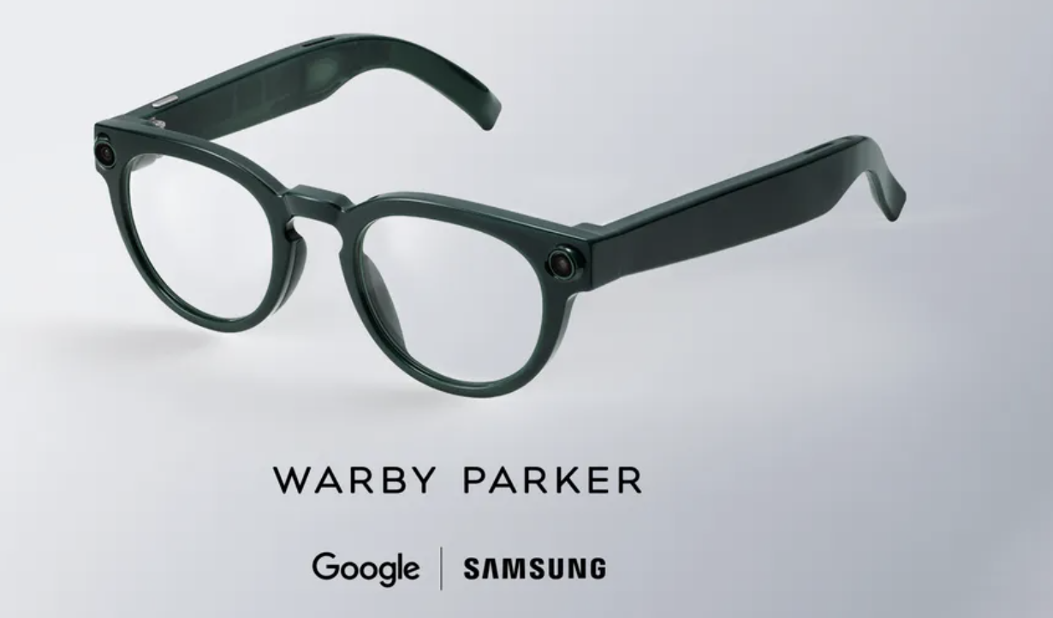
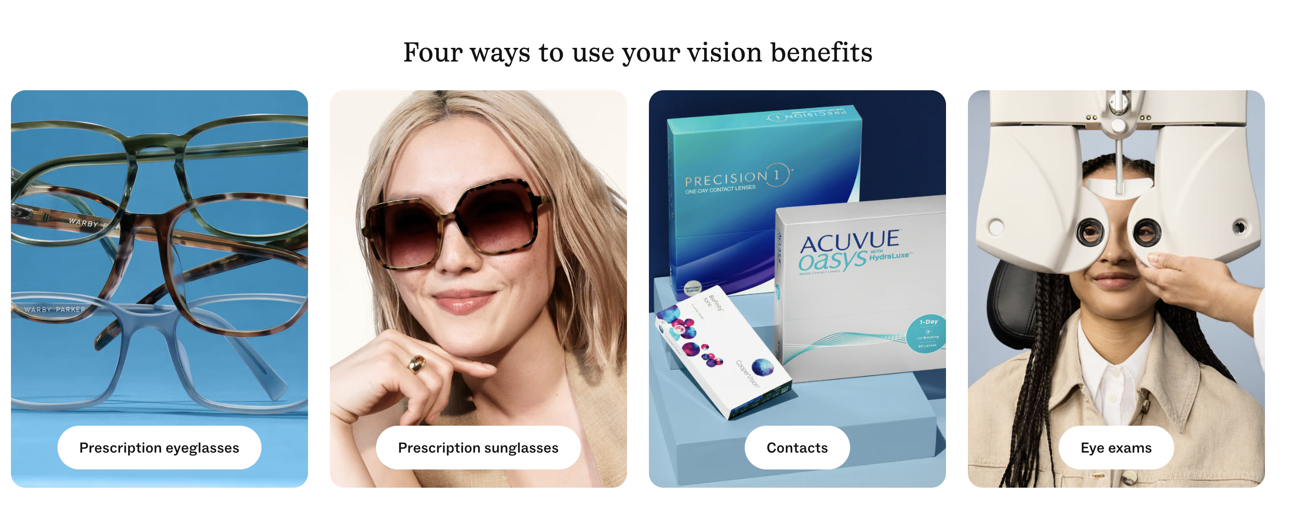
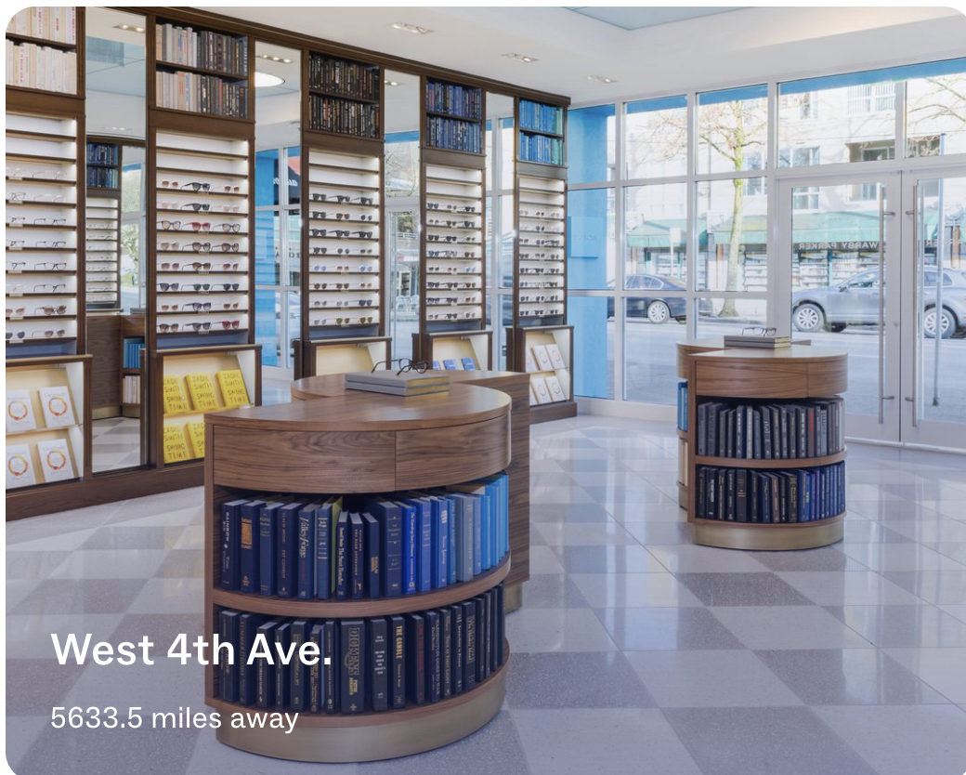
Xin.he 2145653
Warby Parker
Warby Parker：Reshaping Eyewear Retail with E-commerce Strategies
Strategy | Warby Parker’s Measures | Business Components | Result
Differentiation – Customer Intimacy | Virtual Try-On + Advisor personalized recommendations 323 stores by end of 2025; 285 offer in-person eye exams • Home Try-On discontinued; shifted to Virtual Try-On + in-store experience (Warby Parker Inc., 2026a; Warby Parker Inc., 2026b; Wassel, 2025) | Value proposition: Reduce uncertainty of buying prescription glasses online Market strategy: Boost conversion with AR/AI recommendations + physical stores Competitive advantage: Online convenience + offline professional service closed-loop | Creates an omnichannel experience: Discover online → Virtual Try-On → In-store exam → Purchase 3/4 of iOS app users use Virtual Try-On, showing digital experience boosts customer engagement (Wassel, 2025)
Differentiation -Product Leadership | In-house design team for consistent brand aesthetic Expanded product lines: eyeglasses, contacts, eye exams, lens upgrades Partnered with Google / Samsung to develop intelligent eyewear, launching fall 2026 (Warby Parker Inc., 2026a; Google, 2026; Samsung Electronics, 2026) | Value proposition: Upgraded from “affordable eyewear” to design + vision care + smart eyewear Revenue model: Eyeglasses + contact lenses + eye exams + future AI hardware Competitive advantage: Prescription eyewear capability + store network + tech partnerships | Expanded from an eyewear retailer to a vision-care / consumer-tech brand; AI eyewear opens new growth potential (Samsung Electronics, 2026)
19

Slide 20
Xin.he 2145653
Warby Parker
Warby Parker：Reshaping Eyewear Retail with E-commerce Strategies
Strategy | Warby Parker’s Measures | Business Components | Result
Focus / Niche Strategy | Targets digital-native, design-focused, price-sensitive young consumers Starts at $95, emphasizes affordable design Social media + brand storytelling + Buy a Pair, Give a Pair (Warby Parker Inc., 2026a; Earnest Analytics, 2024) | Market opportunity: Serves the design + affordable niche, avoiding direct competition with Luxottica Market strategy: Reach target consumers via social media, brand storytelling, and affordable positioning Competitive advantage: Priced above Zenni, below traditional brands, creating a differentiated buffer zone | Market share: 7.2% (2024), up from 6.8% in Q4 2023 Customers switching from LensCrafters to WP: +3.4% YoY (Earnest Analytics, 2024)
DTC Cost Advantage | Direct-to-consumer via official website & app In-house design, reduced reliance on brand licensing Integrated owned stores + e-commerce channels Starting at $95 (Warby Parker Inc., 2026a) | Revenue model: Cut out middlemen, revenue flows directly to the brand Competitive advantage: Cost savings support low prices and experience investment Value proposition: Supports affordable design positioning | 2025 net revenue: $871.9M, +13.0% YoY Gross margin: 54.0% Adjusted EBITDA margin: 10.9% Full-year net profit: $1.6M (first positive annual profit) (Warby Parker Inc., 2026a)
20

Slide 21
Xin.he 2145653
Warby Parker
Feasibility Analysis & Recommendations
Warby Parker’s strategy is viable in the short term, but long-term sustainability depends on defending differentiation, controlling store/service costs, and managing privacy risks in AI eyewear.
Viability Analysis | Warby Parker Status | Risks | Suggestions
Strategic Analysis — Industry | U.S. eyewear retail remains highly competitive; Luxottica holds ~28% market share Warby Parker: 7.2% share, up from 6.8% in Q4 2023 “Other” small retailers: 32% share, indicating a fragmented market with many entrants (Consumer Edge, 2024) | Competition from low-cost online brands & traditional optical stores Low comparison cost; customers are price-sensitive AI eyewear segment faces competition from tech companies | Avoid price wars; strengthen design + vision care + online convenience AI eyewear highlights WP’s integration of prescription, eye exams, and in-store services
Strategic Analysis — Firm | 323 stores by end of 2025; online DTC + stores form an omnichannel system Virtual Try-On / Advisor improve online selection experience Intelligent Eyewear designed by Warby Parker, with Google AI and Samsung hardware, launching Fall 2026 (Warby Parker Inc., 2026a; Warby Parker Inc., 2026b) | Store expansion raises rent, staffing, doctor costs and management complexity AI eyewear involves privacy, security, data usage and consumer trust Vision care expansion brings medical and compliance pressure | Stores positioned as vision care centers, not just retail outlets Launch AI eyewear with small-scale trials and clear data & privacy rules Leverage Advisor and AR to reduce selection uncertainty and service costs
Financial Analysis | 2025 net revenue: $871.9M, +13.0% YoY First full-year positive net profit: $1.6M; Adjusted EBITDA margin: 10.9% 2025 operating cash flow: $110.8M; Free Cash Flow: $43.7M (Warby Parker Inc., 2026a) | Gross margin affected by tariffs, optometrist headcount, contact lens sales mix and shipping costs GAAP operating loss remains negative, with thin profit buffer High risks in AI eyewear R&D and hardware inventory | Control store expansion pace, prioritize improving single-store profitability Boost sales of lens upgrades, contact lenses, insurance orders and repeat purchases Replace part of high-cost in-store trials with AR and Advisor tools
21

Slide 22
Warby Parker — Section Conclusion
KEY TAKEAWAYS
1
DTC omnichannel strategy successfully disrupted the traditional eyewear duopoly with design-forward, affordable products.
2
Home try-on innovation and physical retail expansion create a differentiated, high-engagement customer journey.
3
Scalability of cost structure and defensibility of brand differentiation determine long-term competitive position.
22
IOM302 | E-Commerce Business Strategies Analysis

Slide 23
E-Commerce Business Strategies Analysis
– Tesla Case Study
Xuan Wu
2254778
23
Notes:
Hello everyone. This slide illustrates how Alibaba's strategy has reshaped its business model.
First, in terms of Value Proposition, Alibaba has moved beyond just providing a marketplace. It now offers an AI-driven, one-stop consumption experience, supported by its strategic pivot to 'User First, AI-Driven'.
Second, its Revenue Model has become highly diversified. As the evidence shows, over 70% of its revenue comes from customer management services like advertising and commissions, proving its success as a service platform for merchants.
Finally, its Competitive Advantage is built on a powerful ecosystem of network effects and data, with nearly a billion active consumers creating a significant barrier to entry for competitors.

Slide 24

Tesla & Core Strategies
Global leading electric vehicle & clean energy enterprise
Customer Intimacy
Online car customization & one-stop purchase via official website/App（Li et al.,2021）
OTA updates & data-driven personalized services
Improve user loyalty and increase customer switching costs
Operational Excellence
Direct-to-consumer model (no traditional dealerships)
Lean production & Giga Press technology
Shorten production cycle & reduce inventory waste
Cost Competition
Vertical integration (battery + software R&D)
Global gigafactories & automated production (Business Model Canvas Templates, 2026)
Cut production and logistics costs significantly
Global Scope
Cross-border online sales supported by universal internet standards (Dai et al., 2023)
Achieve seamless global market coverage
24

Slide 25
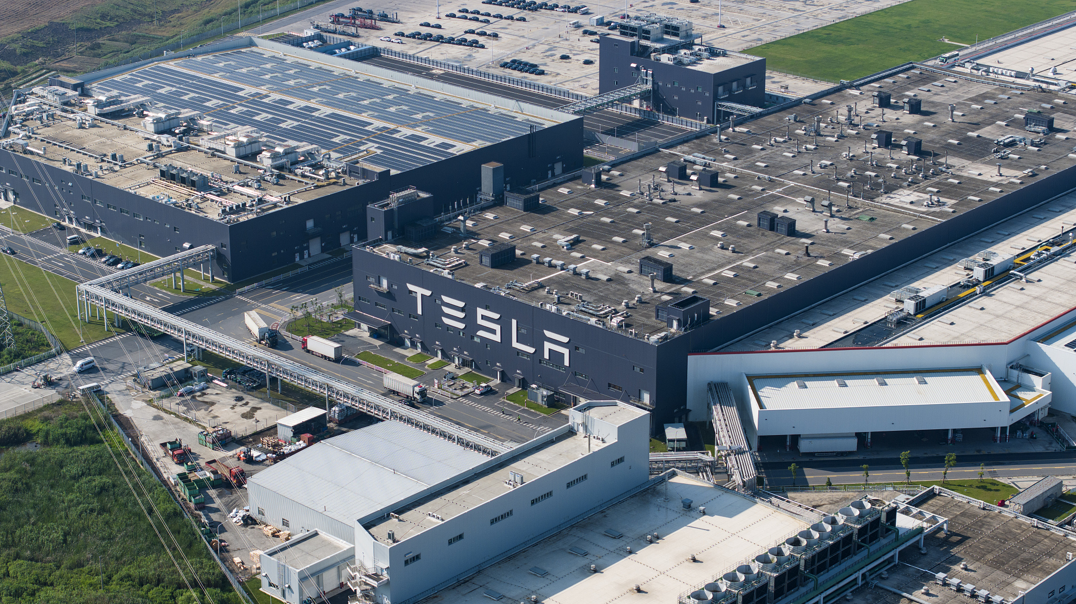




Potential Costs & Risks
High capital investment in R&D, gigafactories and retail infrastructure
Legal and regulatory barriers of direct sales model in some
(regionsLaw & Economics Center, 2026)
Data privacy and user information security risks
Gross margin pressure from industry price wars and supply chain volatility
25
Notes:
Now, let's turn to the risks and challenges. The first major risk is Profitability Pressure. As shown in the data, Alibaba's significant investment in AI and new initiatives has led to a 40% year-on-year decrease in adjusted EBITA.
Secondly, the company faces Intensifying Competition from all sides, not just traditional e-commerce rivals but also content platforms like Douyin.
Finally, Regulatory and Data Risks are a constant concern. Stricter laws in China are forcing the company to continuously adapt its business practices to remain compliant.

Slide 26

Improvement Suggestions
Cost Optimization
Data Compliance
Software Monetization
Network Expansion
Streamline non-core business spending (e.g., reduce unprofitable energy projects)
Accelerate supply chain localization in emerging markets
Optimize gigafactory capacity utilization to lower per-unit production cost
Launch transparent user data collection & usage disclosure mechanism
Upgrade global data security systems to meet GDPR/CCPA standards
Grant users more control over their driving and personal data
Promote FSD subscription model globally with tiered pricing(Basenor, 2026)
Launch paid premium in-car entertainment and connectivity services
Develop commercial fleet management software for enterprise customers
Prioritize charging station deployment in tier-2/3 cities and rural areas
Expand mobile after-sales service teams to cover underserved regions
Integrate online appointment system with offline service centers
26
Notes:
Based on these risks, here are my recommendations. To address profitability pressure, Alibaba should refocus its AI efforts on improving operational efficiency rather than just subsidizing users. To counter competition, the company must deepen customer intimacy by providing truly personalized experiences, similar to how Netflix recommends movies. And to mitigate regulatory risks, enhancing transparency and trust in its data practices is crucial for long-term sustainability. These steps will help Alibaba balance growth with profitability and trust.

Slide 27
Tesla — Section Conclusion
KEY TAKEAWAYS
1
DTC e-commerce model with online customisation eliminates dealer costs and enables direct customer data collection.
2
Vertical integration (battery, software, manufacturing) underpins both cost leadership and product differentiation.
3
Reputational risks and intensifying EV competition require resilient brand management and strategy diversification.
27
IOM302 | E-Commerce Business Strategies Analysis

Slide 28
Zara: Agile Supply Chain + Omnichannel Integration
An Analysis of E-commerce Business Strategies
ZARA
Youtai Wang
2251996
28

Slide 29
Zara's E-commerce Strategy
Speed, Integration, Premium
Strategy: Agile supply chain + Omnichannel integration (Differentiation / Operational Excellence)
Strategy Element | How Zara Implements It
Agile supply chain | 2-3 week design-to-shelf cycle; AI drives 85% of initial production
Omnichannel integration | RFID tracking + SINT system; store as fulfillment node
Zara uses agile supply chain and omnichannel integration to differentiate through speed and scarcity.
29
1
Source: (Inditex, 2026; Li et al., 2025; Musty et al., 2025)

Slide 30
Data & Evidence
From Strategy to Business Value
Data Point | Value | Source
Design-to-shelf cycle | 2-3 weeks (vs industry 3-6 months) | (Inditex, 2026)
Inventory accuracy | 98.9% via RFID | (Inditex, 2026)
End-of-season inventory | 0.6% (vs industry 10-20%) | (Inditex, 2026)
Gross margin (peak) | 62.2% | (Inditex, 2026)
Virtual try-on return reduction | 10% | (Inditex, 2026)
30
1
Source: Inditex, 2026

Slide 31
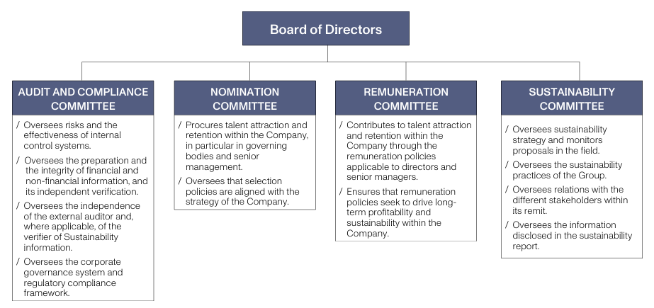
Business Model Impact
From Strategy to Business Value
Component | Analysis
Value proposition | Fresh, scarce products arrive twice weekly. Customers buy now because items won't be there next week.
Revenue model | Brand premium, not low price. 28% price increase in U.S. (2025). Gross margin 62.2%.
Competitive advantage | Vertical integration + AI-driven production + RFID inventory control. Hard to copy because requires decades of supply chain investment.
Source: (Inditex, 2026)
31
1
Source ::(Inditex, 2026; Li et al., 2025)

Slide 32
Risk & Recommendations
Risks and Strategic Solutions
Risk | Detail
Data security | April 2026: 197,000 user records stolen via third-party vendor
Growth | Inditex grew only 7.5% in 2024
AI ethics | AI edits model photos; job displacement concerns
Recommendation | KPI
Time-limited third-party access + token management | Data incident rate: zero breaches in FY2026
Extend AI to personalized styling (Netflix for fashion) | Customer satisfaction
Expand livestream showroom globally | Store productivity
32
1
Source :(Inditex, 2026; Inditex, 2025)

Slide 33
Zara — Section Conclusion
KEY TAKEAWAYS
1
Agile supply chain enables a 2-week design-to-shelf turnaround, creating trend-responsiveness and scarcity urgency.
2
Omnichannel integration aligns online discovery with in-store fulfilment for a seamless premium retail experience.
3
Environmental pressure from fast fashion and data privacy regulations demand proactive sustainability governance.
33
IOM302 | E-Commerce Business Strategies Analysis

Slide 34
References
34
Notes:
This slide can be kept as a backup reference slide, or the references can be copied into the full group reference slide.

Slide 35
Acknowledgements
We would like to express our sincere gratitude to our course instructor and teaching assistants for their valuable guidance throughout IOM302. We also thank the authors and publishers of the academic works cited in this presentation for their foundational contributions to e-commerce strategy research. This group project was a collaborative effort, and we are grateful for each team member's dedication and hard work.
Group Members:
Yiwen Hao (2253659) · Kaiwen Jiang (2251793) · Xin He (2145653) · Xuan Wu (2254778) · Youtai Wang (2251996) · Zezheng Liu (2143890)
35

Slide 36
Q & A
Questions & Answers
Thank you for listening!
IOM302 | E-Commerce Business Strategies Analysis
36

