Slide 1
Performance and Economic Analysis of Electric Vehicle Charging Integration in the WSCC 9-Bus System
Department of Electrical & Electronics Engineering
Presented by: | Grp 12
Hasina Fatema | 22BEEJ64
Laxmi Narayan Sahoo | 22BEEI87
Shaswat Kanungo | 22BEEI24
Priyanshu Sinha | 22BEEC35
Under the Guidance of:
Prof. Rajan Kumar Mishra

Slide 2
CONTENT
Introduction
Motivation
Problem Statement
Objectives
WSCC 9-Bus Test System
Newton-Raphson Method
Particle Swarm Optimization (PSO)
Methodology
Case Studies
Results and Discussion
Conclusion
Future Scope
References

Slide 3
INTRODUCTION
Increasing Electric Vehicle (EV) adoption adds extra load to power systems.
EV charging station placement affects voltage and power losses.
Improper placement reduces system efficiency.
Load flow analysis is required for system evaluation.
WSCC 9-bus system is used for study.
Newton-Raphson load flow used for power flow analysis.
Best location selected based on voltage profile, losses, and cost.

Slide 4
MOTIVATION
Rapid growth of EVs increases power demand.
EV charging affects voltage instability
Improper placement increases power losses.
Operational cost increases due to EV load.
Need optimal EV charging station placement.
Improve voltage profile and reduce power losses.
Ensure economical power system operation.

Slide 5
PROBLEM STATEMENT
EV charging introduces additional load to power system
Improper placement increases transmission losses.
Voltage deviation occurs at load buses.
Generation cost increases due to extra demand
Optimal EV charging bus location not identified.
Need to analyze different EV placement cases.
System performance must be evaluated.

Slide 6
OBJECTIVES
Perform load flow analysis using Newton-Raphson method
Integrate EV charging load in WSCC 9-bus system
Apply PSO for optimal Q_{ev} Allocation
Evaluate voltage profile and power losses
Identify optimal bus for EV charging station

Slide 7
WSCC 9-Bus Test System
Standard benchmark network used for load flow and stability analysis.
It consists of 9 buses.
Bus 1 is considered as the slack bus to balance system power.
Buses 2 and 3 are PV (generator) buses.
Buses 5,6, and 8 are load buses with specified MW and MVAR demand.
Remaining buses act as intermediate transmission buses.
Generator Buses: Bus 1 – Slack bus, Bus 2 & 3 – Generator bus
Load Buses: Bus 5, 6 and 8

Slide 8
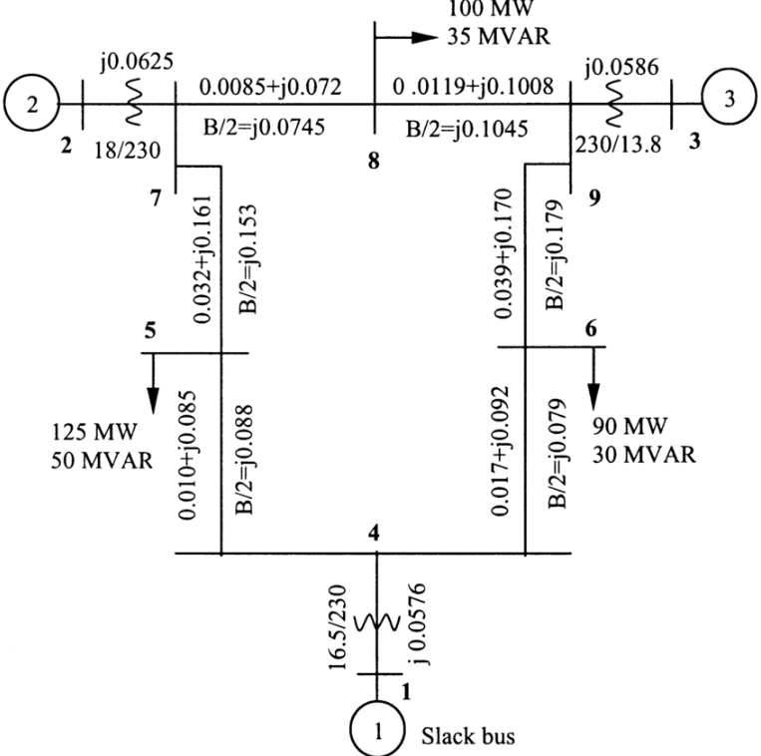
WSCC 9-Bus Test System
System Features:
Transmission lines represented using impedance (R + jX).
Line charging represented using B/2 values.
Transformers included with tap ratios.
Network operates at multiple voltage levels.
Used for power flow and economic analysis.
Purpose of Using WSCC 9-Bus:
Standard test system for research
Easy to analyse EV load integration
Suitable for Newton-Raphson load flow
Helps evaluate voltage profile
Used to calculate transmission losses
Helps identify optimal EV charging bus location
Fig 1: WSCC 9-Bus Test System Single Line Diagram

Slide 9
Newton-Raphson Method
Iterative numerical method for load flow analysis.
Solves nonlinear power flow equations.
Uses Jacobian matrix.
Provides fast convergence.
High accuracy solution.
Requires fewer iterations.
Suitable for large power systems.

Slide 10




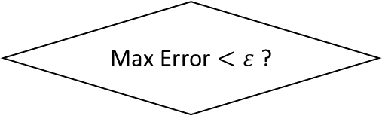
NEWTON-RAPHSON METHOD
Start
Max Error $<ε$ ?
Read Bus data & Line data
Form Y-Bus Matrix
Yes
No
Print Results
Initialize V, $δ$
Calculate Line Flows &Losses
Calculate P, Q
Compute Mismatch $∆P, ∆Q$
End
Form Jacobian Matrix
Solve $\left[\begin{matrix}∆δ \\ ∆V\end{matrix}\right]=J^{−1}[\begin{matrix}∆P \\ ∆Q\end{matrix}]$
Update V, $δ$
Fig 2: Flowchart of Newton-Raphson Method

Slide 11
Particle Swarm Optimization (PSO)
Population-based optimization technique inspired by bird flocking behavior
Used to find optimal EV reactive power allocation at buses 5, 6, and 8
Each particle represents possible reactive power values Q5, Q6, Q8
Fitness function is based on minimizing total transmission power loss
Particle position and velocity updated iteratively
Personal best(pbest) and global best (gbest) are considered
Convergence obtained after maximum iterations
Best solution gives minimum system loss

Slide 12
METHODOLOGY
Model WSCC 9-bus system data.
Perform base case load flow.
Add EV charging load.
Apply PSO for optimal reactive power allocation
Update particle positions and velocities
Run Newton-Raphson load flow for each particle
Calculate voltage profile and power losses
Compare all iterations results.
Identify optimal EV charging allocations with minimum loss

Slide 13
CASE STUDIES
Base case without EV reactive load
Simultaneous Q_{ev} at Buses 5, 6, and 8
PSO used for optimal Q_{ev} allocation
NR load flow run in each iteration
Objective: minimize total power loss
Best Q_{ev} values selected after convergence

Slide 14
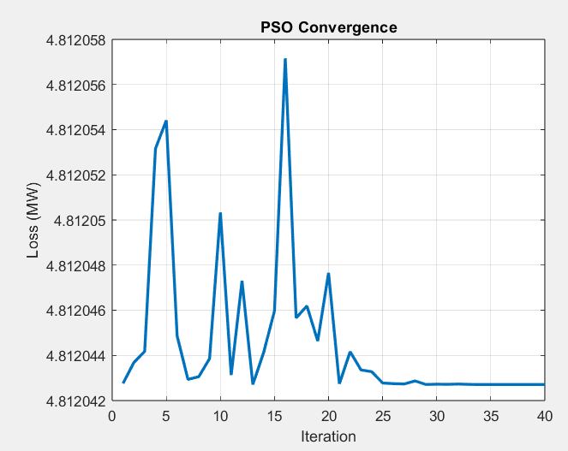
RESULT & DISCUSSION
Base Case Loss = 4.6410 MW
Optimal EV Reactive Power Allocation:
Bus 5 = 0.0000 pu
Bus 6 = 0.1238 pu
Bus 8 = 0.1762 pu
Minimum Total Loss = 4.8120 MW
Reactive power support mainly allocated to Bus 6 and Bus 8
Bus 5 shows no reactive power solution
Simultaneous compensation at buses 5, 6, and 8 considered
Fig 3: PSO Convergence Curve for Loss Minimization

Slide 15
CONCLUSION
Newton-Raphson load flow is implemented on the WSCC 9-bus system for performance analysis. Particle Swarm Optimization is applied to obtain optimal to obtain optimal EV reactive power allocation at Buses 5, 6, and 8. The results show that optimized reactive power support improves voltage profile and help minimize transmission power losses. The combined NR-PSO approach is effective for EV charging integration and power system planning

Slide 16
FUTURE SCOPE
Integration of PV system in the WSCC 9-bus network
Combined PV and EV charging performance and economic analysis
Voltage profile improvement and power loss reduction using PV support

Slide 17
REFERENCES
[1] F. Schäfer and M. Braun, "An efficient open-source implementation to compute the jacobian matrix for the Newton-Raphson power flow algorithm," 2018 IEEE PES Innovative Smart Grid Technologies Conference Europe (ISGT-Europe), Sarajevo, Bosnia and Herzegovina, 2018, pp. 1-6, doi: 10.1109/ISGTEurope.2018.8571471.
[2] M. R. Hossain, M. S. Kaiser, F. I. Ali and M. M. A. Rizvi, "Network flow optimization by Genetic Algorithm and load flow analysis by Newton Raphson method in power system," 2015 International Conference on Electrical Engineering and Information Communication Technology (ICEEICT), Savar, Bangladesh, 2015, pp. 1-5, doi: 10.1109/ICEEICT.2015.7307388.
[3] W. Chuanjun, W. Ling and R. Xuejing, "General particle swarm optimization algorithm," 2023 IEEE 2nd International Conference on Electrical Engineering, Big Data and Algorithms (EEBDA), Changchun, China, 2023, pp. 1204-1208, doi: 10.1109/EEBDA56825.2023.10090725
[4] H. Saadat, Power System Analysis, 3rd ed., McGraw-Hill, 2010.
[5] J.J. Grainger and W.D. Stevenson, Power System Analysis, McGraw-Hill, 1994.

