Slide 1
Student Performance Analyzer — Grade Classification
Group 07 • May 25, 2026

Slide 2
Agenda
Problem & objectives
Dataset & features
Exploratory analysis
Preprocessing & balancing
Model comparison & selection
Evaluation results
Deployment & next steps

Slide 3
Problem & Objective
Goal: predict student grade category (A, B, C, D, Fail).
Use student attributes (study habits, attendance, GPA, etc.) to classify outcomes.
Emphasis on interpretability + deployable inference (API/UI).

Slide 4
Dataset Overview
Source file: student_performance_grade.csv
Labeled rows (classification): 1,671
Features: 18 (numeric + categorical + binary)
Target: Grade (A, B, C, D, Fail) — imbalanced distribution

Slide 5
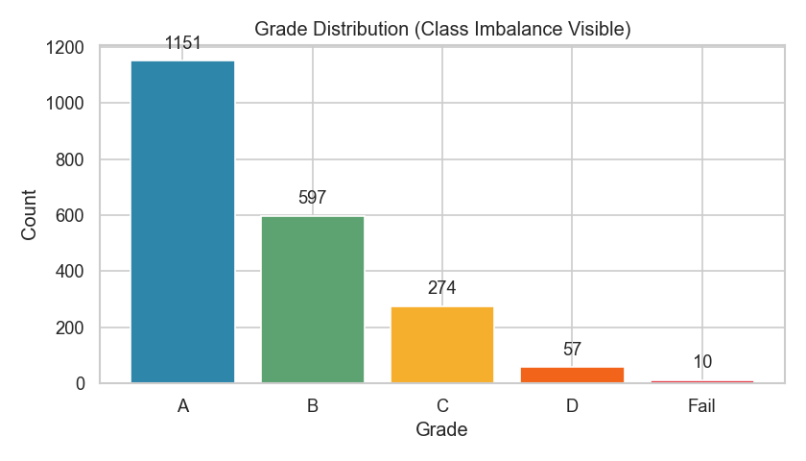
EDA — Grade Distribution
Class imbalance: A dominates; D/Fail are rare

Slide 6
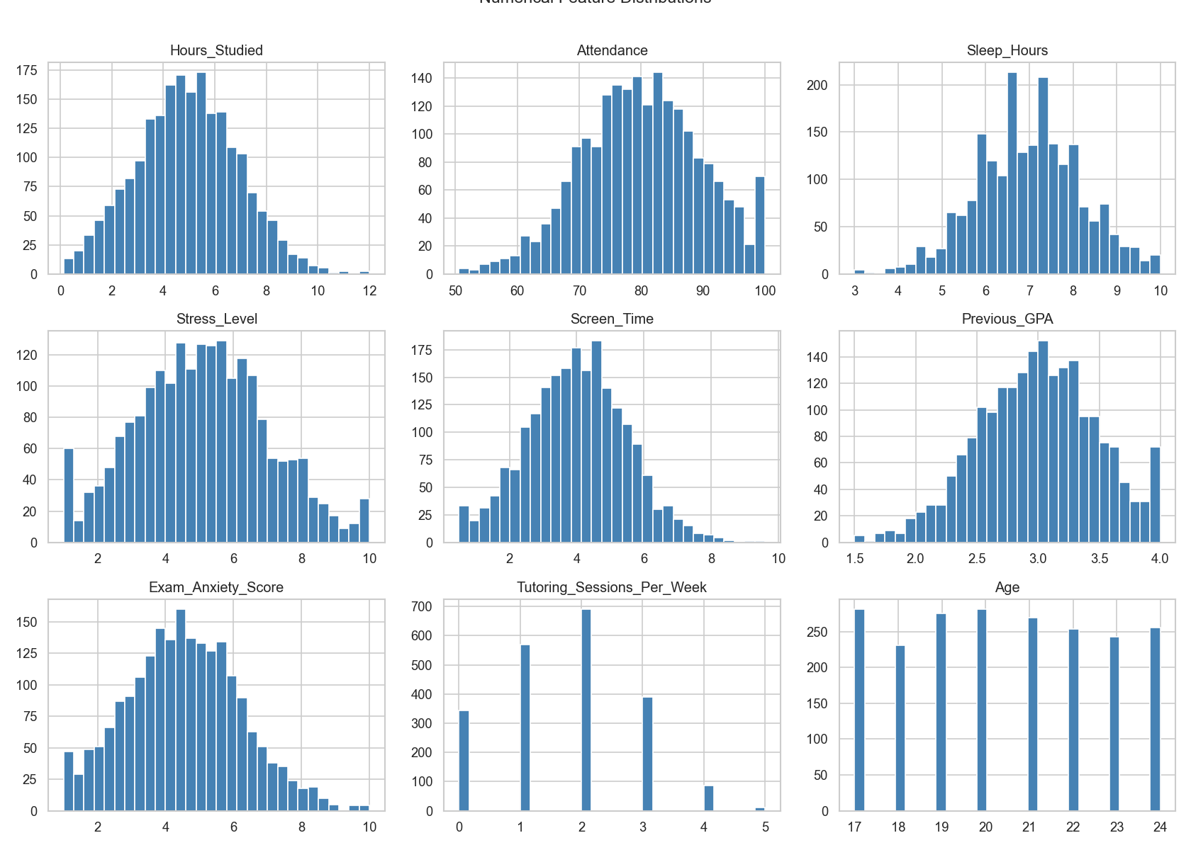
EDA — Numerical Feature Distributions
Key numeric patterns (hours studied, attendance, GPA, etc.)

Slide 7
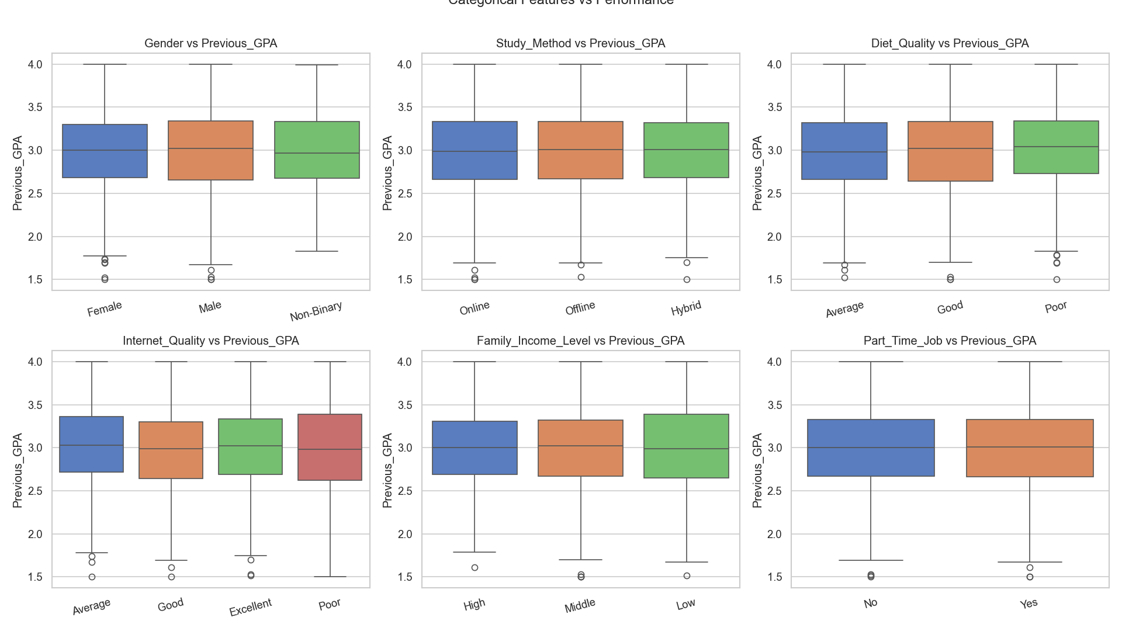
EDA — Categorical Feature Boxplots
Grade variations across categorical attributes

Slide 8
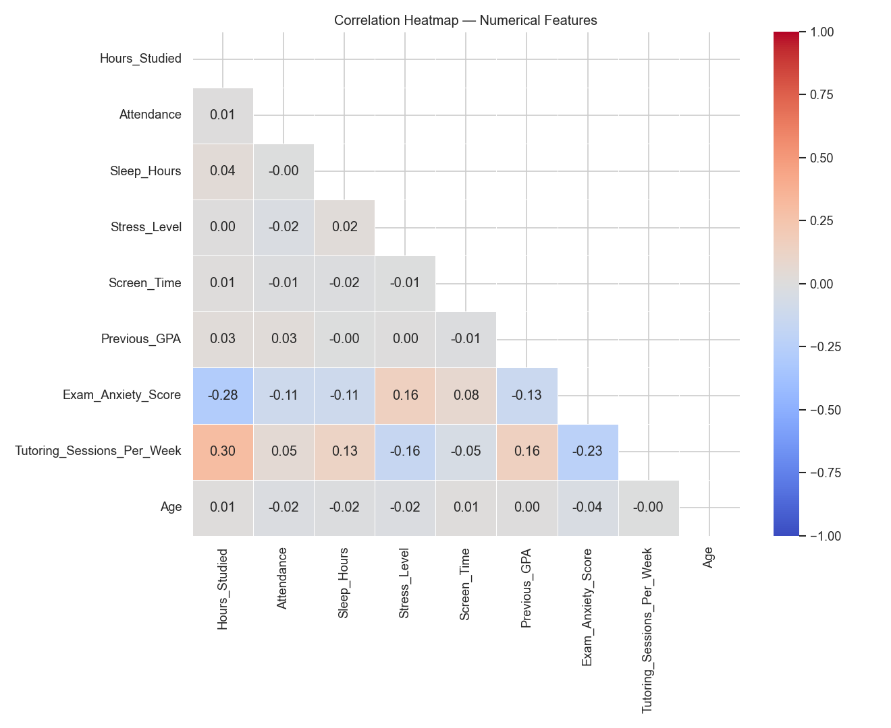
EDA — Correlation Heatmap
Correlations among numeric variables and final score

Slide 9
Preprocessing & Balancing
Encoding: ordinal + one-hot + binary mapping
Scaling: standardization for numeric features
Train/test split with stratification
Class imbalance handled via SMOTE
Before SMOTE: A=921, B=477, C=219, D=46, Fail=8
After SMOTE: all classes balanced to 921 each

Slide 10
Model Comparison (CV F1 — weighted)
Model | CV F1 (mean) | Std
Logistic Regression | 0.8300 | 0.0207
K-Nearest Neighbors | 0.8751 | 0.0333
Random Forest | 0.9237 | 0.0300
Gradient Boosting | 0.8719 | 0.0320

Slide 11
Best Model — Random Forest (Tuned)
Best params: n_estimators=200, max_depth=None, min_samples_split=2
Best CV F1 (weighted): 0.9264
Selected for balance of performance + interpretability

Slide 12
Test Set Performance
Accuracy: 0.73
Weighted F1: 0.72
Macro F1: 0.49 (minority classes remain challenging)
Low recall for D and Fail reflects rare class scarcity

Slide 13
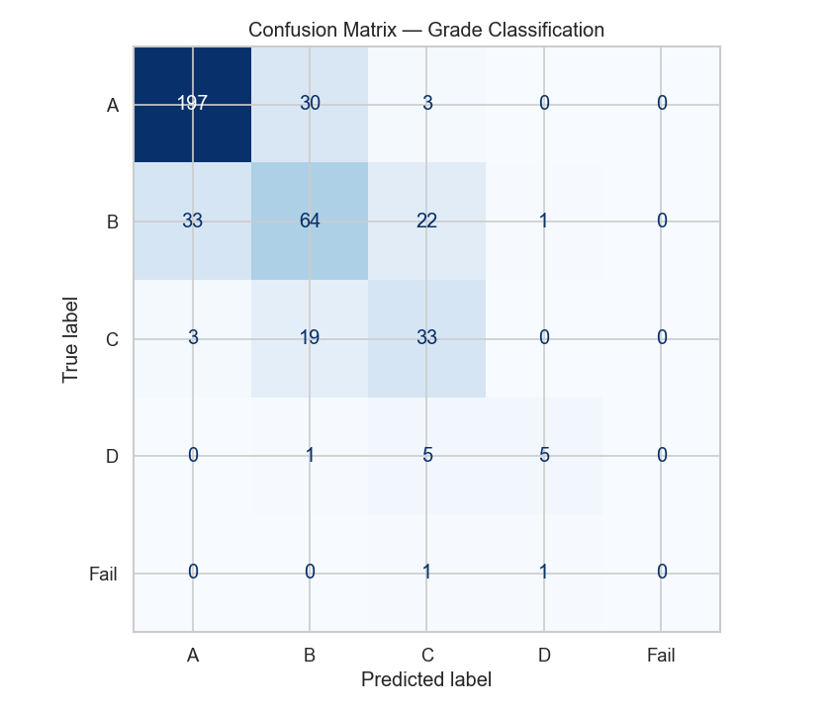
Confusion Matrix — Grade Classification
Most confusion occurs among adjacent grades; minority classes hardest

Slide 14
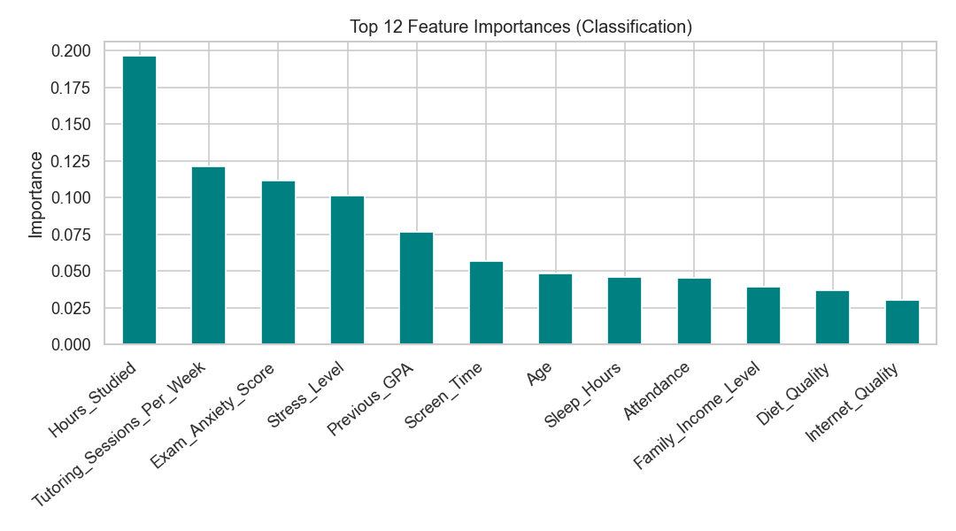
Top Feature Importances (Random Forest)
Most influential features include GPA, attendance, study time, and anxiety

Slide 15
Deployment
Model saved: model_classification.pkl + preprocessor_classification.pkl
Gradio app UI: app.py
Flask API endpoint: app_flask.py (/predict)
Supports JSON input → predicted grade + probabilities

Slide 16
Sample Prediction
Example input (Age=20, Study Method=Hybrid, Attendance=85%, GPA=3.2, …)
Predicted Grade: A
Probabilities: A=0.980, B=0.020, C=0.000, D=0.000, Fail=0.000

Slide 17
Limitations & Next Steps
Minority classes (D/Fail) underrepresented → low recall
Collect more data for rare classes; explore cost-sensitive learning
Calibrate probabilities; evaluate with macro/weighted metrics
Add new features (behavioral, longitudinal trends) for robustness

Slide 18
Q&A
Thank you! Questions?

