Slide 1
Fake currency detection using image processing
NAME: CHENCHALA HASINI
ROLL NO: 19261A05D1
GUIDED BY: VEDAVATHI. K

Slide 2
ABSTRACT
Counterfeit money refers to fake or imitation currency that is produced with the idea to deceive. According to recent reports, demonetization led to an all-time high inflow of fake notes into banks, resulting in a spike in suspicious transactions. The existing works to detect a counterfeit note are mostly based on image processing techniques. This paper deals with Deep Learning in which a convolution neural network(CNN) model is built with the motive to identify counterfeit notes. Images are acquired using the smartphone camera and fed to the CNN network. The results obtained are encouraging and can be improvised by further research and improvements in the architecture of the Deep CNN model.

Slide 3
LITERATURE SURVEY
S.NO | Paper Title, Authors, Year of Publication | Techniques/ Algorithms/ Methods Used | Merits | Demerits | Link to the Paper
1 | Ayalew Tessfaw, M. E., Ramani, M. B., & Kebede Bahiru, M. T. (2018). Ethiopian Banknote Recognition and Fake Detection Using Support Vector Machine. | Image Processing SVM. | The result displayed in the form of confusion matrix with total recognition accuracy rate 98%. | This currency recognition system prototype only recognizes banknotes scanned on the front side only | https://ieeexplore.ieee.org/document/8473013 DOI:10.1109/ICICCT.2018.8473013

Slide 4
LITERATURE SURVEY
S.NO | Paper Title, Authors, Year of Publication | Techniques/ Algorithms/ Methods Used | Merits | Demerits | Link to the Paper
2 | Murthy, S., Kurumathur, J., & Reddy, B. R. (2016). Design and implementation of paper currency recognition with counterfeit detection. | Object Detection, Likelihood algorithm | To determine the unfit notes from fit notes with high accuracy | Accuracy can be improved by more than 90% but this process takes time | https://ieeexplore.ieee.org/document/7916838 DOI:10.1109/GET.2016.7916838

Slide 5
LITERATURE SURVEY
S.NO | Paper Title, Authors, Year of Publication | Techniques/ Algorithms/ Methods Used | Merits | Demerits | Link to the Paper
3 | Deepak M. P and Prajwala N. B, Identification of Fake Notes and Denomination Recognition (2018) | Probabilistic Neural Network, GLCM, Noise Removal methods | Developed an efficient system for the monetary standards with high accuracy. | The system doesn’t recognize the hidden features like, latent image and the watermark of the paper currency | https://ieeexplore.ieee.org/document/8524275 DOI: 10.1109/ICCSP.2018.8524275

Slide 6
LITERATURE SURVEY
S.NO | Paper Title, Authors, Year of Publication | Techniques/ Algorithms/ Methods Used | Merits | Demerits | Link to the Paper
4 | Gautam, Kalpna (2020). [IEEE 2020 International Conference on Computer Science, Engineering and Applications (ICCSEA) -Indian Currency Detection using Image Recognition Technique. | Image Processing, PCA Algorithm, LCB and Euclidean distance | Hybrid algorithm based on PCA and LBP techniques here which basically increased the recognition accuracy by giving the 100% correct recognition | The software suggested here could not be utilised for various monetary standards | https://ieeexplore.ieee.org/document/9132955 DOI: 10.1109/ICCSEA49143.2020.9132955

Slide 7
LITERATURE SURVEY
S.NO | Paper Title, Authors, Year of Publication | Techniques/ Algorithms/ Methods Used | Merits | Demerits | Link to the Paper
5 | Van-dung-hoang, Hoang-Thang-vo (2018), Hybrid discriminative models for banknote recognition and anti-counterfeit | Deep Learning, Support Vector Machine Algorithm | The hybrid approach of SVM and Deep Learning provided good results | Less accuracy, Better algorithms could increase accuracy | https://ieeexplore.ieee.org/document/8606900 DOI:10.1109/NICS.2018.8606900

Slide 8
Methodology
Tensor Flow
Tensor Flow uses multi-layer neural networks to build complex applications with great accuracy. It can be used for image processing, video analysis, real-time object detection, decision-making, audio, manipulation, and the detection of anomalies in a dataset. It provides algorithms and structure to implement Machine Learning using ANN and decision trees to compute large numerical datasets while maintaining accuracy.
Keras
Keras is an open-source software library that provides a python interface for neural networks. It acts as an interface for the TensorFlow library. Keras supports utility layers like normalization, dropout, and pooling.

Slide 9
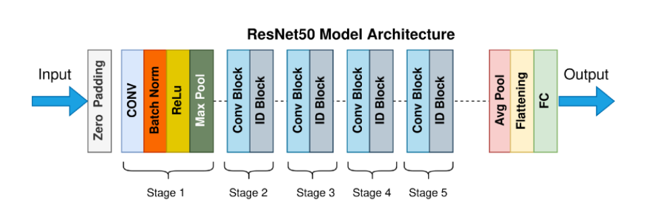
ResNet50
Resnet50 is a convolutional neural network (CNN) that is 50 layers deep. A Residual Neural Network (ResNet) is an Artificial Neural Network (ANN) of a kind that stacks residual blocks on top of each other to form a network[18]. A ResNet50 model was pretrained on a million images from the ImageNet database and can classify images into 1000 object categories. Based on this new dataset of CT images, a transfer learning model was adapted to significantly shorten the training time and improve the accuracy.

Slide 10
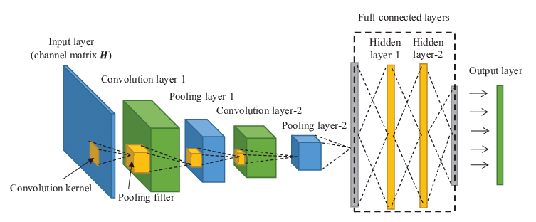
CNN
A Convolutional Neural Network is a Deep Neural Network (DNN) widely used for the purposes of image recognition and processing and NLP. Also known as a ConvNet, a CNN has input and output layers, and multiple hidden layers, many of which are convolutional. In a way,CNN’ss are regularized multilayer perceptrons.

Slide 11
Input currency note
Pre-processing
Training
Model
Dataset
Validation
CNN
Feature extraction and Reduction
Testing
Fully connected Layer
Classification(Neural Networks)

Slide 12
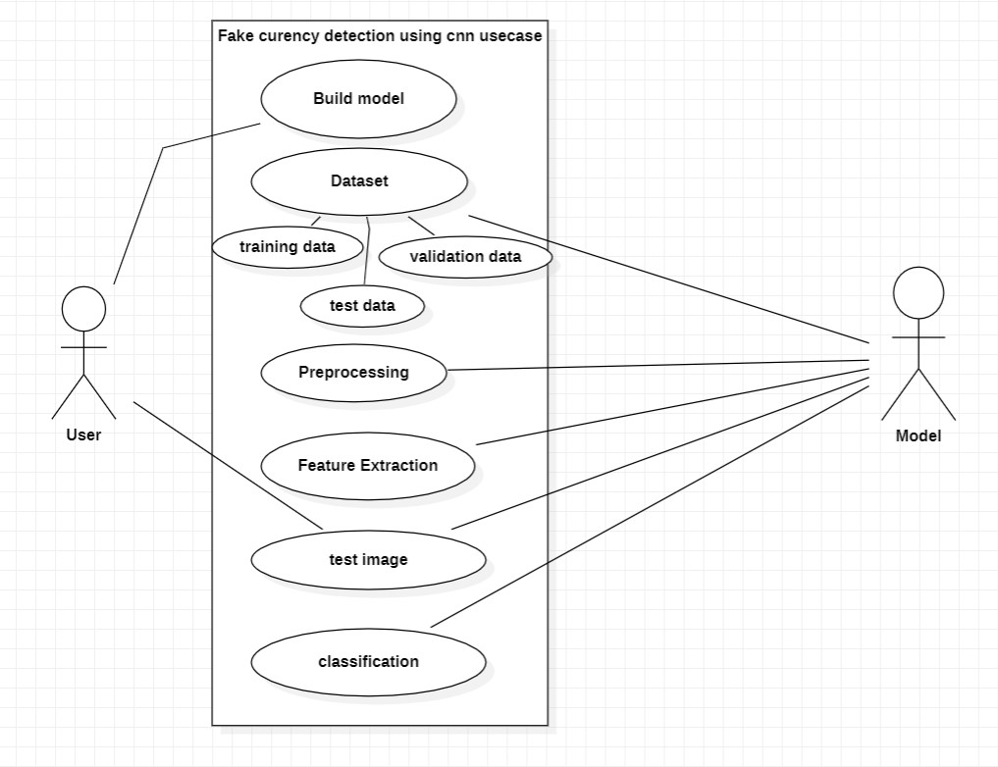
Use case diagram

Slide 13
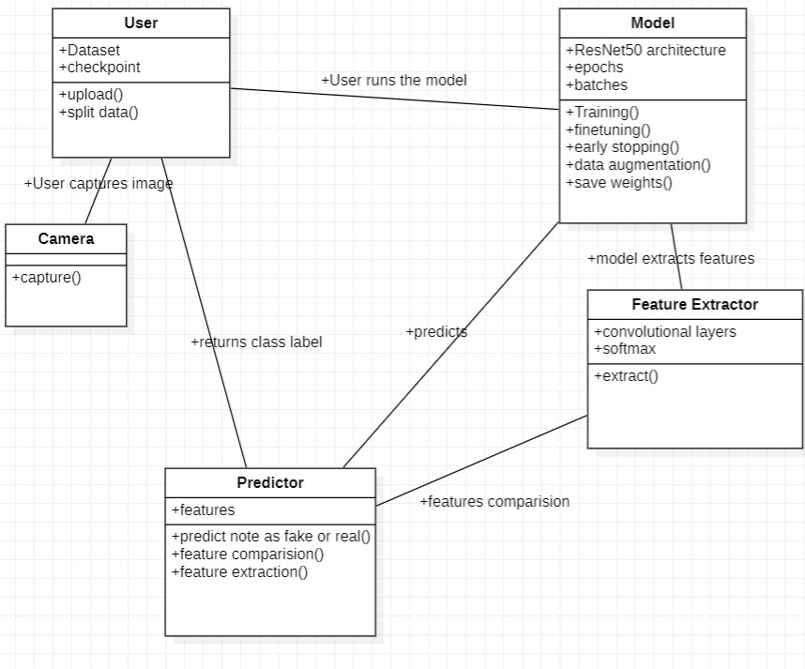
Class diagram

Slide 14
CODING RESULTS
Training accuracy of batch sizes 32, 64, and 128 for ResNet Model
OPTIMISATION | BATCH SIZE 32 | BATCH SIZE 64 | BATCH SIZE 128
SDG | 91.2 | 92.5 | 93.2

Slide 15
CODING RESULTS
Testing accuracy of batch sizes 32, 64, and 128 for ResNet Model
OPTIMISATION | BATCH SIZE 32 | BATCH SIZE 64 | BATCH SIZE 128
SDG | 93.1 | 93.3 | 93.6

Slide 16
CODING RESULTS
Training Loss of batch sizes 32, 64, and 128 for ResNet Model
OPTIMISATION | BATCH SIZE 32 | BATCH SIZE 64 | BATCH SIZE 128
SDG | 2.66 | 0.03 | 0.03

Slide 17
CODING RESULTS
Testing Loss of batch sizes 32, 64, and 128 for ResNet Model
OPTIMISATION | BATCH SIZE 32 | BATCH SIZE 64 | BATCH SIZE 128
SDG | 1.06 | 1.30 | 1.4

Slide 18
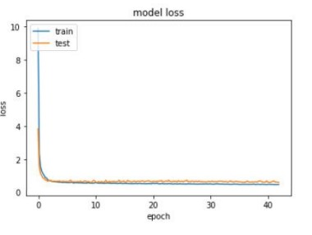

Slide 19
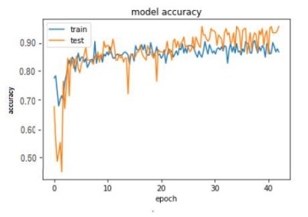

Slide 20
Thank you

