Slide 1
Data Analyst Internship Portfolio
Hasini Lavanga

Slide 2
Internship Overview
During this internship, I worked on multiple data analytics projects covering data cleaning, exploratory data analysis, business intelligence, dashboard development, and time series forecasting.
Technologies Used
Python
Pandas
NumPy
Matplotlib
Seaborn
Scikit-learn
Statsmodels
Git
GitHub
VS Code
Internship Objectives
Analyze real-world datasets
Generate business insights
Build interactive dashboards
Apply forecasting techniques
Present findings effectively

Slide 3
Task 1 – Data Immersion & Wrangling
Objective
Perform data cleaning and exploratory analysis to understand dataset structure, trends, and patterns.
Activities Performed
Imported and explored dataset
Handled missing values
Removed duplicates
Performed data transformation
Generated summary statistics
Created visualizations for trend analysis
Skills Demonstrated
Data Cleaning
Data Wrangling
Exploratory Data Analysis
Data Visualization
Outcome
Successfully transformed raw data into a clean and analysis-ready dataset.

Slide 4
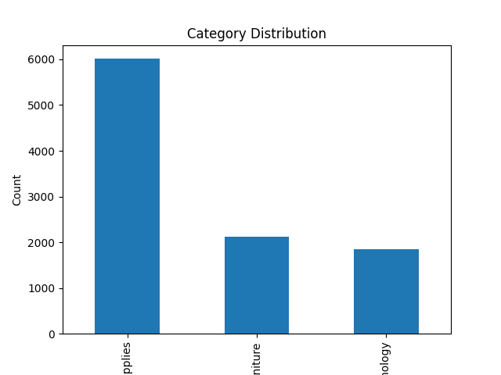

Slide 5
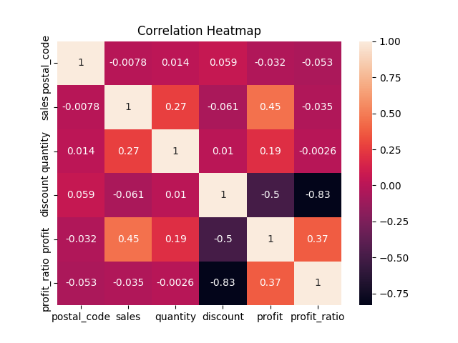

Slide 6
Task 2 – Exploratory Data Analysis (EDA) & Business Intelligence
Objective
Analyze business data to uncover meaningful insights and support decision-making.
Activities Performed
Defined business KPIs
Analyzed sales performance
Evaluated profitability trends
Studied customer and product behavior
Created analytical visualizations
Skills Demonstrated
KPI Analysis
Business Intelligence
Data Storytelling
Visualization Design
Outcome
Generated actionable insights from business data through visual analytics.

Slide 7
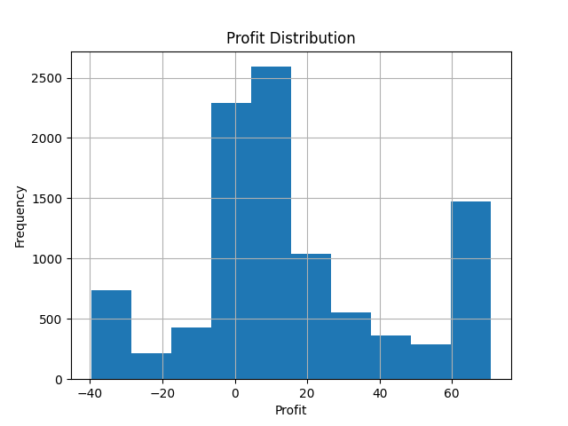
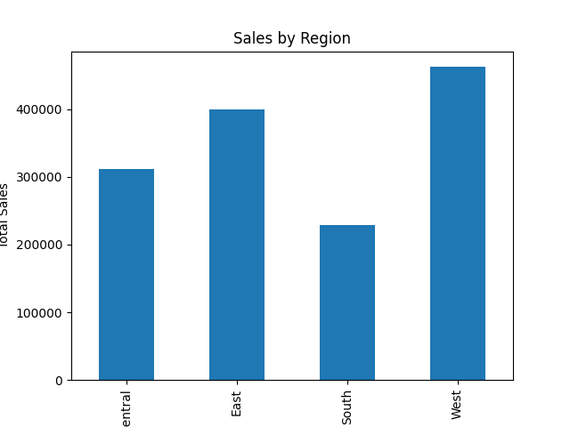
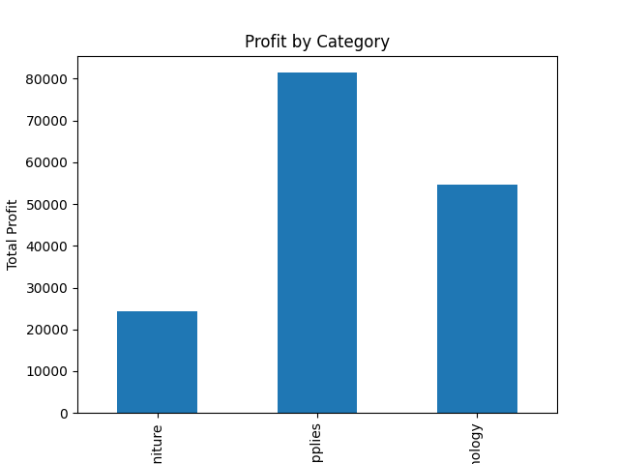
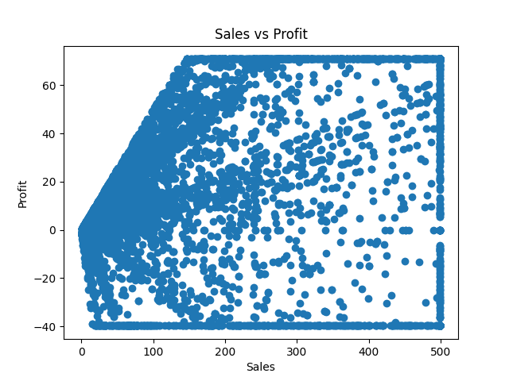

Slide 8
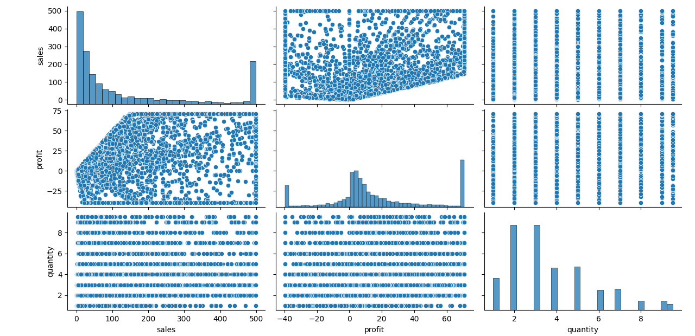

Slide 9
Task 3 – Deep-Dive Analysis & Interactive Dashboarding
Objective
Design and develop an interactive dashboard for business performance monitoring.
Activities Performed
Created dashboard layout
Designed visual reports
Implemented filters and interactions
Summarized business metrics
Skills Demonstrated
Dashboard Design
Interactive Reporting
Business Visualization
Data Presentation
Outcome
Built a dashboard that enables users to explore business performance efficiently.

Slide 10
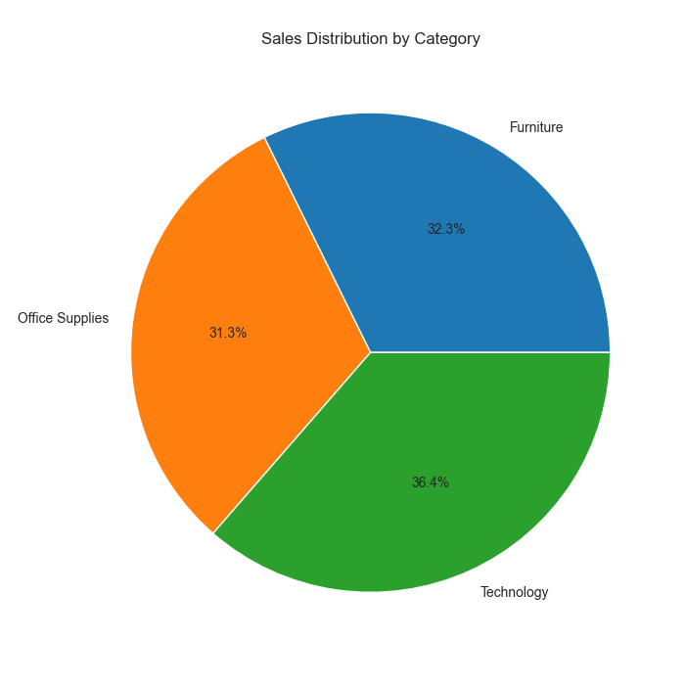
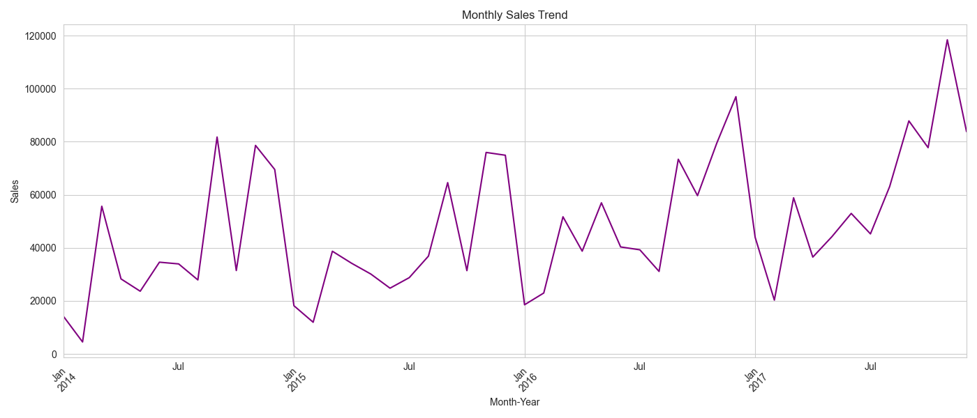
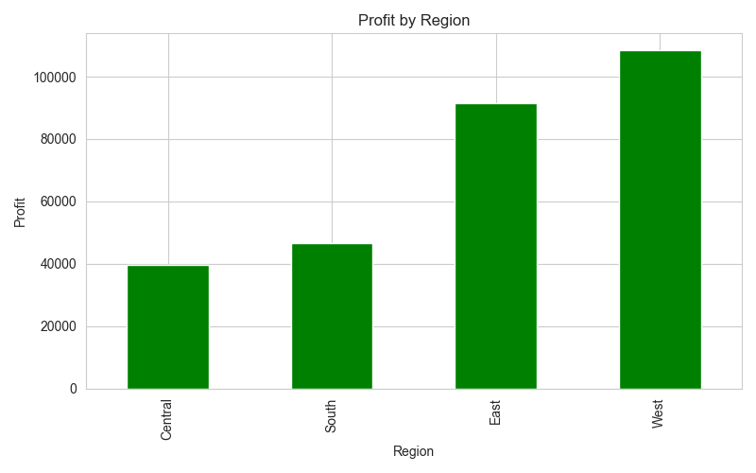
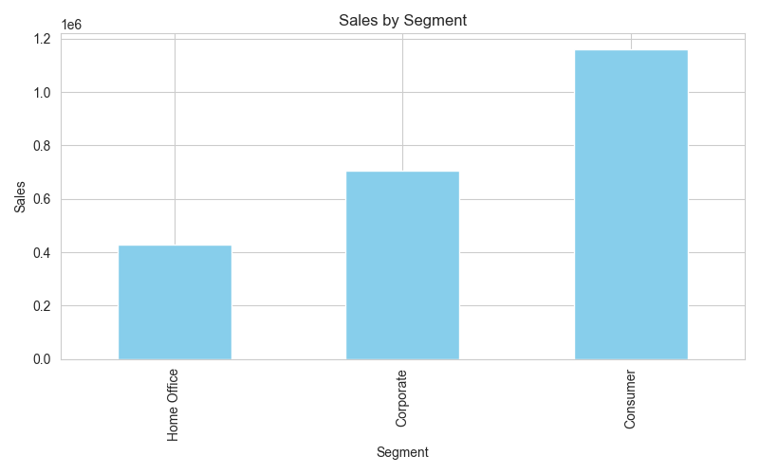
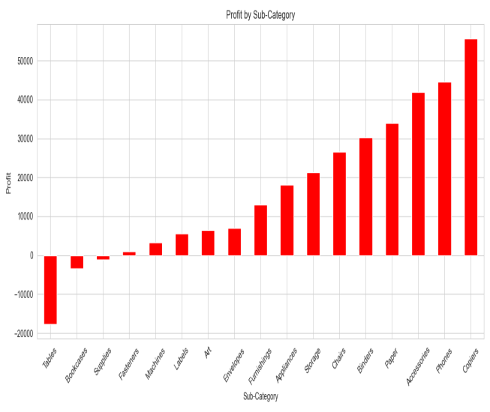

Slide 11
Task 4 – Data Storytelling & Statistical Validation
Objective
Develop forecasting models to predict future trends using historical data.
Activities Performed
Prepared time series data
Performed trend analysis
Built forecasting models
Evaluated model performance
Generated future predictions
Skills Demonstrated
Time Series Analysis
Forecasting
Predictive Analytics
Model Evaluation
Outcome
Successfully predicted future trends using forecasting techniques and model evaluation metrics.

Slide 12
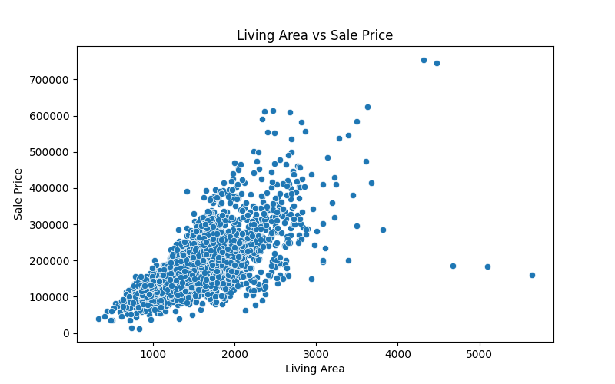
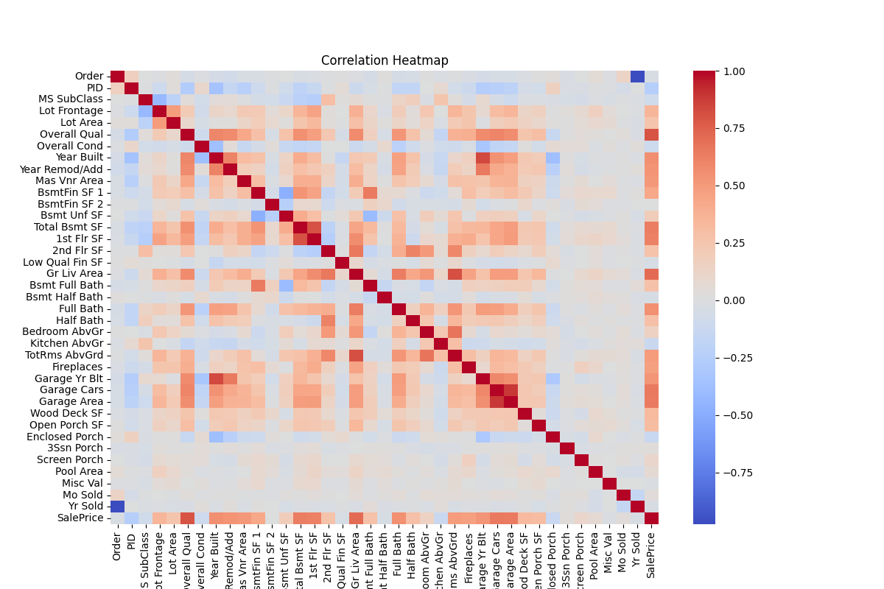

Slide 13
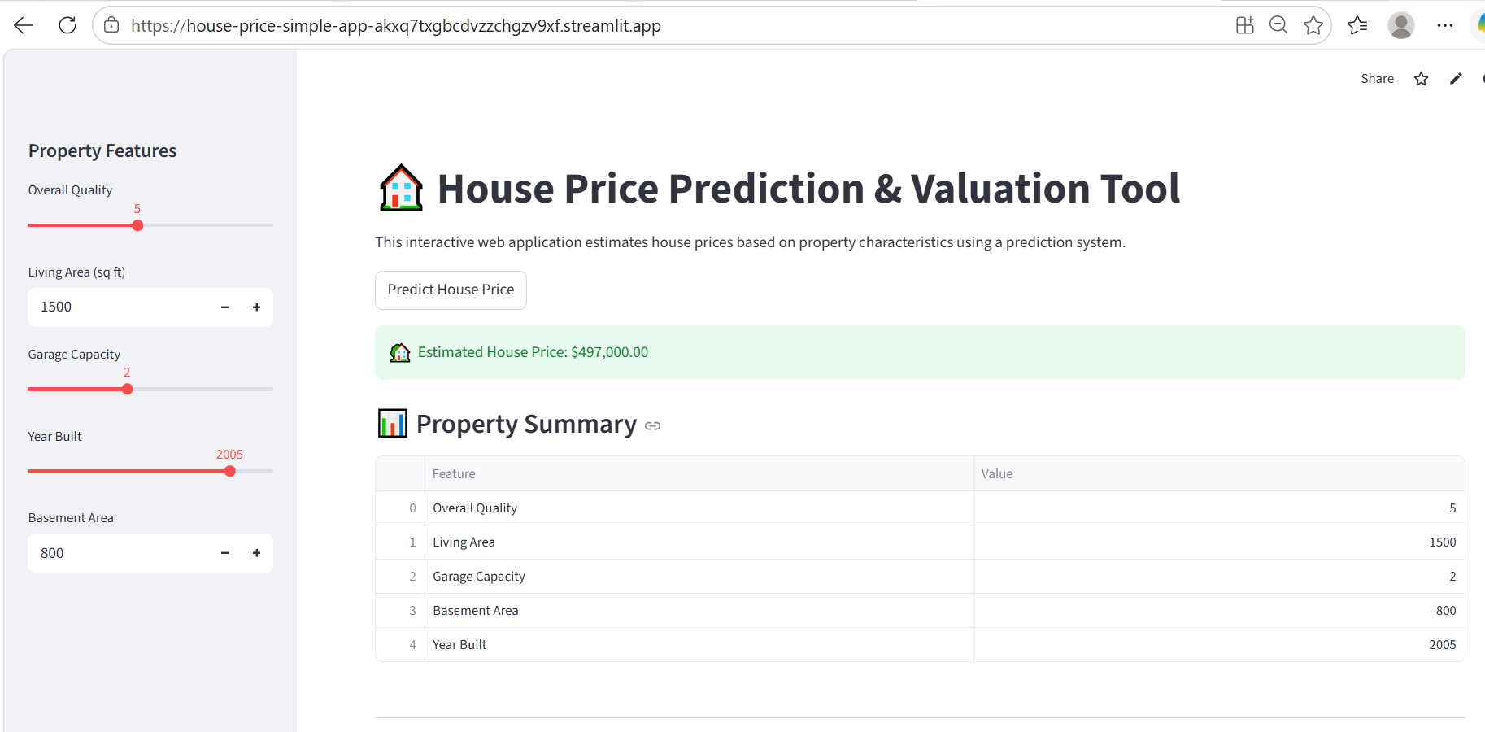

Slide 14
Technical Skills Demonstrated
Programming
Python
Data Analysis Libraries
Pandas
NumPy
Visualization Libraries
Matplotlib
Seaborn
Machine Learning & Forecasting
Scikit-learn
Statsmodels
Tools & Platforms
VS Code
Git
GitHub

Slide 15
Key Learnings
Technical Learnings
Data Cleaning and Preparation
Exploratory Data Analysis
Statistical Analysis
Dashboard Development
Forecasting Techniques
Professional Learnings
Problem Solving
Analytical Thinking
Data Storytelling
Documentation
Version Control with Git
Outcome
Strengthened practical data analytics skills through hands-on project experience.

Slide 16
Portfolio Repository & Project Links
Master Portfolio Repository
This portfolio repository contains:
https://github.com/HasiniLavanga/Data-Wrangling-ApexPlanet
https://github.com/HasiniLavanga/EDA-Business-Intelligence-ApexPlanet
https://github.com/HasiniLavanga/superstore-sales-dashboard-analysis
https://github.com/HasiniLavanga/house-price-simple-app
Highlights
End-to-End Data Analytics Workflow
Business Insights Generation
Dashboard Development
Forecasting Project

Slide 17
Conclusion
This internship provided valuable hands-on experience in data analysis, visualization, dashboarding, and forecasting.
The projects completed during this internship strengthened my technical and analytical skills while improving my ability to solve real-world business problems using data.
Thank you

