Slide 1
Team Haptix 2.0 Capstone Project Update

Slide 2
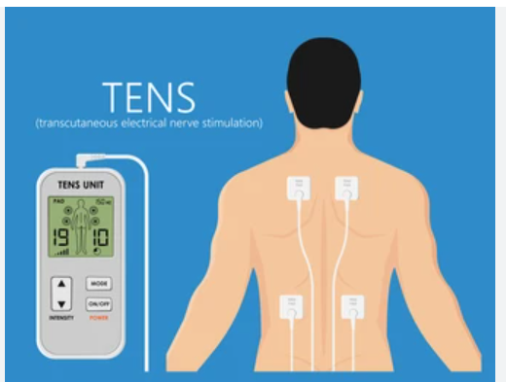
Application Update
Haptix for Physiotherapy/Pain relief
Existing Application
TENS - https://uihc.org/health-topics/transcutaneous-electrical-nerve-stimulator-tens

Slide 3
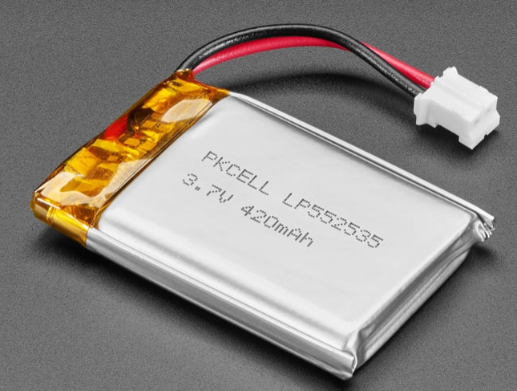
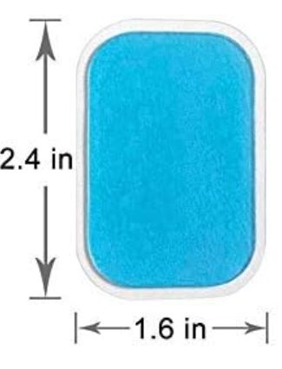
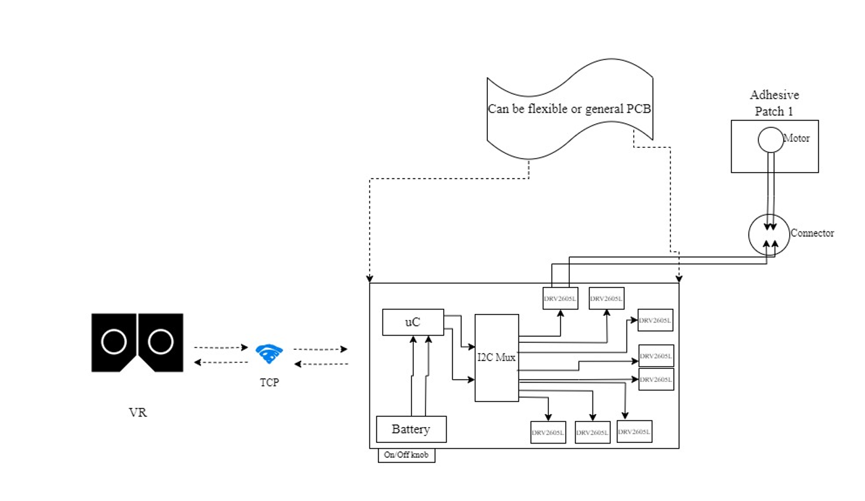
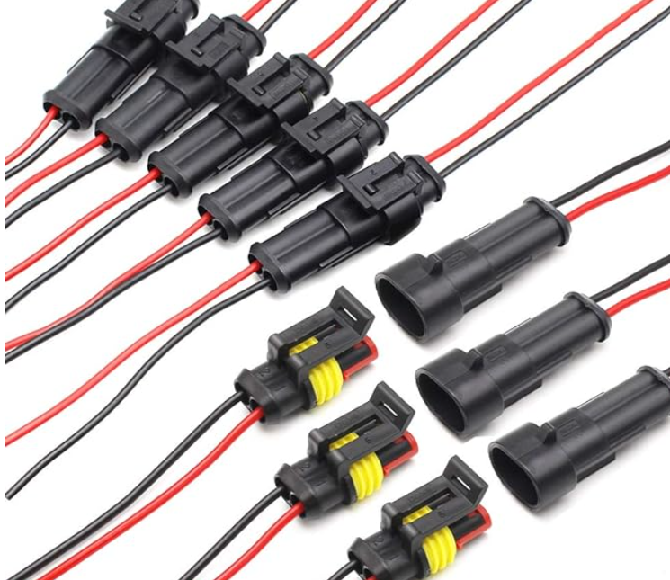
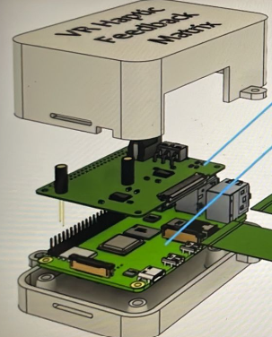
System Design

Slide 4
Components & Communication
Components
DRV2605L
Actuator – Tested ERM
I2C mux – TCA9548A
Controller – ESP32
Battery - LiPo
Power knob
Adhesive patch
Connectors
VR
Communication
I2C
TCP

Slide 5
Voltage, Current, Power requirements
ERM motor:
Voltage supply – 2 to 5v
Current drawn by the motor – 40-80mAmp
Power – 80-400mW
ESP32
Voltage supply – 2 to 5v
Current drawn by the ESP32 – 80-130mA (without Wifi)
Start up no WiFi 40-45mA, Flash Mode 20-25mA, With WiFi 120-125mA
Power - 481mW (with Wifi)
DRV2605L
Voltage supply – 2 to 5.2v
Current drawn by the DRV2605L – 10mA to 30mA
Power - 2.2mW

Slide 6
Contd…
TCA9548A
Voltage supply –1.65V to 5.5V
Current drawn by the motor – 3μA (inactive) to 600μA (active)
Power - 15μW to 3mW

Slide 7
Motor types – ERM, LRA, FEA

Slide 8
PCB designing
Followed tutorials on schematic and PCB layout. Need support with routing and further steps.

