Slide 1
Team Haptix 2.0 Capstone Project Update

Slide 2
Driver updates
DRV8833
DRV2603
But not for Haptic applications. Supports servo motors.
DRV2605 & DRV2605L – Haptic drivers with ERM motors

Slide 3
Power calculations
Tested with 3.3v, 170mAh battery.
Initial battery - 3.869v (actually 4.2v according to datasheet)
Same Battery connected to ESP32 and other circuit
Battery voltage – 3.7v
Run time – 1hr
When voltage drops to 3.57v, ESP32 went to sleep mode.
Entire circuit draws 0.169Amps ~ 170mA
Separate Battery connected to ESP32 and Other circuit
Battery voltage – 3.81v
Run time – 1hr 20 mins
The circuit was working till 3.3v battery but below 3.5v, some On-board LEDs of driver are fluctuating. Not sure if its because of loose connections on bread board.

Slide 4
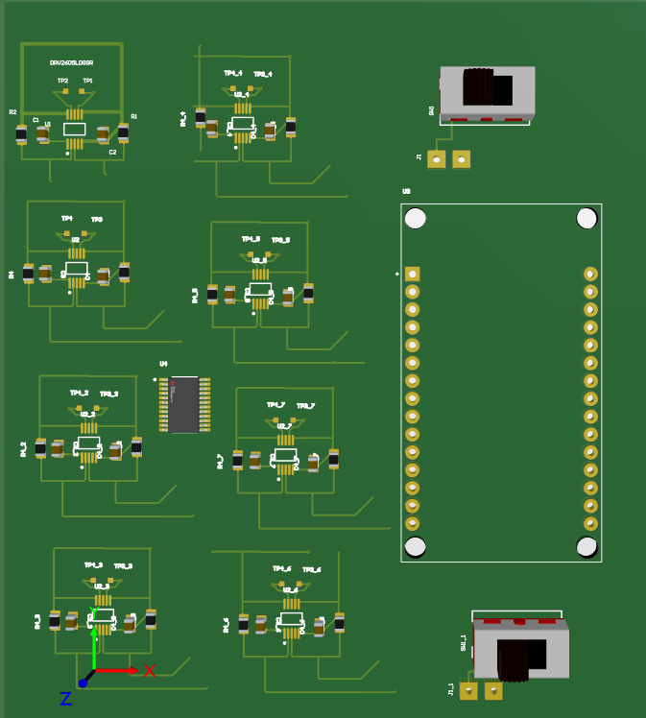
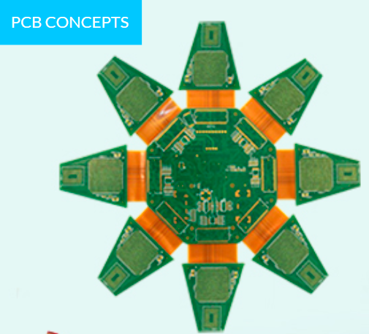
PCB Layout
Flex Rigid PCB
Rigid PCB - 10x8 Cm

Slide 5
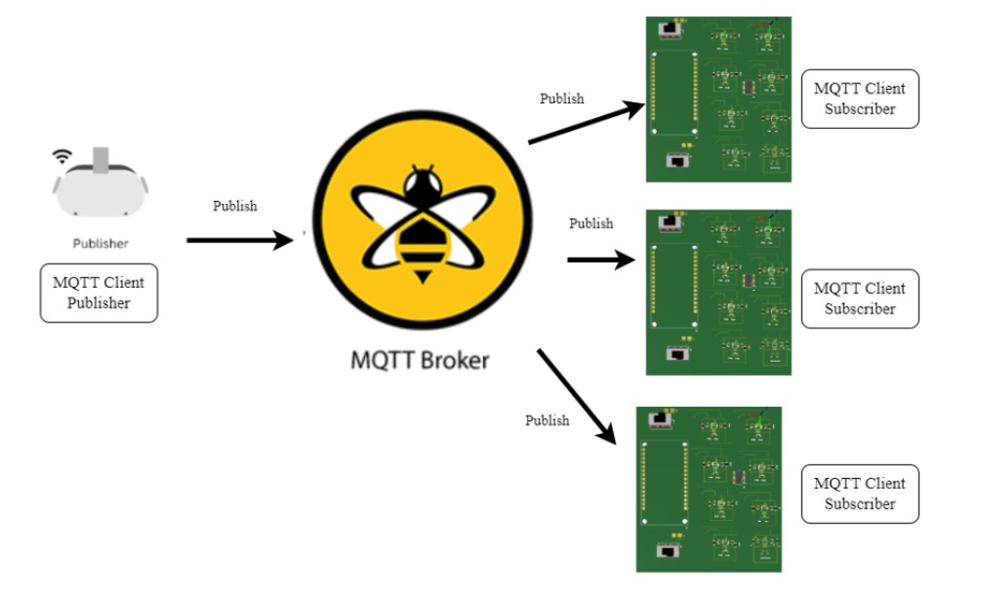
Software Flow

Slide 6
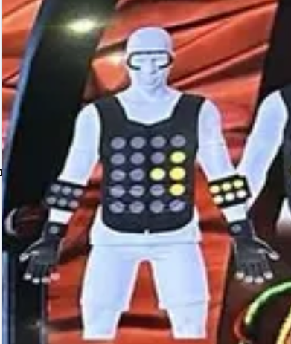


Fall Implementation
VR application with a virtual environment room that has some objects like desk, pen, book.
When any object is touched in VR environment, person can feel the touch.
Properties: Different Intensities different vibrations.
Ripple effect in VR when any object is touched.
Band with Haptic actuators
Haptic Glove

Slide 7
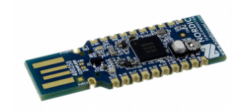
BT update
nRF52840 SoC

