Slide 1


Noninvasive Thalamocortical Neuromodulation with Low-Intensity Focused Ultrasound for Persistent Developmental Stuttering
Hasini Weerathunge, PhD
Postdoctoral Fellow, University of Michigan
Notes:
This study aims to establish an individualized workflow to probe the causal thalamocortical mechanisms underlying persistent developmental stuttering.

Slide 2
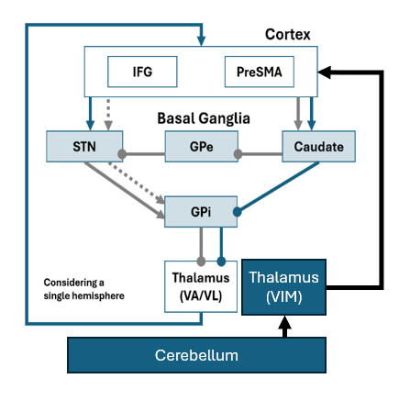


Can we causally perturb speech-motor circuitry in stuttering?
Persistent developmental stuttering has been associated with altered cerebellar and basal ganglia–thalamocortical networks involved in speech sequencing and timing.
We targeted the ventral intermediate thalamus using MRI-guided low-intensity focused ultrasound.
Research question: Does VIM-LIFU alter neural, behavioral, and speech measures related to speech motor control?
LIFU Stim
The VIM is a cerebellar-receiving motor-thalamic node whose projections intersect with cortical regions participating in basal-ganglia–thalamo-cortical speech-control loops.
Cortico-basal-ganglia and cerebellar- thalamocortical pathways
Correlational circuit evidence → Causal neuromodulation
Notes:
Persistent developmental stuttering has been associated with altered basal ganglia–thalamo–cortical and cerebello–thalamo–cortical circuits involved in speech timing, sequencing, and response control.
However, much of this evidence is correlational. Our question is whether we can perturb one deep node in these circuits and observe measurable behavioral and neural consequences.
We focus on the left ventral intermediate nucleus of the thalamus, or VIM, thalamus—because it provides a clinically and experimentally motivated entry point into motor thalamocortical circuitry.
We use low-intensity focused ultrasound, or LIFU, to test whether perturbing VIM changes speech fluency, motor timing, response inhibition, and neural functional connectivity between cortical and subcortical nodes of thalamocortical circuits.

Slide 3

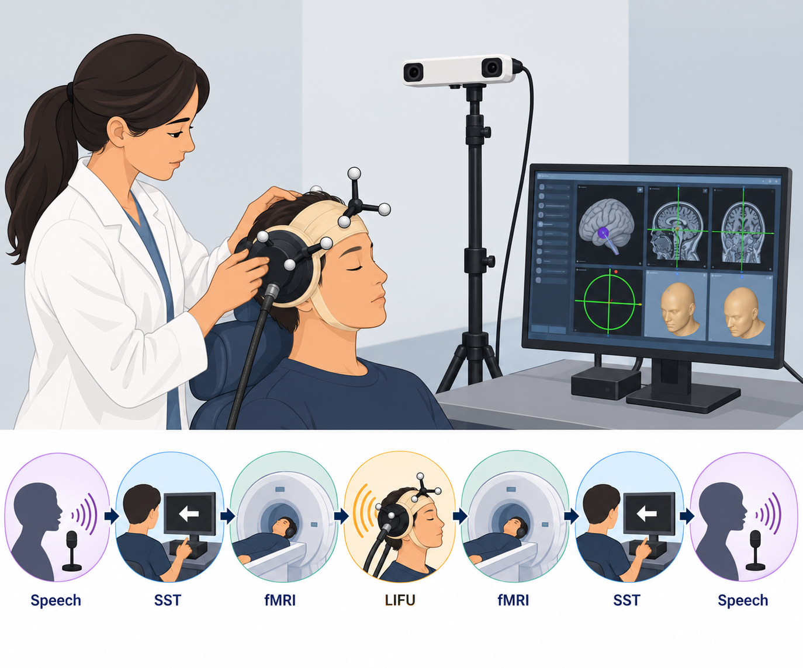

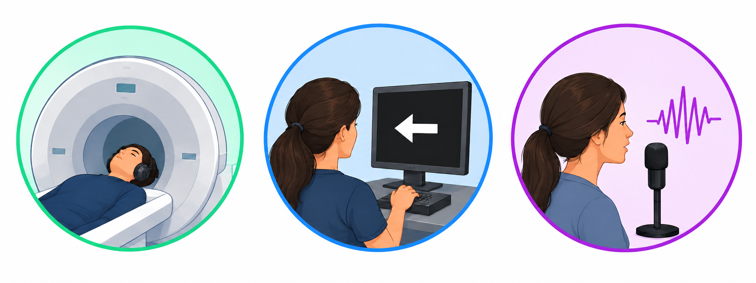
ClinicalTrials.gov
OSF Preregistration
NCT07668882
Within-participant active–sham VIM-LIFU study
Preliminary N = 2
Speech
Behavioral
Neural
LIFU
Neural
Behavioral
Speech
Neural
rsfMRI
Task fMRI (SST)
BrainSight
Neuronavigation
Functional connectivity
Functional connectivity during task
Beat-Based Advantage (BBA)
Stop Signal Task (SST)
Behavioral
Speech motor timing
Response inhibition
Speech
% Stuttered Syllables in Speech
LIFU Stimulation: BrainSonix transducer/BXPulser 1002; 650 kHz, 10 Hz PRF, 100 ms pulses, 70% duty cycle, 12 blocks of 30 s ON / 30 s OFF stimulation, targeted to the left VIM.
Notes:
We are conducting an MRI-guided, within-participant active-versus-sham pilot study in adults with persistent developmental stuttering.
The left VIM target is individualized using structural MRI. Participants receive either active or sham LIFU, followed by pre- and post-stimulation assessments.
These assessments include the neural, behavioral, and speech outcomes.
Percent stuttering severity in speech,
Stop-Signal Task, which measures response inhibition; the Beat-Based Advantage Task, which measures rhythm-discrimination sensitivity;
and resting-state as well as task based functional connectivity.
The central prediction is that active VIM-LIFU will produce condition-specific changes in connectivity within speech-motor circuits, behavioral variations in response control, motor timing, as well as modulation of speech fluency.

Slide 4
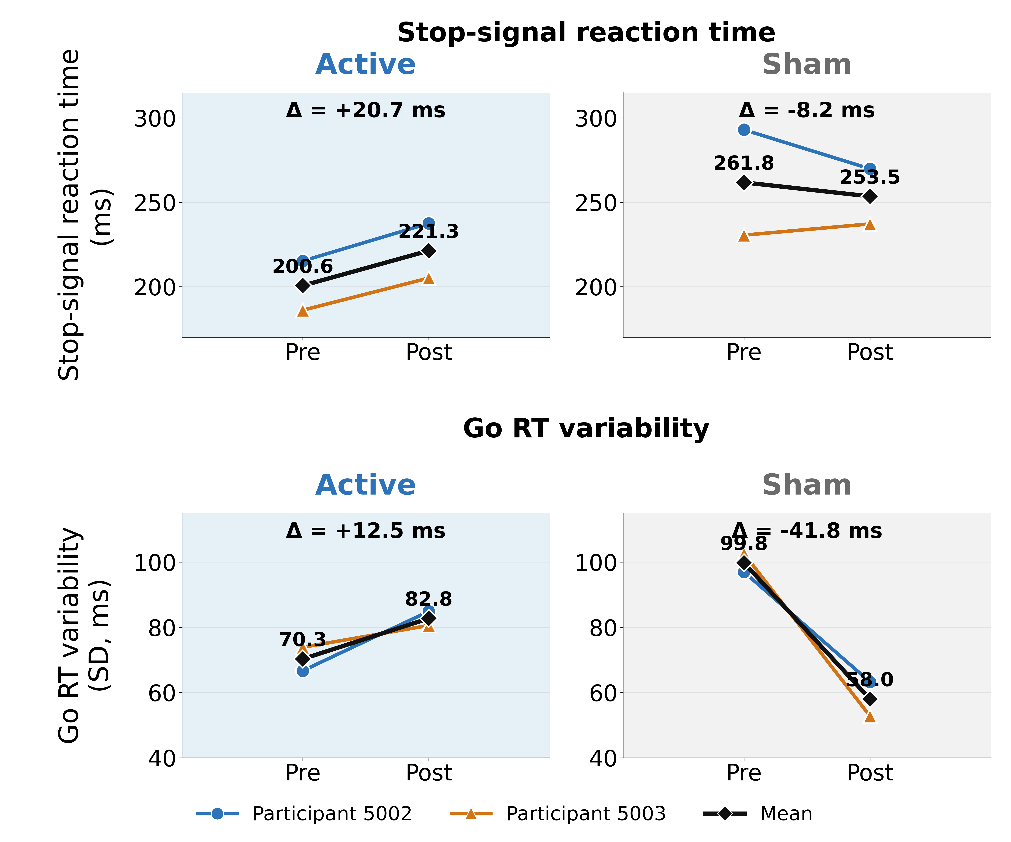
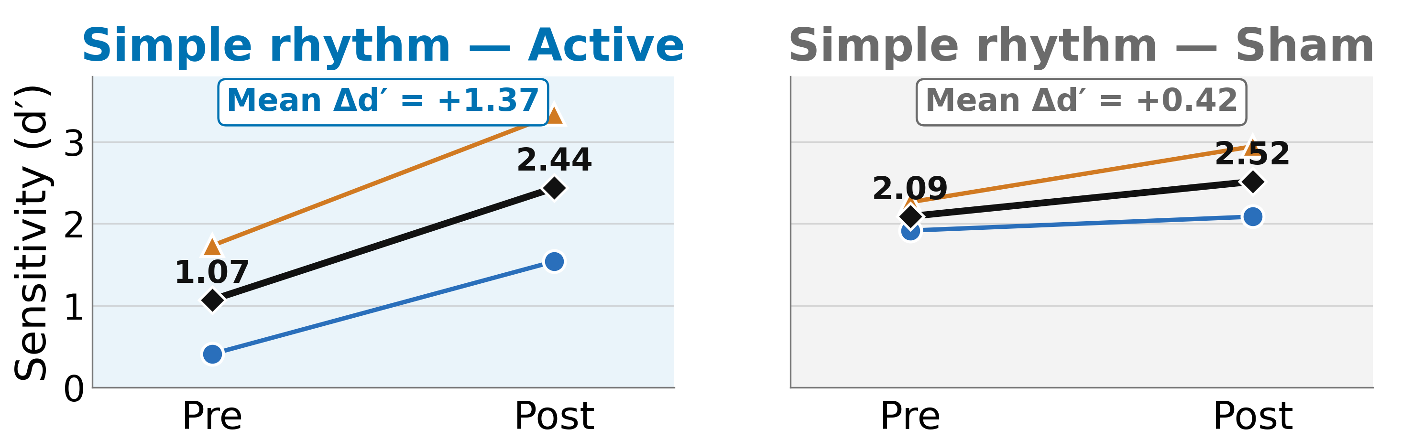
Preliminary behavioral and neural effects of VIM-LIFU
Preliminary N = 2
Stop Signal Task (SST)
Response inhibition
Beat-Based Advantage (BBA)
Speech motor timing
rsfMRI
Functional connectivity
Notes:
These are preliminary findings from the first two participants, so we are presenting them descriptively rather than as group-level inference.
Behaviorally, active LIFU appears to alter response-control dynamics relative to sham.
We also see an early pattern suggesting enhanced discrimination of simple rhythms after active stimulation.
In the resting-state data, using the stimulated coordinates of the left VIM as a seed, we observe preliminary pre–post changes in connectivity with inferior frontal regions, including triangular and opercular subdivisions of the inferior frontal gyrus.
However, Preliminary findings remain heterogeneous across participants
This gives us an early indication that VIM-LIFU may influence both behavior and distributed cortical circuitry.
These results are not yet definitive, but they establish feasibility and motivate completion of the pilot.
The take-home message is that MRI-guided VIM-LIFU provides a way to move from correlational circuit differences in stuttering toward a causal, multimodal test of speech-motor networks.

Slide 5

Visit Our Poster
Hasini Weerathunge¹, Hyunwoo Jang², Emily Garnett¹, Yanni Liu¹, Zirui Huang², Soo-Eun Chang¹
¹Department of Psychiatry, ²Department of Anesthesiology; University of Michigan, Ann Arbor, MI

