Slide 1

SREYAS INSTITUTE OF ENGINEERING & TECHNOLOGY
(AUTONOMUS)
(Approved by A.I.C.T.E.,New Delhi., Affiliated to JNTUH Hyderabad, Accredited by NAAC ‘A’ Grade & NBA)
DEPARTMENT OF COMPUTER SCIENCE ENGINEERING(AI&ML)
Stress Sense
Presented by
B.Bhavitha
D.Grahita
N.Hasini
V.Sumshaya
B.Tejasvi
P.Vyshnavi
Notes:
1

Slide 2



Stress Sense: Understand, Track, Reduce
A comprehensive platform designed to support student mental well-being throughout academic life through understanding stress patterns, tracking daily levels, and providing evidence-based tools for meaningful stress reduction.
Notes:
2

Slide 3

Supporting Student Well-Being Through Technology
Stress Sense combines evidence-based mental health practices with modern technology to create a safe and supportive digital environment. The platform empowers students to reflect on their mental state, recognize stress triggers, and take timely action.
By promoting self-awareness and balance, Stress Sense encourages healthier academic and personal lives while maintaining privacy and building trust.
Evidence-Based
Student-Focused
Safe Environment
Built on proven mental health practices and research
Designed specifically for academic life challenges
Privacy-first approach with ethical data practices
Notes:
3

Slide 4
Core System Modules
Each module addresses a specific aspect of student mental health to form a holistic support system that guides students from awareness to action.
01
02
Daily Stress Check-In
Stress Trigger Identification
Quick daily assessments to monitor current stress levels and emotional state through simple, non-intrusive questions.
Analyzes patterns to identify and explain key causes of student stress, from academic pressure to personal challenges.
03
04
Stress Dashboard
Self-Help Tools
Visualizes stress trends, levels, and insights over time with intuitive charts and personalized analytics.
Provides calming activities and evidence-based stress-reduction resources available anytime, anywhere.
Notes:
4

Slide 5
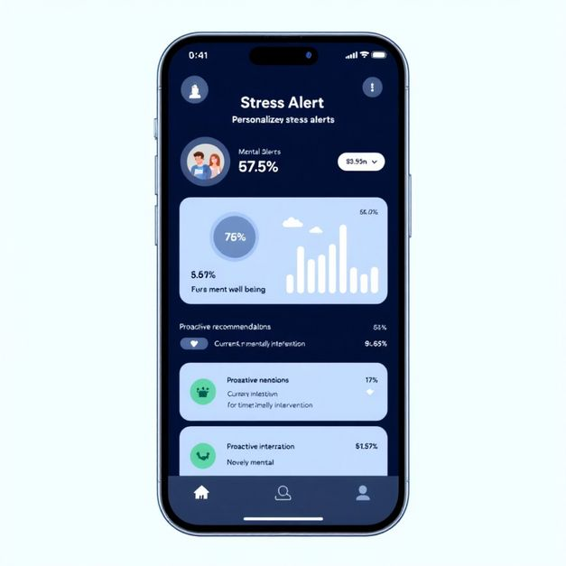
Stress Analysis, Scoring & Early Warning System
Personalized Stress Assessment
Students answer questions related to workload, sleep quality, mood, and focus to generate a personalized stress score reflecting current mental well-being.
When stress reaches concerning levels, the Early Warning System proactively notifies students with specific date and time details, enabling timely intervention and self-care actions.
Personalized Insights
Proactive Alerts
Prevention-Focused
Tailored feedback based on individual patterns and responses
Timely notifications when intervention may be beneficial
Early identification to address stress before it escalates
Notes:
5

Slide 6




Reduce Stress with Supportive Tools
Stress Sense offers a curated set of anti-stress and self-help tools designed to promote calmness without pressure, competition, or judgment. These activities help students reset mentally and build emotional resilience.
Mental Relaxation
Daily Affirmations
Calming Exercises
Logic puzzles and word games designed to redirect focus and provide gentle mental engagement
Mindfulness tips and positive affirmations to cultivate self-compassion and perspective
Simple breathing techniques and relaxation exercises for immediate stress relief
No pressure, no competition—only well-being. Every tool is designed to support, not to measure or compare.
Notes:
6

Slide 7



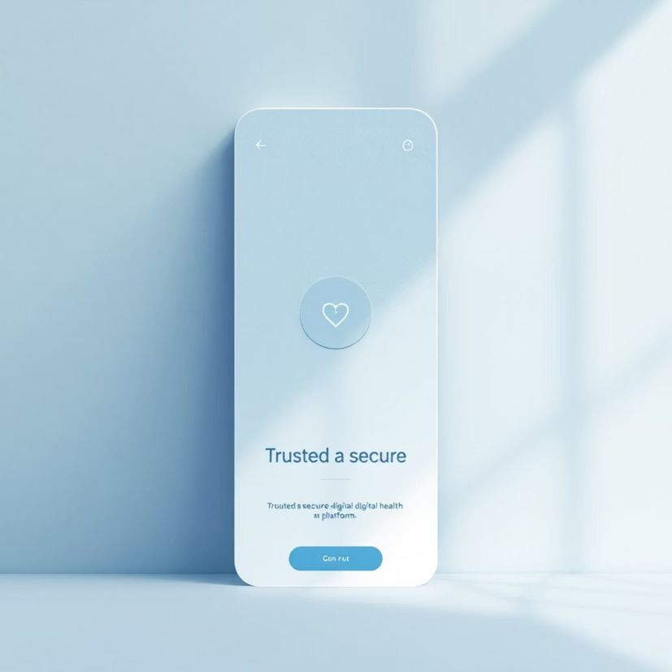
Privacy, Ethics & User Trust
Stress Sense is built with strong ethical principles and data protection standards at its foundation. Student safety, confidentiality, and autonomy guide every design decision.
User Consent
Secure Storage
Transparency
Transparent data collection with clear consent and control
Confidential, encrypted data handling with ethical usage policies
Authentic insights with clear explanations and user empowerment
Stress Sense prioritizes student trust, safety, and well-being above all.
Your mental health journey is personal, private, and entirely in your control.
Notes:
7

