Slide 1
HTTP Security Headers
IT19952376
S.A.D.H. Vishwajith

Slide 2



content
What are HTTP Security Headers
HTTP Security Headers
HTTP Strict Transport Security (HSTS)
X-Frame-Options
Cross Site Scripting Protection (X-XSS)
How HTTP Security Headers Can Improve Web Application Security

Slide 3

What are HTTP Security Headers
HTTP security headers are a fundamental part of website security. Upon implementation, they protect you against the types of attacks that your site is most likely to come across.

Slide 4

HTTP Strict Transport Security (HSTS)
It helps to protect websites against man-in-the-middle attacks and cookie hijacking

Slide 5
How works HSTS
Strict-Transport-Security: max-age=31536000
Strict-Transport-Security: max-age=31536000; includeSubDomains
Strict-Transport-Security: max-age=0

Slide 6
Why HSTS is important
It will guide the browser
It protect user against passive eavesdropper
Prevent some classes of man-in-the-middle (MITM) attacks

Slide 7
Which vulnerability can hsts prevent
Man-in-middle attacks
Eavesdropping attacks

Slide 8
Advantages of hsts
Protection against HTTP downgrade attacks (SSL stripping attacks) by requiring all traffic to utilize HTTPS.
Mixed content defence.
Better security in general: An HSTS-compliant browser aborts the connection to an HSTS-compliant server whenever the security of a certificate can't be confirmed

Slide 9
Disadvantages of hsts
HSTS is not a compensating control for having application functionality accessible over HTTP.
HSTS cannot prevent a MITM attack on the first visit to a website.
HSTS can be issued over HTTPS only

Slide 10

X-Frame-Options
Used to tell a browser whether or not a page should be rendered in a frame or iframe

Slide 11
How works xfo
X-Frame-Options : DENY
X-Frame-Options : SAMEORIGIN

Slide 12
Why xfo is important
Prevent click-jacking attacks
It allows content publishers to prevent their own content

Slide 13
Which vulnerability can xfo prevent
Clickjacking attacks

Slide 14
Advantages of xfo
X-Frame-Options allows content publishers to prevent their own content from being used in an invisible frame by attackers.
The DENY option is the most secure, preventing any use of the current page in a frame. More commonly, SAMEORIGIN is used, as it does enable the use of frames, but limits them to the current domain.

Slide 15
disAdvantages of xfo
Does not support a whitelist of allowed domains
Only one option can be used on a single page
The ALLOW-FROM option is not supported by all browsers
deprecated option in most browsers

Slide 16

Cross Site Scripting Protection (X-XSS)
These header detect dangerous HTML input and either prevent the site from loading or remove potentially malicious scripts

Slide 17
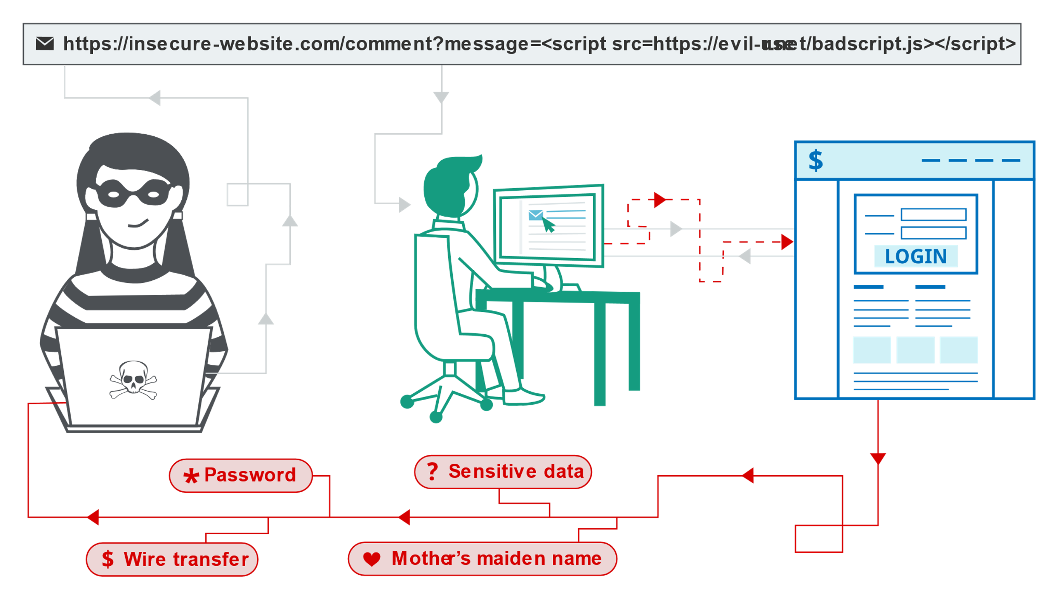
How works xss

Slide 18
Why xss is important
It helps prevent Cross-Site Scripting

Slide 19
Which vulnerability can XSS prevent
Cross-Site scripting

Slide 20
Advantages of xss
Free Usually have a narrow focus, but do the job well Wide variety to choose from: you can use many simultaneously

Slide 21
Disadvantages of xss
Low to medium quality in most cases No centralized support May integrate poorly (or not at all) with other security tools

Slide 22
How HTTP Security Headers Can Improve Web Application Security
HTTP security headers provide an extra layer of security by restricting behaviors that the browser and server allow once the web application is running.

Slide 23
thank You!

