Slide 1

TRANSPORTATION

Slide 2
Transportation
Transportation means the conveyance of goods and passengers from one place to another. It removes the hindrances of place.

Slide 3
Types of Transportation
Land Transport
Water Transport
Air Transport

Slide 4
Land Transport
Land transport is divided in to road transport, rail transport and pipeline transport.

Slide 5
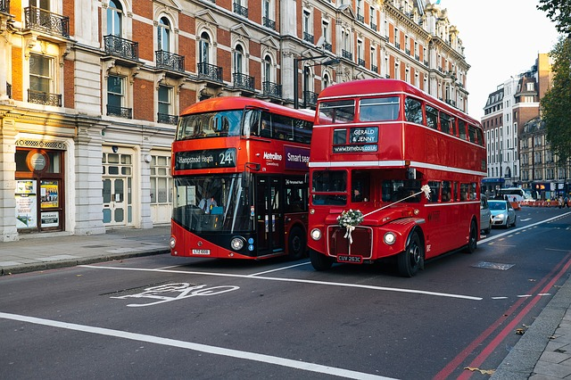
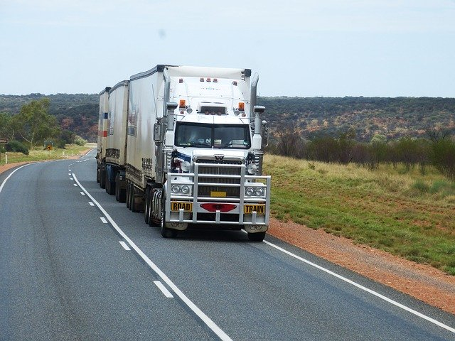
1. Road Transport
This is the oldest and simplest form of transport. It is largely used for carrying goods as well as passengers over a short distance.

Slide 6
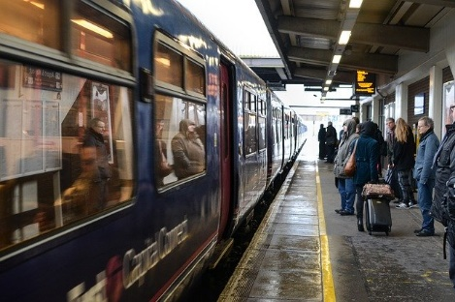
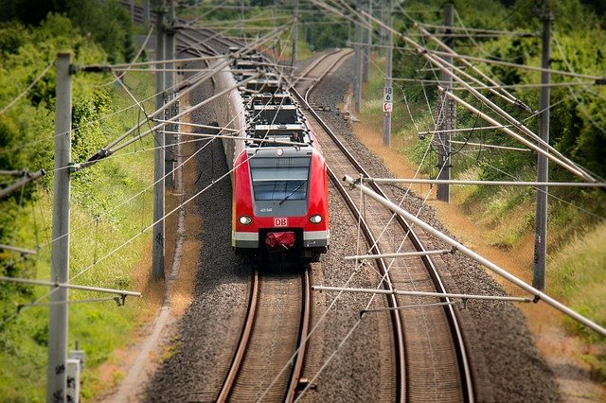
2. Rail Transport
Rail transport is a cheap and quick form of transportation for carrying goods and services over long distance.

Slide 7
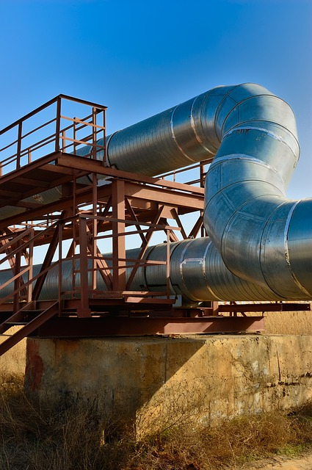
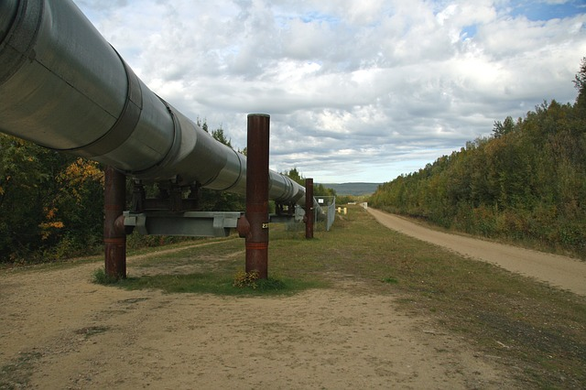
3. Pipeline Transport
This mode of transport is exclusively suited for transportation of liquids and gases.

Slide 8
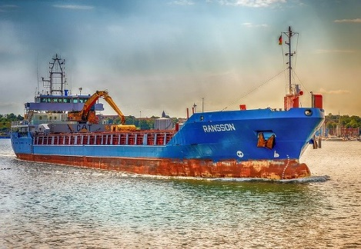
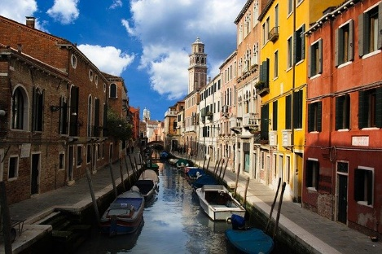
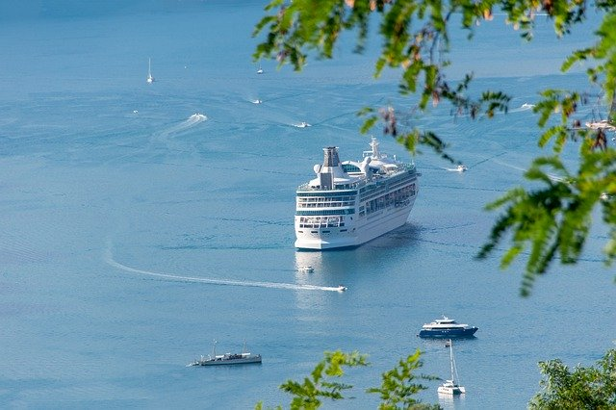
Water Transport
Water transport is the cheapest form of transport. It is broadly divided in inland and ocean transport.

Slide 9
1. Inland Transport
Inland transport refers to transportation through canals, rivers etc. It is deal for transportation of goods in small lots between villages and local markets.

Slide 10
2. Ocean Transport
Ocean transport is the carriage of goods and passengers through oceans. It helps the growth of international trade.

Slide 11
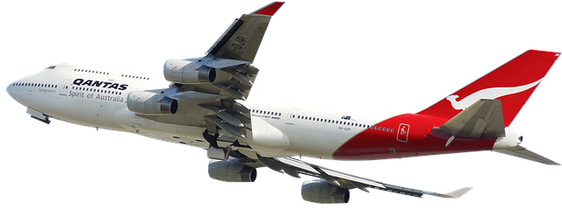
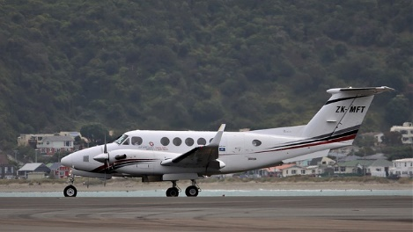
Air Transport
This is the fastest mode of transport. It is used for the movement of passengers and goods having less volume but high value. It has the advantages of high speed.

Slide 12
THANK YOU

