Slide 1







IT Trends
Pedro Henrique Novicov de Andrade
30/08/2024

Slide 2



OUTLINE
Executive Summary
Introduction
Methodology
Results
  Visualization – Charts
  Dashboard
Discussion
  Findings & Implications
Conclusion
Appendix

Slide 3

EXECUTIVE SUMMARY
Over 10k entries to identify the trend of the industry
Most commonly used
  Language: JavaScript
  Database: MongoDB
  Web Frame: React.js
Most desired to work with next year:
  Language: JavaScript
  Database: PostgreSQL
  Web Frame: React.js
Overwhelmingly male respondent base
Overwhelmingly American respondent base

Slide 4

INTRODUCTION
Thousands of respondents from across the world
Technologies currently used were asked:
  Language
  Database
  Web Frame
  Operating System
Technologies to be used next year
Comparison
  Present and Future
  By multiple metrics

Slide 5

METHODOLOGY
Web Scraped data using Python
Exploring the data using SQLite and Python
Cleaning the data for use
Visualization of Data
  Google Looker Studio
  SQLite, Pandas and Seaborn Libraries from Python

Slide 6
RESULTS
There seems to be little shift in the use of any technology with the only one to present a noticeable change being databases with PostgreSQL overtaking MongoDB.
We can see a predominantly male respondent base primarily from the U.S.
We can see the use of Windows, Linux and MacOS still retain the top 3 most used operating Systems.
We were able to gather better insight on the it industry's professionals.

Slide 7
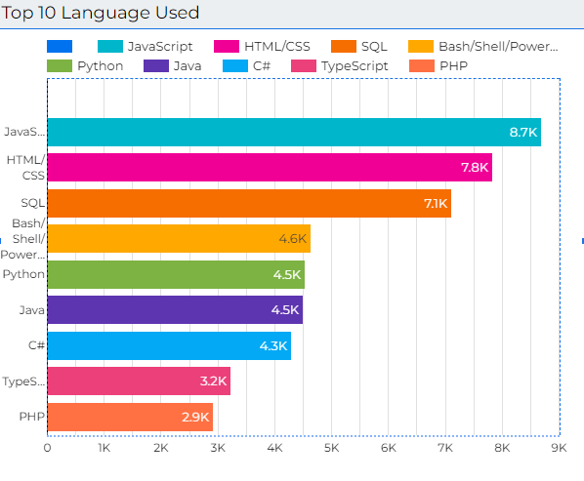
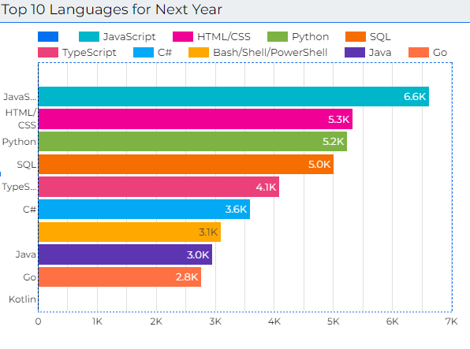
PROGRAMMING LANGUAGE TRENDS
Current Year
Next Year

Slide 8
PROGRAMMING LANGUAGE TRENDS - FINDINGS & IMPLICATIONS
Findings
JavaScript remains at the top though with decrease in popularity
Increased interest in non-web languages
Go seems to be garnering interest quickly
Implications
The overall distribution of languages seems stable
Interest in web development seems to be cooling down
There is an interest in new languages/ engagement with new versions of existent ones

Slide 9
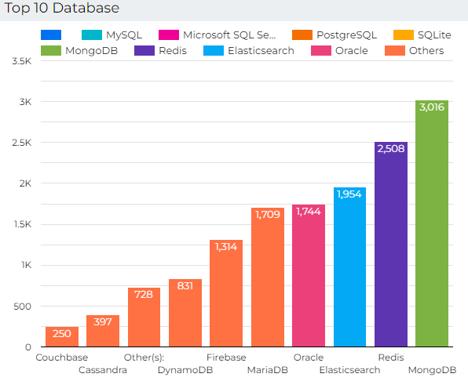
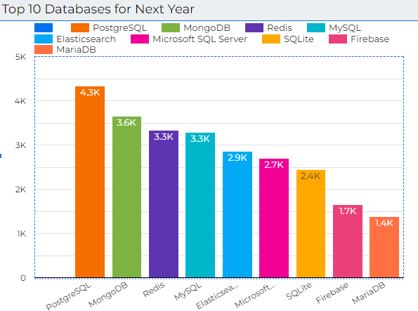
DATABASE TRENDS
Current Year
Next Year

Slide 10
DATABASE TRENDS - FINDINGS & IMPLICATIONS
Findings
PostgreSQL overtakes MongoDB in the projection
SQLite seems to have lost the most in the prediction
Little change overall
Implications
The userbase of established databases are very stable
Renewed interest in PostgreSQL can be due to a recent or near update
Databases with a small userbase seem to be migrating to bigger ones

Slide 11

DASHBOARD
GitHub link to Google Looker Dashboard pdf
GitHub link to the full project

Slide 12
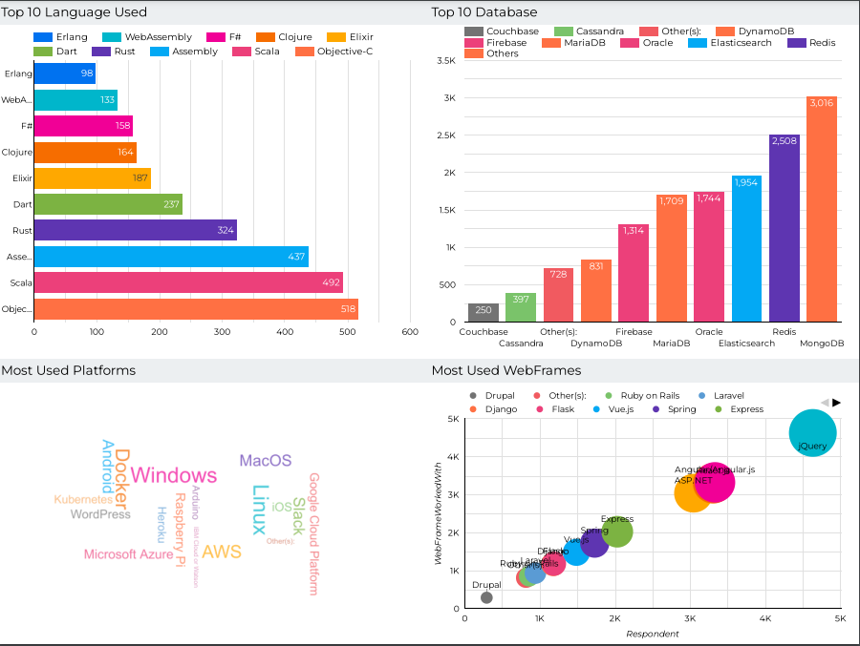
DASHBOARD TAB 1

Slide 13
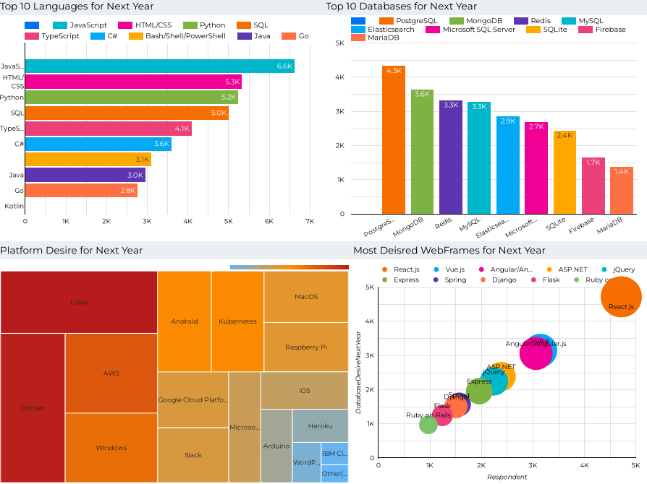
DASHBOARD TAB 2

Slide 14
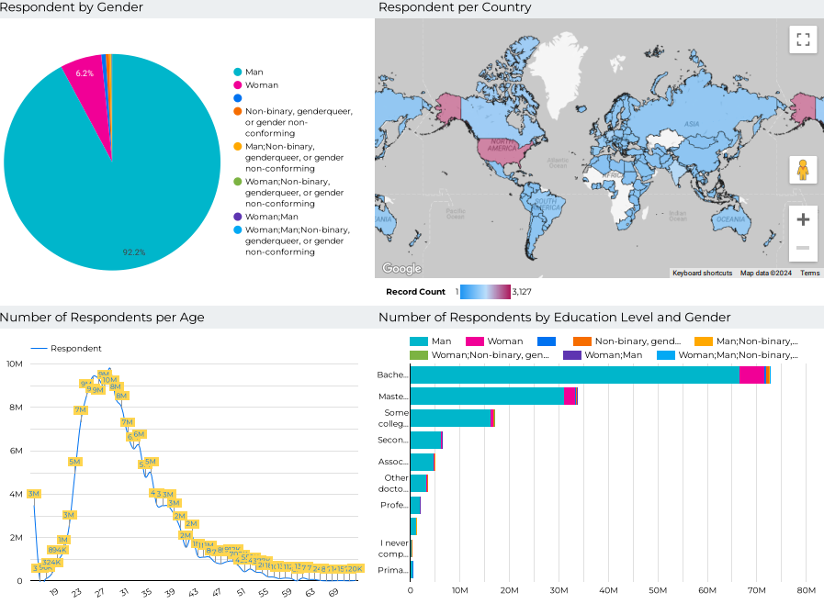
DASHBOARD TAB 3

Slide 15
DISCUSSION
For future reference we should review our data gathering methods to ensure that the respondents' gender ratio is a reflection of the industry, not of flawed gathering method

Slide 16
OVERALL FINDINGS & IMPLICATIONS
Findings
Predominantly young male respondent base from the U.S with a bachelor's or master degree
Stability in the use of technology with a slight shift to more popular technologies
We can see that there is a healthy influx and interest on the industry
Implications
A young demographic with a continuous interest on the industry
A cycle of more popular tool gets more support and thus gets more popular may be happening
The use of more customizable platforms like Linux and Docker seem to be prefered

Slide 17

CONCLUSION
The respondent base is high from across the world indicating a universality to the trend
A young respondent base with ages from 23 to 31 who are engaging with the subject indicates a healthy amount of professionals entering the industry
There seems to be a preference for customizability for professionals when it comes to platform use
With more refined data we will be able to get a more definite picture of the industry but even now we can get a good view of the pattern of behavior

Slide 18
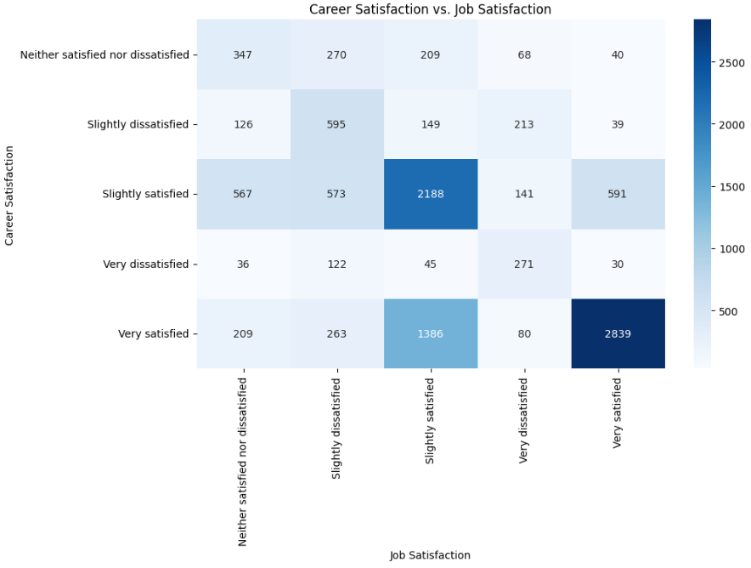
APPENDIX

Slide 19
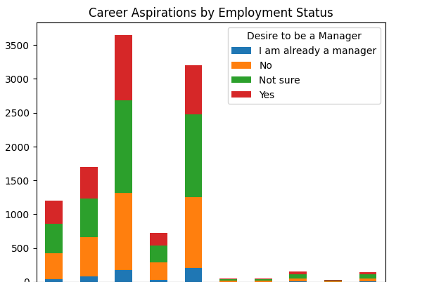
APPENDIX

Slide 20
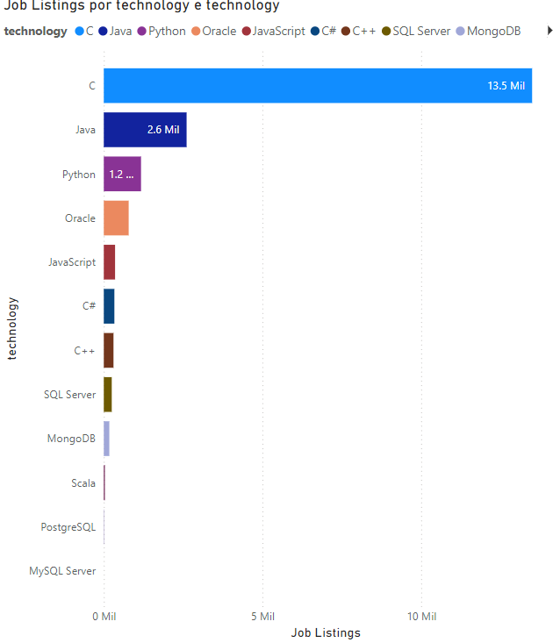
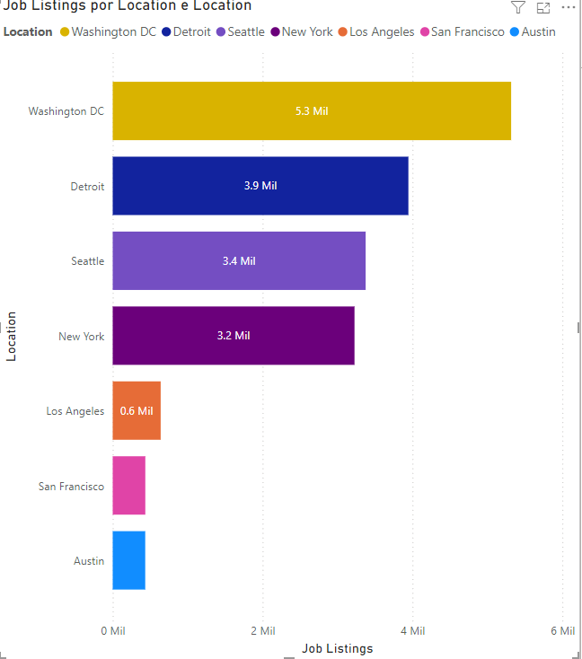
JOB POSTINGS

Slide 21
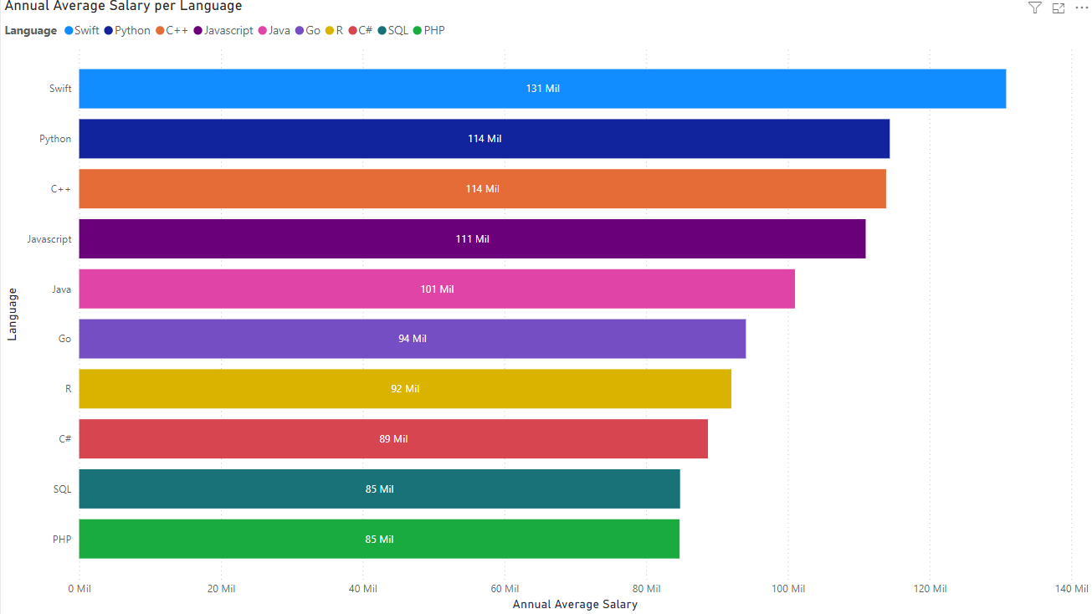
POPULAR LANGUAGES

