Slide 1
Fur using Shells and Fins

Slide 2

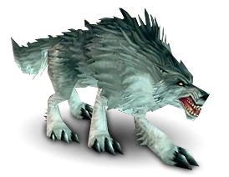
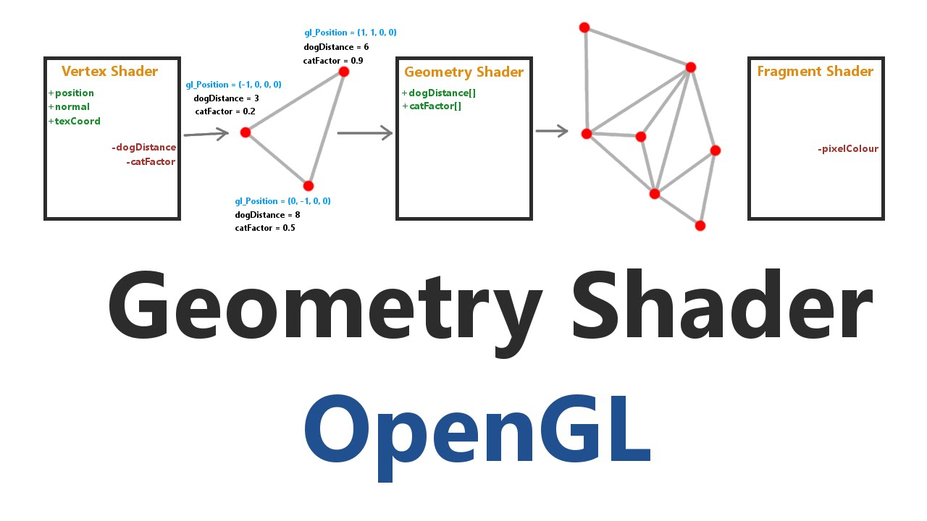
Problem
We want to render furry animals. But just applying some fancies textures may not cut it. There a lot of other methods, but with the introduction of the Geometry Shader new methods have come to fruition.

Slide 3
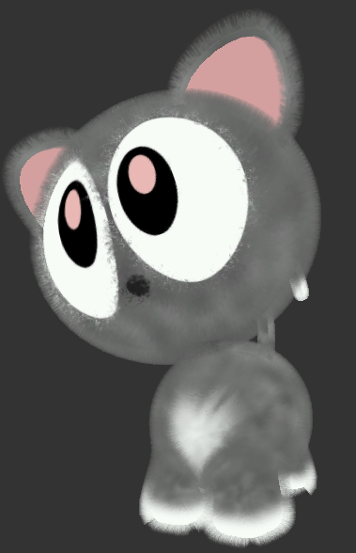

Introducing the technique
The Shells and Fins technique. It already existed, but now we also add the GS to the equation.

Slide 4
A Guide to Shells
The Shells technique consists on just rendering the mesh multiples time and each time extruding along the normal by an amount proportional to the index of the shell.
Each shell is textured from an slice of a 3D Texture.

Slide 5
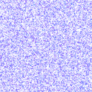
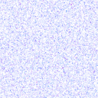
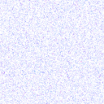
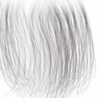
A Guide to Shells
The 3D texture consists on multiple 2D textures, each one used by it’s corresponding shell.

Slide 6

Apply Shells

Slide 7
A Guide to Fins
Here, the geometry shader makes its appearance.
The GS is used to detect silhouette edges, and extrude them.
On the old times, you would add degenerate triangles on all edges.

Slide 8
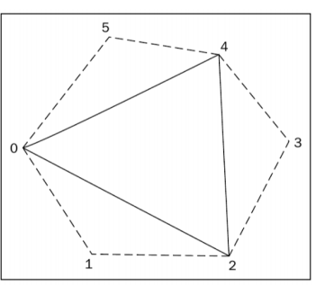
A Guide to Fins
Silhouette edges happens when a triangle is front facing, and the opposite one that has the same edge is back facing.
To check this, while on Camera Space, if the Normal
has -Z, it’s at the back, if it’s +Z, it’s at the front.

Slide 9
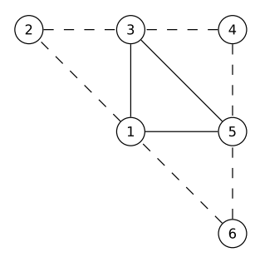
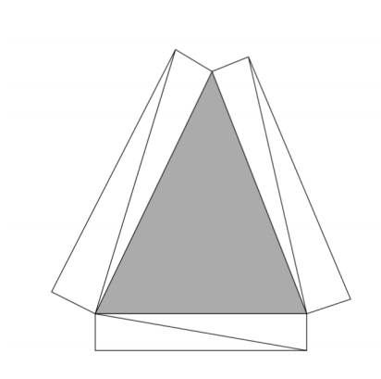
A Guide to Fins
All of this is done on the GS, which takes a Triangle Adjacency list as input, an outputs the extruded vertices. This step also requires some textures.

Slide 10
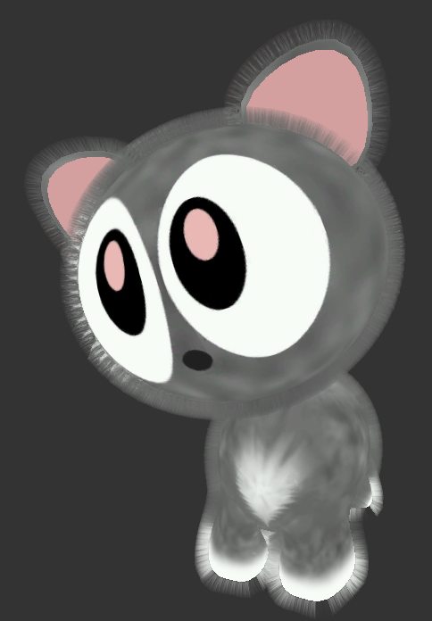
Apply Fins

Slide 11
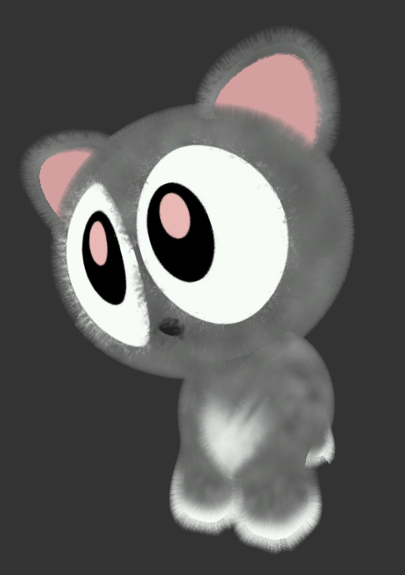
Mix it all together

Slide 12
Demo Time

Slide 13
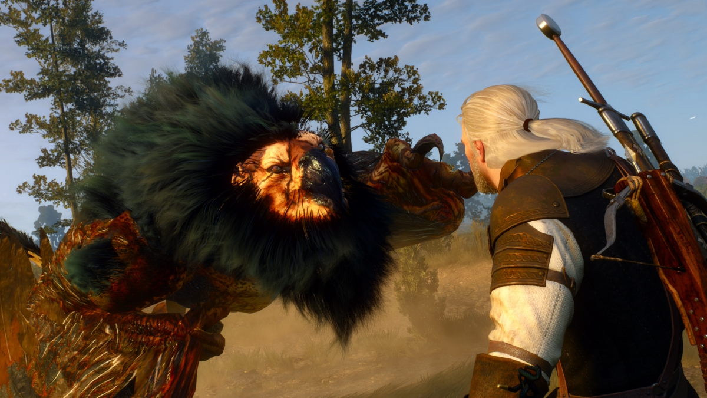
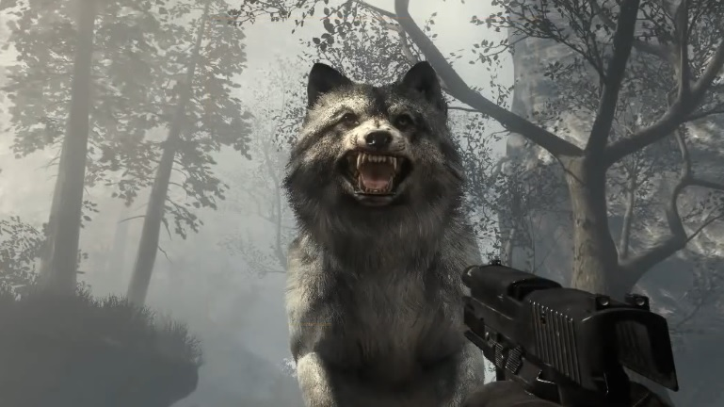
When should I use this?
You should use this when you want to render fur on an small Mesh or you don’t need ultra-realistic fur.

Slide 14
Is there another way?
Render all hair as individual geometry.
Can get pretty realistic results
Extremely Costly
Nvidia Hairworks
??????????

Slide 15
Pros
Easy to understand and easy to implement (logic is mostly on shaders)
Can also work with light and shadows

Slide 16
Cons
Requires pre-generated fur textures (But you can generate them)
More shells means more render calls
Artifacts may appear if the triangle adjacency list is badly built

Slide 17
Improvements
The paper uses line adjacency in the geometry shader, but you can use triangle adjacency instead.
You can take advantage from that, and also render the mesh alongside the fins.

Slide 18
Problems that I found
I need textures -> You can’t easily find them -> Track down the original demo and take them -> They are .dds -> Load them anyways -> Not supported -> Transform them to .png/.jpg

