Slide 1

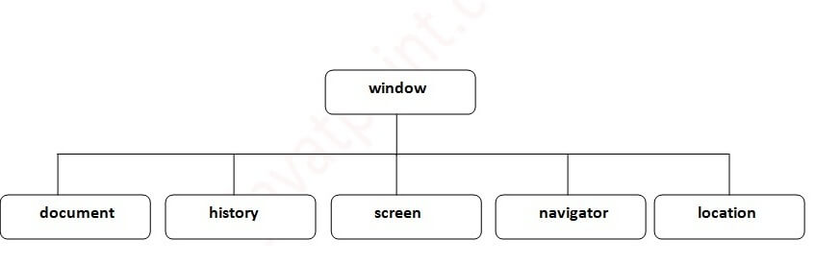
JAVASCRIPT COURSE
The Browser Object Model (BOM)
The Browser Object Model (BOM) is the core of JavaScript on the web. The BOM provides you with objects that expose the web browser’s functionality.
www.sunnyschool.am Trainer: Gevorg Abgaryan

Slide 2
JAVASCRIPT COURSE
JavaScript Window
The window object is the Global object
The global object of JavaScript in the browser is the window object. It means that all variables and functions declared globally with the var keyword become the properties and methods of the window object.
Method | Description
alert() | displays the alert box containing message with ok button.
confirm() | displays the confirm dialog box containing message with ok and cancel button.
prompt() | displays a dialog box to get input from the user.
open() | opens the new window.
close() | closes the current window.
setTimeout() | performs action after specified time like calling function, evaluating expressions etc.
www.sunnyschool.am Trainer: Gevorg Abgaryan

Slide 3
JAVASCRIPT COURSE
Open a new window
To open a new window or tab, you use the window.open() method:
window.open(url, windowName, [windowFeatures]);
The window.open() method accepts three arguments: the URL to load, the window target and a string of window features.
The third argument is a command-delimited string of settings specifying displaying information for the new window such as width, height, menubar, and resizable.
www.sunnyschool.am Trainer: Gevorg Abgaryan

Slide 4
JAVASCRIPT COURSE
Some methods:
window.close() - close the current window
window.moveTo() - move the current window
window.resizeTo() - resize the current window
www.sunnyschool.am Trainer: Gevorg Abgaryan

Slide 5
JAVASCRIPT COURSE
Window Screen
The Screen object provides the attributes of the screen on which the current window is being rendered.
To access the Screen object, you use the screen property of the window object:
window.screen
No. | Property | Description
1 | width | returns the width of the screen
2 | height | returns the height of the screen
3 | availWidth | returns the available width
4 | availHeight | returns the available height
5 | colorDepth | returns the color depth
6 | pixelDepth | returns the pixel depth.
www.sunnyschool.am Trainer: Gevorg Abgaryan

Slide 6
JAVASCRIPT COURSE
Window Screen Color Depth
The screen.colorDepth property returns the number of bits used to display one color.
All modern computers use 24 bit or 32 bit hardware for color resolution:
24 bits = 16,777,216 different "True Colors"
32 bits = 4,294,967,296 different "Deep Colors"
Window Screen Pixel Depth
The screen.pixelDepth property returns the pixel depth of the screen.
www.sunnyschool.am Trainer: Gevorg Abgaryan

Slide 7
JAVASCRIPT COURSE
JavaScript Location
The Location object represents the current location (URL) of a document. You can access the Location object by referencing the location property of the window or document object.
Both window.location and document.location link to the same Location object.
JavaScript Location properties
Suppose that the current URL is:
http://localhost:8080/js/index.html?type=listing&page=2#title
The following picture illustrates the properties of the Location object:
www.sunnyschool.am Trainer: Gevorg Abgaryan

Slide 8
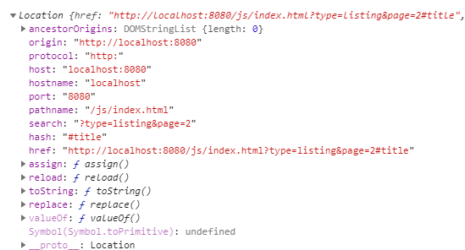
JAVASCRIPT COURSE
www.sunnyschool.am Trainer: Gevorg Abgaryan

Slide 9
JAVASCRIPT COURSE
Location.href
The location.href is a string that contains the entire URL.
"http://localhost:8080/js/index.html?type=listing&page=2#title"
Location.protocol
The location.protocol represents the protocol scheme of the URL including the final colon (:).
'http:'
Location.host
The location.host represents the hostname:
"localhost:8080“
Location.port
The location.port represents the port number of the URL.
"8080"
www.sunnyschool.am Trainer: Gevorg Abgaryan

Slide 10
JAVASCRIPT COURSE
Location.pathname
The location.pathname contains an initial '/' followed by the path of the URL.
"/js/index.html"
Location.search
The location.search is a string that represents the query string of the URL:
"?type=listing&page=2"
Location.hash
The location.hash returns a string that contains a ‘#’ followed by the fragment identifier of the URL.
"#title"
Location.origin
The location.origin is a string that contains the canonical form of the origin of the specific location.
"http://localhost:8080"
www.sunnyschool.am Trainer: Gevorg Abgaryan

Slide 11
JAVASCRIPT COURSE
Location.username
The location.username is a string that contains the username before the domain name.
Location.password
THe location.password is a string that represents the password specified before the domain name.
Manipulating the location
The Location object has a number of useful methods: assign(), reload(), and replace().
assign()
The assign() method accepts an URL, navigate to the URL immediately, and make an entry in the browser’s history stack.
location.assign('https://www.javascripttutorial.net');
When the window.location or location.href is set to a URL, the assign() method is called implicitly:
www.sunnyschool.am Trainer: Gevorg Abgaryan

Slide 12
JAVASCRIPT COURSE
window.location = ' http://sunnyschool.am/ ';
location.href = ' http://sunnyschool.am/ ';
If you change hostname, pathname, or port property, the page reloads with the new value. Note that changing hash property doesn’t reload the page but does record a new entry in the browser’s history stack.
When a new entry is created in the browser’s history stack, you can click the back button of the browser to navigate to the previous page.
www.sunnyschool.am Trainer: Gevorg Abgaryan

Slide 13
JAVASCRIPT COURSE
replace()
The replace() method is similar to the assign() method except it doesn’t create a new entry in the browser’s history stack. Therefore, you cannot click the back button to go to the previous page.
The following code uses the replace() method to navigate to the URL http://sunnyschool.am/ after 3 seconds:
setTimeout(() => {
location.replace(' http://sunnyschool.am/ ');
}, 3000);
www.sunnyschool.am Trainer: Gevorg Abgaryan

Slide 14
JAVASCRIPT COURSE
reload()
The reload() method reloads the currently displayed page. When you call the reload() method with no argument, the browser will reload the page in the most efficient way e.g., it loads the page resources from the browser’s cache if they haven’t changed since the last request.
reload();
To force a reload from the server, you pass true to the reload() method:
reload(true);
Note that the code after the reload() may or may not execute, depending on many factors like network latency and system resources.
www.sunnyschool.am Trainer: Gevorg Abgaryan

Slide 15
JAVASCRIPT COURSE
JavaScript History
When you launch the web browser and open a new webpage, the web browser creates a new entry in its history stack.
If you navigate to another webpage, the web browser also creates a new entry in the history stack.
The history stack stores the current page and previous pages that you visited.
To manipulate the history stack, you use the history object which is a property of the window object:
window.history
The history object provides three methods for navigating between pages in the history stack:
back()
forward()
go()
www.sunnyschool.am Trainer: Gevorg Abgaryan

Slide 16
JAVASCRIPT COURSE
Move backward
To move backward through history, you use the back() method:
history.back();
This behaves like you click the Back button in the toolbar of the web browser.
Move forward
Similarly, you can move forward by using the forward() method:
history.forward();
It works like when you click the Forward button.
Move to a specific URL in the history
To move to a specific URL in the history stack, you use the go() method. The go() method accepts an integer that is the relative position to the current page. The current page’s position is 0.
history.go(-1);
www.sunnyschool.am Trainer: Gevorg Abgaryan

Slide 17
JAVASCRIPT COURSE
To move forward a page, you just call:
history.go(1)
To refresh the current page, you either pass 0 or no argument to the go() method:
history.go(0);
history.go();
To determine the number of URLs in the history stack, you use the length property:
history.length
www.sunnyschool.am Trainer: Gevorg Abgaryan

Slide 18
JAVASCRIPT COURSE
JavaScript Navigator
The JavaScript Navigator provides information about the web browser and its capabilities. You can reference the Navigator object via the read-only window.navigator property.
The Navigator object has properties that convey the browser’s information. For example, the userAgent is a property of the window.navigator object. It is a long string that identifies the web browser.
window.navigator.userAgent
In Google Chrome, you may see the following output:
"Mozilla/5.0 (Windows NT 10.0; Win64; x64) AppleWebKit/537.36 (KHTML, like Gecko) Chrome/79.0.3945.117 Safari/537.36“
Note that the userAgent may be a little bit different, depending on the Google Chrome version.
www.sunnyschool.am Trainer: Gevorg Abgaryan

Slide 19
JAVASCRIPT COURSE
JavaScript Navigator Properties & Methods
Property / Method | Description
appCodeName | Returns “Mozilla” even in non-Mozilla browsers.
appName | Returns the full browser name.
appVersion | Returns the browser version. However, it typically does not correspond to the actual version of the browser.
platform | Returns the system platform on which the browser is running.
cookieEnabled | Returns true if if cookies are enabled; otherwise false.
userAgent | Represents the user-agent string of the browser.
www.sunnyschool.am Trainer: Gevorg Abgaryan

Slide 20
JAVASCRIPT COURSE
JavaScript Cookies
What are Cookies?
Cookies are data, stored in small text files, on your computer.
When a web server has sent a web page to a browser, the connection is shut down, and the server forgets everything about the user.
Cookies were invented to solve the problem "how to remember information about the user":
When a user visits a web page, his/her name can be stored in a cookie.
Next time the user visits the page, the cookie "remembers" his/her name.
www.sunnyschool.am Trainer: Gevorg Abgaryan

Slide 21
JAVASCRIPT COURSE
For the example we will create 3 JavaScript functions:
A function to set a cookie value
A function to get a cookie value
A function to check a cookie value
www.sunnyschool.am Trainer: Gevorg Abgaryan

Slide 22
JAVASCRIPT COURSE
A Function to Set a Cookie
First, we create a function that stores the name of the visitor in a cookie variable:
Example
function setCookie(cname, cvalue, exdays) {
var d = new Date();
d.setTime(d.getTime() + (exdays*24*60*60*1000));
var expires = "expires="+ d.toUTCString();
document.cookie = cname + "=" + cvalue + ";" + expires + ";path=/";
}
Example explained:
The parameters of the function above are the name of the cookie (cname), the value of the cookie (cvalue), and the number of days until the cookie should expire (exdays).
The function sets a cookie by adding together the cookiename, the cookie value, and the expires string.
www.sunnyschool.am Trainer: Gevorg Abgaryan

Slide 23
JAVASCRIPT COURSE
A Function to Get a Cookie
Then, we create a function that returns the value of a specified cookie:
Example
function getCookie(cname) {
var name = cname + "=";
var decodedCookie = decodeURIComponent(document.cookie);
var ca = decodedCookie.split(';');
for(var i = 0; i <ca.length; i++) {
var c = ca[i];
while (c.charAt(0) == ' ') {
c = c.substring(1);
}
if (c.indexOf(name) == 0) {
return c.substring(name.length, c.length);
}
}
return "";
}
www.sunnyschool.am Trainer: Gevorg Abgaryan

Slide 24
JAVASCRIPT COURSE
Function explained:
Take the cookiename as parameter (cname).
Create a variable (name) with the text to search for (cname + "=").
Decode the cookie string, to handle cookies with special characters, e.g. '$'
Split document.cookie on semicolons into an array called ca (ca = decodedCookie.split(';')).
Loop through the ca array (i = 0; i < ca.length; i++), and read out each value c = ca[i]).
If the cookie is found (c.indexOf(name) == 0), return the value of the cookie (c.substring(name.length, c.length).
If the cookie is not found, return "".
www.sunnyschool.am Trainer: Gevorg Abgaryan

Slide 25
JAVASCRIPT COURSE
A Function to Check a Cookie
If the cookie is not set, it will display a prompt box, asking for the name of the user, and stores the username cookie for 365 days, by calling the setCookie function:
Example
function checkCookie() {
var username = getCookie("username");
if (username != "") {
alert("Welcome again " + username);
} else {
username = prompt("Please enter your name:", "");
if (username != "" && username != null) {
setCookie("username", username, 365);
}
}
}
www.sunnyschool.am Trainer: Gevorg Abgaryan

Slide 26
JAVASCRIPT COURSE
JavaScript Execution Context
Consider the following code:
let x = 10;
function timesTen(a){
return a * 10;
}
let y = timesTen(x);
console.log(y); // 100
In this code:
First, assign 10 to the x variable.
Second, declare a function timesTen() that multiplies its argument with 10.
Third, call the timesTen() function by passing in x as a parameter and store the return value in the variable y.
Finally, output the variable y to the Console.
www.sunnyschool.am Trainer: Gevorg Abgaryan

Slide 27
JAVASCRIPT COURSE
The code is straightforward. However, behind the scene, JavaScript does many things. In this tutorial, we will focus on the execution contexts.
When a JavaScript engine executes a script, it creates execution contexts. Each execution context has two phases: the creation phase and the execution phase.
The creation phase
When a script executes for the first time, the JavaScript engine creates a Global Execution Context. During this creation phase, it performs the following tasks:
Create a global object i.e., window in the web browser or global in Node.js.
Create a this object binding which points to the global object above.
Setup a memory heap for storing variables and function references.
Store the function declarations in the memory heap and variables within the global execution context with the initial values as undefined.
www.sunnyschool.am Trainer: Gevorg Abgaryan

Slide 28
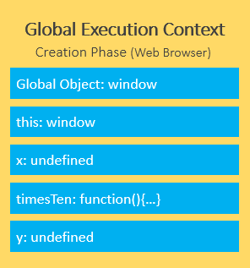
JAVASCRIPT COURSE
In our example, during the creation phase, the JavaScript engine stores the variables x and y and the function declaration timesTen() in the Global Execution Context. Besides, it initializes the variables x and y to undefined.
www.sunnyschool.am Trainer: Gevorg Abgaryan

Slide 29
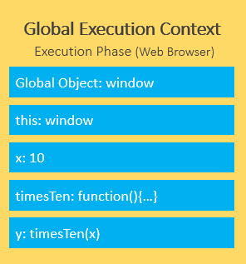
JAVASCRIPT COURSE
The execution phase
During the execution phase, the JavaScript engine executes the code line by line. In this phase, it assigns values to variables and executes the function calls.
www.sunnyschool.am Trainer: Gevorg Abgaryan

Slide 30
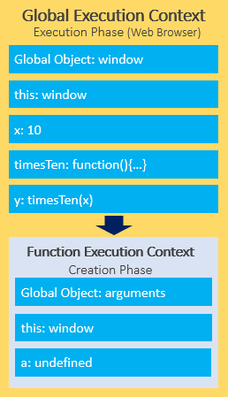
JAVASCRIPT COURSE
For every function call, the JavaScript engine creates a new Function Execution Context. The Function Execution Context is similar to the Global Execution Context, but instead of creating the global object, it creates the arguments object that contains a reference to all the parameters passed into the function:
www.sunnyschool.am Trainer: Gevorg Abgaryan

Slide 31
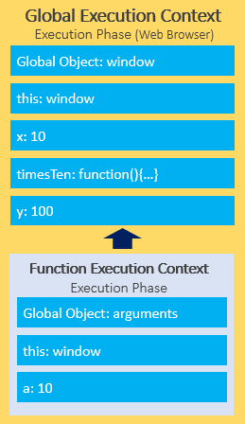
JAVASCRIPT COURSE
In our example, the function execution context creates the arguments object that references all parameters passed into the function, sets this value to the global object, and initializes the a parameter to undefined.
During the execution phase of the function execution context, it assigns 10 to the parameter a and returns the result (100) to the Global Execution Context.
To keep track of all the execution contexts including the Global Execution Context and Function Execution Contexts, the JavaScript engine uses a data structure named call stack
www.sunnyschool.am Trainer: Gevorg Abgaryan

Slide 32
JAVASCRIPT COURSE
JavaScript Call Stack
JavaScript engine uses a call stack to manage execution contexts: the Global Execution Context and Function Execution Contexts.
The call stack works based on the LIFO principle i.e., last-in-first-out.
When you execute a script, the JavaScript engine creates a Global Execution Context and pushes it on top of the call stack.
Whenever a function is called, the JavaScript engine creates a Function Execution Context for the function, pushes it on top of the Call Stack, and starts executing the function.
If a function calls another function, the JavaScript engine creates a new Function Execution Context for the function that is being called and pushes it on top of the call stack.
www.sunnyschool.am Trainer: Gevorg Abgaryan

Slide 33
JAVASCRIPT COURSE
When the current function completes, the JavaScript engine pops it off the call stack and resumes the execution where it left off in the last code listing.
The script will stop when the call stack is empty.
JavaScript call stack example
function add(a, b) {
return a + b;
}
function average(a, b) {
return add(a, b) / 2;
}
let x = average(10, 20);
www.sunnyschool.am Trainer: Gevorg Abgaryan

Slide 34
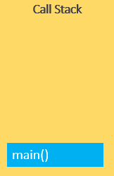
JAVASCRIPT COURSE
When the script runs, the JavaScript engine places the global execution context (denoted by main() or global() function on the call stack.
www.sunnyschool.am Trainer: Gevorg Abgaryan

Slide 35
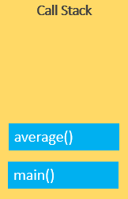
JAVASCRIPT COURSE
The global execution context enters the creation phase and moves to the execution phase.
The JavaScript engine executes the call to the average(10, 20) function and creates a function execution context for the average() function and pushes it on top of the call stack
www.sunnyschool.am Trainer: Gevorg Abgaryan

Slide 36
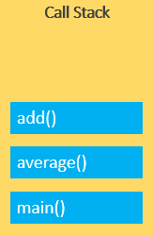
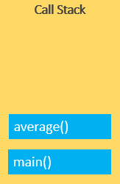
JAVASCRIPT COURSE
The JavaScript engine starts executing the average() since it is at the top of the call stack.
The average() function calls add() function. At this point, the JavaScript engine creates another function execution context for the add() function and places it on the top of the call stack
JavaScript engine executes the add() function and pops it off the call stack
www.sunnyschool.am Trainer: Gevorg Abgaryan

Slide 37
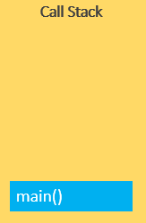

JAVASCRIPT COURSE
At this point, the average() function is on top of the call stack, JavaScript engine executes it and pops it off the call stack.
Now, the call stack is empty so the script stops executing:
www.sunnyschool.am Trainer: Gevorg Abgaryan

Slide 38
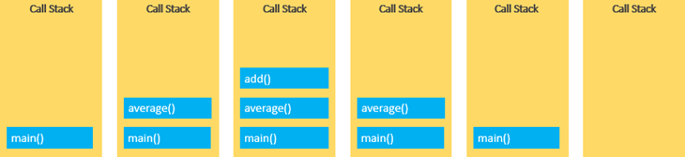
JAVASCRIPT COURSE
The following picture illustrates the overall status of the Call Stack in all steps
www.sunnyschool.am Trainer: Gevorg Abgaryan

Slide 39
JAVASCRIPT COURSE
Asynchronous JavaScript
JavaScript is the single-threaded programming language. The JavaScript engine has only one call stack so that it only can do one thing at a time.
When executing a script, the JavaScript engine executes code from top to bottom, line by line. In other words, it is synchronous.
Asynchronous is the opposite of synchronous, which means happening at the same time. So how does JavaScript carry asynchronous tasks such as callbacks, promises, and async/await
www.sunnyschool.am Trainer: Gevorg Abgaryan

Slide 40
JAVASCRIPT COURSE
JavaScript single-threaded model
JavaScript is a single-threaded programming language. In other words, it can do only one thing at a time.
JavaScript engine executes a script from the top and works its way down creating execution contexts and pushing and popping functions onto and off the call stack.
If you have a function that takes a long time to execute, then you cannot do anything on the web browser during the function’s execution. The webpage just hangs.
The function that takes a long time to execute is known as a blocking function. The blocking functions block all the interactions with the webpage such as mouse click. Some examples of blocking functions are the functions that download files from a remote server or functions that connect to a database server to retrieve data.
www.sunnyschool.am Trainer: Gevorg Abgaryan

Slide 41
JAVASCRIPT COURSE
Consider the following script:
function task(message) {
// emulate time consuming task
let n = 10000000000;
while (n > 0){
n--;
}
console.log(message);
}
console.log('Start script...');
task('Download a file.');
console.log('Done!');
output:
Start script...
Download a file.
Done!
www.sunnyschool.am Trainer: Gevorg Abgaryan

Slide 42
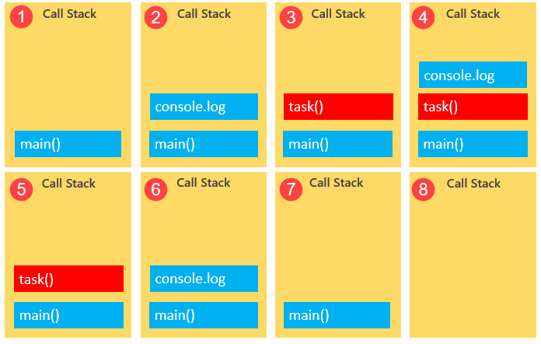
JAVASCRIPT COURSE
www.sunnyschool.am Trainer: Gevorg Abgaryan

Slide 43
JAVASCRIPT COURSE
Callbacks to the rescue
To prevent blocking functions from blocking other activities, you typically wrap them in callback functions which can be executed later. For example:
console.log('Start script...');
setTimeout(() => {
task('Download a file.');
}, 1000);
console.log('Done!');
www.sunnyschool.am Trainer: Gevorg Abgaryan

Slide 44
JAVASCRIPT COURSE
In this example, you will see the message 'Start script...' and 'Done!' immediately. And after a while, you will see the message 'Download a file'.
Here is the output:
Start script...
Done!
Download a file.
As mentioned earlier that JavaScript can do only one thing at a time. However, it’s more precise to say that the JavaScript runtime can do one thing at a time.
The web browser has more components than just the JavaScript engine. When you make a call to the setTimeout() function, an AJAX call, or click a button, the web browser is capable of doing these activities concurrently and asynchronously.
The setTimeout(), AJAX calls, and DOM events are parts of Web APIs of the web browser.
www.sunnyschool.am Trainer: Gevorg Abgaryan

Slide 45
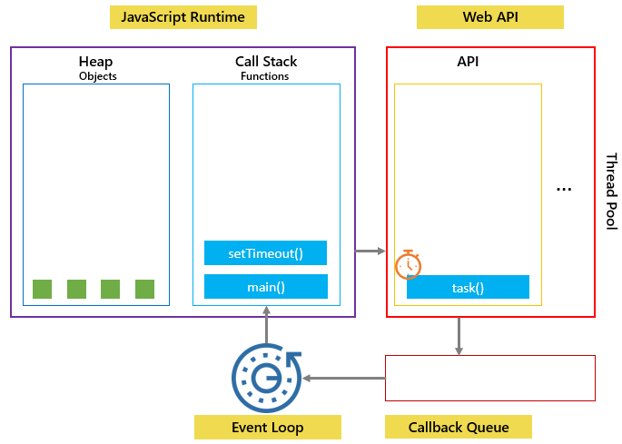
JAVASCRIPT COURSE
In our example, when setTimeout() function is called, it is placed on the call stack and the Web API creates a timer that will expire in 1 second.
www.sunnyschool.am Trainer: Gevorg Abgaryan

Slide 46
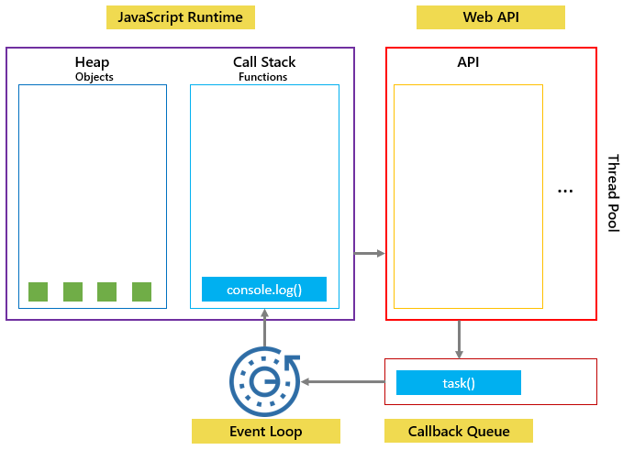
JAVASCRIPT COURSE
Then the task() function is then placed into a queue called callback queue or task queue:
www.sunnyschool.am Trainer: Gevorg Abgaryan

Slide 47
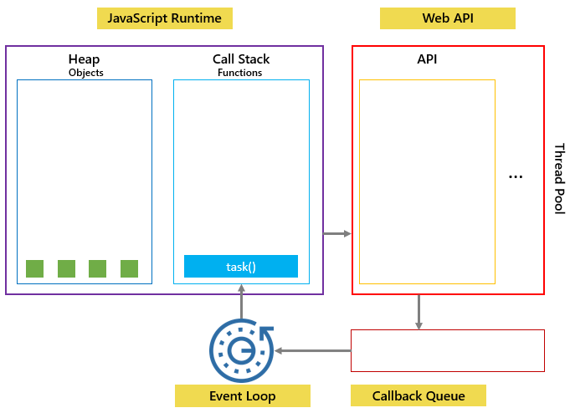
JAVASCRIPT COURSE
The event loop is a constantly running process that monitors both the callback queue and the call stack.
If the call stack is not empty, the event loop waits until it is empty and places the next function from the callback queue to the call stack. If the call queue is empty, nothing will happen
www.sunnyschool.am Trainer: Gevorg Abgaryan

Slide 48
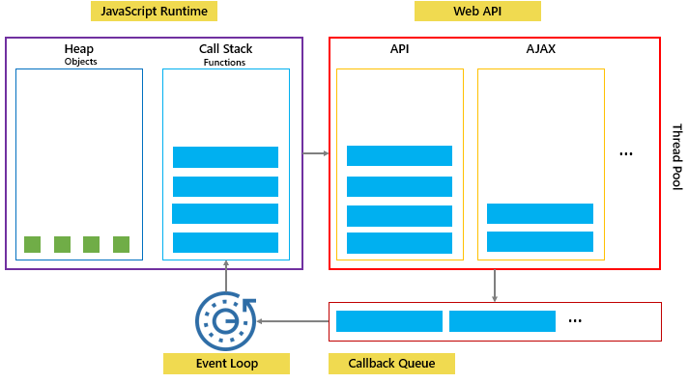
JAVASCRIPT COURSE
The following picture illustrates JavaScript runtime, Web API, Call stack, and Event loop
www.sunnyschool.am Trainer: Gevorg Abgaryan

Slide 49
JAVASCRIPT COURSE
JavaScript Hoisting
When you execute a piece of JavaScript code, the JavaScript engine creates the global execution context.
The global execution context has two phases: creation and execution.
During the creation phase, the JavaScript engine moves the variable and function declarations to the top of your code. This feature is known as hoisting in JavaScript.
www.sunnyschool.am Trainer: Gevorg Abgaryan

Slide 50
JAVASCRIPT COURSE
JavaScript hoisting occurs during the creation phase of the execution context that moves the variable and function declarations to the top of the script.
The JavaScript engine hoists the variables declared using the let keyword, but it doesn’t initialize them as the variables declared with the var keyword.
Function expressions and arrow functions aren’t hoisted
www.sunnyschool.am Trainer: Gevorg Abgaryan

Slide 51
THANK YOU FOR ATTENTION
Trainer` Gevorg Abgaryan
Training center «Sunny School»
www.sunnyschool.am
095 09 08 00
info@sunnyschool.am
https://www.facebook.com/sunnyschool1/

