Slide 1
Spring WebMVC and Integration Tests
Hasmik Kirakosyan 05 November, 2021

Slide 2
Agenda
What is Spring WebMVC?
Spring MVC Workflow
Benefits of Spring WebMVC
The DispatcherServlet
Processing
Testing / Integration testing
References

Slide 3

What is Spring WebMVC
Spring Web MVC is the original web framework built on the Servlet API and has been included in the Spring Framework from the very beginning. The formal name, “Spring Web MVC,” comes from the name of its source module (spring-webmvc), but it is more commonly known as “Spring MVC”.

Slide 4
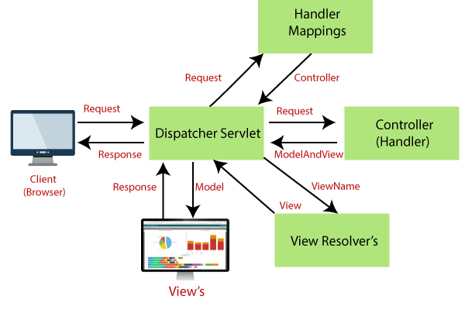
Spring MVC Workflow

Slide 5
Model - A model contains the data of the application. A data can be a single object or a collection of objects.
Controller - A controller contains the business logic of an application. Here, the @Controller annotation is used to mark the class as the controller.
View - A view represents the provided information in a particular format. Generally, JSP+JSTL is used to create a view page. Although spring also supports other view technologies such as Apache Velocity, Thymeleaf and FreeMarker.
Front Controller - In Spring Web MVC, the DispatcherServlet class works as the front controller. It is responsible to manage the flow of the Spring MVC application.

Slide 6
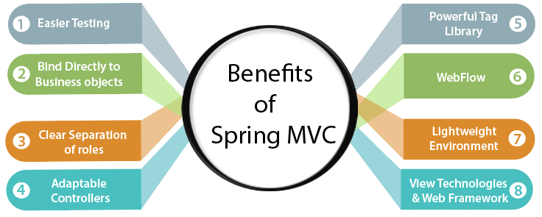
Benefits of Spring WebMVC

Slide 7
More testable code (validation has no dependency on Servlet API)
No ActionForms. Bind directly to domain objects
Spring provides a very clean division between controllers, JavaBean models, and views.
Spring Controllers are configured via IoC like any other objects. This makes them easy to test, and beautifully integrated with other objects managed by Spring.
Spring provides a lightweight container that can be activated without using web server or application server software.

Slide 8
It is modular, allowing you to use only those parts that you need. It allows us to just choose any part of it in isolation.
It supports both XML- and annotation-based configuration.
The Spring Web MVC framework provides powerful and a flexible Web framework as an alternative to Struts and other framework.

Slide 9
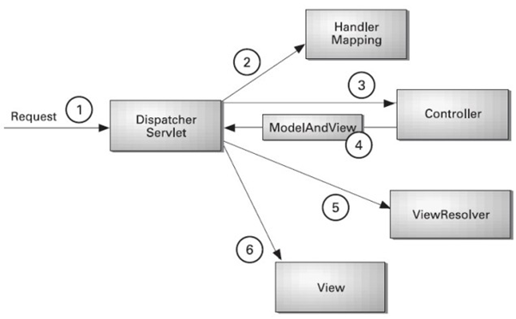
The DispatcherServlet
The DispatcherServlet is the heart of the Spring Web MVC framework; this core component receives all requests to your application.

Slide 10
Processing
The DispatcherServlet processes requests as follows:
The WebApplicationContext is searched for and bound in the request as an attribute that the controller and other elements in the process can use. It is bound by default under the DispatcherServlet.WEB_APPLICATION_CONTEXT_ATTRIBUTE key.
The locale resolver is bound to the request to let elements in the process resolve the locale to use when processing the request (rendering the view, preparing data, and so on).
The theme resolver is bound to the request to let elements such as views determine which theme to use.
If you specify a multipart file resolver, the request is inspected for multiparts. If multiparts are found, the request is wrapped in a MultipartHttpServletRequest for further processing by other elements in the process.
An appropriate handler is searched for. If a handler is found, the execution chain associated with the handler (preprocessors, postprocessors, and controllers) is run to prepare a model for rendering. Alternatively, for annotated controllers, the response can be rendered (within the HandlerAdapter) instead of returning a view.
If a model is returned, the view is rendered. If no model is returned (maybe due to a preprocessor or postprocessor intercepting the request, perhaps for security reasons), no view is rendered, because the request could already have been fulfilled.

Slide 11
Testing / Integration testing
Spring’s integration testing support has the following primary goals:
To manage Spring IoC container caching between test execution.
To provide Dependency Injection of test fixture instances.
To provide transaction management appropriate to integration testing.
To supply Spring-specific base classes that assist developers in writing integration tests.

Slide 12
While doing integration testing in spring boot applications, we shall keep in mind that:
An integration test is supposed to test whether different modules are bounded correctly and if they work as expected.
The integration tests shall not utilize the actual production dependencies (e.g. database/network) and they can mimic the certain behaviors.
The application shall run in ApplicationContext and run tests in it.
Spring boot provides @SpringBootTest annotation which starts the embedded server, creates a web environment and then enables @Test methods to do integration testing. Use it’s webEnvironment attribute for it.
It also creates the ApplicationContext used in our tests.
It is good to use h2 in-memory DB for mimicking the database. Though it is not mandatory and we can use mockito to mock the database interactions.
It is recommended to use test specific configurations using @TestConfiguration annotation.

Slide 13
MockMVC Example
There are multiple ways to implement integration tests for SpringMVC app. Here is an example with MockMVC. Simple Rest controller test configuration
@RunWith(SpringRunner.class)
@WebMvcTest(DeviceRESTController.class)
public class DeviceRESTControllerTests {
@Autowired
private MockMvc mvc;
}

Slide 14
SpringRunner is an alias for the SpringJUnit4ClassRunner. It is a custom extension of JUnit’s BlockJUnit4ClassRunner which provides functionality of the Spring TestContext Framework to standard JUnit tests by means of the TestContextManager and associated support classes and annotations.
@WebMvcTest annotation is used for Spring MVC tests. It disables full auto-configuration and instead apply only configuration relevant to MVC tests.
The WebMvcTest annotation auto-configure MockMvc instance as well.
Using DeviceRESTController.class as parameter, we are asking to initialize only one web controller and you need to provide remaining dependencies required using Mock objects.

Slide 15
Test Examples
@Test public void shouldGetAllDevices() throws Exception { mvc.perform( MockMvcRequestBuilders .get("/devices") .accept(MediaType.APPLICATION_JSON)) .andDo(print()) .andExpect(status().isOk()) .andExpect(MockMvcResultMatchers.jsonPath("$.devices").exists()) .andExpect(MockMvcResultMatchers.jsonPath("$.devices[*].id").isNotEmpty()); }
@Test void shouldReturnListOfDevicesWithOwner() { this.deviceRepository.save(new Device("Bob-nout-1", "Bob")); this.deviceRepository.save(new Device("Bob-mobile-1", "Bob")); this.deviceRepository.save(new Device("Bob-nout-2", "Bob")); this.deviceRepository.save(new Device("John-mobile-1", "JohnJ")); List<Device> devices = deviceRepository.findByOwner("Bob"); System.out.println(devices.size()); assertEquals(3, devices.size()); }

Slide 16
References
How Spring Web MVC Really Works
Testing Web Controllers With Spring Boot @WebMvcTest
Testing in Spring Boot
Integration Testing

