Slide 1


Speech-Captioner
2310030103-Hasmitha
Under the Guidance of
Dr. Sumit Hazra

Slide 2
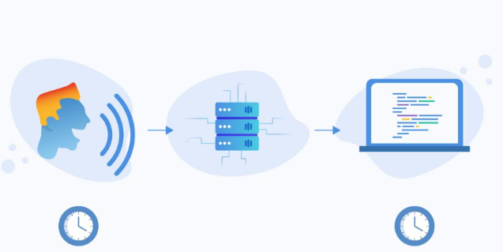
Introduction
What is a Speech Captioner?
A speech captioner is a system that listens to spoken language and
converts it into accurate text in real-time or post-recording.
Importantance of Speech-Captioner
Enhances accessibility for the hearing impaired
Useful in education, meetings, and media
Bridges communication gaps in noisy environments
Relevance to Machine Learning
Speech captioning involves audio signal processing, Natural Language Processing (NLP), and neural networks
which are core areas of ML.

Slide 3
Objectives
1.To develop a machine learning-based system that converts spoken audio into readable text captions
2. To support real-time speech-to-text conversion for use in live meetings, lectures, and events.
3. To reduce the word error rate (WER) by using advanced deep learning architectures such as LSTM or Transformer models.
4. To implement noise reduction and speech preprocessing techniques for clearer audio input handling.
5. To build a user-friendly interface that accepts microphone input or pre-recorded audio files.

Slide 4
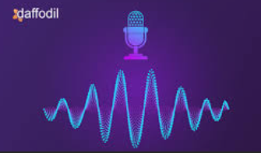
Methodology
1.Data Collection
Use microphone input and audio files
Train with datasets like LibriSpeech or Common Voice
2.Preprocessing
Normalize audio
Remove noise and silence
3.Feature Extraction
Extract MFCC or spectrogram features
4.Model Training
Use models like RNN, LSTM, or Transformers .
5.Caption Generation
Decode predictions into text
Use language models for grammar correction
6.Evaluation
Measure performance using Word Error Rate (WER) and accuracy

Slide 5
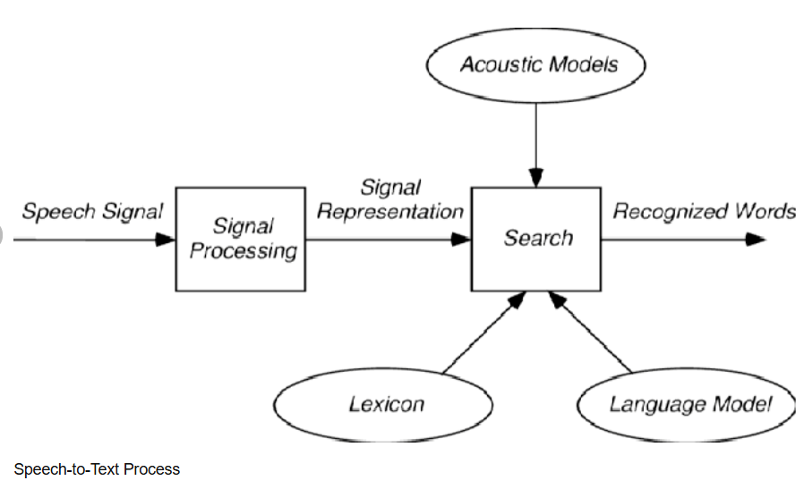
Flow Diagram

Slide 6
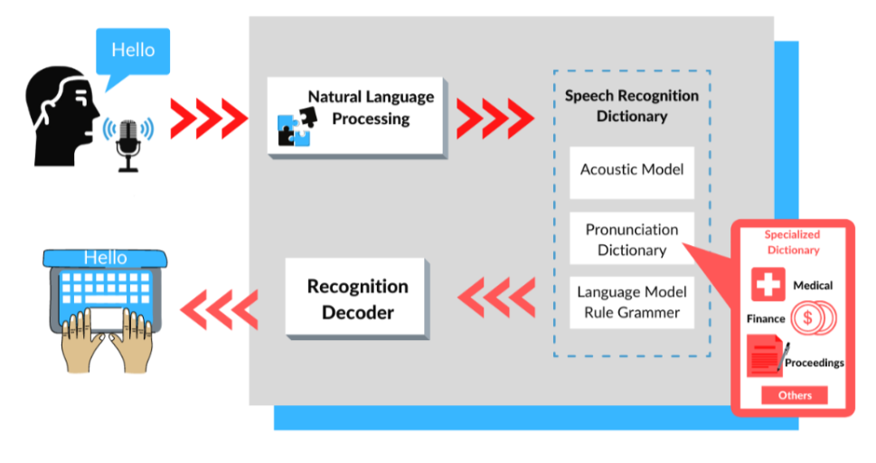
Tools Used
Programming & Scripting
Python – Primary language for development
📚 Libraries & Frameworks
SpeechRecognition / Librosa – For audio processing
TensorFlow / PyTorch – For building and training ML models
NLTK / spaCy – For text processing
🧠 Models
DeepSpeech and Whisper – For speech-to-text conversion
💻 Development Environment
Jupyter Notebook / Google Colab – For experimentation and prototyping
VS Code – For writing and organizing code

Slide 7
Expected Results
Goals of the Project
Achieve accurate speech-to-text conversion using machine learning
Generate real-time or near real-time captions from audio input
Handle various speech patterns, accents, and moderate background noise
Target Metrics (Expected)
Accuracy: Aim for 85–90% in clean audio environments
Word Error Rate (WER): Below 15% with proper preprocessing
Latency: Real-time caption generation with minimal delay

Slide 8
Conclusion
This project proposes a machine learning-based Speech Captioner system
Aims to convert spoken audio into accurate text captions
Can be beneficial for accessibility, communication, and education
Uses modern ML models like Whisper for speech-to-text conversion

Slide 9

Thank
You

