Slide 1
HerbLang
Amira Khezzar - U23104100 (sec 61)
Hasna Imad Eldin Abdul Hay - U23100997 (sec 61)
FATMA A. S. ALKHODARI - U22104519 (sec 62)
Mona M. M. Mansour - U22104988 (sec 62)
Fatma Ibrahim khammas - U23101181 (sec 62)

Slide 2
Concept Overview
HerbLang models computation through natural processes (growth, cut, split, etc.)
Uses entities like seed, grow, cut, flower to give meaning to operations
Repetition of symbols (e.g., +++ ) defines how many times the operation applies
Combines symbolic clarity with intuitive natural metaphors

Slide 3
Syntax and Entities meaning:
Syntax: <entity1><number1><operators><number2><entity2>
seed → start value (for addition)
cut → start value (for subtraction)
grow → start value (for multiplication)
split → start value (for division)
flower → result of addition
leaf → result of subtraction
tree → result of multiplication
root → result of division

Slide 4
Examples
Expression | What it means | Math | Result
seed5 +> 3flower | Add 3 once | 5 + 3 | 8
seed5 ++> 3flower | Add 3 twice | 5+3+3 | 11
seed5 +++> 3flower | Add 3 thrice | 5+3+3+3 | 14
cut10 --> 2leaf | Subtract 2 twice | 10-2-2 | 6
grow2 **> 3tree | Multiply by 3 twice | 2×3×3 | 18
split12 //> 3root | Divide by 3 twice | 12÷3÷3 | 1.33

Slide 5
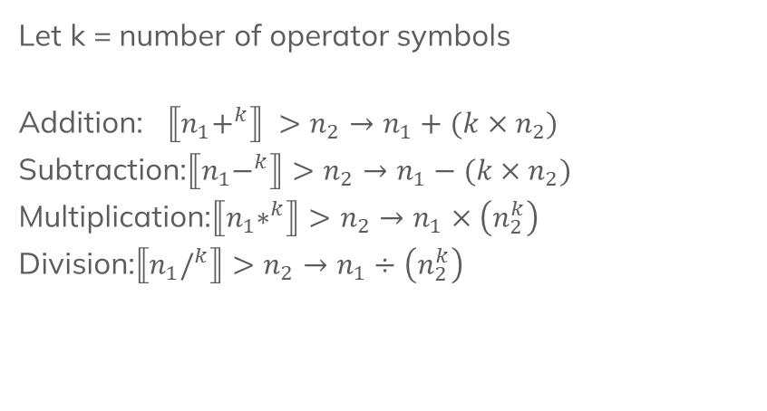

Semantics
Mathematical Semantics:
Recursive Semantics:
Example (Addition):
eval(n, k):
If k == 0:
return n
else:
return eval(n + $n_{2}$, k -1)
Let k = number of operator symbols
Addition: $⟦n_{1}+^{k}⟧ >n_{2}→n_{1}+(k×n_{2})$
Subtraction:$⟦n_{1}−^{k}⟧>n_{2}→n_{1}−(k×n_{2})$
Multiplication:$⟦n_{1}∗^{k}⟧>n_{2}→n_{1}×\left(n_{2}^{k}\right)$
Division:$⟦n_{1}/^{k}⟧>n_{2}→n_{1}÷\left(n_{2}^{k}\right)$

Slide 6
Our language follows FUNCTIONAL PARADIGM:
1. IMMUTABILITY
- seed5 never changes into something else
- A NEW flower value is created
2. PURE FUNCTIONS
- seed5 +++> 3flower always = 14
- No side effects, no global state
3. RECURSION (not loops)
- Repetition implemented via recursion
- No mutable loop counters
4. REFERENTIAL TRANSPARENCY
- Any expression = its value
- Can substitute without changing meaning

Slide 7
Implementation Architecture
Implementation: Python 3
- Chosen for readability and fast prototyping
- Lexer uses regex patterns
- Parser uses recursive descent
- Interpreter uses recursive evaluation
Four components:
SOURCE CODE
↓
LEXER (Tokenization)
↓
PARSER (AST Construction - CFG based)
↓
INTERPRETER (Recursive Evaluation)
↓
RESULT

Slide 8
Grammar (CFG)
Non-terminals:
<program>, <statement>, <arith_expr>, <func_call>, <entity_open>, <entity_close>, <op_seq>, <op>, <func_name>, <arg_list>, <args>, <number>, <digit>
Terminals:
Entities: seed, grow, cut, split, flower, leaf, tree, root
Operators: +, -, *, /
Special symbol: > [ ] ,
Digits: 0 1 2 3 4 5 6 7 8 9
Start symbol: <program>

Slide 9
Production Rules:
<program> → <statement>
<statement> → <arith_expr> | <func_call>
<arith_expr> → <entity_open> <number> <op_seq> > <number> <entity_close>
<entity_open> → seed | cut | grow | split
<entity_close> → flower | leaf | tree | root
<op_seq> → <op> | <op> <op_seq>
<op> → + | - | * | /
<func_call> → <func_name> [ <arg_list> ] | flourish [ <arg_list> ] <number>
<func_name> → propagate | harvest | bloom | wither | average | sort | uproot | unique
<arg_list> → ε | <args>
<args> → <number> | <number> , <args>
<number> → <digit> | <digit> <number>
<digit> → 0 | 1 | 2 | 3 | 4 | 5 | 6 | 7 | 8 | 9

Slide 10
Lexer Example
Token Type | Value
START | seed
NUM | 5
OP | +
OP | +
OP | +
ARROW | >
NUM | 3
END | flower
Input: seed5 +++> 3flower

Slide 11
Abstract Syntax Tree
Input expression | AST tuple produced
seed 5 +++> 3 flower | ('ADD', 5, 3, 3)
seed 5 +> 3 flower | ('ADD', 5, 1, 3)
cut 10 --> 2 leaf | ('SUB', 10, 2, 2)
grow 2 **> 3 tree | ('MUL', 2, 2, 3)
split 12 //> 3 root | ('DIV', 12, 2, 3)
harvest [1, 2, 3] | ('FUNC', 'harvest', [1,2,3], None)
propagate [4, 5] | ('FUNC', 'propagate', [4,5], None)
flourish [5, 2, 8, 1] 4 | ('FUNC', 'flourish', [5,2,8,1], 4)
sort [3, 1, 4, 1, 5] | ('FUNC', 'sort', [3,1,4,1,5], None)
unique [1, 2, 1, 3, 2] | ('FUNC', 'unique', [1,2,1,3,2], None)

Slide 12
Built-in Functions (Nature-themed):
harvest [list] → sum
bloom [list] → maximum
wither [list] → minimum
sort [list] → ascending order
unique [list] → remove duplicates
flourish [list] N → keep > N

Slide 13
Limitations & Future Work
Current Limitations:
No variables - can't store values
No parentheses - limited expressions
Only numbers - no strings or booleans
No user-defined functions
No control flow (if/else/while)
Minimal error messages
Future Work:
Variable assignment and lookup
Parentheses and operator precedence
More data types
File input support
Better error reporting with line numbers
Control flow constructs
Implement reserved built-in functions (prune and absorb).

Slide 14
Theoretical part complete. Now switching to live demonstration

Slide 15
Thank you for listening

