Slide 1
Community Mobility and COVID-19 in Fairfield County, CT
Hasnah Said

Slide 2
Introduction
The main tool that was used to control the spread of COVID19 was to impose lockdown measurements and restrictions to non essential travel
Investigate the relationship between the spread of COVID19 and community mobility in Fairfield County, CT

Slide 3
Research Questions
How did community mobility changed during COVID19 Pandemic in Fairfield County, Connecticut?
Test the following hypotheses:
There is a correlation between % of increase in covid cases and community mobility

Slide 4
Datasets & Methodology
Datasets:
John Hopkins University Daily Confirmed Cases
Google Community Mobility Report
Analysis Method:
Pearson correlation coefficient

Slide 5
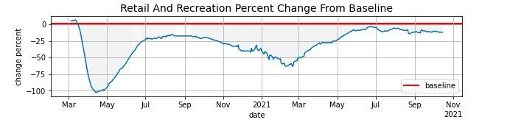
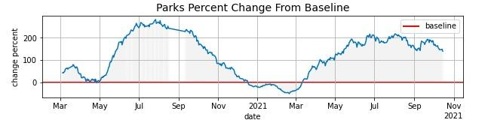
Daily Mobility Trends

Slide 6
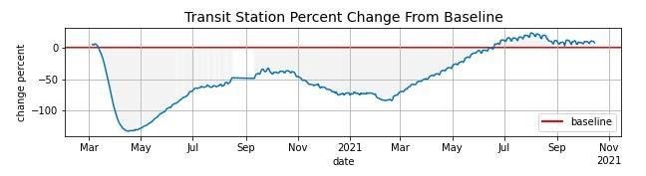
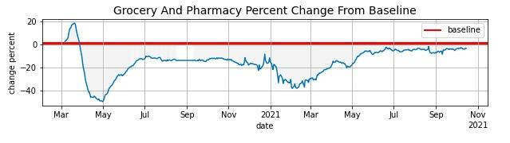
Daily Mobility Trends

Slide 7
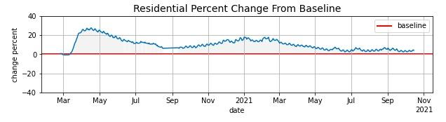
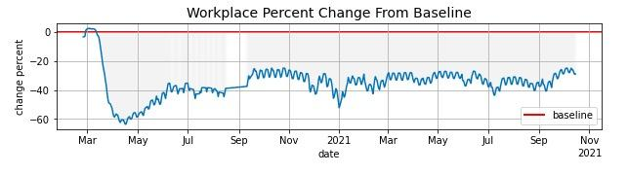
Daily Mobility Trends

Slide 8
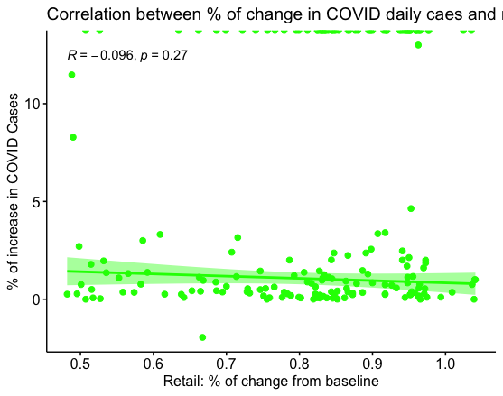
Retail and Recreation

Slide 9
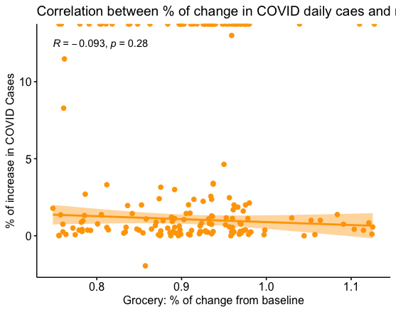
Grocery and Pharmacy

Slide 10
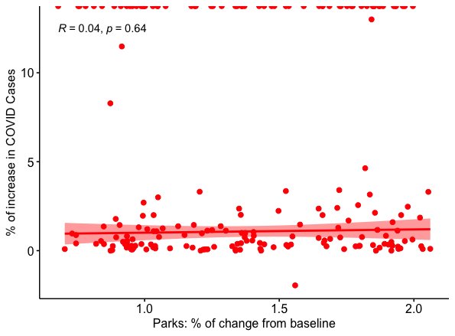
Parks

Slide 11
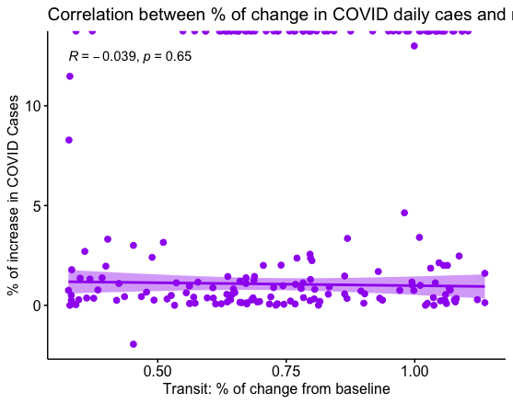
Transit Stations

Slide 12
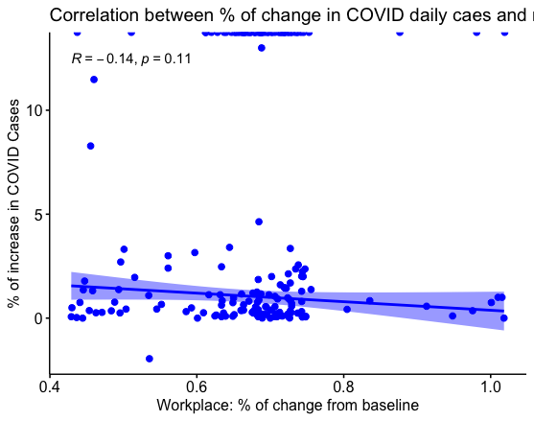
Workplaces

Slide 13
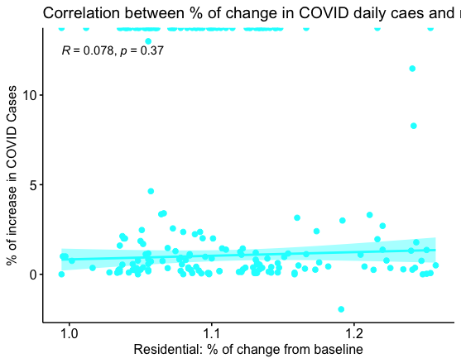
Residential

