Slide 1
Exponential quantum speedup in simulating coupled classical oscillators
< Womanium Quantum+AI Project >
- By Paarth and Hasnain

Slide 2
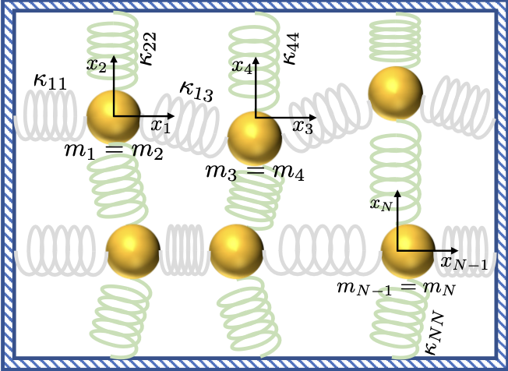
Problem Statement
< Womanium Quantum+AI Project >
For a system of N=2^{n} coupled harmonic oscillators(each with a mass and spring constant, and initial conditions):
Simulate their time evolution and estimate properties like kinetic energy
Using a quantum algorithm that efficiently encodes these dynamics into a quantum state and Provides an exponential quantum speedup for simulating such systems
Efficient and Optimized performance on quantum hardware
FIG 1: An example system of N/2 oscillators in D = 2 dimensions

Slide 3
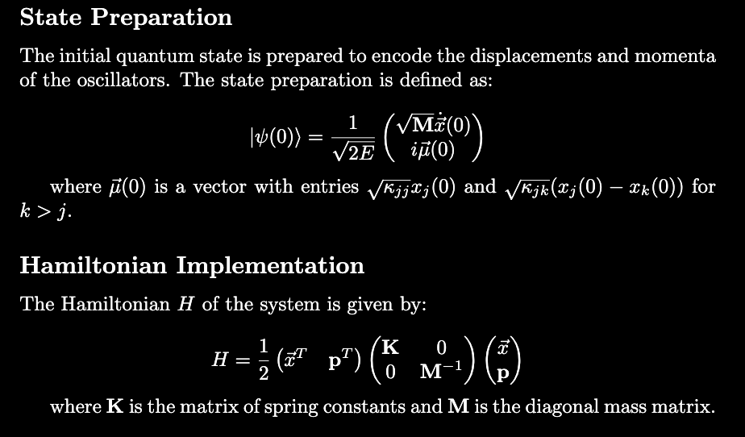
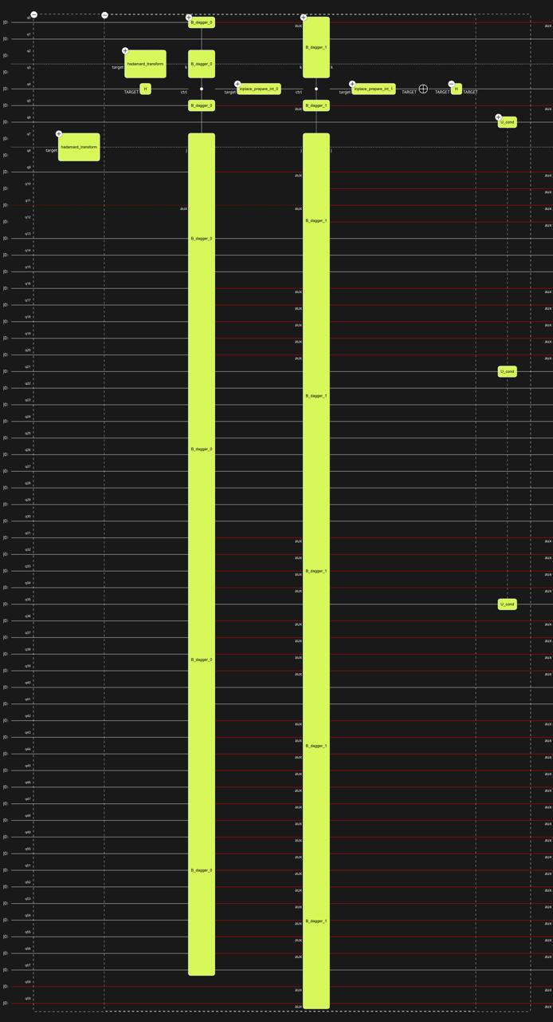
Solution
< Womanium Quantum+AI Project >
Fig.1 Hamiltonian’s Circuit

Slide 4
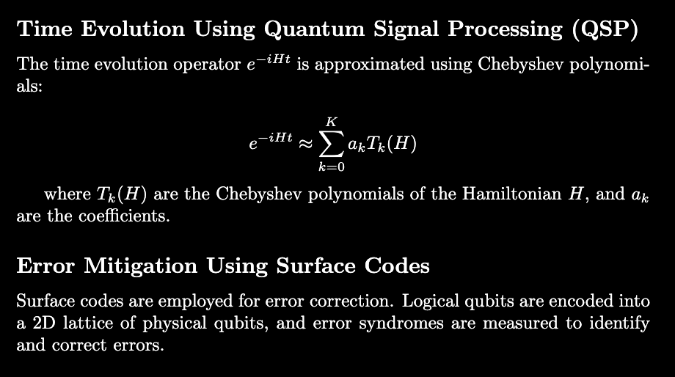
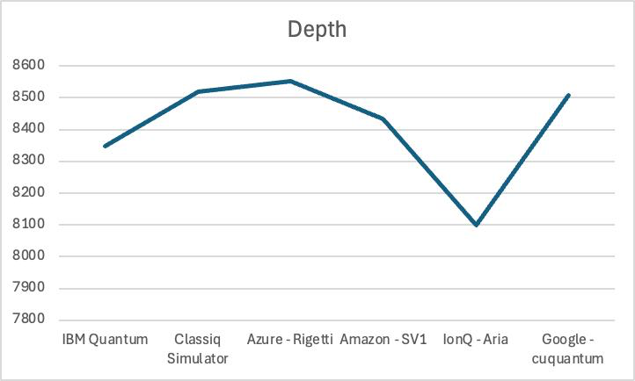
Solution
< Womanium Quantum+AI Project >
Fig.1 Circuit Depth vs Hardware

Slide 5
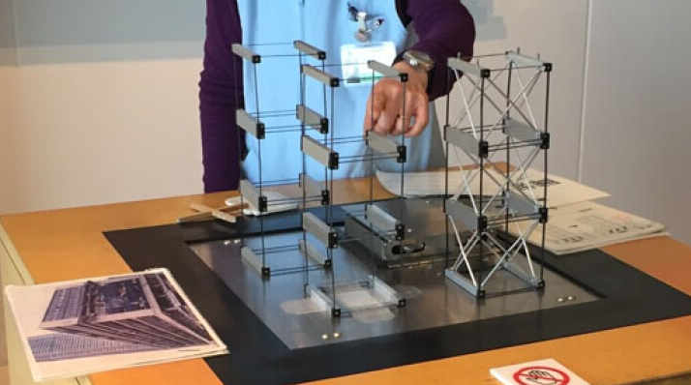
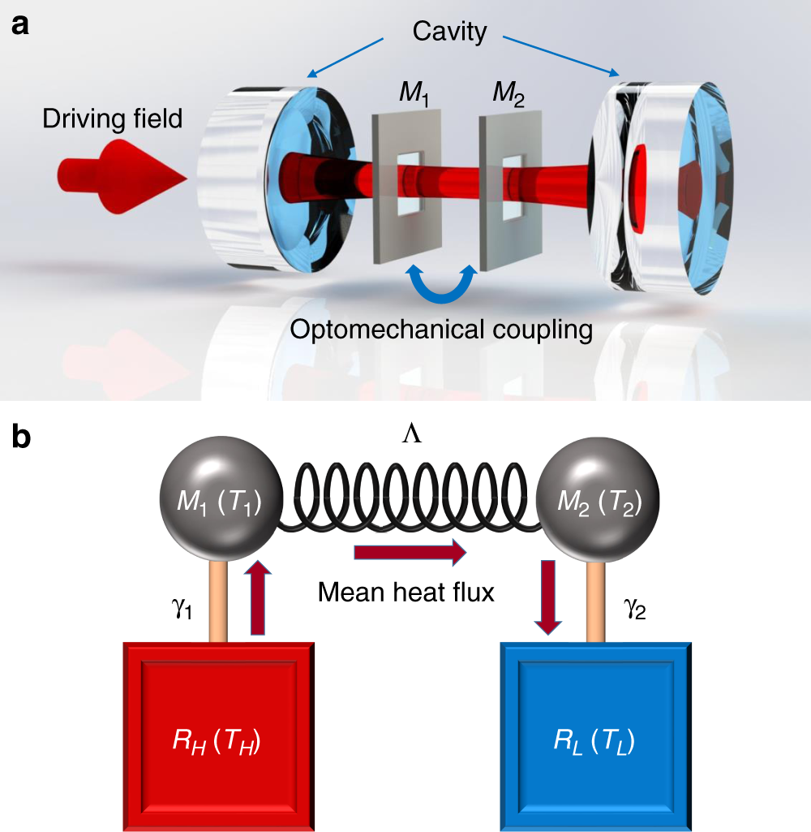
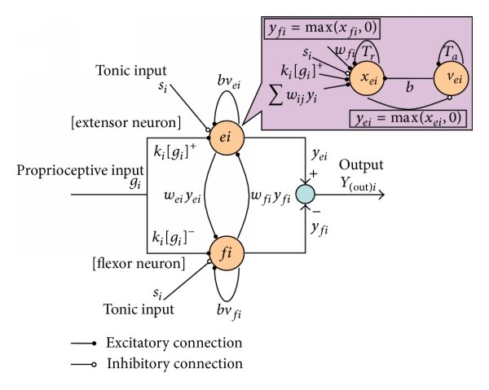
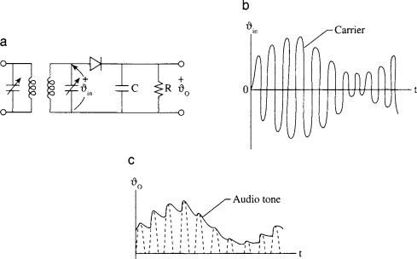
Scope & Applications
< Womanium Quantum+AI Project >
Applications: oscillators
Simulating the dynamics of mechanical structures, would enable efficient earthquake and Storm simulation software, and become a viable and inexpensive alternative to physical model testing.[Fig. 1]
Simulations of the vibrational modes of a material can predict its mechanical properties, thermal conductivity. This can be used in simulation software for the design of new materials. [Fig.2]
Coupled oscillators can model the activity of neurons. Efficient simulation of neural dynamics can help in understanding brain disorders. [Fig. 3]
Electrical circuits with capacitors and inductors can be modeled as coupled oscillators. The simulation can be used to study the transient response of electrical circuits, which is in the EV industry.[Fig. 4]
Scope:
- This simulation requires requires O(poly(N)) logical qubits, and would be highly useful once Quantum Computers with larger number of Qubits are built
Fig. 1
Fig. 2
Fig. 3
Fig. 4

Slide 6
Citations
< Womanium Quantum+AI Project >
https://www.sciencedirect.com/topics/computer-science/resonant-circuit
https://www.nwnewsnetwork.org/disasters-and-accidents/2017-03-24/japanese-earthquake-simulators-shake-you-out-of-complacency
https://www.researchgate.net/figure/Neural-oscillator-model-proposed-by- Matsuoka_fig1_282546989
https://www.nature.com/articles/s41467-020-18426-4
https://arxiv.org/abs/2303.13012
http://dx.doi.org/10.1103/PhysRevLett.118.010501

