Slide 1
SE 801 · SOFTWARE PROJECT LAB III
Adapta: A General Purpose Transfer Learning Framework
for Cross-Domain Classification
Presented by
Hasnain Sheikh
BSSE-1408
Supervised by
Dr. Mohammad Shoyaib
Professor, IIT, University of Dhaka
Notes:
Title slide. Introduce the project: a modular desktop framework that unifies transfer learning and domain adaptation methods for cross-domain classification.

Slide 2
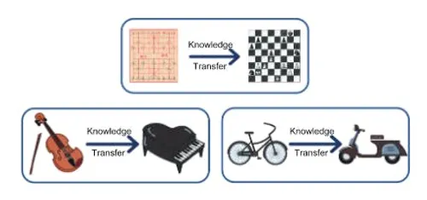
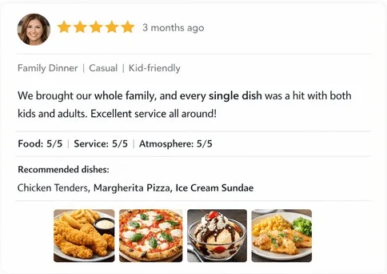
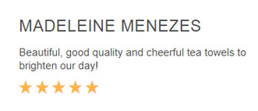
WHY TRANSFER LEARNING MATTERS
Applications of Transfer Learning
1
Object Recognition
Trained on: car images
→
Applied to: trucks & buses
A recognizer trained on cars already encodes wheels, windows, headlights, and body contours. Those features transfer to trucks and buses, so a new vehicle class needs no full labeled dataset of its own.
2
Sentiment Analysis
Trained on: book reviews
→
Applied to: food reviews
Cues such as "disappointing" or "worth every penny" carry across product categories, even though the vocabulary differs — plot and characters versus blender and warranty. Adaptation aligns the shared sentiment signal.
3
Software Defect Prediction
Trained on: firefox defect history
→
Applied to: predict chrome browser defect
A new project has no defect history to learn from. Cross-project defect prediction transfers a model built on a mature project’s labeled code metrics to flag defect-prone modules in the new one.
Notes:
Four application areas of transfer learning. Emphasise the common thread: each pairs a label-rich source domain with a label-scarce, differently distributed target domain. Software defect prediction is the application area most relevant to this project, since the OCMTL method the proposed OCMTL+ builds on was evaluated on cross-project defect prediction.

Slide 3
PROBLEM STATEMENT
What is wrong with how this is done today
1
Labeled data is scarce
Supervised learning needs annotated data that is costly, slow, and sometimes impossible to obtain for a new domain.
2
Source and Target from different class
Training and test data are assumed to share one distribution. In practice they rarely do, and accuracy drops sharply.
3
Implementations are scattered and incompatible
Reference code is split across MATLAB and Python with different input formats, interfaces, and reported metrics.
Notes:
Four problems with the current state: annotation scarcity, distribution shift, undetected negative transfer, and fragmented implementations.

Slide 4
MOTIVATION
Why this framework needs to exist
1
2
3
Reuse instead of re-annotate
One protocol, fair comparison
Know before you transfer
Transfer knowledge from a label-rich source domain so a usable model can be built without fully annotating the target.
Every method runs on the same data, preprocessing, and metric suite — so differences reflect the method, not the setup.
Domain similarity and MMD are measured up front, and negative transfer is flagged against a no-transfer baseline.
Beyond research, the framework is a teaching instrument.
A student / researcher can observe distribution shift, apply an adaptation method, and watch the two domain clouds move together — without first implementing any of the underlying mathematics.
Notes:
Three motivations plus the teaching angle. Emphasise that no single method dominates, so fair comparison infrastructure is itself the contribution.

Slide 5
OVERVIEW OF THE PROJECT
A modular desktop framework for cross-domain classification
Experiment pipeline
Methods: TCA · JDA · BDA · CORAL · GFK · JCSA · DALI · OCMTL · proposed
1
Load & validate datasets
Dataset Used:
Image Classification: COIL 20, MNIST, PIE, Office-caltech (Surf), Office-caltech (Decaf), Office-31 (Decaf)
Sentiment Analysis: Reuters, 20-Newsgroups, Amazon_reviews
Software Defect Prediction: NASA, AEEEM, RELINK, SOFTLAB
2
Assign source / target domains
3
Preprocess both domains
4
Apply transfer learning
5
Train baseline classifier
6
Evaluate on target domain
Built with
Python · PyQt · scikit-learn · NumPy · pandas · Matplotlib · Git & GitHub
7
Visualize & export results
Notes:
Overview slide. The highlighted pipeline step is the core research contribution area — the interchangeable adaptation layer.

Slide 6
QUALITY FUNCTION DEPLOYMENT
Normal Requirements
Dataset Import: Load datasets in .csv, .mat, and .arff formats.
Dataset Validation: Validate features, labels, and data quality.
Property Inspection: Display dataset statistics and properties.
Domain Assignment: Assign source and target datasets.
Preprocessing: Apply normalization, standardization to both domains.
Transfer Method Selection: Select a transfer learning method.
Hyperparameter Configuration: Configure method-specific parameters.
Classifier Training: Train the selected classifier.
Model Evaluation: Evaluate using standard classification metrics.
Result Display: Display results in tabular format.
Notes:
Eleven normal requirements — the baseline functional core of the framework.

Slide 7
QUALITY FUNCTION DEPLOYMENT
Expected Requirements
Report Export: Export results as PDF and CSV.
Feature Space Visualization: Visualize domains with PCA and t-SNE.
Experiment Dashboard: Display recent experiments and metrics.
Comparative Analysis: Compare multiple transfer learning methods.
Progress Feedback: Show experiment execution progress.
Experiment Persistence: Save and reload experiment configurations.
MMD Computation: Measure MMD before and after adaptation.
Error Handling: Report clear errors for invalid inputs.
Notes:
Ten expected requirements — these separate a usable research tool from a bare script runner.

Slide 8
QUALITY FUNCTION DEPLOYMENT
Exciting Requirements
Transfer method recommendation
Automated hyperparameter search
Domain similarity scoring
Rank the available methods by expected suitability for a given domain pair, using similarity, dimensionality and past outcomes.
Search a user-defined grid for the selected method and report the best-performing configuration.
Combine MMD, distribution overlap and class-conditional divergence into a pre-experiment advisory score.
Interactive alignment visualization
Batch experiment execution
Adaptation interpretability
Inspect individual points and toggle source and target subsets in a live scatter plot.
Evaluate every method over every domain pair of a dataset family to produce a full comparison matrix.
Report the contribution of individual feature dimensions to the alignment achieved.
Notes:
Six exciting requirements. The method recommendation and negative transfer advisory are the clearest differentiators from existing tooling.

Slide 9
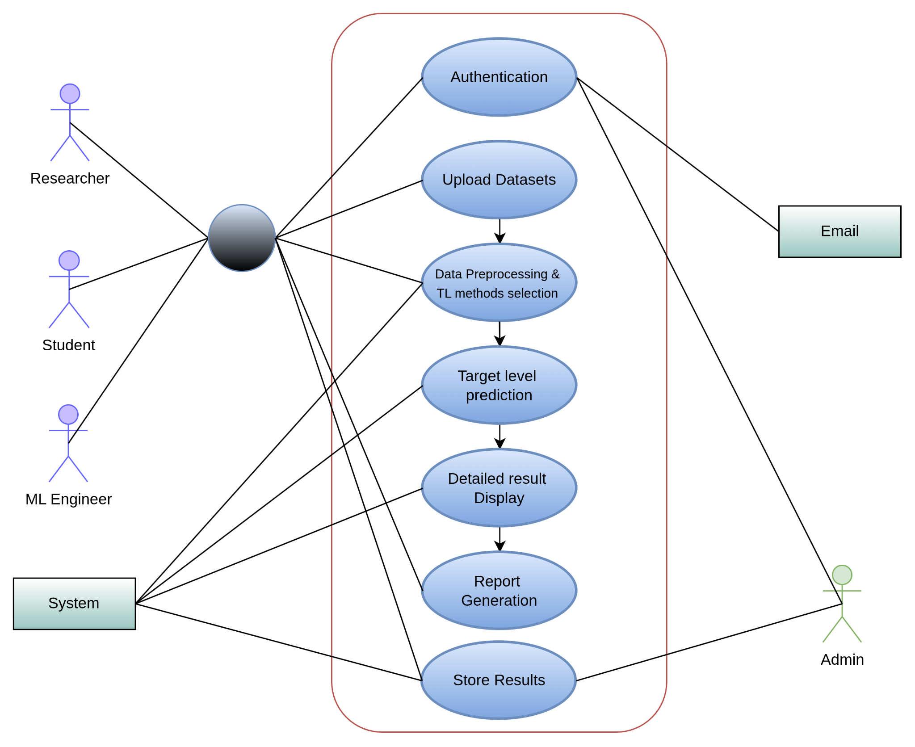
SCENARIO-BASED MODELING
Use Case Diagram
Actors
Primary
Researcher · ML Engineer · Student · System
Secondary
Admin · Email Service
Modules (Level 1 use cases)
Authentication
Upload Datasets
Data Preprocessing & TL Method Selection
Target Level Prediction
Detailed Result Display
Report Generation
Store Results
Figure: Level 1 use case diagram of Adapta
Notes:
Goal in context: the diagram shows the seven functional modules of the framework and the actors that interact with them.

Slide 10
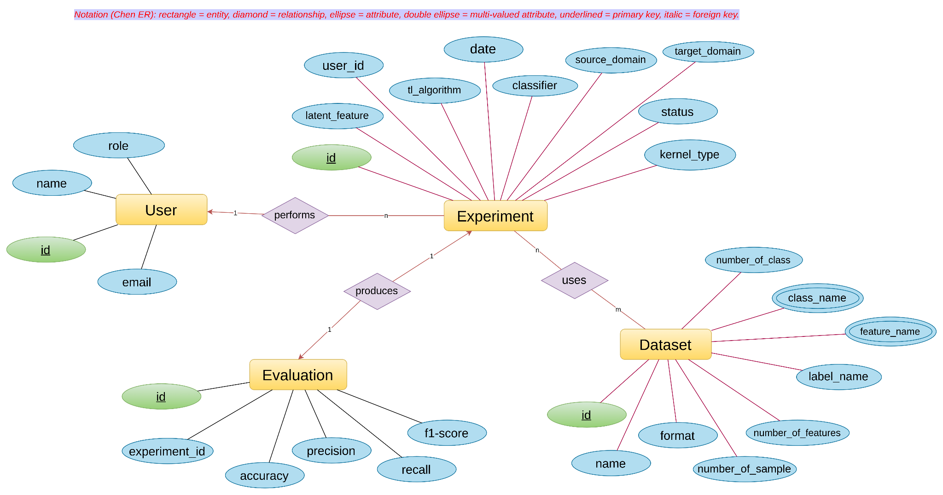
DATA & INFORMATION MODELING
Entity Relationship Diagram
Data objects identified for the framework:
User
id, name, email, role
Experiment
id, user_id, source & target domain, tl_algorithm, classifier, normalization, date, status, hyperparameters
Dataset
id, name, format, samples, features, feature & label names, classes
Evaluation
id, experiment_id, accuracy, precision, recall, f1-score
Figure: Entity Relation Diagram of Adapta
Notes:
Four entities. User performs many Experiments; an Experiment uses Datasets and produces exactly one Evaluation.

Slide 11
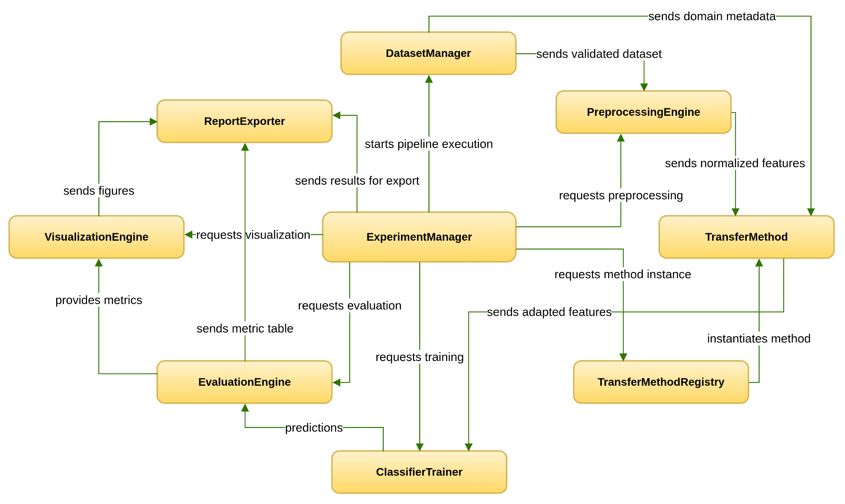
CLASS-BASED MODELING
Class Responsibility & Collaboration
The identified analysis classes:
DatasetManager
PreprocessingEngine
TransferMethod
TransferMethodRegistry
ClassifierTrainer
EvaluationEngine
VisualizationEngine
ExperimentManager
ReportExporter
ExperimentManager is the pipeline orchestrator
Figure: Class responsibility and collaboration (CRC) diagram
Notes:
Nine classes. Each collaborates through defined interfaces so that adding a new adaptation method touches only the registry and the method itself.

Slide 12
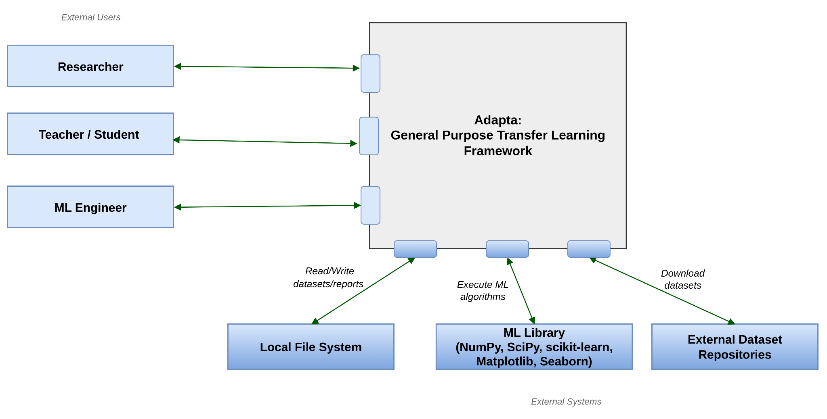
SOFTWARE ARCHITECTURE
Architectural Context Diagram
External users
Researcher
Teacher
Student / General people
External & peer systems
Local File System — dataset files, saved configurations, exported reports
ML Library— NumPy, SciPy, scikit-learn, Matplotlib, Seaborn
External Dataset Repositories — benchmark dataset sources
Figure: Architectural context diagram
Notes:
The framework sits between three categories of user above and three supporting systems below.

Slide 13
SOFTWARE ARCHITECTURE
Archetypes — Layered Architecture
A four-layer pattern with clear separation of concerns. Each layer interacts with adjacent layers through well-defined interfaces.
Presentation Layer
User Interface · Configuration Forms · Progress Monitor
Application Logic Layer
Experiment Orchestrator · Method Registry · Execution Engine · Configuration Validator
Paste the Archetypes Diagram here
Domain Logic Layer
Data Management · Preprocessing · Domain Adaptation · Learning · Evaluation · Visualization
Persistence Layer
Configuration Store · Result Cache · Export Writer · File Adapters
Notes:
Four layers. Modularity means adding a new adaptation method requires no change outside the Domain Logic layer.

Slide 14
SOFTWARE ARCHITECTURE
Top-Level Components
Each component exposes one interface, so dependencies run one way — from presentation towards domain logic.
UI Component IUserInteraction
Experiment Manager IExperimentControl
Dataset Manager IDatasetAccess
Preprocessing Engine IPreprocessing
Paste the Top-Level Component Diagram here
Method Registry IMethodCatalogue
Transfer Method Impl. ITransferMethod
Classifier Trainer IModelTraining
Evaluation Engine IEvaluation
Visualization Engine IVisualization
Report Exporter IExport
Notes:
Ten components. The Method Registry plus ITransferMethod interface is the single extension point of the system.

Slide 15
PRELIMINARY TEST PLAN
Testing Objectives
Ensure correct parsing of all supported dataset formats and accurate metadata extraction.
Validate proper handling of invalid datasets and input errors.
Confirm the correct application of preprocessing techniques.
Evaluate the correctness of the implemented transfer learning methods.
Validate the computation of evaluation metrics, including Accuracy, Precision, Recall, F1-score.
Ensure accurate generation of visualizations and result displays.
Validate experiment reproducibility using saved configurations.
Confirm successful generation of PDF and CSV reports.
Evaluate system responsiveness during long-running experiments.
Assess system performance on large-scale datasets.
Notes:
Nine testing objectives spanning data handling, numerical correctness, protocol integrity, and reproducibility.

Slide 16
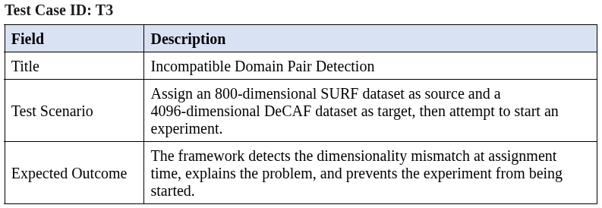
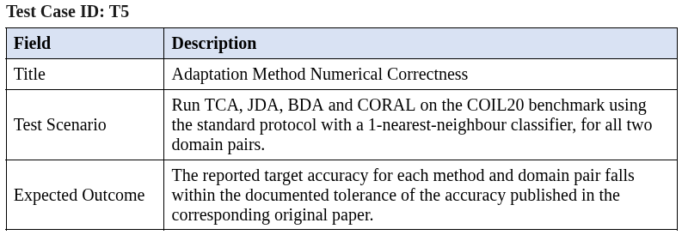
PRELIMINARY TEST PLAN
Example Test Cases
Notes:
Four representative test cases drawn from the full set of twelve in the technical report.

Slide 17
CURRENT STATUS
Work Progress
Done
In Progress
Incomplete
Requirement analysis & SRS
Use case and activity modeling
ER and CRC modeling
Architectural design & archetypes
Dataset management and validation
Preprocessing module
Baseline methods: TCA, JDA, BDA, CORAL
Report export (PDF)
Remaining methods: GFK, JCSA, DALI, OCMTL
Evaluation module and metric suite
Visualization module (PCA / t-SNE)
PyQt user interface integration
Proposed method
Negative transfer detection
Benchmarking and validation
Final technical report
Report export (CSV)
Notes:
Adjust these three columns to reflect actual progress before presenting.

Slide 18
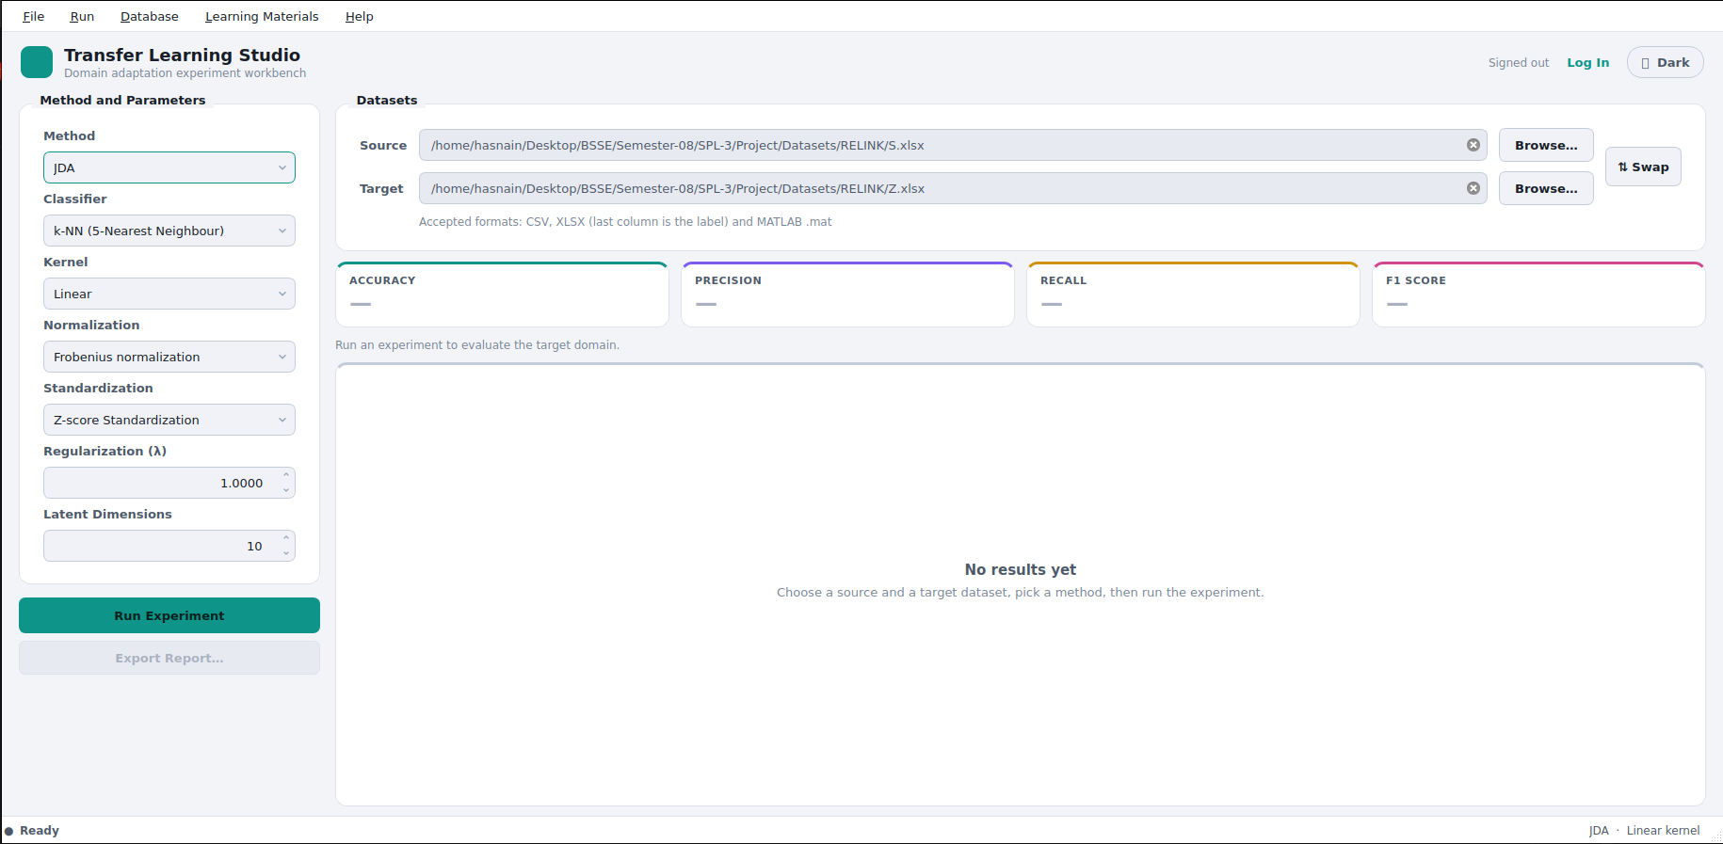
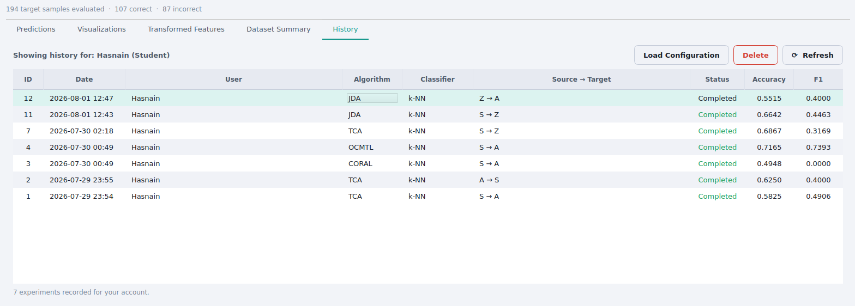
IMPLEMENTATION
User Interface
Dataset management · experiment configuration · results and visualization panels
Notes:
Replace each placeholder with a screenshot of the running application.

Slide 19
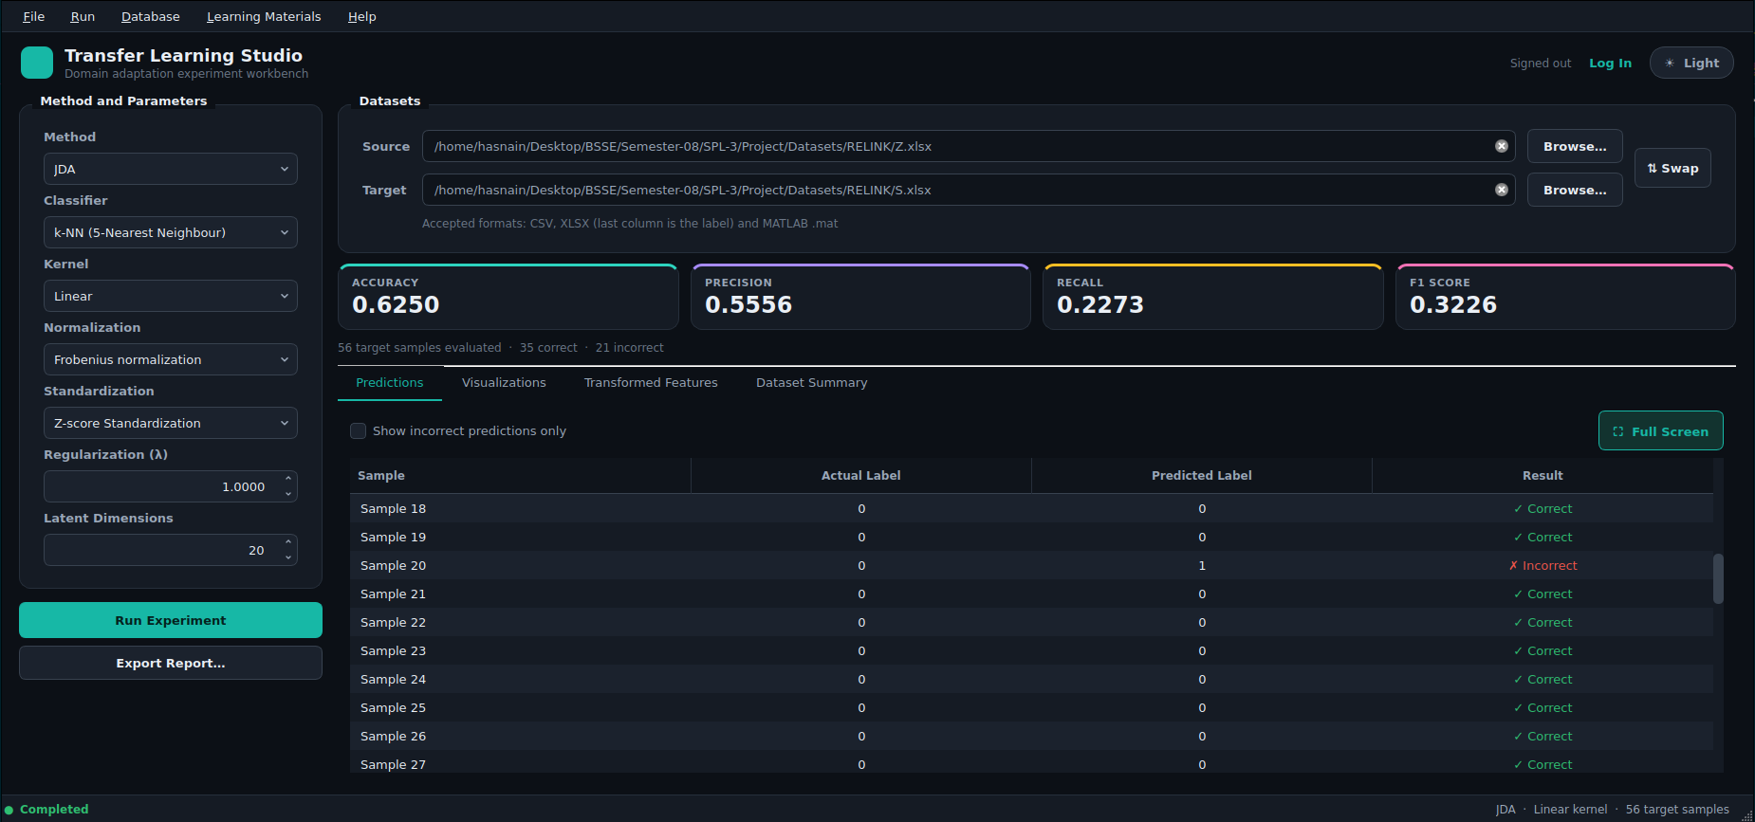
Notes:
Replace each placeholder with a screenshot of the running application.

Slide 20
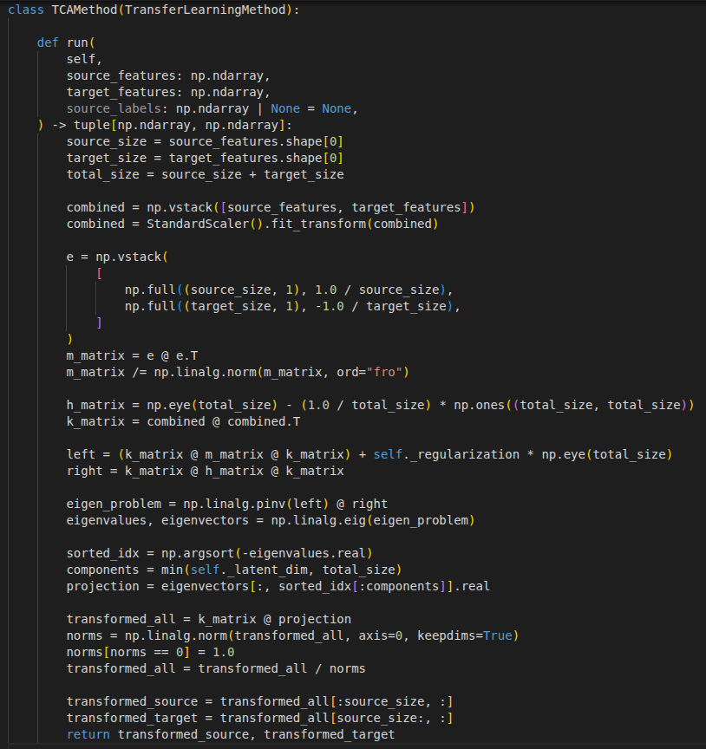
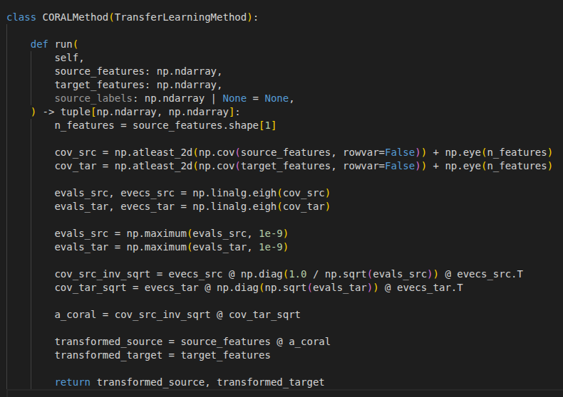
IMPLEMENTATION
Source Code
Notes:
Suggested: show the abstract TransferMethod interface alongside a concrete method such as BDA, to demonstrate the extension point.

Slide 21
Thank You
Questions and feedback are welcome.
Hasnain Sheikh · BSSE-1408 · Institute of Information Technology, University of Dhaka
Notes:
Closing slide.

