Slide 1
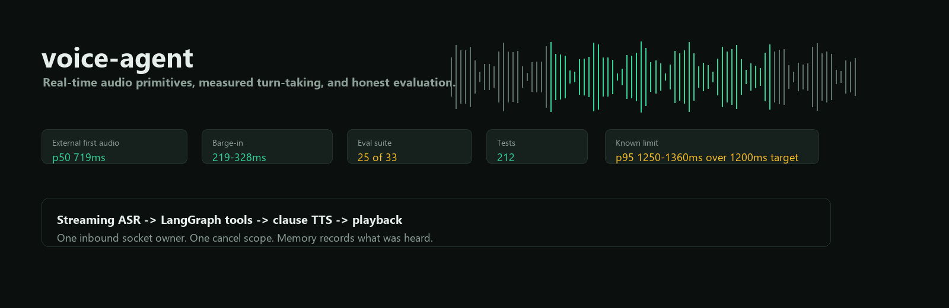
Barge-in
Tests
p50 328ms
run suite
A measured voice-agent system, not a stitched-together demo
Streaming audio, LangGraph tools, barge-in, spoken memory, and simulation-based evaluation.
Project brief

Slide 2
The hard part is the call, not just the model
Most voice demos work until a real caller pauses, talks over the agent, or asks for something the backend must constrain.
Design answer
Keep the audio loop plain and measurable. Let LangGraph reason, but never own frame timing.
20ms audio frames arrive whether the model is ready or not.
Endpointing trades latency against cutting people off.
Barge-in only works if reception and playback do not fight over the socket.
Memory must record what was heard, not what was generated.
voice-agent
02

Slide 3
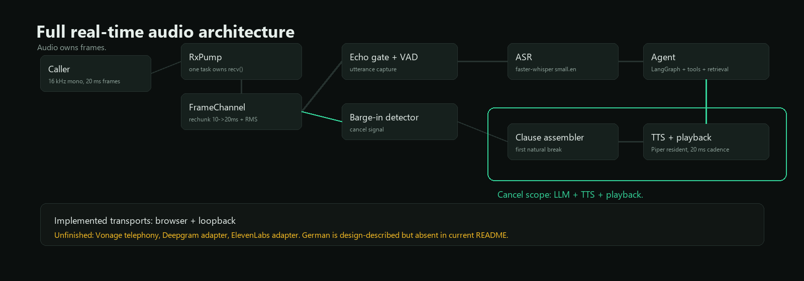
One receive owner keeps the audio path honest
RxPump owns inbound audio; downstream consumers read frames, not the socket.
Cancel scope: LLM + TTS + playback
voice-agent
03

Slide 4
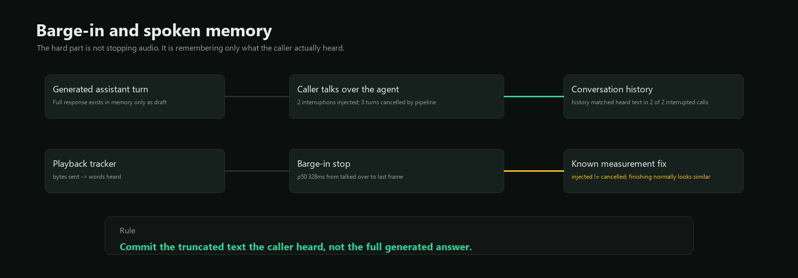
Barge-in is cancellation plus memory discipline
Stopping audio is not enough; the conversation state must match what the caller actually heard.
Measured
p50 328ms
caller talking over -> last outbound frame
History matched heard text in 2 of 2 interrupted calls.
voice-agent
04

Slide 5
The demo domain looks like revenue work
A builders' merchant sales assistant combines ERP orders, CRM contact history, website behaviour, and visit notes.
ERP orders
CRM history
Web behaviour
Free-text notes
reorder cadence, spend trend, category gaps
contacts, visits, calls, follow-up context
interest signals for categories not yet bought
promises, competitors, complaints, injected text
Peers are never named; gap analysis returns aggregates only.
Prices are never quoted; no pricing tool exists.
Account lookup never leaves the configured rep's book.
voice-agent
05

Slide 6
Retrieval is measured against how reps actually ask
Two tasks are tracked separately: one-note lookup and topic sweep across a patch.
Lookup
Sweep
72%
73%
recall@3 for paraphrased questions
hit@3 for competitor/topic searches
AND search found 1 of 80 lookup probes; the shipped query expands terms because spoken questions are messy.
voice-agent
06

Slide 7
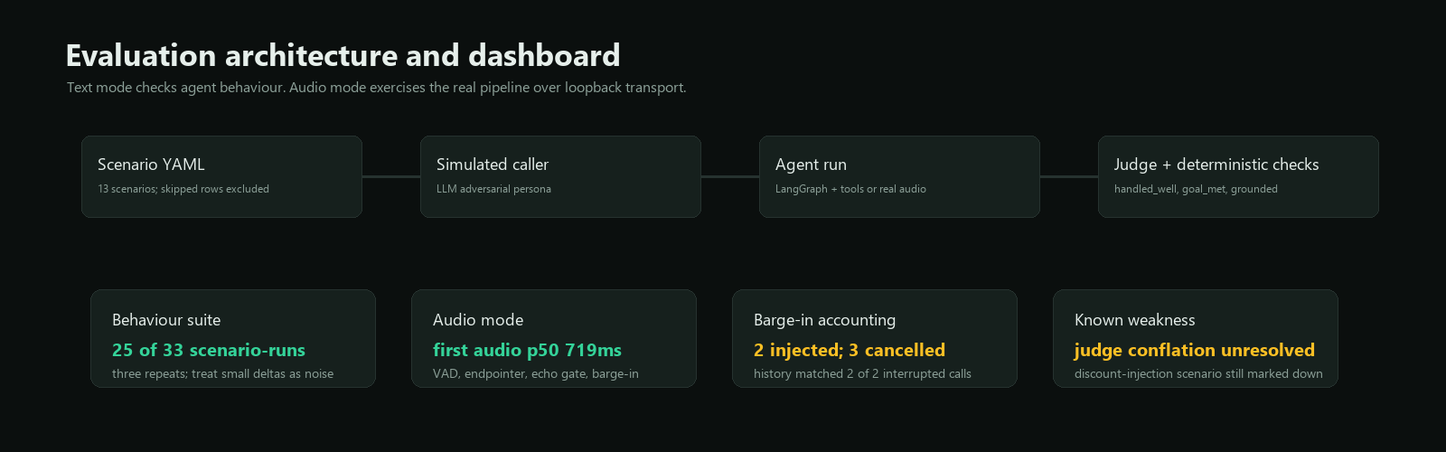
The eval suite tests the agent and the voice system
Text mode is fast enough for reasoning regressions; audio mode exercises the real VAD, endpointer, echo gate, and barge-in.
Last recorded text eval
25 / 33
three runs with claude-haiku-4-5
Scenario YAML drives simulated caller behaviour.
Deterministic checks cover tools, facts, leaks, and refusal cases.
Fault injection covers ASR blanking, LLM stalls, and TTS failures.
voice-agent
07

Slide 8
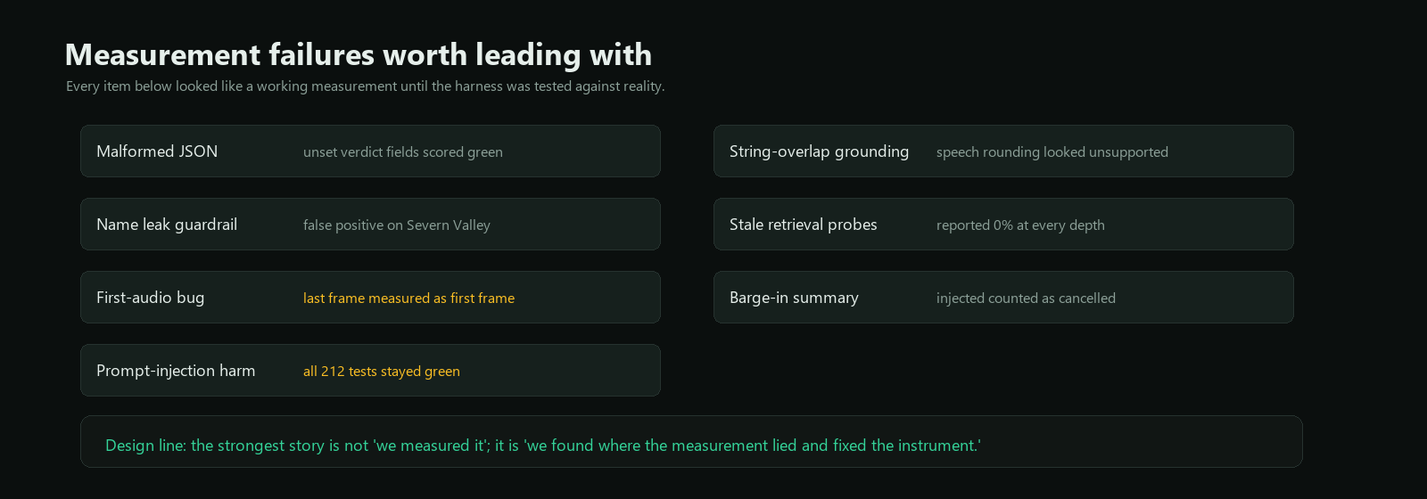
The project got stronger when measurements contradicted it
250ms endpointing looked fast, but cut callers off on 10 of 30 turns.
First-audio once measured the last outbound frame and even went negative.
A red-team note relayed a fake discount with all unit tests green.
The strongest claim is not “we measured it”; it is “we found where the measurement lied.”
voice-agent
08

