Slide 1

UniTrack Learning Management System
DBMS-Based Full-Stack Web Application
Presented By:
Hasnain Ahmed Ansari | FA23-BSCS-0134

Slide 2
Project Overview
Simplify university academic operations using database-driven automation
Secure access for Admins, Students, and Instructors
Manage course availability, student enrollments, and grading
Key Modules:
Student, Instructor, Admin, Courses, Departments, Grades

Slide 3
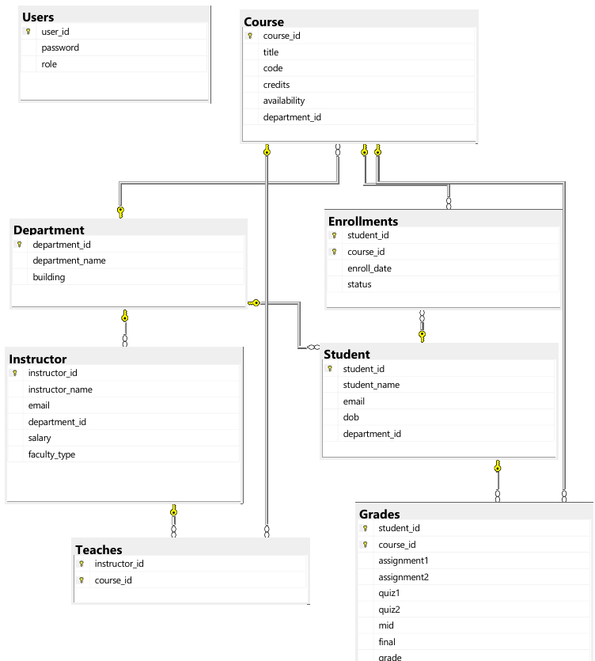
DBMS Focus – ER Diagram & Schema
Core Entities: Student, Instructor, Course, Department
Relationships:
One-to-Many: Department → Courses, Students
Many-to-Many: Students–Courses, Instructors–Courses
Schema Highlights:
Normalized tables
PKs, FKs, Prefixed user_id (e.g., S1, I2)

Slide 4
DBMS Features – Constraints & Triggers
Constraints:
CHECK (grade ranges, availability)
UNIQUE (email, course code)
FK/PK integrity
Triggers:
Prevent enrollment in closed courses
Auto-insert login in Users
Prevent instructor assignment to closed courses
Auto-grade calculation

Slide 5
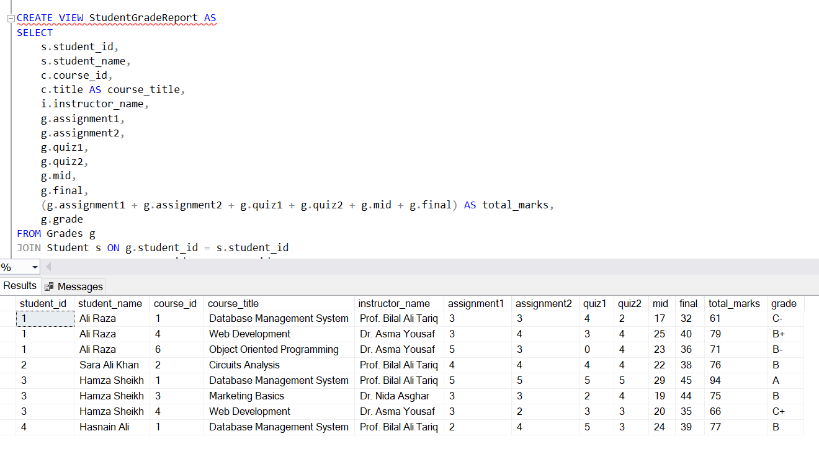
Views & Stored Procedures
Views:
StudentGradeReport
InstructorCourses
CourseEnrollments
Stored Procedures:
sp_AssignGrades – grading logic
sp_AssignInstructorToCourse – validates + assigns

Slide 6
Technology Stack
Frontend: React.js, Tailwind CSS
Backend: Node.js, Express.js
Database: Microsoft SQL Server
Communication: Axios, REST API
Architecture:
React → Axios → Express → MSSQL → Views/Procedures

Slide 7
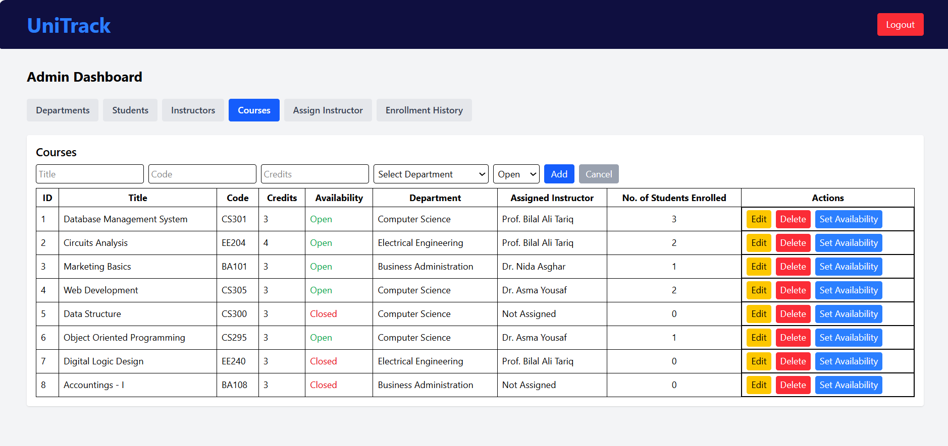
Demo Flow
Admin: CRUD Operations, toggle availability, assign instructors, view enrollments history.
Student: view/enroll courses, view grades
Instructor: view courses, assign grades
Triggered errors
Grade reports via view
Real-time DB updates

Slide 8
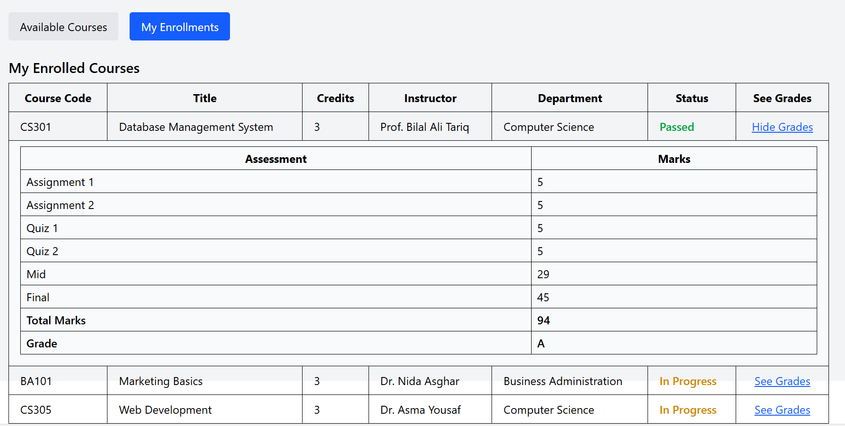
Conclusion
Strong focus on DBMS concepts
Practical use of constraints, triggers, views, stored procedures
Full-stack architecture
Future enhancements: class scheduling, analytics

