Slide 1
Muhammad Hasnain Data Analyst/Data Engineer
Computer Science Graduate – UBIT (Dec 2025)
Skilled in SQL, Python, Excel, Power BI
Experience in Data Cleaning, ETL , Data Modelling & Dashboards
Currently Learning Cloud Data Engineering (SMIT)

Slide 2
Los Angeles Crime Analytics Dashboard
This project analyzes crime data in Los Angeles.
Identifies patterns based on time, location, crime type, and severity.
Converts raw crime data into meaningful insights.
Helps in understanding public safety trends for better decision making.

Slide 3
Rising Crime & Data Gaps
Law enforcement agencies in Los Angeles face rising crime rates year over year. They lack visibility into high-crime areas, peak timing, and whether cases are being resolved. Without a dashboard, they cannot allocate patrol resources effectively. This leads to delayed response and increased public safety risks.

Slide 4
Dataset Overview
Crime dataset of Los Angeles from 2015 to 2019
Contains detailed records of each crime incident
Includes date, time, area, crime type, and victim information
Also includes weapon usage, location (latitude/longitude), and case status
Used to analyze crime trends, patterns, and severity

Slide 5
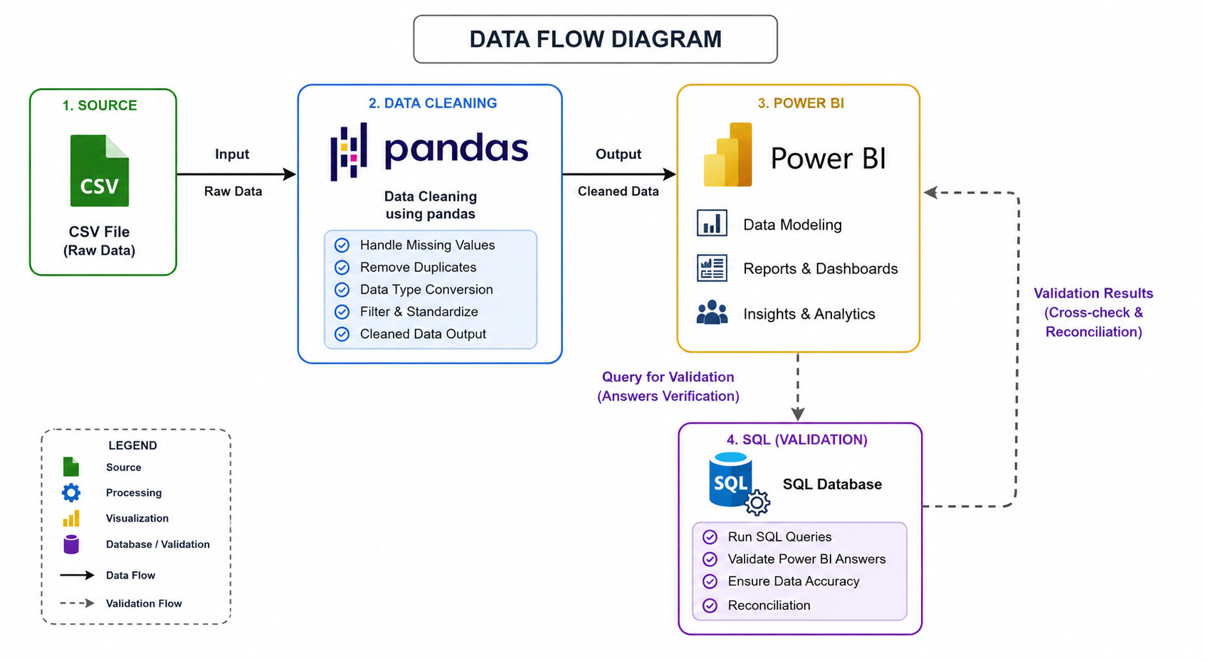

Slide 6
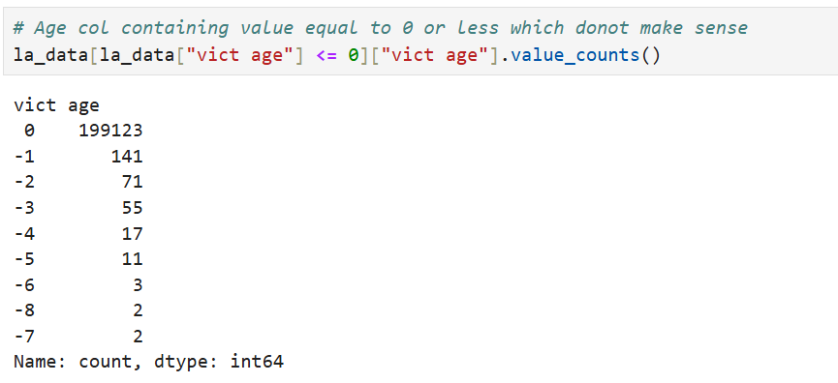
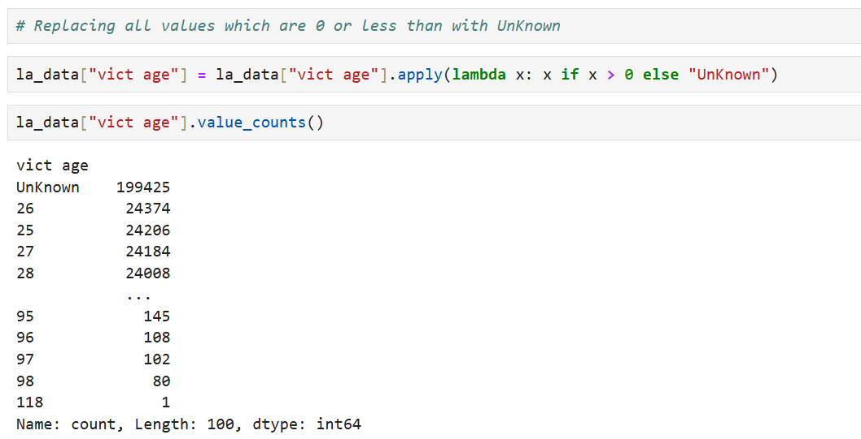
Data Cleaning & Preparation
Performed multiple data cleaning and transformation steps to ensure data quality. Below is one example from the Victim Age column.
Invalid Age Values (≤ 0)
Cleaned Data (Unknown Replaced)
Conclusion:
Identified unrealistic values and handled them appropriately to improve data consistency and ensure accurate analysis.

Slide 7
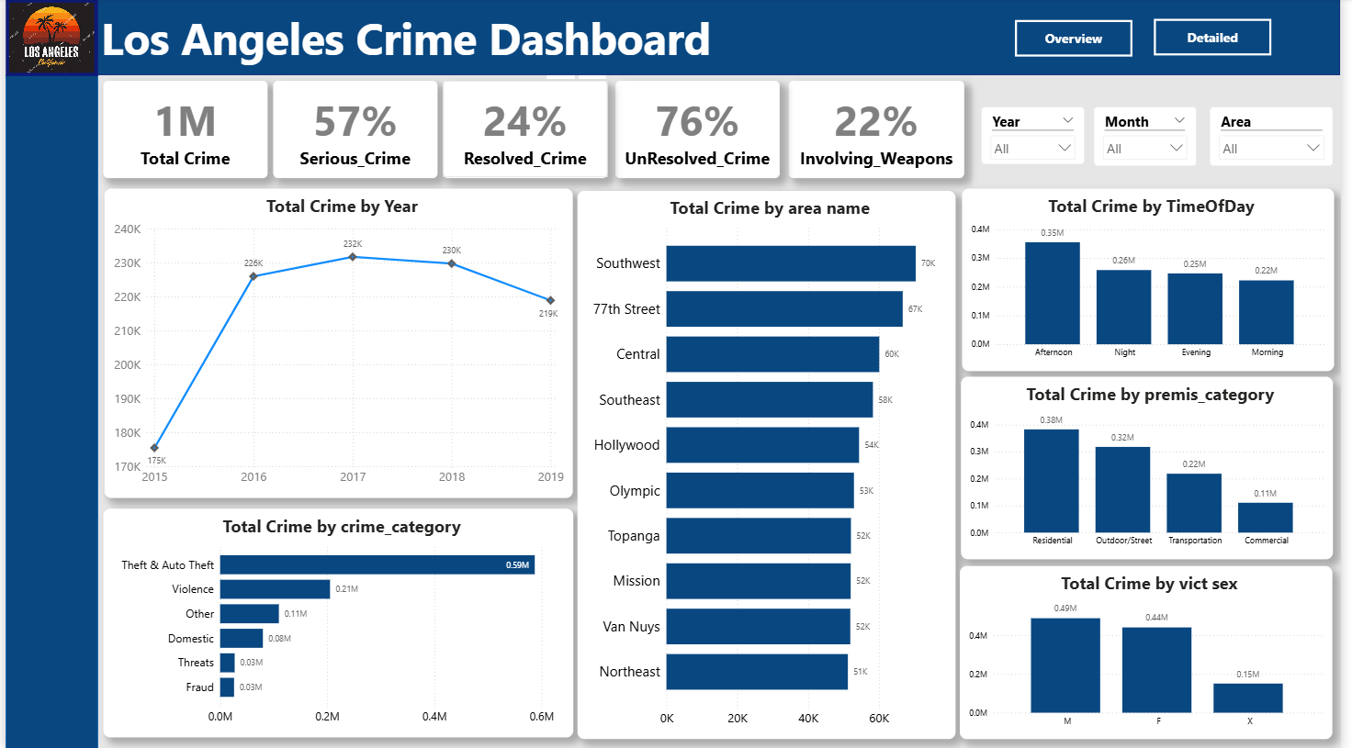
Crime Overview Dashboard
Peak crime year: 2017 with 232K incidents
Southwest records the highest crime volume at 70K incidents
Afternoon accounts for the most crimes: 350K occurrences
Residential premises lead with 380K crimes – highest risk location
Theft & auto theft is the top category: 590K cases

Slide 8
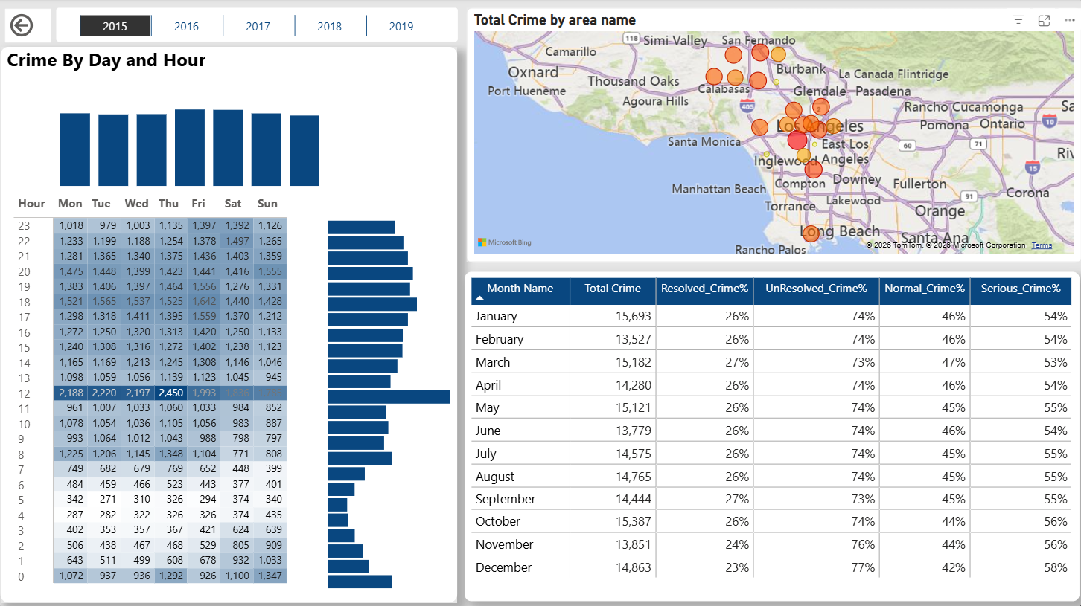
Crime Detailed Dashboard
Crime peaks on weekend afternoons (12 PM – 8 PM), with Fridays and Saturdays showing the highest volume.

Slide 9
Key Insights for Law Enforcement
❓ Where and when should patrol resources be concentrated?
Southwest area – highest crime volume (70K incidents) – deploy additional units.
Afternoon (12 PM – 6 PM) – peak crime window (350K occurrences) – increase daytime patrols.
Weekend afternoons (Friday & Saturday, 12 PM – 8 PM) – highest density – prioritize weekend shifts.
❓Which crime types and locations pose the greatest threat to public safety?
Theft & Auto Theft – #1 category (590K cases) – launch targeted prevention campaigns.
Residential premises – 380K crimes – highest risk for residents; recommend neighborhood watch and security lighting.
Weapon involvement (22% of crimes) – elevates threat level – fast response protocols needed.
❓Are crimes being resolved effectively, and is the trend improving?
Unresolved crimes: (76% of total) – major backlog; strong need for more investigative resources.
Resolved crimes: 22% – relatively low resolution rate.
Crime peaked in 2017 (232K) and declined to 219K in 2019 – positive trend, but still elevated.
Serious crimes: 225K – nearly half of all incidents; prioritize unresolved serious cases for detective units.

Slide 10
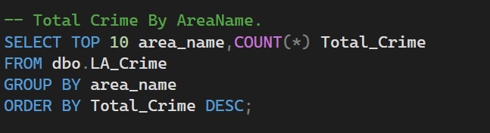
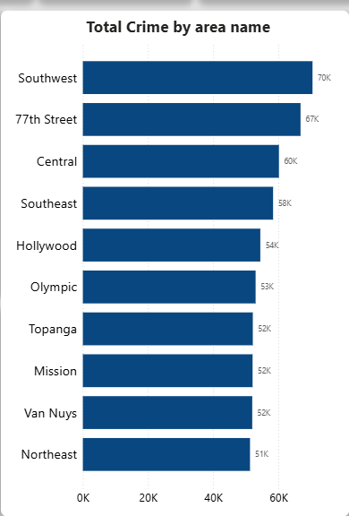
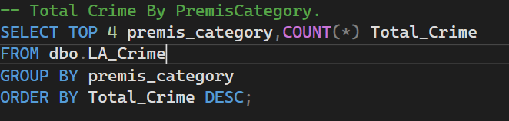
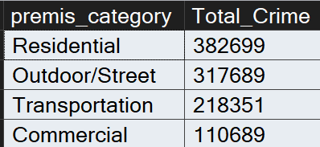
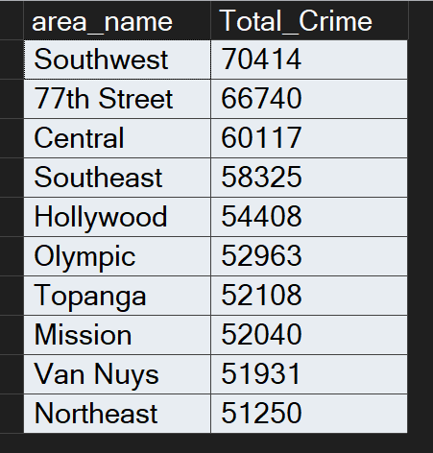
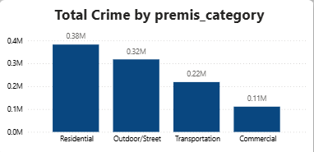
Data Validation Using SQL
Purpose of Validation : Cross-checked results between raw and cleaned data

Slide 11
Conclusion
Behind every data point is a real-world incident
Patterns in data help reveal where attention is needed most
Clear insights support smarter and more informed decisions
Project Resources
Complete project and materials available on GitHub
Thank you for your time and consideration I appreciate the opportunity and look forward to your response

