Slide 1
Teaching Matilda in an ESL Context
Course: Anglo-American Culture.
Topic: Teaching Matilda .
Name: Ahmad Hasnain .
ID: 302630197.

Slide 2
Target Context
Age: 12–15 (Secondary)
Level: Intermediate ESL
Setting: International classroom
Students respect authority
Limited exposure to Western culture

Slide 3
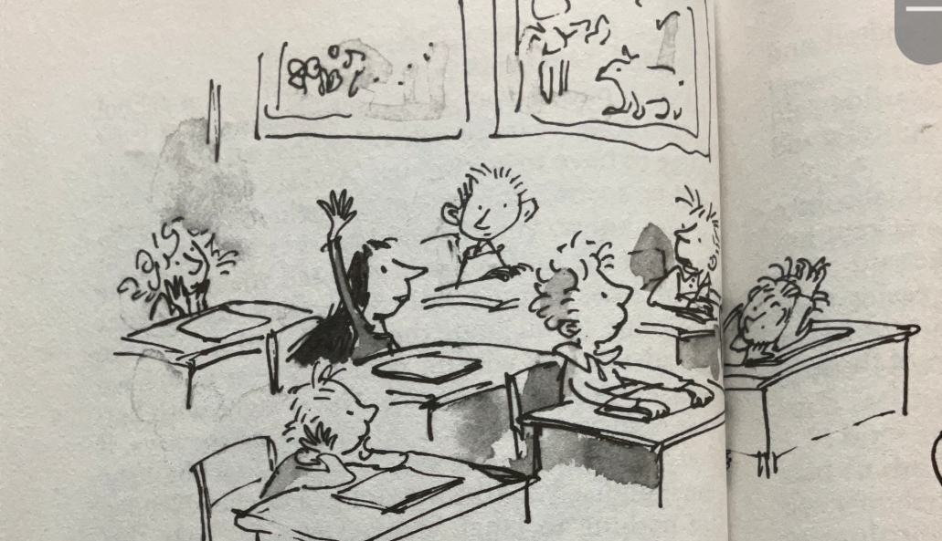
Why Matilda?
Simple and engaging language
Relatable school setting
Introduces independence
Challenge: cultural differences in authority and humor

Slide 4

British Cultural Values
1. Individualism
2. Resistance to Authority
3. Humor and Discipline

Slide 5

Individualism
Matilda is independent
Reads and solves problems alone
Students learn different thinking styles

Slide 6

Resistance to Authority
Matilda challenges unfair rules
Encourages critical thinking
Important contrast with strict cultures

Slide 7

Teaching Approach
Discussion-based learning
Cultural comparisons
Guided questioning

Slide 8
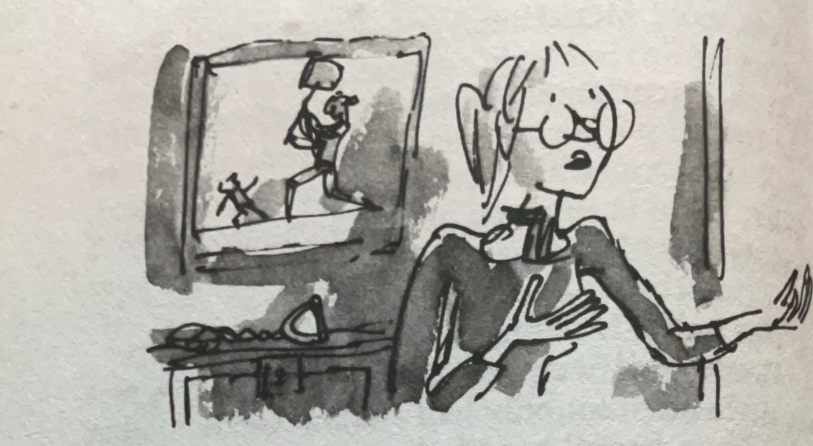
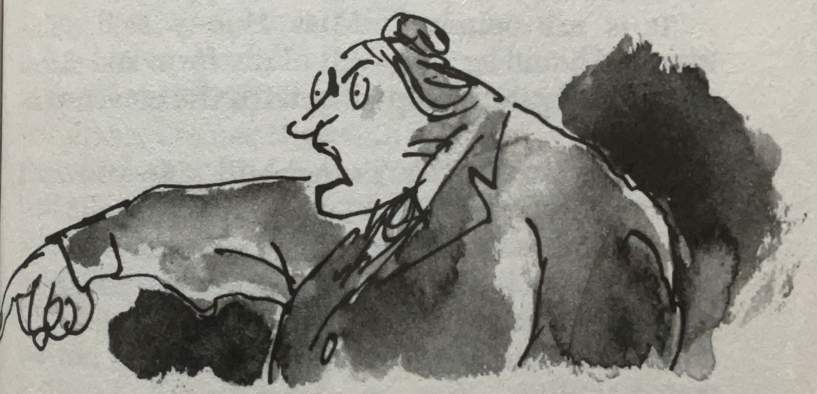
Classroom Activities
Role Play (Matilda vs Trunchbull)
Compare UK vs Home Culture
Group Discussion

Slide 9
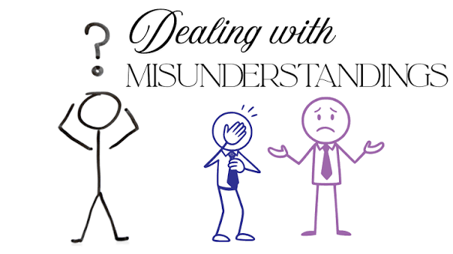
Handling Misunderstandings
Explain difference between disrespect and justice
Encourage respectful discussion

Slide 10
Theoretical Link (culture texts and context)
Knowledge of cultures
Skills to compare
Open attitudes
Critical cultural awareness
Welcomeing

Slide 11
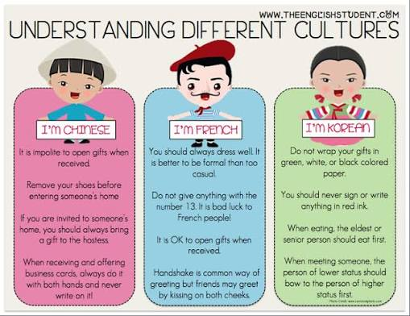
Culture Difference.

Slide 12
Conclusion
Matilda teaches language, culture, and thinking.
Helps students understand global perspectives and alot of complicated words with continivity.

Slide 13

Open to Questions?

