Slide 1

AN AGGREGATOR FOR E-SHOPPING Guided by Dr. Vinod Pathari
Presented by
HASNAIN SAJJAD
M120389CA

Slide 2
OUTLINE OF PRESENTATION
Introduction
Background
Motivation
Design
User Interface
Conclusion
Work Done
Reference

Slide 3
INTRODUCTION
The “An aggregator for e-shopping” project attempts to bring many of the online shops on one platform, where user can easily access items from different websites. When a user enters a query, this site generates a query for different e-shopping websites. Then based on the searched query it gathers links of all resulting e-shopping websites with their price on a webpage. Now, user has an option to choose links based on their prices. After clicking on the link it will display the corresponding e-shopping website, where the user can see the details of the product and choose to buy.

Slide 4
BACKGROUND
There are a lot of online e-shopping websites from where user can directly navigate to the website and purchase the suitable product after comparing from different websites. Users usually purchase product from particular trusted e-shopping sites, and sometimes may be the user is unable to find actual product which they want, but user will go with the remaining options in the site, which is similar to the product available in the website. These online e-shopping sites are not beneficial for the user every time.

Slide 5
MOTIVATION
With boom in ecommerce sites there is increase in competition. People are in search for best discounts offered by different websites for the same product. When a user searches for a product to be bought he/she has to go to different websites priory known to him/her. This work is to provide an automated aggregator to do this job on the user’s behalf. Thus the required item is given prominence – what are wants – and not what the online seller has.

Slide 6
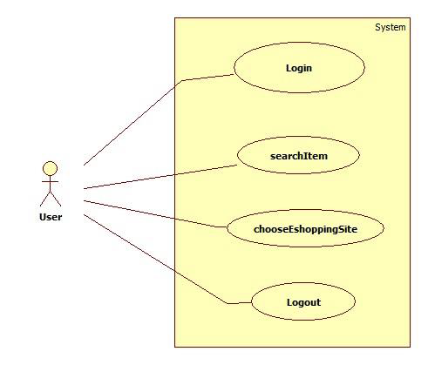
DESIGNS
Use case Diagaram
Figure 1.1: Use case

Slide 7
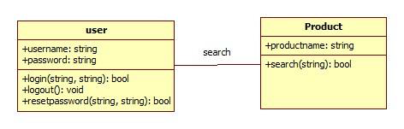
DESIGNS
Class Diagram
Figure 1.2: Class Diagram

Slide 8
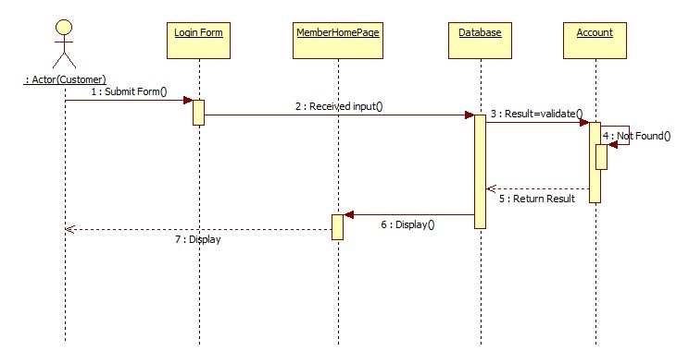
SEQUENCE DIAGRAM FOR LOGIN

Slide 9
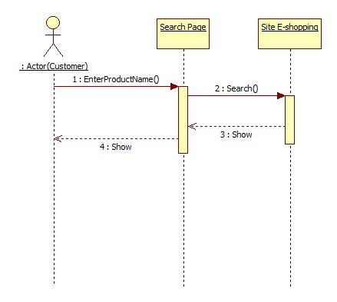
SEQUENCE DIAGRAM FOR SEARCH

Slide 10
USER INTERFACE
An aggregator for e-shopping Website will have a complete web based user interface which can run on any browser. This interface will be interactive form based which will be capable to get mouse inputs and keyboard strokes.

Slide 11
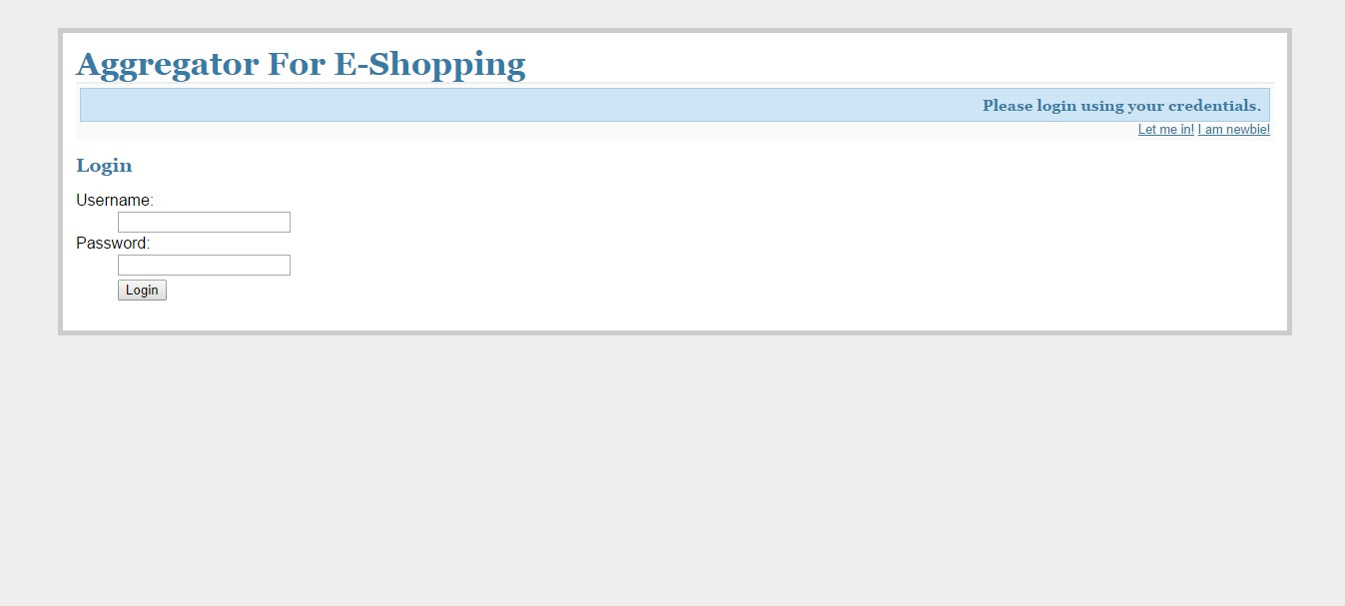
Home page: Displays the landing page from where user can choose different actions.

Slide 12
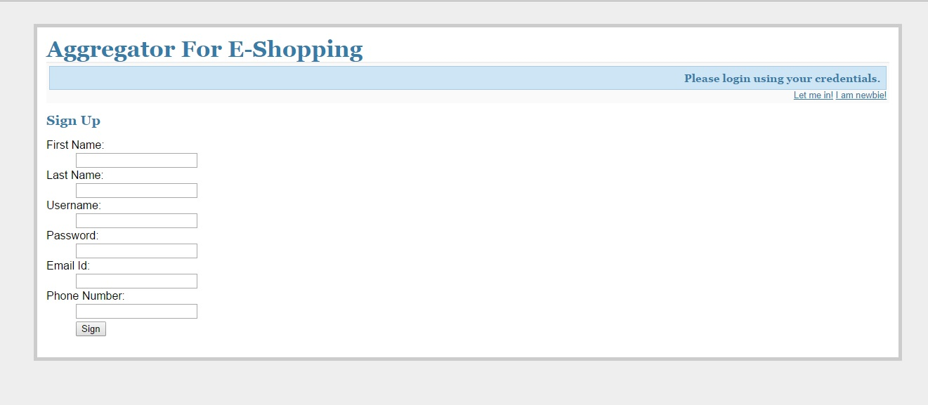
Sign Up page: User can sign up with their personal details.

Slide 13
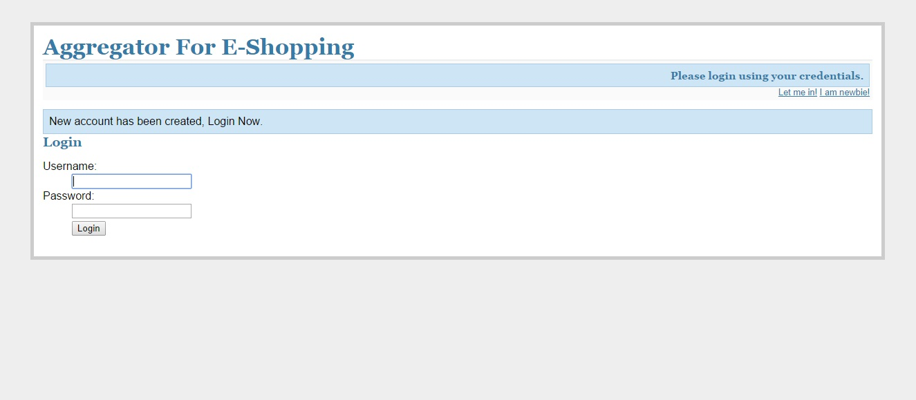
Login Page: User can login with username and password.

Slide 14
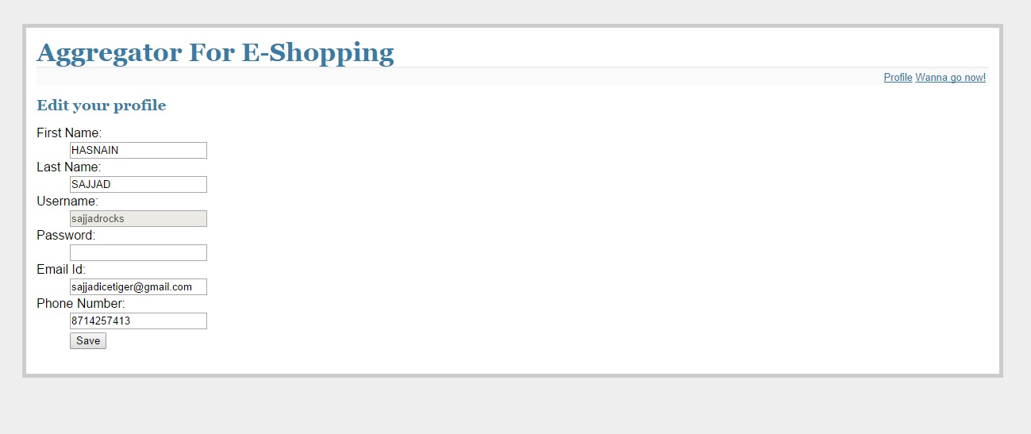
Edit Page: User can edit their details except username.

Slide 15
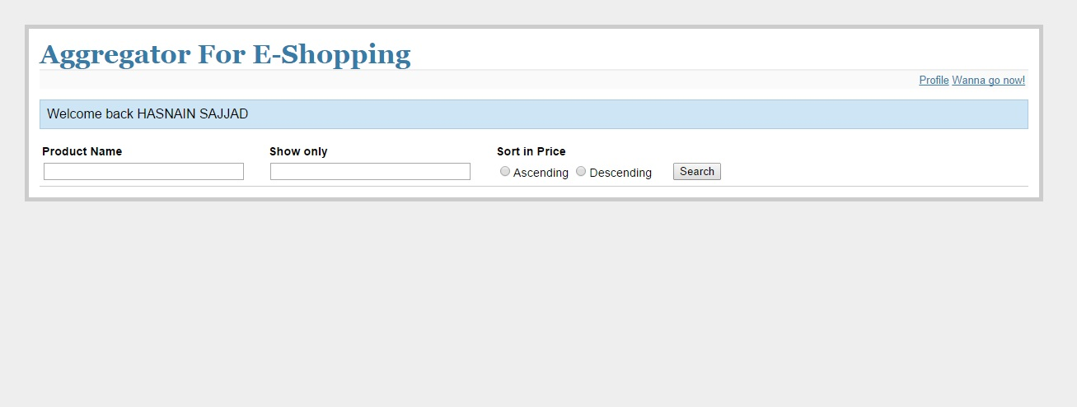
Search Page: Search field where user can search the specific product.

Slide 16
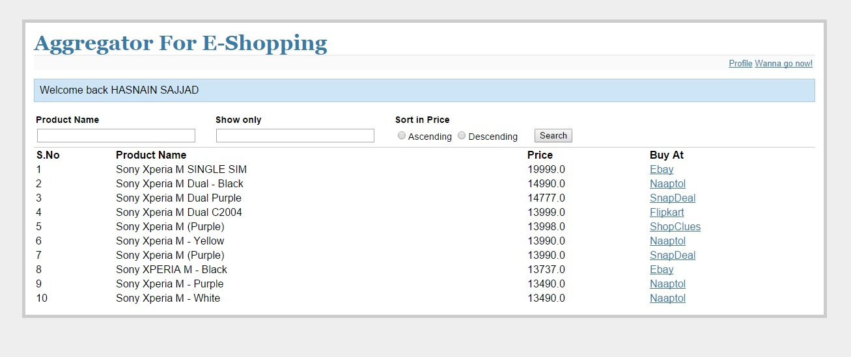
Search Result Page: Shows results of the search query entered by the user.

Slide 17
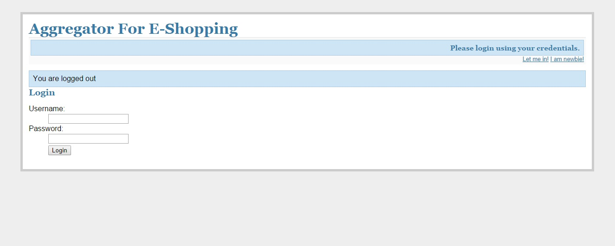
Logout Page: Display the successful logout.

Slide 18
CONCLUSION
An Aggregator for e-shopping saves time.
More efficient and more accurate.
A user gets what he/she wants; not what a single site has to offer.

Slide 19
WORK DONE
Understood the concept of “An aggregator for e-shopping”.
Created login system for user.
Created search item GUI.
Created search item mechanism.
Generated interface for website links in the searched item page.

Slide 20
REFERENCES
https://www.python.org/
http://www.codecademy.com/en/tracks/python
http://www.tutorialspoint.com/python/
Ramez Elmasri, Navathe, Fundamentals of Database Systems, fifth edition, 2013

Slide 21
Thank you.....

