Slide 1
Recap
Sessions 1-2

Slide 2

LINUX

Slide 3
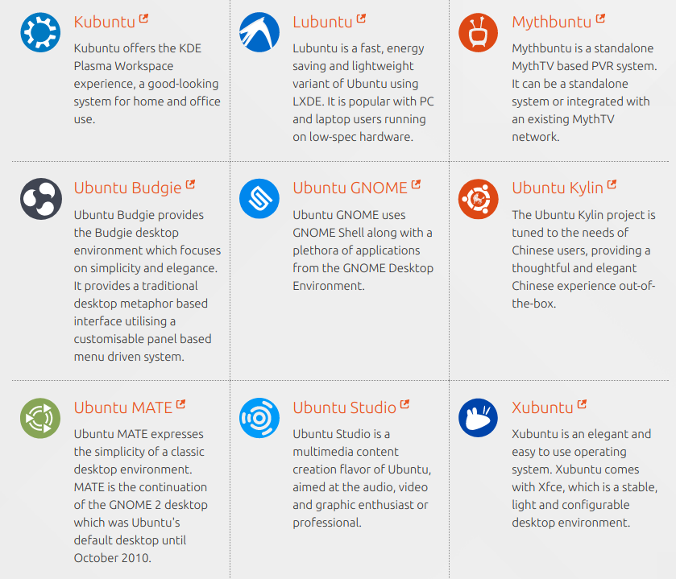
UBUNTU-FLAVORS

Slide 4
Installation Types
USB BOOT
DUAL BOOT
Virtual Machine
Docker New*

Slide 5
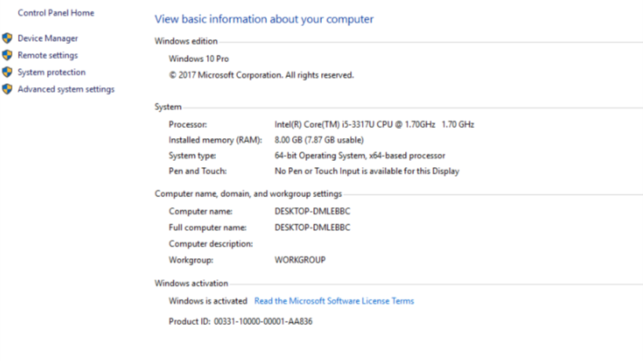
Check OS Version

Slide 6
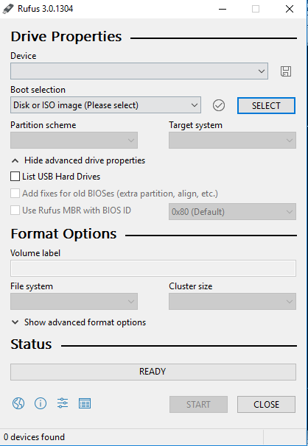
USB BOOT + DUAL BOOT

Slide 7
DUALBOOT-PRECAUTIONS
Legacy has maximum partitioning size of 2 Terabyte.
UEFI has partitioning size of 9 Zetabyte which is huge.
Legacy can have 4 Primary Partition.
UEFI can have 128 Primary Partitions.
Legacy is good for loading 2 OS on same system.
UEFI is Great for loading more than 2 OS on the single system.

Slide 8
1.VIRTUAL MACHINE
1) KUBUNUTU 16.04 LTS ISO
//https://kubuntu.org/getkubuntu/
2) Virtual Box
//https://virtualbox.org/wiki/Downloads

Slide 9
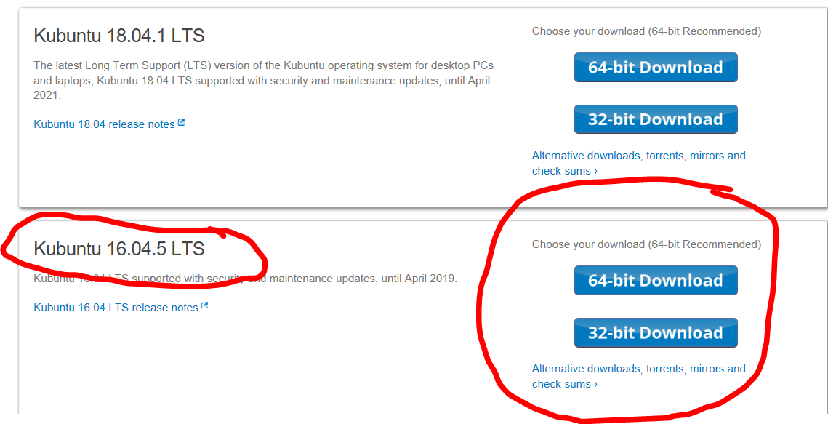

Slide 10
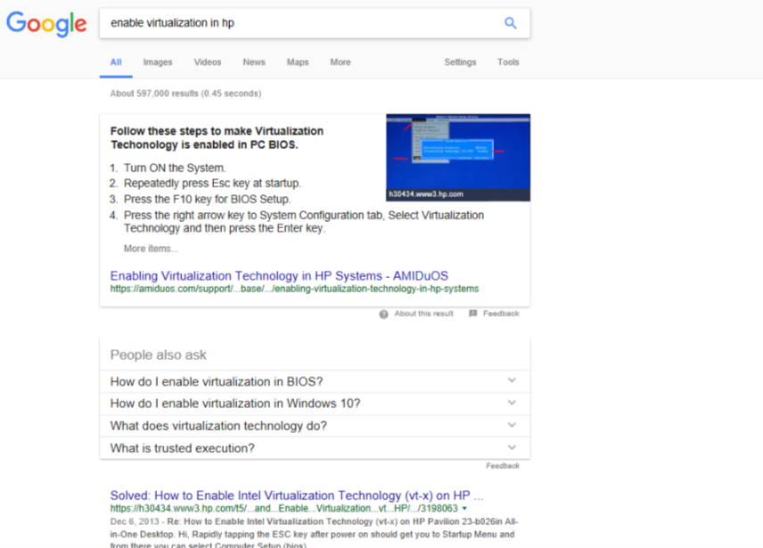
Virtualization

Slide 11
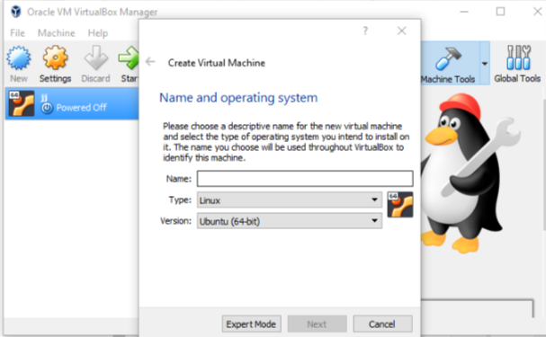

Slide 12
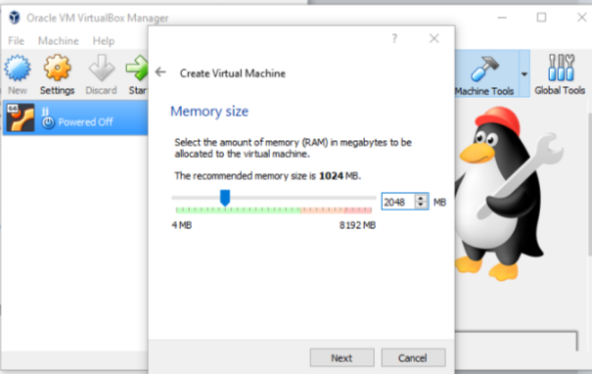

Slide 13
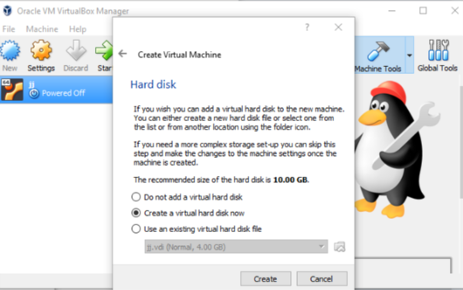

Slide 14
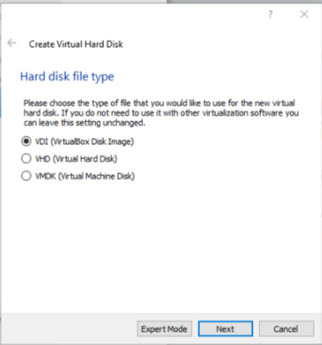

Slide 15
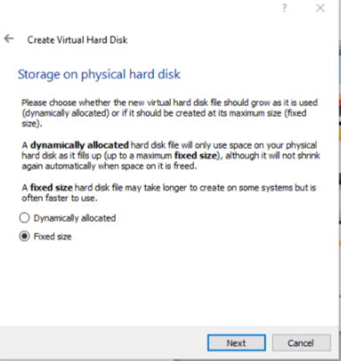

Slide 16
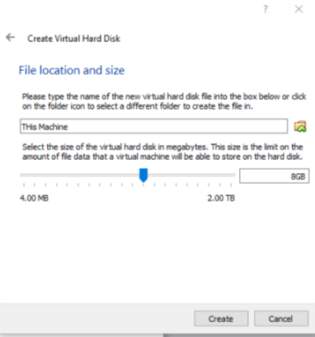

Slide 17
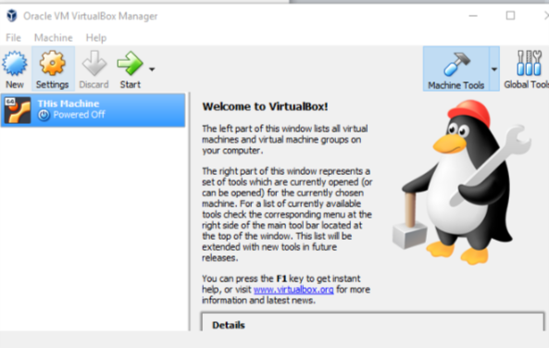

Slide 18
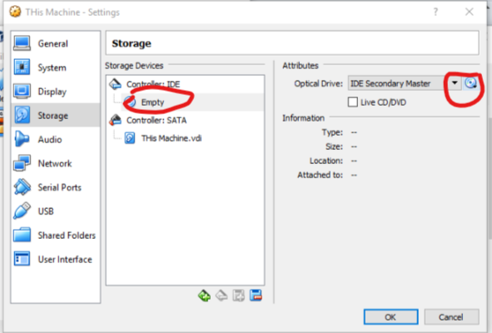

Slide 19
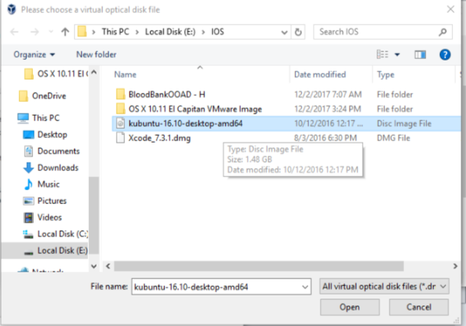

Slide 20
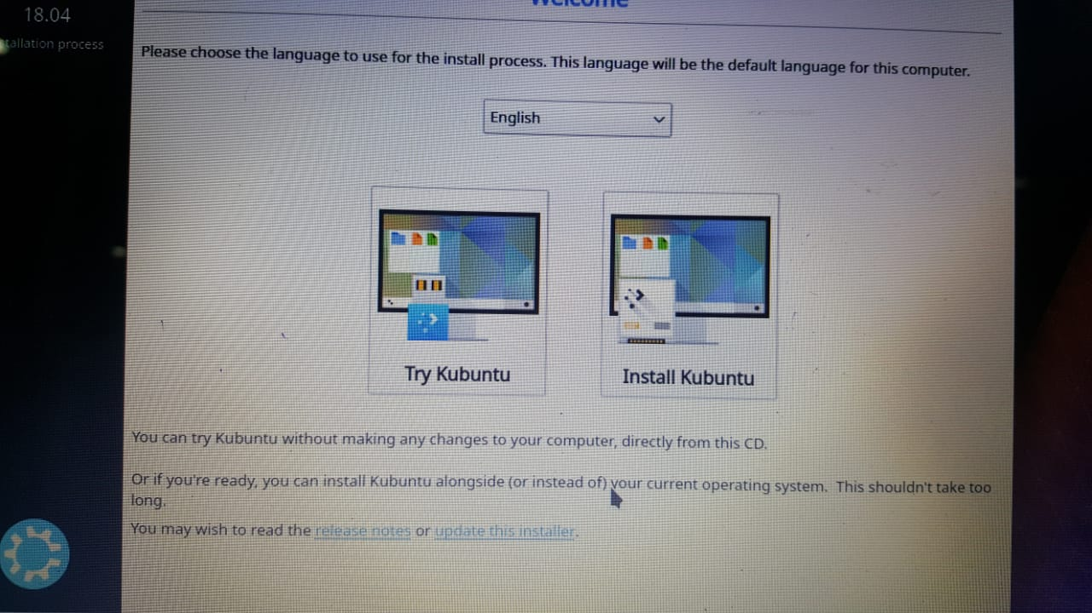

Slide 21
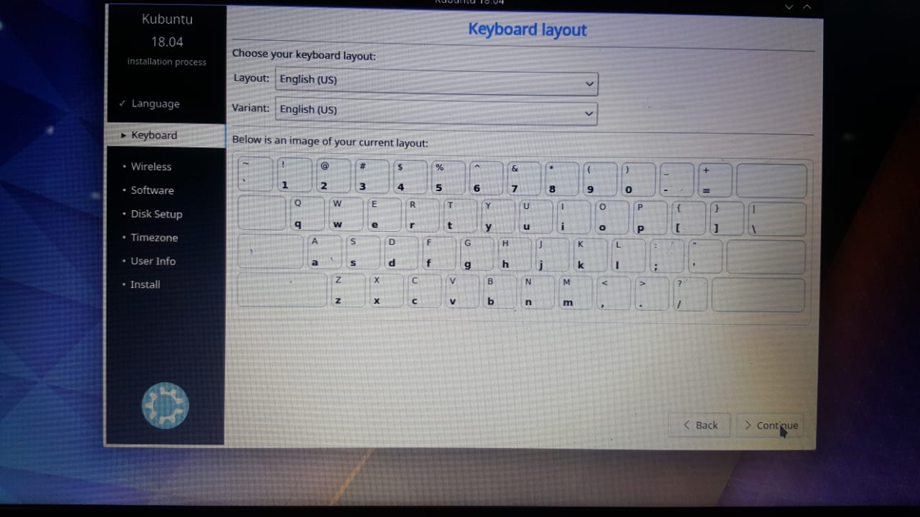

Slide 22
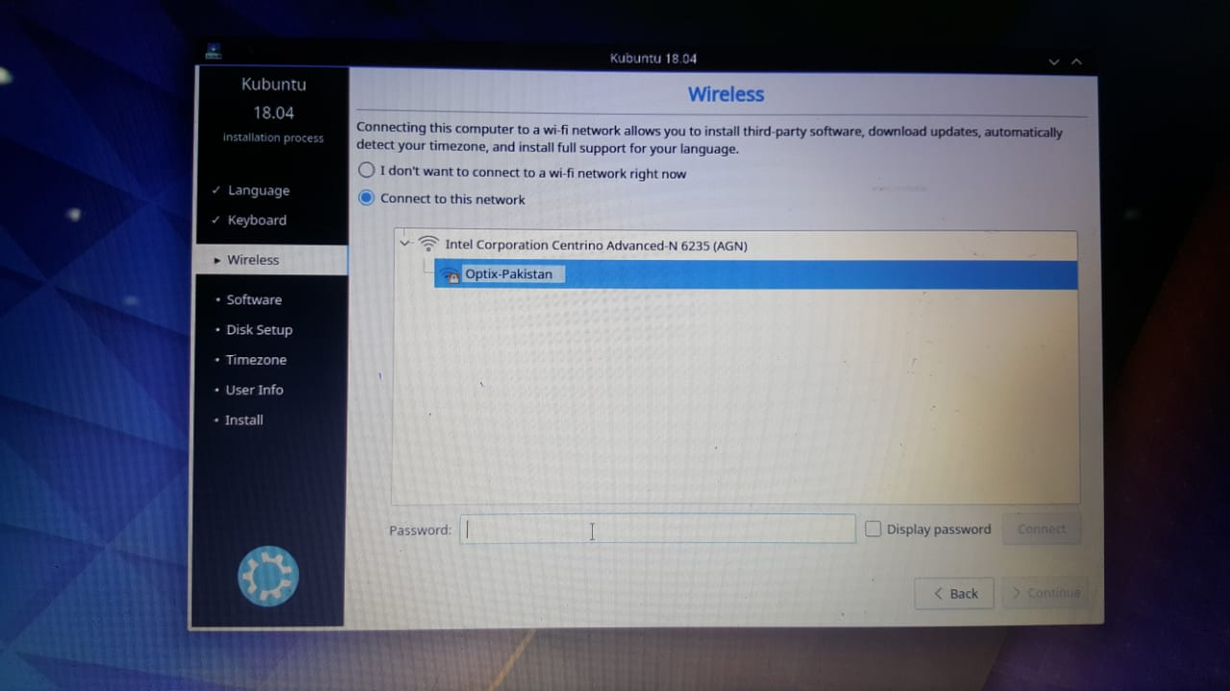

Slide 23
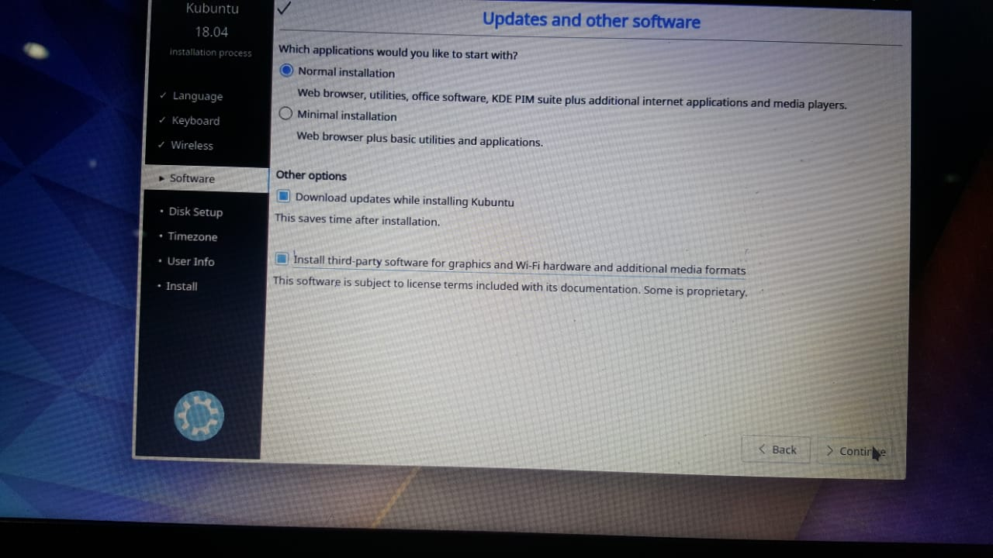

Slide 24
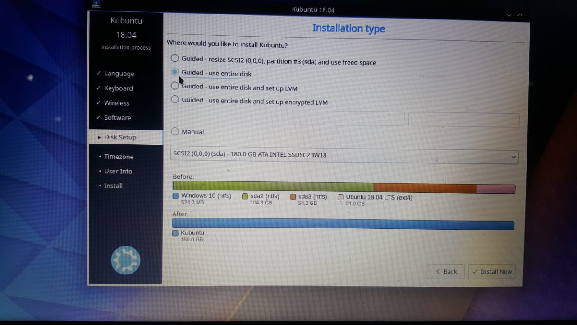

Slide 25
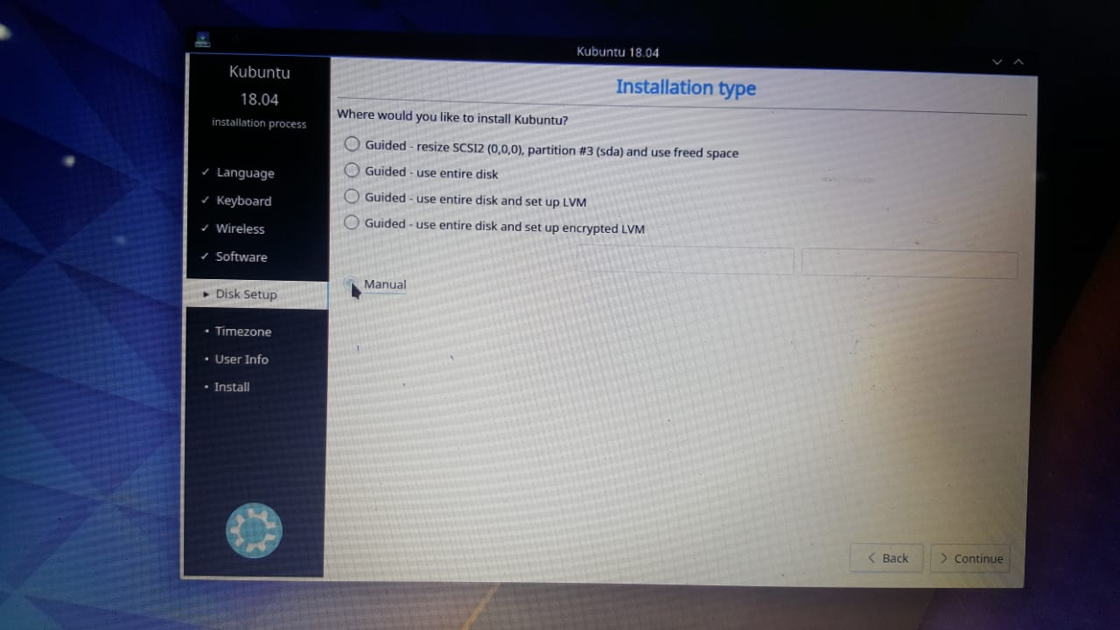

Slide 26
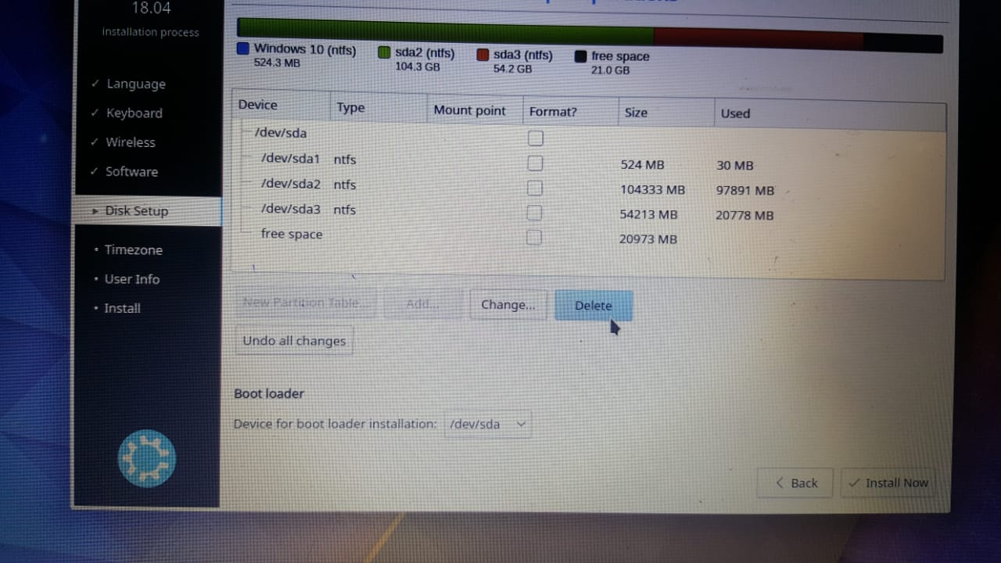
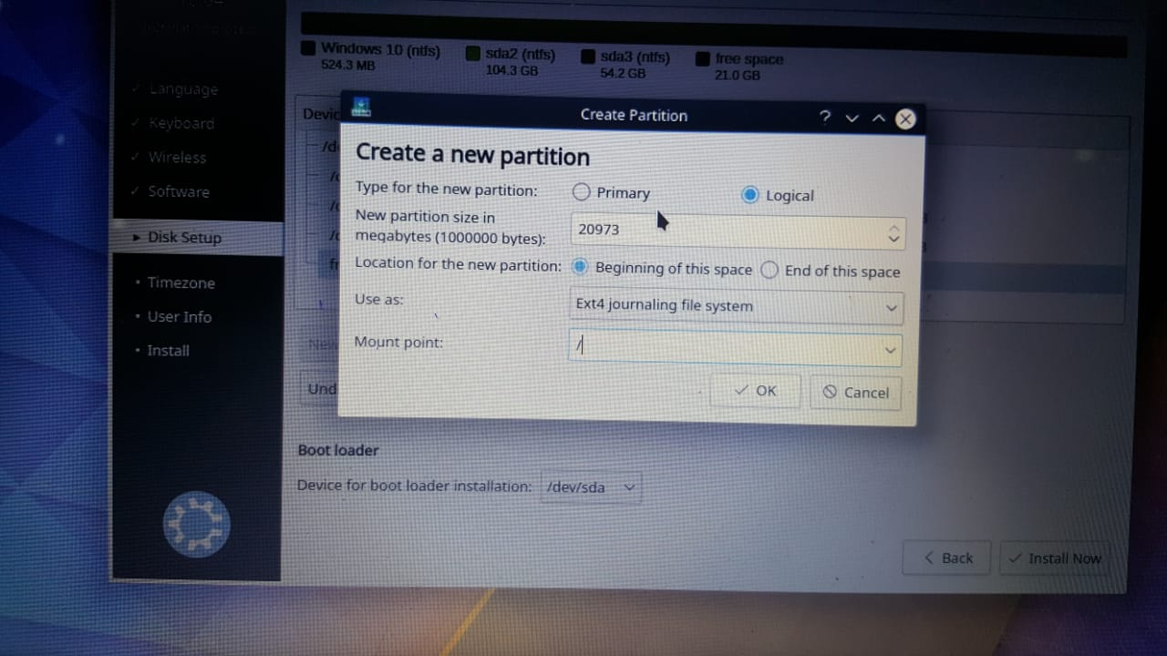
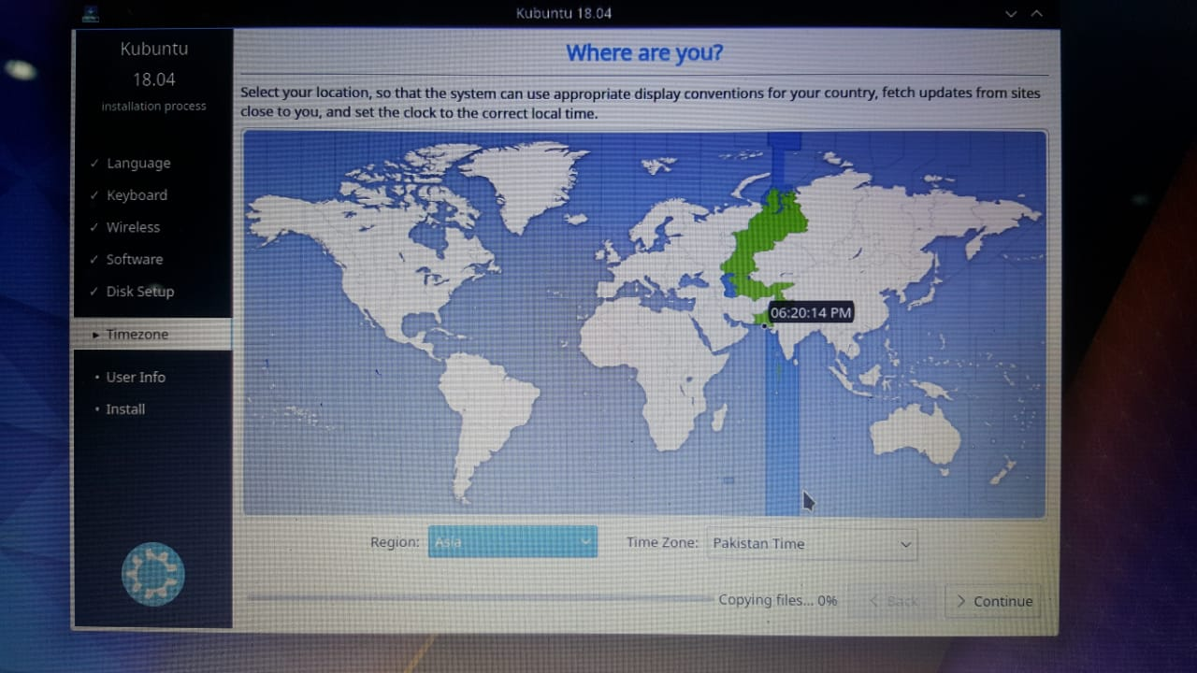

Slide 27
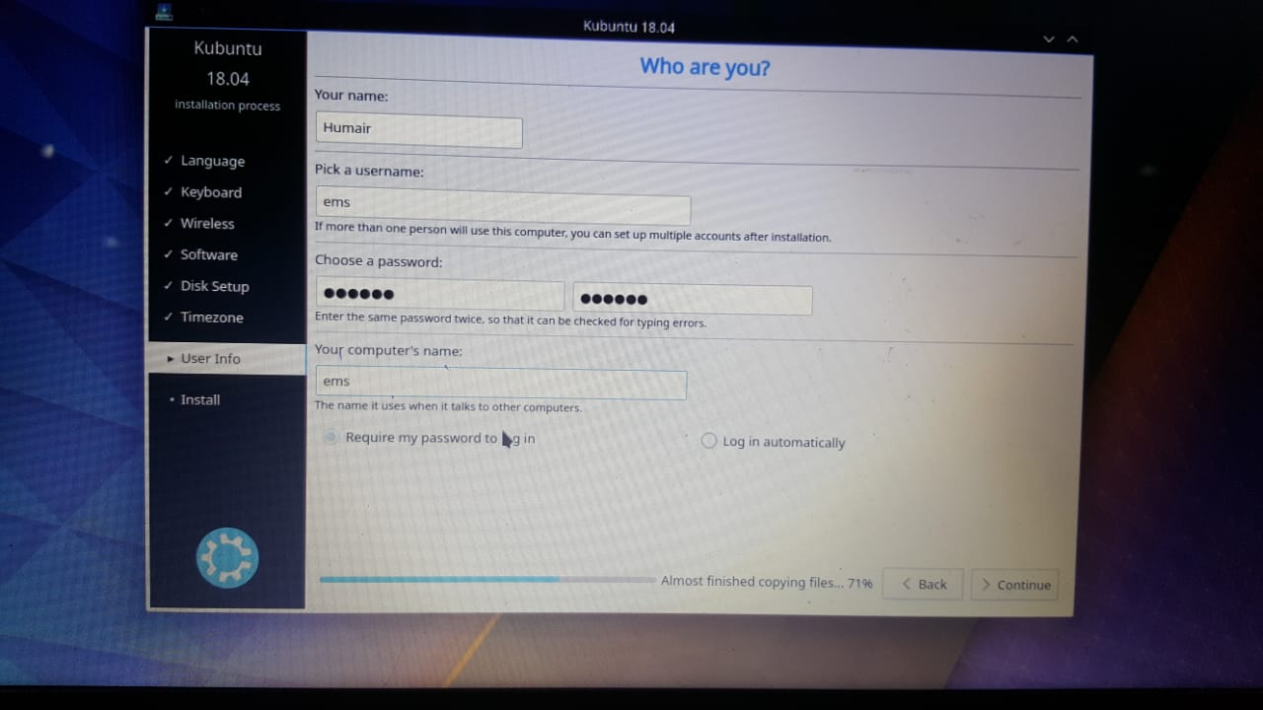
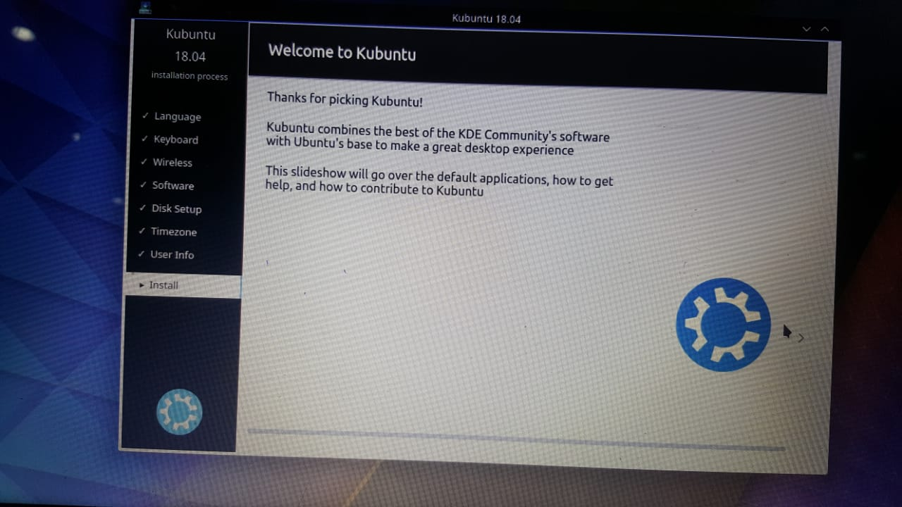

Slide 28
Commands
Ls
Mkdir
Rmdir | rm
Cd
Kate
touch
Gcc

