Slide 1
Probability
Chapter 1

Slide 2
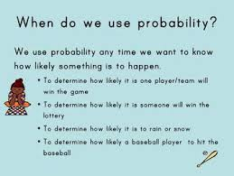

Slide 3
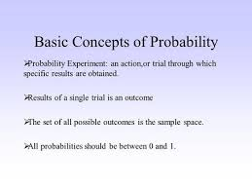

Slide 4
