Slide 1
Hasnain ali khan
INSTITUTE OF MANAGEMENT SCIENCES

Slide 2
ROM
A Deep Dive into Read-Only Memory

Slide 3
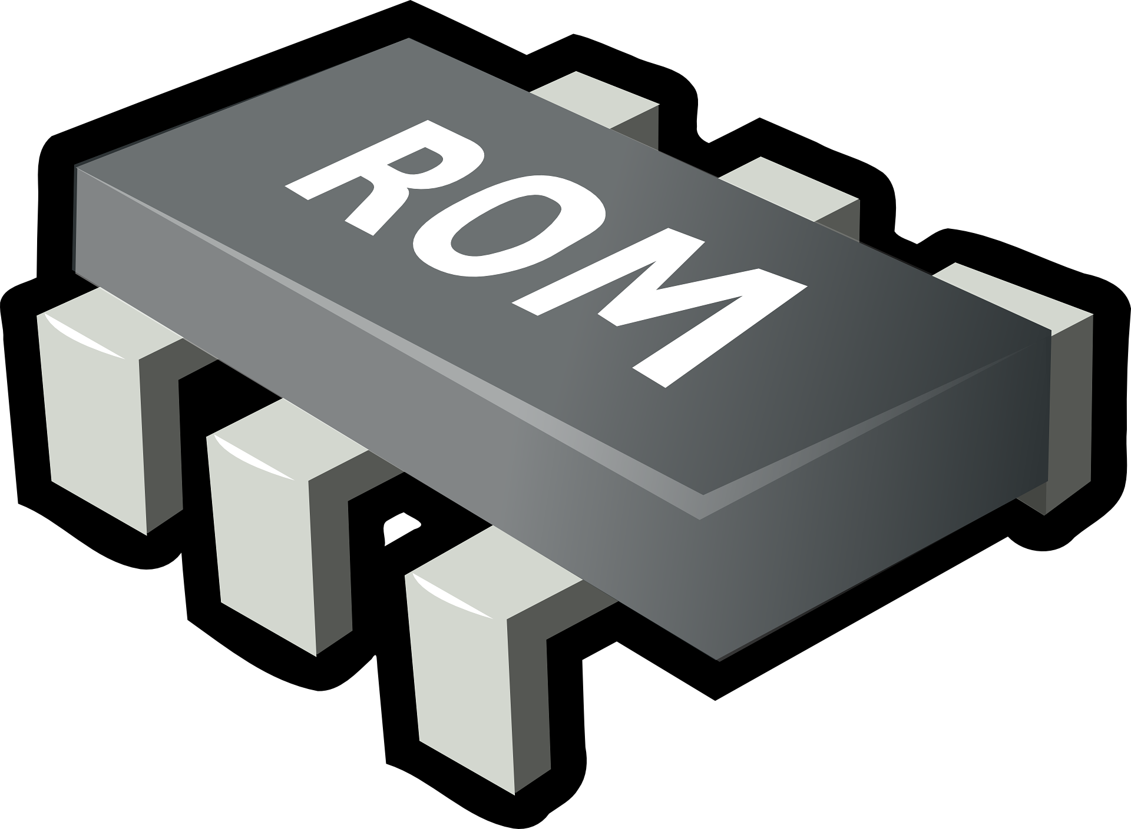

What is ROM?
ROM, or Read-Only Memory, is a type of non-volatile storage.
It is used in computers and electronic devices.
It retains its data even when the power is turned off.
USES
TRANSISTORS
USES
DIODES

Slide 4
Key Characteristics of ROM
Non-volatile: Retains data without power.
Read-Only: Typically cannot be modified after initial programming.
Fast access: Provides quick data retrieval for essential system functions.

Slide 5

Types of ROM
PROM: Programmable once after manufacture.
EPROM: Can be erased using UV light and reprogrammed.
EEPROM: Electrically erasable and reprogrammable, offering flexibility in updates.
PROM
ONE TIME
EEPROM
ELECRTRICAL
EPROM
UV LIGHT

Slide 6
Applications of ROM
Storing BIOS in computers for booting.
Firmware in appliances like microwaves.
Game consoles for pre-installed games.
ROM
BIOS
GAMES
FIRMWARE

Slide 7
thankyou

