Slide 1
Hasnain ali khan
INSTITUTE OF MANAGEMENT SCIENCES

Slide 2
ROM
A Deep Dive into Read-Only Memory

Slide 3
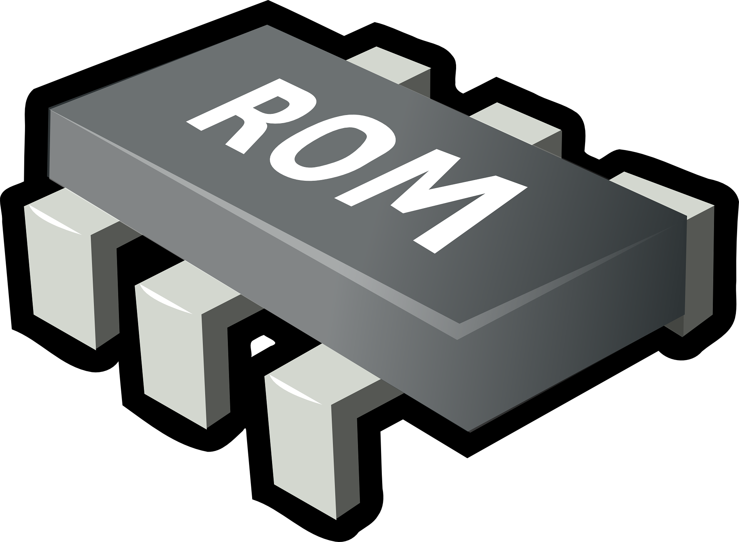

What is ROM?
ROM, or Read-Only Memory, is a type of non-volatile storage.
It is used in computers and electronic devices.
It retains its data even when the power is turned off.
USES
TRANSISTORS
USES
DIODES

Slide 4
HISTORY OF ROM
Before ROM computers used punch cards and magnetic tape for data storage.
The first true ROMs were developed in the 1960s.
These were typically hardwired devices.
They were used primarily for bootstrapping computers.

Slide 5
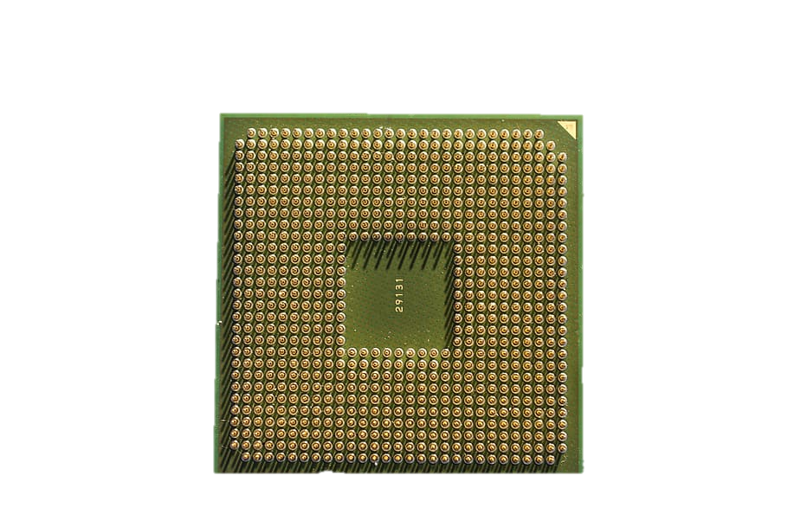

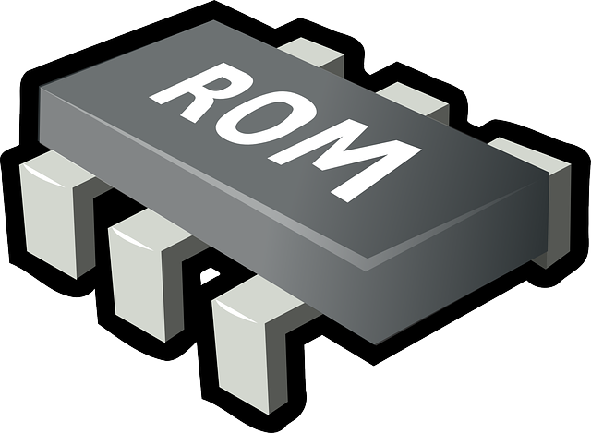
How does a rom work
Data is written to ROM during manufacturing.
When a device is powered on, the processor accesses the ROM to retrieve the instructions stored within.
Rom is faster than Ram.
POWERED ON

Slide 6

Types of ROM
PROM: Programmable once after manufacture.
EPROM: Can be erased using UV light and reprogrammed.
EEPROM: Electrically erasable and reprogrammable, offering flexibility in updates.
PROM
FUSES
EEPROM
FLOATING GATE
TRANSISITORS
EPROM
CAPACITORS&
TRANSISTORS

Slide 7
Applications of ROM
Storing BIOS in computers for booting.
Firmware in appliances like microwaves.
Game consoles for pre-installed games.
ROM
BIOS
GAMES
FIRMWARE

Slide 8
thankyou

