Slide 1
STM32 Debugger
With Instruction Trace support
Youssef Hasnaoui

Slide 2
Agenda
1
Debugging embedded systems
5
Trace Extraction
2
What is Trace?
6
Trace Processing
3
Problem & Proposed solution
7
UI Views
4
Debugger Architecture
8
Perspective

Slide 3
Debugging embedded systems

Slide 4
How Embedded Debugging Works
Debugger Software
User
Hardware Probe
Target Microcontroller

Slide 5
How Embedded Debugging Works
Sends Commands
Debugger Software
Hardware Probe
USB/TCP
Sends Data and Events
Reading/Writing from and to memory
Halting or resetting the device
Reading Core registers
Setting up breakpoints

Slide 6
How Embedded Debugging Works
Hardware Probe
Commands over USB/TCP
Device Protocol
Translates the commands to something the microcontroller understands

Slide 7
How Embedded Debugging Works
Hardware Probe
STM32
SWD/JTAG
Trace Pins

Slide 8
What is Trace

Slide 9
To understand trace, we need to understand the different types of debugging

Slide 10
Typical debugging actions
Setting Breakpoints
Reading and writing to memory
Changing execution flow
Halting and resetting the microcontroller
Intrusive Debugging

Slide 11
Debugging types
Intrusive Debugging
Non-Intrusive Debugging
Setting Breakpoints
Reading and writing to memory
Changing execution flow
Halting and resetting the microcontroller
Sampling Program Counter value
Performance Counters
Checking Processor state
Capturing execution behavior

Slide 12
Non-Intrusive Debugging
Observing system behavior without modifying the state of the device

Slide 13
Non-Intrusive Debugging
An example of that is: Tracing

Slide 14
What do we have in STM32 Microcontrollers?

Slide 15
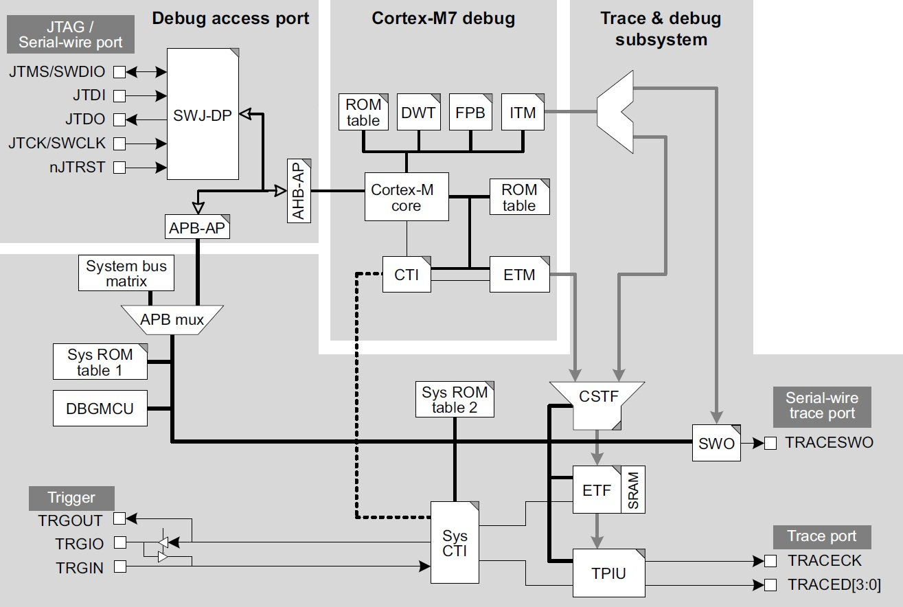
Debug Infrastructure in STM32 MCUs

Slide 16
Debug Infrastructure in STM32 MCUs

Slide 17
Debug Infrastructure in STM32 MCUs

Slide 18
Trace Sources in STM32 MCUs
Generates trace for events such as:
How many extra cycles an instruction took to execute
How many cycle it took to enter/exit an exception
How many cycles are spent in sleep mode
Generates trace packets from multiple sources:
Software, this is useful for printf debugging
DWT events are propagated via the ITM
Timestamping locally from the ITM component or globally
Generates trace packets related to core execution:
The number of instructions executed in the same cycle
Changes in program flow
Conditional code information

Slide 19
Debug Infrastructure in STM32 MCUs
Hardware Trace
Software Trace
Instruction Trace

Slide 20
How can we get this data out?

Slide 21
Debug Infrastructure in STM32 MCUs

Slide 22
Trace Sinks in STM32 MCUs
Off Chip Solutions
Transmit the trace data over dedicated pins
On Chip Solutions
Store the trace data in dedicated memory inside the chip

Slide 23
Trace Sinks
Off Chip Solutions
On Chip Solutions
Allows to virtually store an infinite amount of trace
Guarantees that the trace data is output in real-time
Guarantees that no data is lost due to high bandwidth
Can be extracted after the data was generated
Requires dedicated pins that can’t be used by the application
Requires extra hardware to capture
Very small buffer size, cannot capture large sessions
Can potentially stall the core

Slide 24
All the Debug & Trace components in STM32 MCUs are provided by Arm
The debug solution provided by Arm is named “CoreSight”

Slide 25
Full Path of Trace Data
Captures execution flow information and generates instruction trace
Reads Trace data from the TMC and sends it to the debugger
Executing normally
Captures trace data
Processes the Trace Data
Core
ETM
TMC
Hardware Probe
Debugger
ATB
DAP
USB

Slide 26
Why is Trace useful?

Slide 27
Why is Trace useful?
Besides the fact that it doesn’t alter the system’s behavior, so we get an accurate picture of what’s happening
Performance Analysis
Measure the performance of your application and identify bottlenecks
Code coverage
Debugging through crashes
It allows us to narrow down the execution path during a failure
Check what code is executing and what isn’t

Slide 28
Problem

Slide 29
Instruction Trace Today
IDE
Probes with Supported Trace
IAR
I-Jet/J-Trace (Partially)
Keil Uvision
ULinkPro, J-Trace
Open-Source tools (openocd, pyOCD)
none

Slide 30
The Gaps
Trace needs a dedicated hardware probe per IDE
IDEs don’t support the full capabilities of trace components
No trace decoding is possible outside of a debug session

Slide 31
Proposed Solution

Slide 32
Proposed Solution
Implement a Proof-of-Concept showcasing the ability to enable, configure and extract trace using an ST-Link
Implement a debugger making use of the extracted trace data, offering trace processing capabilities during and outside of a debug session.

Slide 33
How is it different from available solutions?

Slide 34
Why a new debugger
It is based on open-source software:
  Extending openocd with trace component modules
  Implements trace processing using OpenCSD
  Makes use of LLVM and LLDB for generating useful information for trace analysis
It doesn’t need an active debug session to decode Trace

Slide 35
Debugger Architecture

Slide 36
A Debugger Has Two Jobs
Debugger
Talk to the Probe
Talk to the User

Slide 37
User Interface
Communicates
Over DAP
User
UI
Debugger Core
Dap: Debug Adapter Protocol

Slide 38
Inside the Debugger’s Core
Communicates
With the UI
Transport Layer
Requests &
Responses
Events
Orchestrator
Serialize/Deserialize messages
& dispatches the appropriate handler
Handles MCU
State
Device Manager
Trace Manager
Memory Manager
Handles Memory
Operations

Slide 39
Inside the Debugger’s Core
Trace Manager
Setup Trace Extraction infrastructure
Process the generated Trace

Slide 40
Trace Extraction

Slide 41
Integrating OpenOCD
The infrastructure that handles device communication is built on top of openocd so it’s worth it to take a look at how OpenOCD operates

Slide 42
OpenOCD Architecture for Cortex-M devices
New +
Target Model
Represents the device in software
Via components: e.g. core, flash etc…
Our additions
Debug Interface Layer
Software abstraction over
The Arm Debug Interface
Debug Adapter Layer
SWD/JTAG protocol handler
Hardware Probe Driver
ST-Link, J-Link, etc…

Slide 43
Additional OpenOCD modules
Embedded Trace Macrocell V4:
Trace Memory Controller:
Create ETM model object
Initialize the component inside the chip
Configure Trace generation features
Enable/Disable Trace generation
Create TMC model object
Initialize the component inside the chip
Configure Trace capture features
Configure how to output the Trace data (e.g. a file, or callback function)
Enable/Disable Trace capture

Slide 44
Trace Processing

Slide 45
Step 1 — Raw Trace Data
Raw Trace Data
Instruction Trace Packets
Execution History
Corresponding Instructions
Source Code Correlation
Once the data becomes available in the TMC, we can read it out via the Ram Read Data (RRD) register which acts as a FIFO (We continuously read from it until the value is 0xFFFFFFFF)
We save this data in the debugger and pass it to the next stages

Slide 46
Step 2 — Instruction Trace Packets
Raw Trace Data
Instruction Trace Packets
Execution History
Corresponding Instructions
Source Code Correlation
The CoreSight Architecture Specification describes how to decode raw trace data into byte packets
We use OpenCSD’s implementation to get instruction trace packets out of the raw data.
At this point, the Trace packets aren’t decoded yet and aren’t useful.
Example Packet types:
Trace On: Indicates that tracing has started or restarted
Address: Indicates the start address and Instruction Set
Atom: Indicates whether a conditional branch was taken or not

Slide 47
Step 3 — Execution History
Raw Trace Data
Instruction Trace Packets
Execution History
Corresponding Instructions
Source Code Correlation
Given the binary image of the firmware alongside the trace data, we can create a history of all the instructions executed by the processor
We again use OpenCSD to decode the trace packets into generic packet information, such as ranges of execution, and we combine these generic packets into a meaningful list of executed instructions

Slide 48
Step 3 — Execution History
Raw Trace Data
Instruction Trace Packets
Execution History
Corresponding Instructions
Source Code Correlation
- Trace Info Element
- Trace On Element
- Address Element (0x100)
0x100 LDR R0, [R2]
0x102 ADDS R4, R1, R0
0x104 CMP R4, R0
0x106 BEQ #0x200
0x108 MOVS R6, #0x0
…
0x200 PUSH {R4, LR}
Atom Element:
- If the branch is taken Atom E
- If the branch is not taken Atom N
Continue @ 0x200
Continue @ 0x108

Slide 49
Step 4 — Corresponding instructions
Raw Trace Data
Instruction Trace Packets
Execution History
Corresponding Instructions
Source Code Correlation
The earlier step provides the range of addresses that have been executed
We disassemble the firmware’s image and get the instructions corresponding to these addresses.
0x100 LDR R0, [R2]
0x102 ADDS R4, R1, R0
0x104 CMP R4, R0
0x106 BEQ #0x200
ADDR_RANGE(0x100, 0x106)

Slide 50
Step 5 — Source Code Correlation
Raw Trace Data
Instruction Trace Packets
Execution History
Corresponding Instructions
Source Code Correlation
To get more insightful information, we can parse the debug information in the ELF file corresponding to the executed instructions
Examples of this information:
  The variables corresponding to the instruction’s operands
  The line number and file name corresponding to the instruction.

Slide 51
UI Views

Slide 52
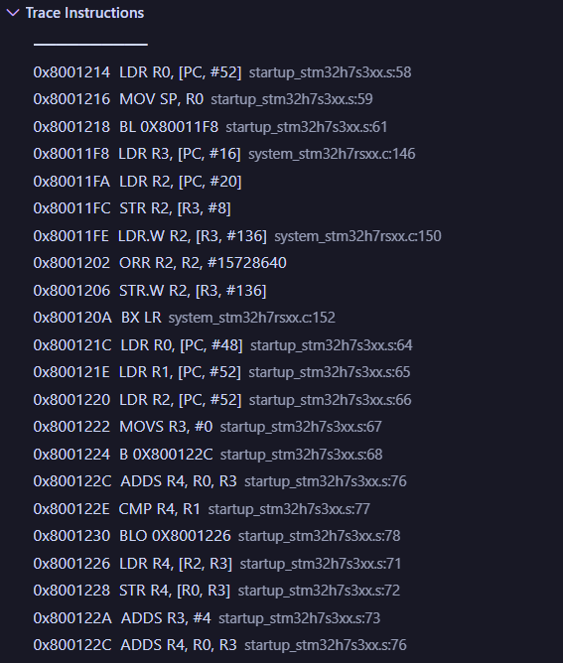
Instruction Trace View
File name and line number of the instruction
Instruction Address
Instruction Mnemonic

Slide 53
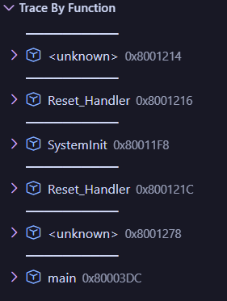
Function Trace View
Sequential order of executed functions

Slide 54
I added a few extra things that are supported natively

Slide 55
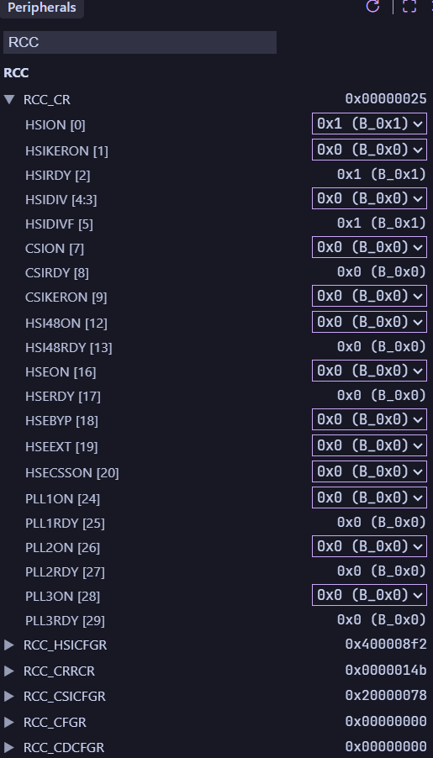
Peripheral View

Slide 56
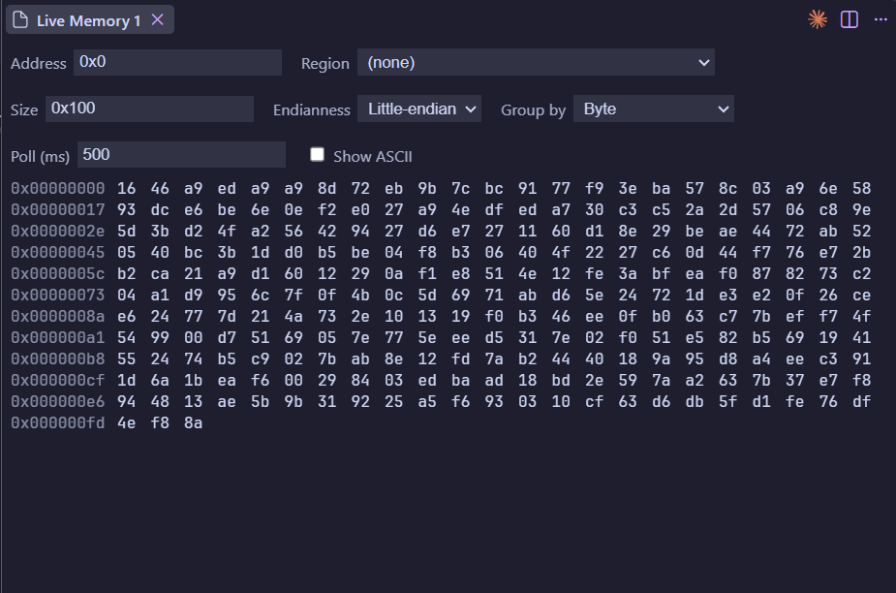
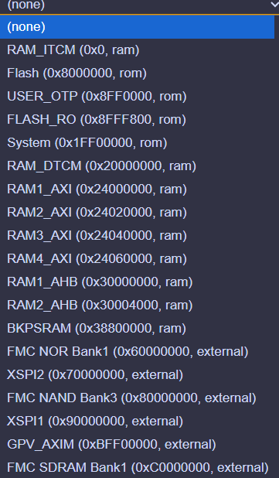
Memory View

Slide 57
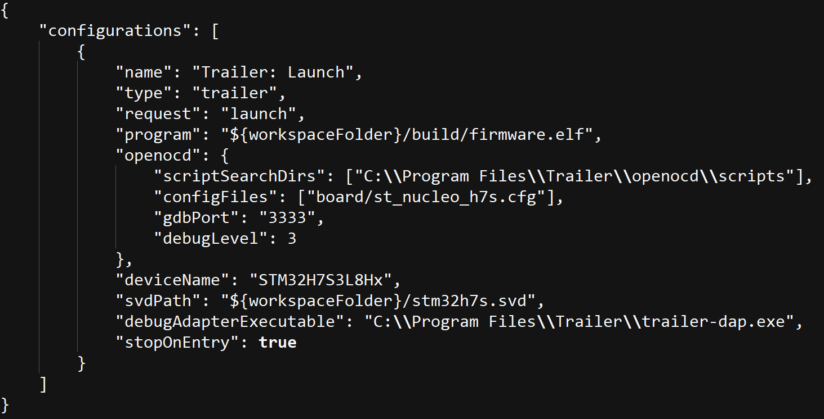
Sample VSCode Configuration

Slide 58
Perspective

Slide 59
Perspective
Conditional Tracing
Multi-Core & Multi-Buffer Support
Profiling & Coverage
Graphical Configuration Interface

Slide 60
Thank you for your attention
Questions ?

Slide 61
Find out more at www.st.com

Slide 62

For further support in creating a PowerPoint presentation, including graphic assets, formatting tools and additional information on the ST brand
you can visit the ST Brand Portal
https://brandportal.st.com

